Slide 1
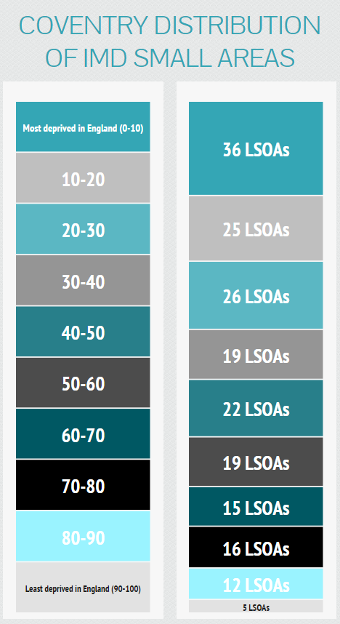
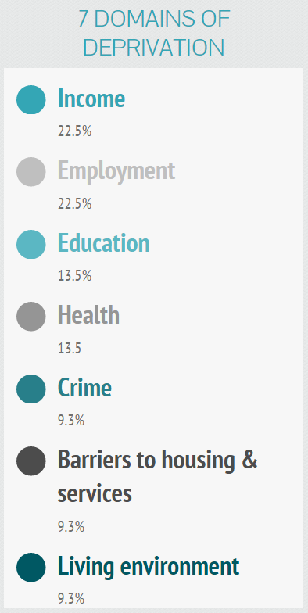
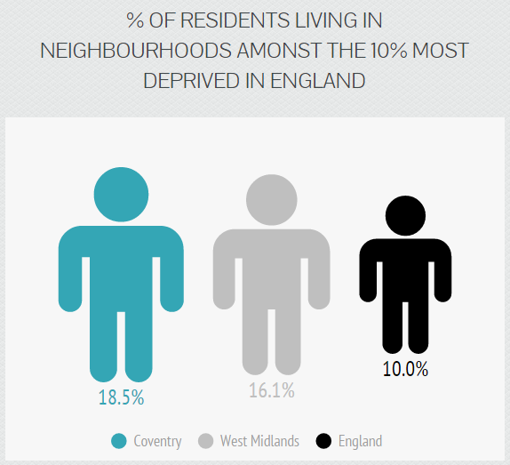
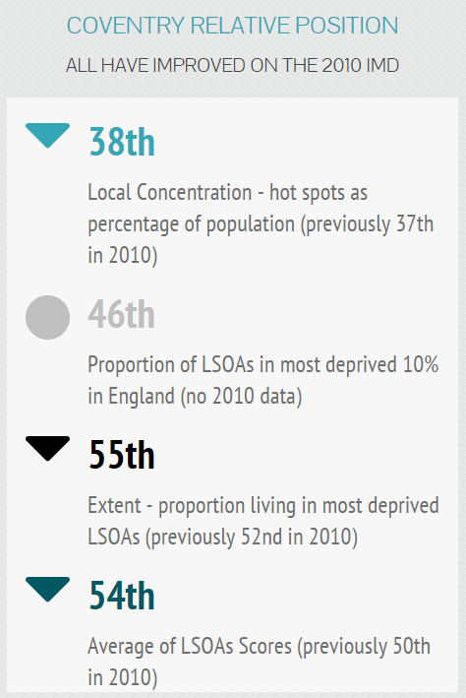
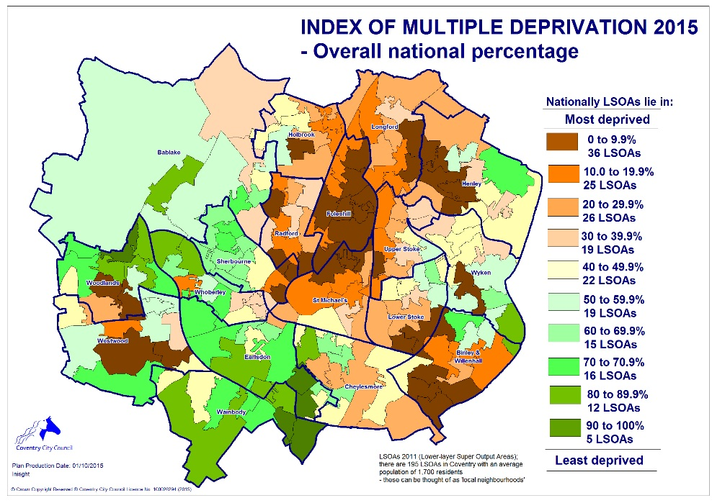
Coventry Index of Multiple Deprivation (IMD) 2015
How can it be used
comparing small areas across England
identifying the most deprived small areas
exploring the domains (or types) of deprivation
comparing larger areas e.g. local authorities
looking at changes in relative deprivation between versions (i.e. changes in ranks)
quantifying how deprived a small area is
identifying deprived people
saying how affluent a place is
comparing with small areas in other UK countries
measuring real change in deprivation over time

