Slide 1
Sarah Watson
Green Business Programme Manager

Slide 2
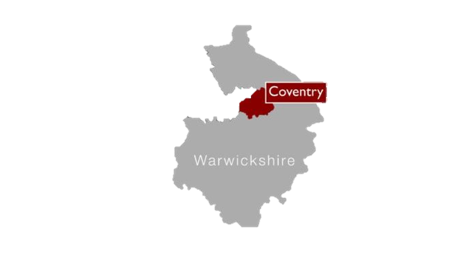
What is it?
A support programme for SMEs and organisations in Coventry and Warwickshire to help business become more energy efficient and make the most low carbon opportunities.
Who?
All small to medium size businesses (SMEs) in Coventry and Warwickshire
Employ less than 250 employees.
Have an annual turnover of not exceeding €50 million and/or an annual balance sheet not exceeding €43million.

Slide 3
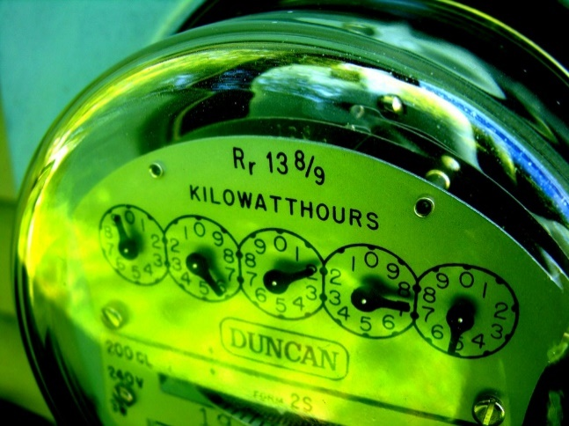
Energy efficiency audits
Identify potential energy efficiency measures
Audit looks at:
Building fabric - insulation
Energy bills
Heating and cooling, controls
Lighting
Equipment and machinery
Processes
Behavioural
Energy efficiency report
Energy efficiency grants – current programme now closed

Slide 4
Pressing company
Opportunity 5.7.1 | Power Factor Correction
Energy Input | Annual carbon savings | Annual cost saving (£) | Implementation cost (£) | Simple Payback (Years)
Electricity | 50 tonnes CO₂ | £20,000 | £10,000 - £20,000 | Less than 1 year
Current Situation | The Power Factor fluctuates on average between 0.3 and 0.4. This means power is being wasted and you are also being charged more for having a low power factor.
Opportunity | Install automatic Power Factor correction equipment. This will ensure the Power Factor is improved and the value becomes nearer to 1 thus minimising wasted energy, improving the efficiency of a plant, liberating more kW from the available supply and saving you money.
Savings | Cost savings, electricity savings, carbon savings

Slide 5
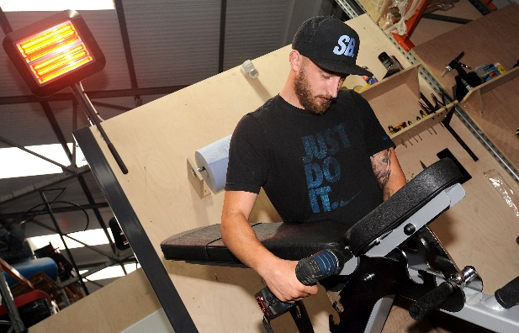
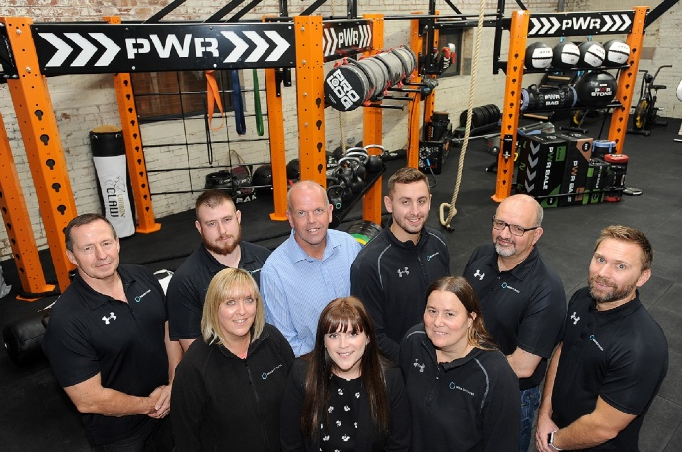
Indigo Fitness
UK’s largest Fitness equipment manufacturer
£62,070 energy efficiency grant
New insulated roof. 30% energy saving
Sensor controlled LED lighting throughout. 70% energy savings
New heating system plus infrared heating with sensor controls
Lighting will save 22 tonnes of carbon per year
Roof insulation will save 13 tonnes of carbon per year
£6,000 a year saving on energy costs

Slide 6
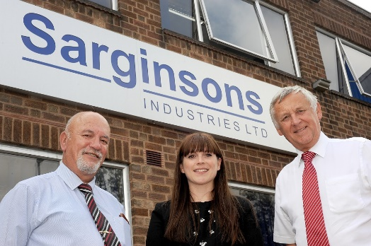
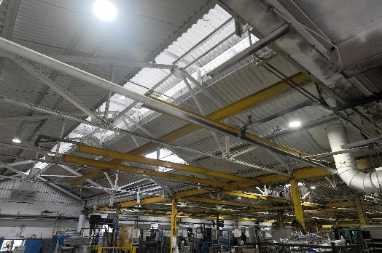
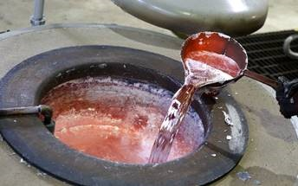
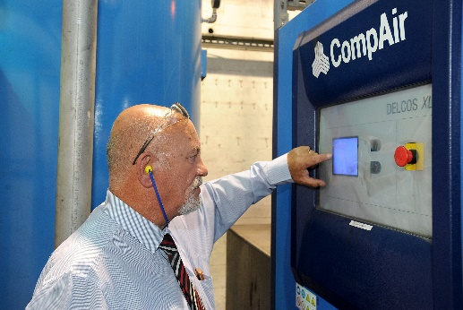
Sarginsons
£370,000 spend per annum electricity and gas
£130,000 capital investment
£26,000 energy efficiency grant
2 recuperation gas furnaces
Variable speed air compressors and drying equipment
LED lighting throughout
Power Factor Correction
Payback – 1.5 year
335 Tonnes CO2 saving/ annum

Slide 7
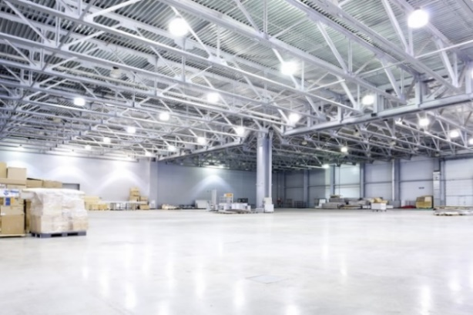
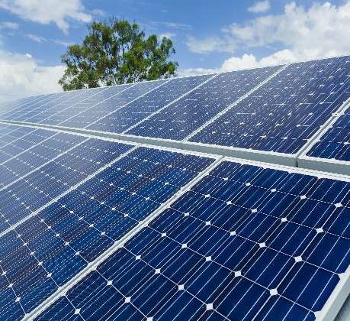
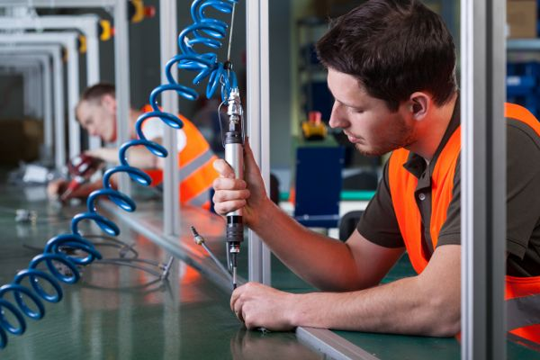
Phase 2 – coming soon (still awaiting final confirmation)
40% energy efficiency grants
Capital grants to improve efficiency (Up to £50k)
Must show a carbon saving
Covering:
Energy
Waste
Water
Materials
Eligibility:
>50% B2B
Match funding can’t be via another public sector grant etc.

Slide 8
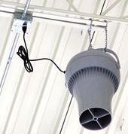
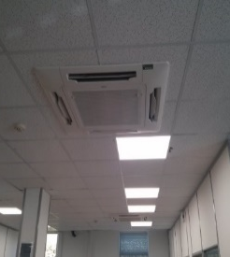
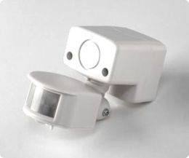
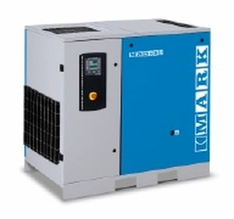
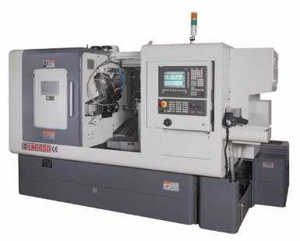
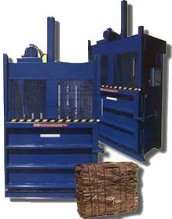
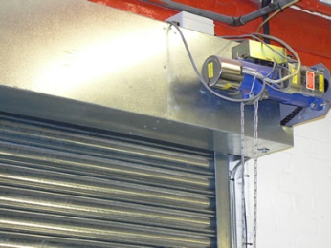
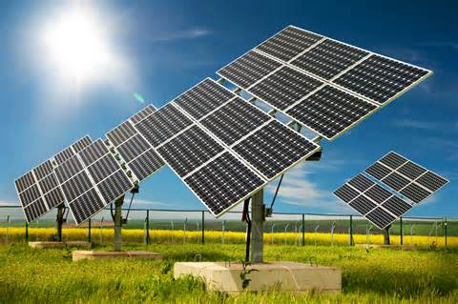
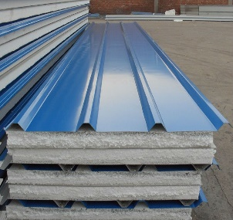
Examples of measures eligible for grants

Slide 9
Green Business Network
Membership is free and offers a range of benefits:
Monthly newsletter – news, events new legislation, case studies
Membership certificate
Events and seminars
Workshops
Expert advice
Signposting to other grants
Business Support
Innovation
Skills 4 Growth

Slide 10
Upcoming Events
22 November 2018 – UK Energy Storage: The Opportunities - Coventry
28 November 2018 – Success and Opportunities for Supporting Your Business – One Friargate, Coventry
30 November 2018 – Energy Saving and Low Carbon Workshop – Coventry
For more information visit http://bit.ly/cwgreenevents

Slide 11
Green Business Programme
Contact us
Telephone: 024 7678 6901
Email: GreenBusiness@coventry.gov.uk
Website: www.coventry.gov.uk/greenbusiness
Twitter: @cwgreenbusiness
Join our LinkedIn group

