Slide 1
SolarEdge Technologies
S:TitleSlide_StorEdgeIntro
Richard Fuell

Slide 2
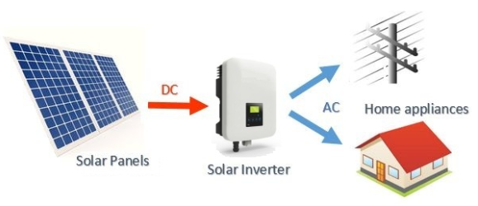
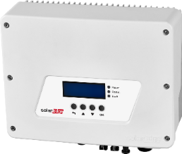
Solar Photovoltaic system

Slide 3
SolarEdge Milestones
2006
2010
2012
2013
2014
2015
2016
Founded in Herzliya, Israel
Beginning mass production
Cumulative shipment quantity of power optimiser exceeds 1 million units
SolarEdge Wins the Prestigious Intersolar 2012 Innovation Award for its next generation power optimiser
Cumulative shipment quantity of power optimisers exceeds 2 million units
The cumulative shipment quantity of power optimiser >3 million. Shipment quantity of inverters >100,000
Listed on the US NASDAQ
More than 10 million power optimisers shipped
SolarEdge Wins the Intersolar Award in Photovoltaic for its HD-Wave technology inverter

Slide 4
SolarEdge in Numbers
Notes:
Started to do it when we were startup
Small and proud of every achievement
Wanted to acknowledge it
Kept doing it
still consider ourselves somewhat a startup,
Purpose driven, embrace change, and quick to react
Numbers from this quarter

Slide 5
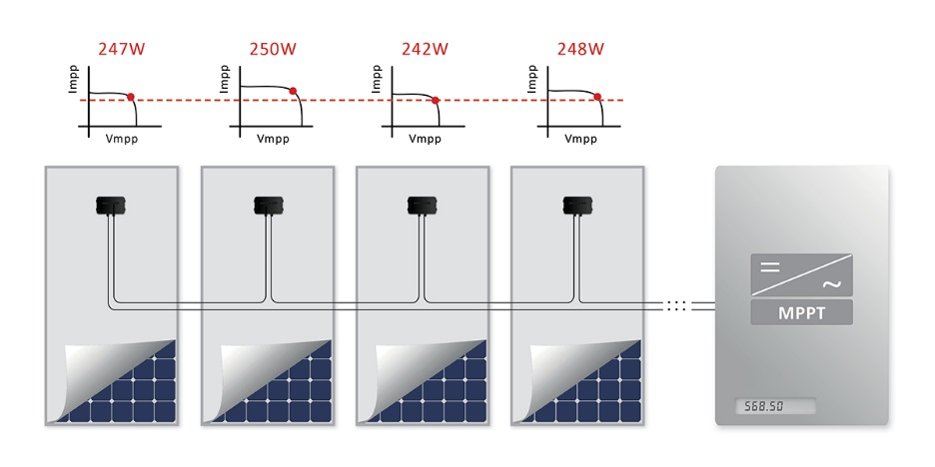
Module Mismatch Causes Power Loss
Traditional inverters perform MPPT (Maximum Power Point Tracking) for the entire string
Due to the panel mismatch, weaker panels impact the output of the entire string by reducing the output of the other panels.
All panels in the same string operate at the same current, regardless of their individual MPP
Module mismatch  power losses

Slide 6
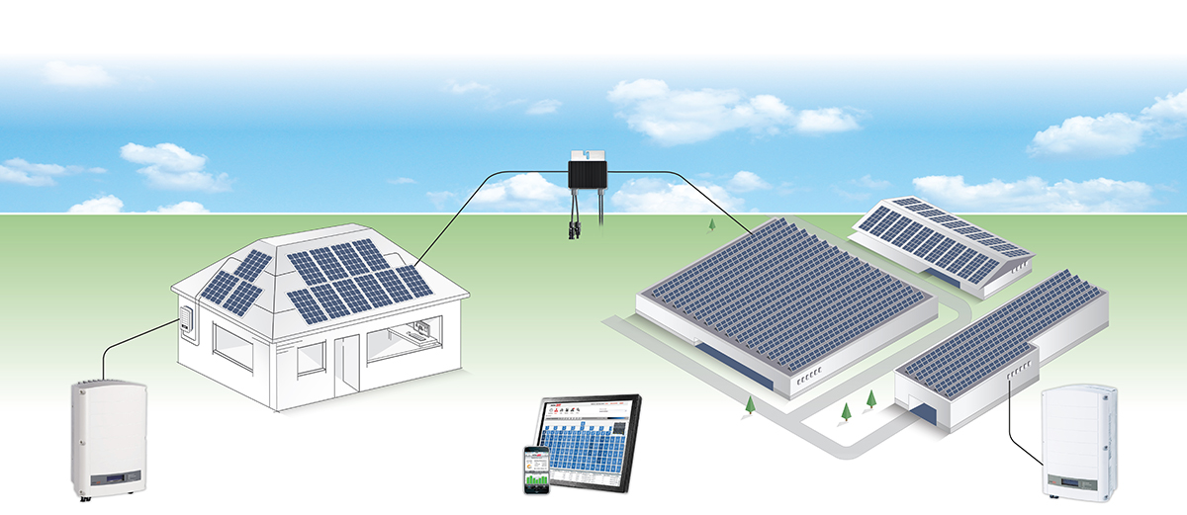
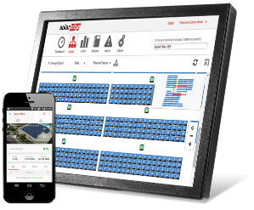
The SolarEdge Solution
Includes basically…
…a Simplified PV-Inverter (Single-Phase or Three-Phase) for Residential or Commercial projects
…Power Optimizers for Residential and Commercial projects
…Cloud-Based Monitoring Platform
Power Optimizer
P300-P700
Single-Phase Inverter: 2.2 - 6kW
Three-Phase Inverter
15 – 17kW
25, 27.6, & 33.3kW
Cloud-Based
Monitoring Portal
Notes:
PO – central element of SE solution

Slide 7
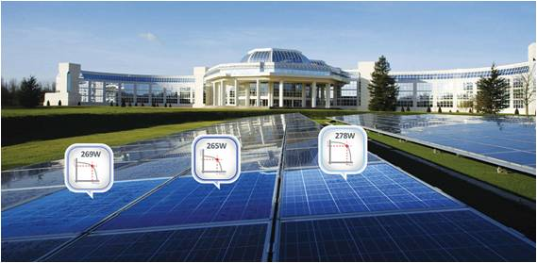
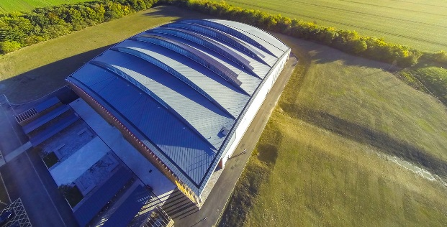
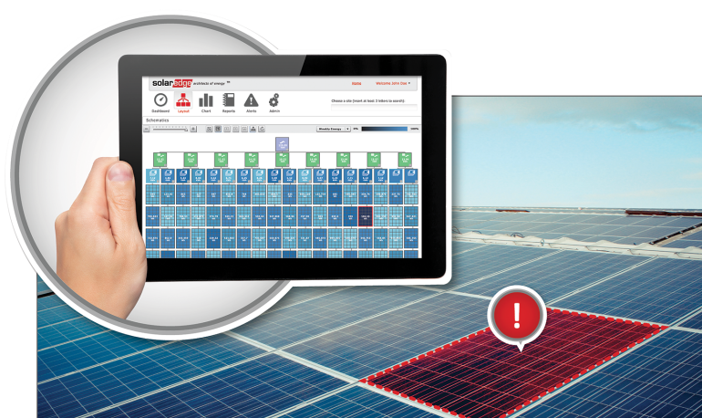
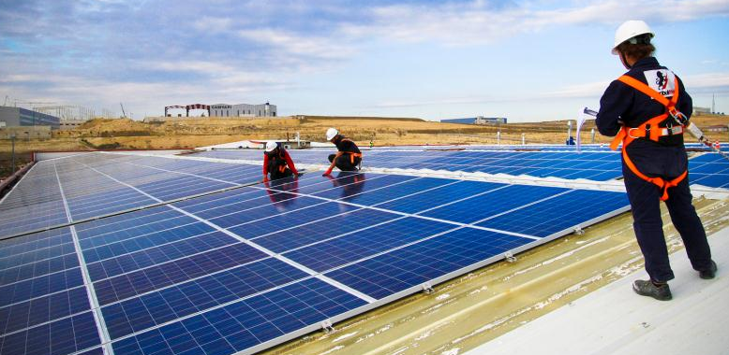
SolarEdge Solution Benefits
More Energy
Constraint Free Design
Increased energy yield & faster return on investment through module-level MPPT
Maximum space utilization with minimum design time
Lower O&M Cost
Enhanced Safety Solution
Full visibility of system performance & remote troubleshooting
Safety during installation, maintenance, firefighting, & other emergencies

Slide 8
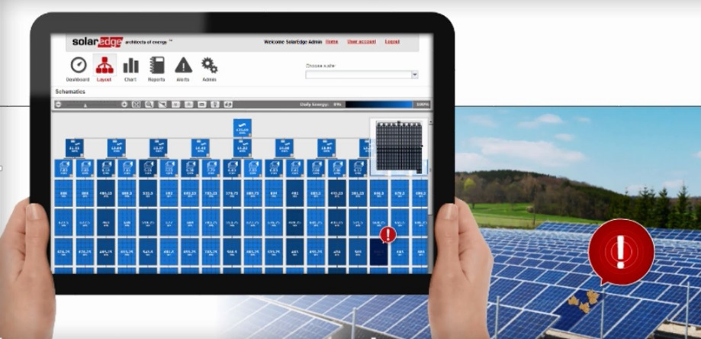
Asset Management
Protect your asset with full visibility into system performance
Allows remote troubleshooting for reduced O&M costs
Free for life module level monitoring
Fault detection pinpointed on a virtual site map
Automatic email alerts on system issues
Save cost of scaffolding; access with tower / cherry picker

Slide 9
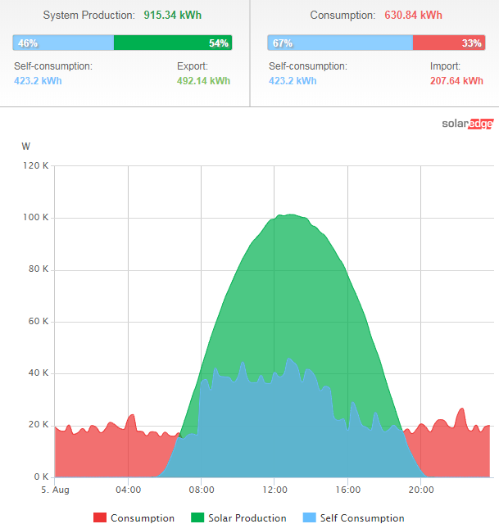
Daily output

Slide 10
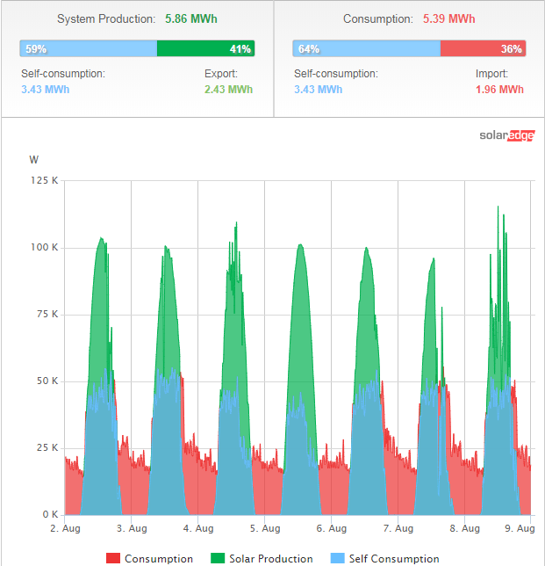
Weekly data

Slide 11
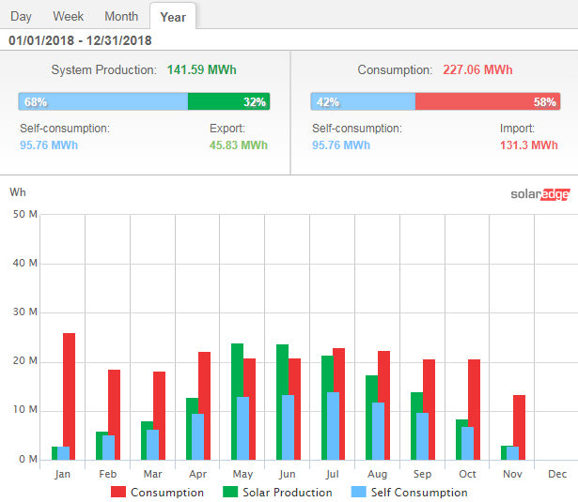

Slide 12
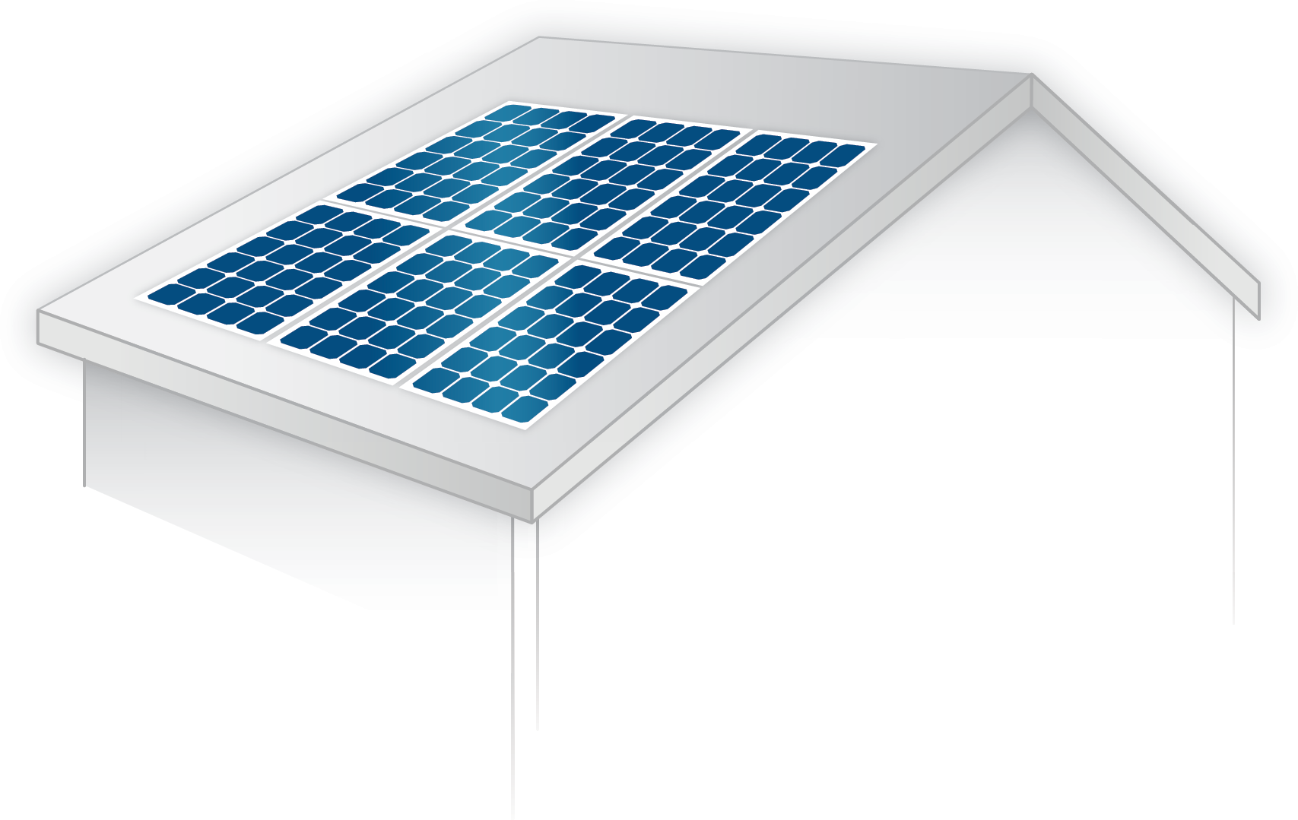
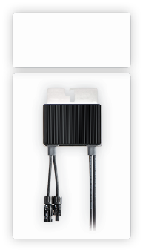
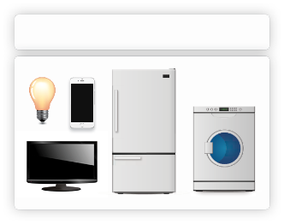
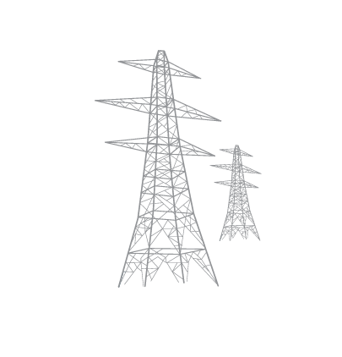
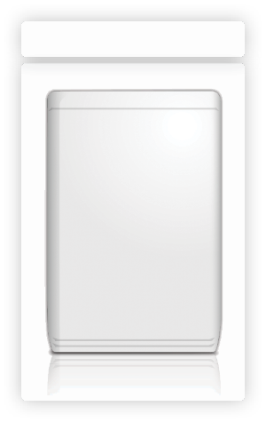
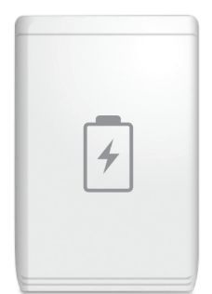
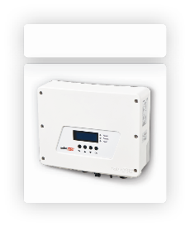
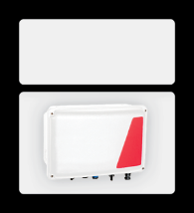
Introducing “StorEdge” - Typical Setup
S:StorEdge_UseCase_TypicalInterface
Power Optimizers
Loads
Grid
Battery
Inverter
StorEdge Interface
Meter
RS485
DC
AC
Notes:
Here we can see the typical setup of a StorEdge Interface system. The inverter and the StorEdge interface are both connected to AC. The AC connection of the interface is only used to supply power to the electronics of interface and battery. It is not used to charge the battery. The power optimizers are connected directly to the inverter, while the DC connection of the battery runs through the StorEdge interface. RS485 communications are used to connect battery, interface, inverter and meter

Slide 13
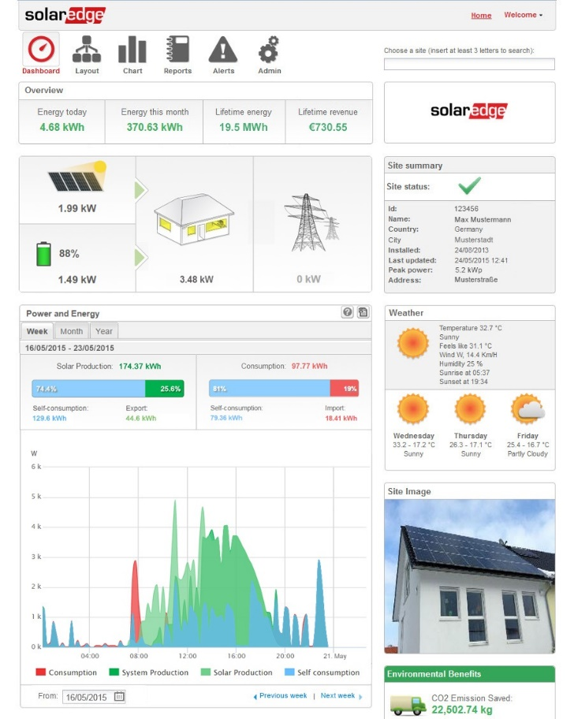
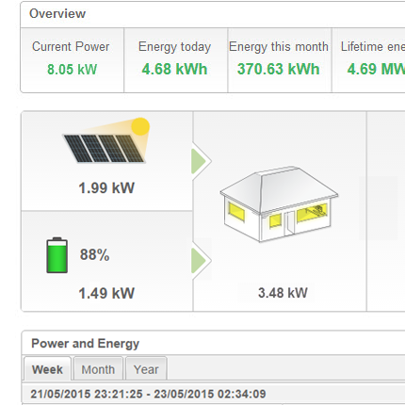
Full Visibility
S:StorEdge_FullVisibility1
Monitor PV production, self-consumption and battery status
Notes:
Fourth benefit: Full visibility The integrated, free for lifetime, monitoring solution allows you to keep track of PV production, self-consumption and battery status. In this screenshot you can see the PV system and the battery both supplying power to your household loads.

Slide 14
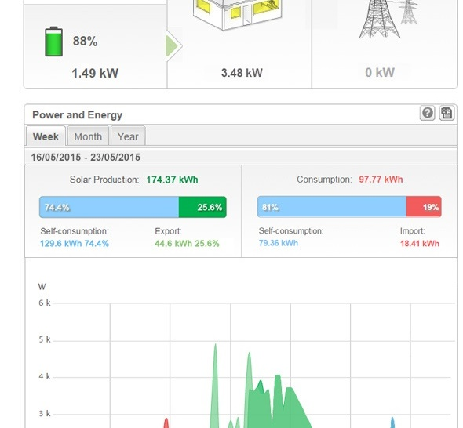
Understand Energy Usage
S:StorEdge_FullVisibility2
View consumption & production ratios
Solar Energy Consumed
Energy Produced
Solar Energy Exported to Grid
Energy Produced
Energy Purchased from Grid
Energy Consumed
Notes:
The production and consumption overview gives you weekly, monthly and annual data about your self-consumption, energy export and energy import

Slide 15
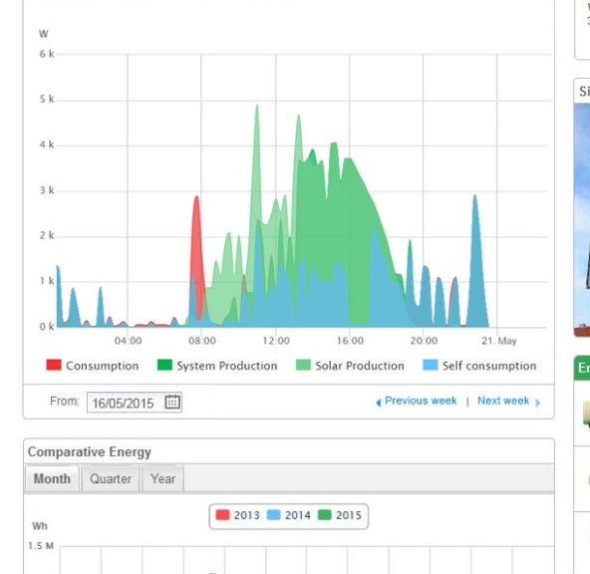
Easy to understand
S:StorEdge_FullVisibility3
Reduce your electricity bill by optimizing your consumption
Notes:
The detailed power graph allows you to visualize your pv production curve and your power consumption. It also allows you to see at what times energy is drawn from the battery and when it is drawn from the grid. At the end it also enables you to adapt your consumption behavior in order to reduce your electricity bill.

Slide 16
Integrated PV/EV charger

Slide 17
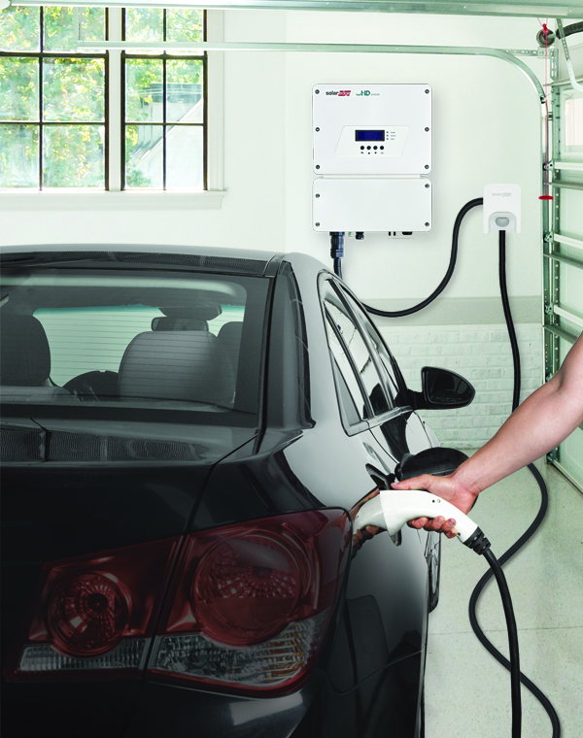
The World’s 1st Inverter-Integrated EV Charger
Reduces cost & labour of installing a separate standalone EV charger and a PV inverter
Innovative solar boost mode combining grid power and PV power for faster charging
Integration with the SolarEdge monitoring platform
7.4kW (32 AMP) Level 3 charger

Slide 18
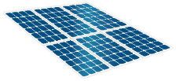
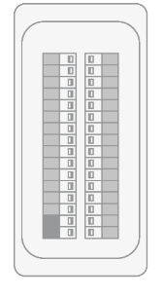
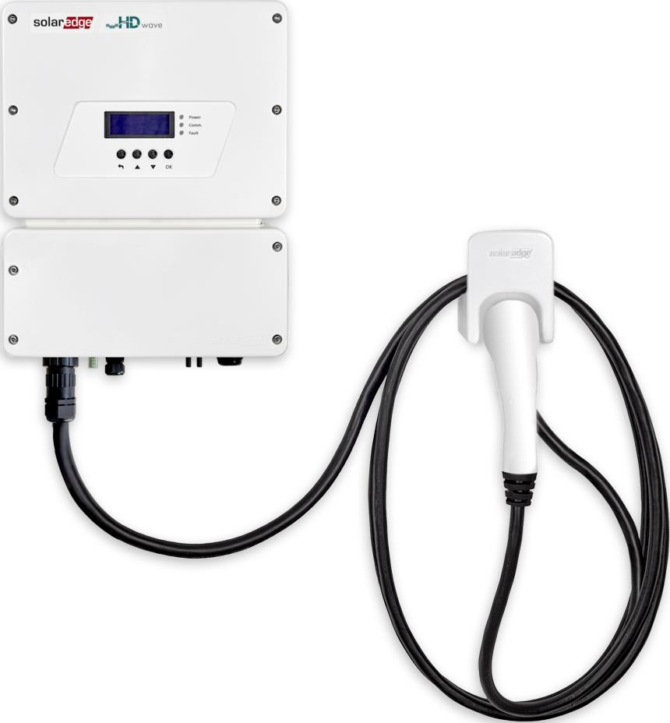
Integration Means 2 Power Sources
PV
SE3680H
SE6000H
Up to 27.5A
Up to 27.5A
Inverter-Integrated EV Charger
Solar Boost Mode
EV 32A
Max64A

Slide 19
The Evolution of Incentive Structures

Slide 20
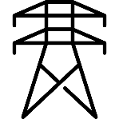
The Evolution of Incentive Structures
FiT
Utilities pay renewable energy producers a fixed and above-retail rate for electricity supplied to the grid.

Slide 21
The Evolution of Incentive Structures
Net Metering
The cost of the electric energy consumed from the grid is offset by the electric energy generated by the renewable source.

Slide 22
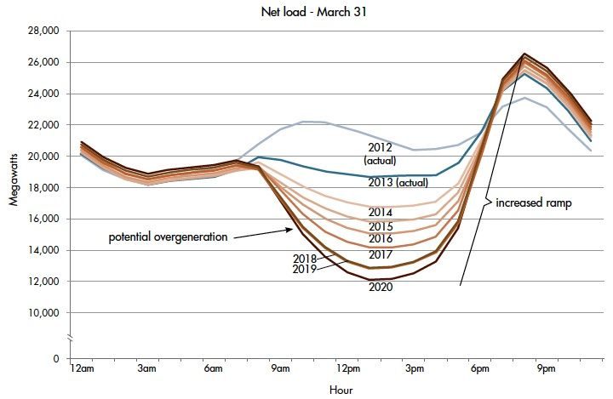
High PV Penetration Burdens the Grid
California’s load curve, March 2013
Ramp needed =13,000 MWh in 3 hours
Minimum generation = 15,000 MWh
Sources: California ISO publication
Notes:
http://www.raponline.org/wp-content/uploads/2016/05/rap-lazar-teachingducktofly-2014-jan.pdfs

Slide 23
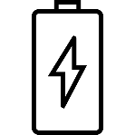
The Evolution of Solar PV
Self-Consumption
PV system owners consume self-generated solar electricity.

Slide 24
How Can We Further Enhance PV Proliferation?
Three separate developments need to happen simultaneously for progress
Product
Individual components advancement
System
Synchronization of products and components
Seamless user experience
Network
Multiple systems synced to create a distributed network
Product
System
Network

Slide 25
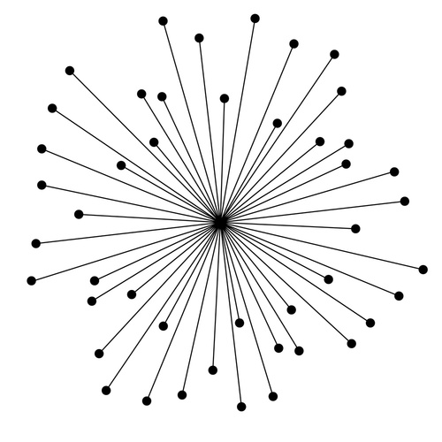
Network Evolution
Centralized power production is outdated and inefficient
Remained unchanged for nearly a century
Product
System
Network
Centralized Network

Slide 26
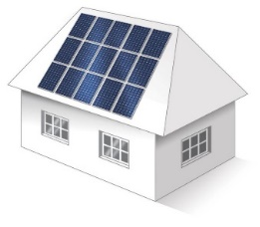
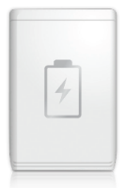
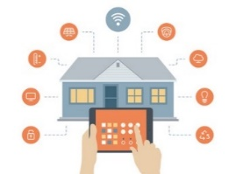
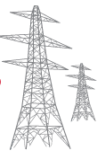
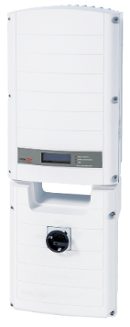
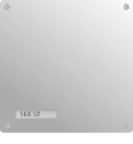
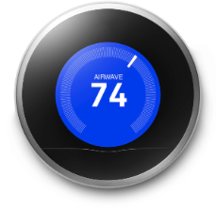
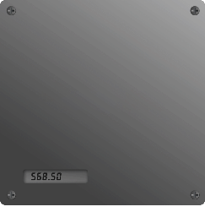
System Evolution
PV
Storage
Backup
Device control
Product
System
Network

Slide 27
Product Evolution
Products (modules, inverters, BoS, batteries) need to improve to drive market growth
Higher efficiency
Lower price per watt
Higher reliability
Easier installation and usability
More interconnected
Product
Power: 6 kW
Volume: 14.5 liters
Weight: 9.5 kg
Efficiency: 99%
2 powerful DSPs
System
Network

Slide 28
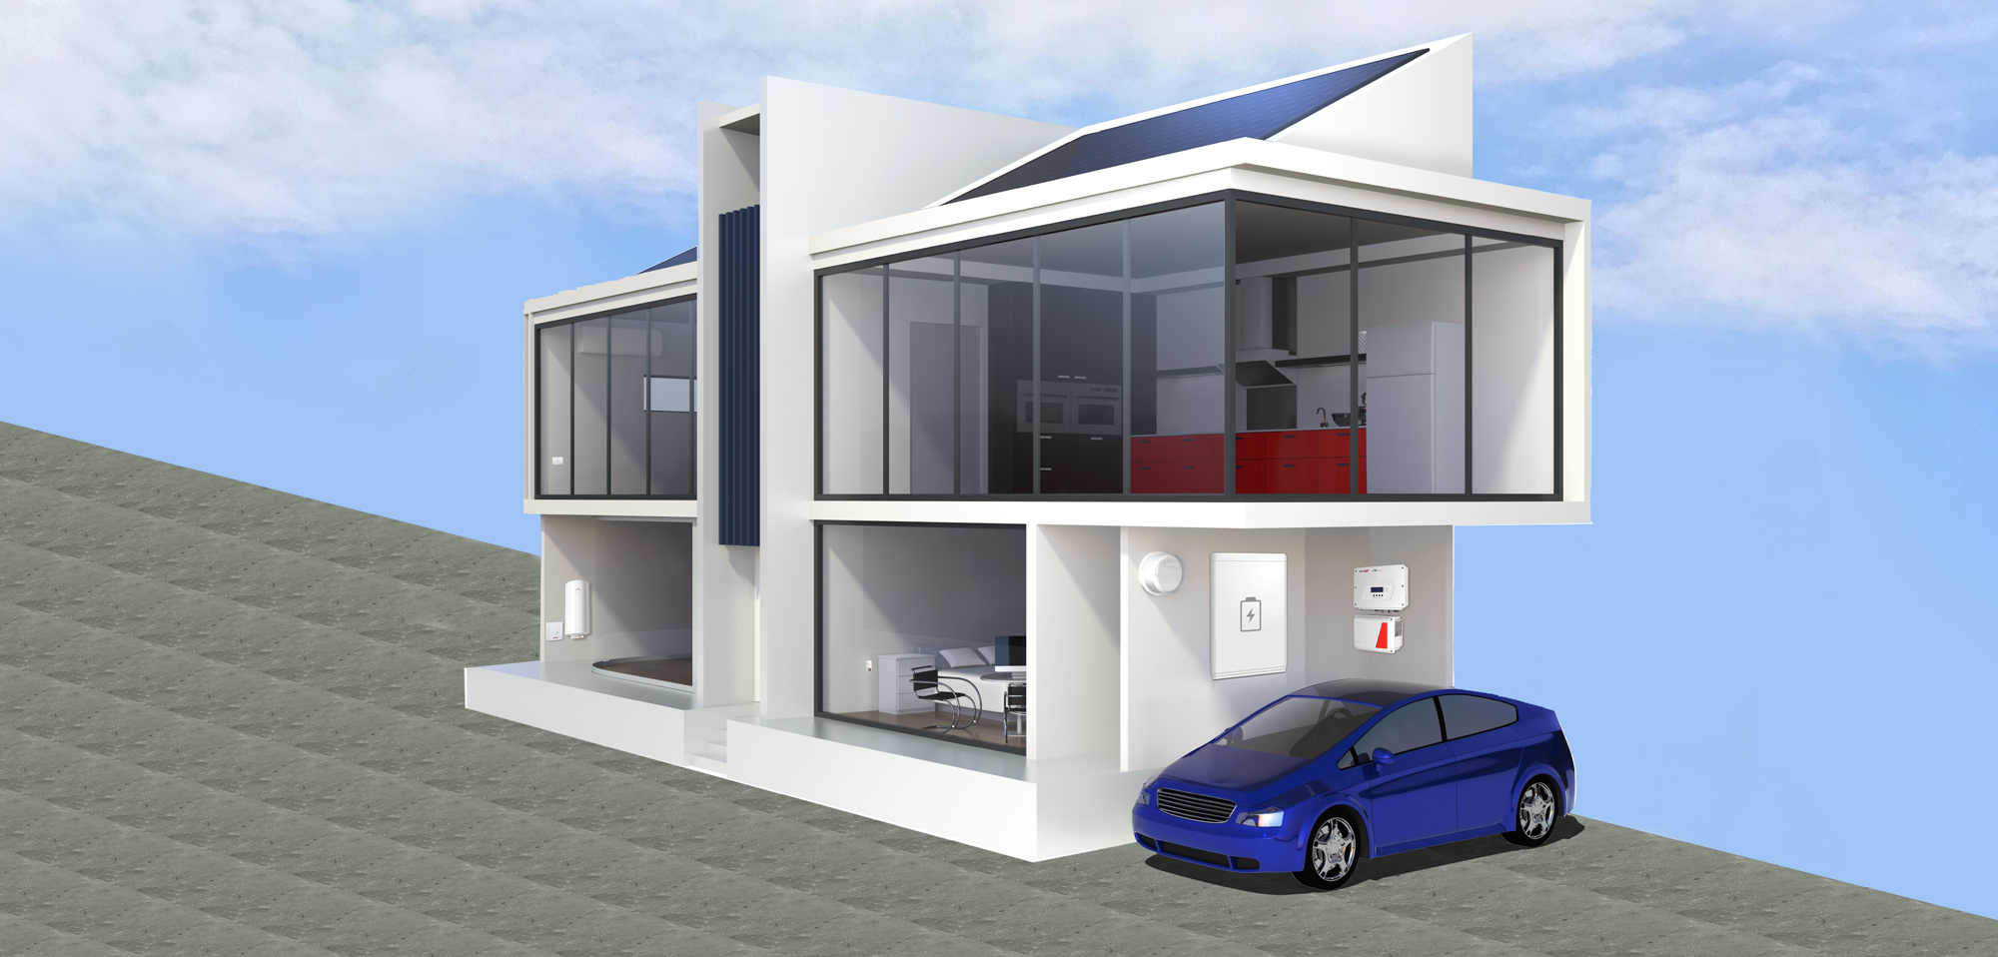
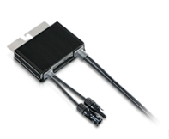
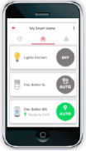
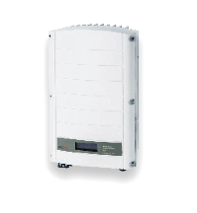
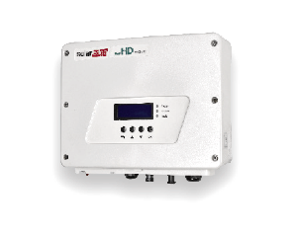
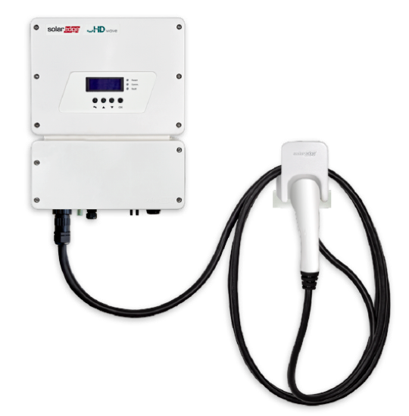
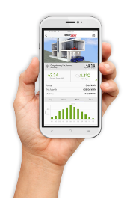
Maximising Self-Consumption
Power Optimizer
Smart Energy
Smart Energy Relay
Inverter
Single phase
Three phase
Smart Energy Hot Water
Smart Energy Socket
Monitoring Platform
EV-ready
StorEdge™
EV Charging

Slide 29
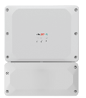
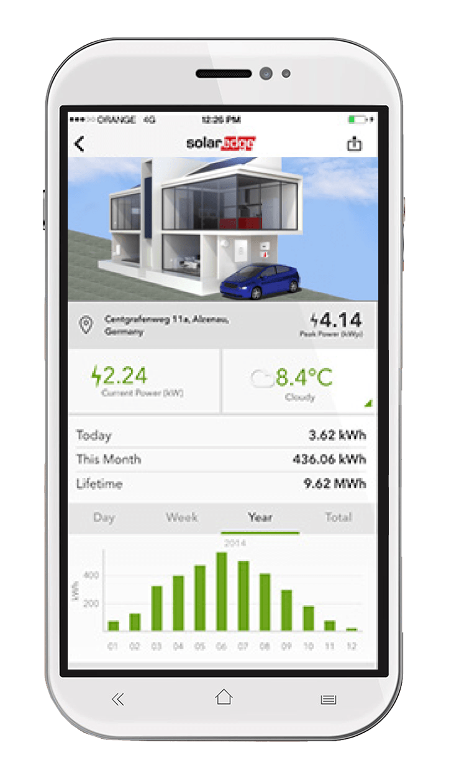
All-in-One Inverter
All needs seamlessly accommodated from a single product
PV
Storage
Backup
Device control
EV Charging

Slide 30
Thanks
Richard.Fuell@SolarEdge.com

