Slide 1
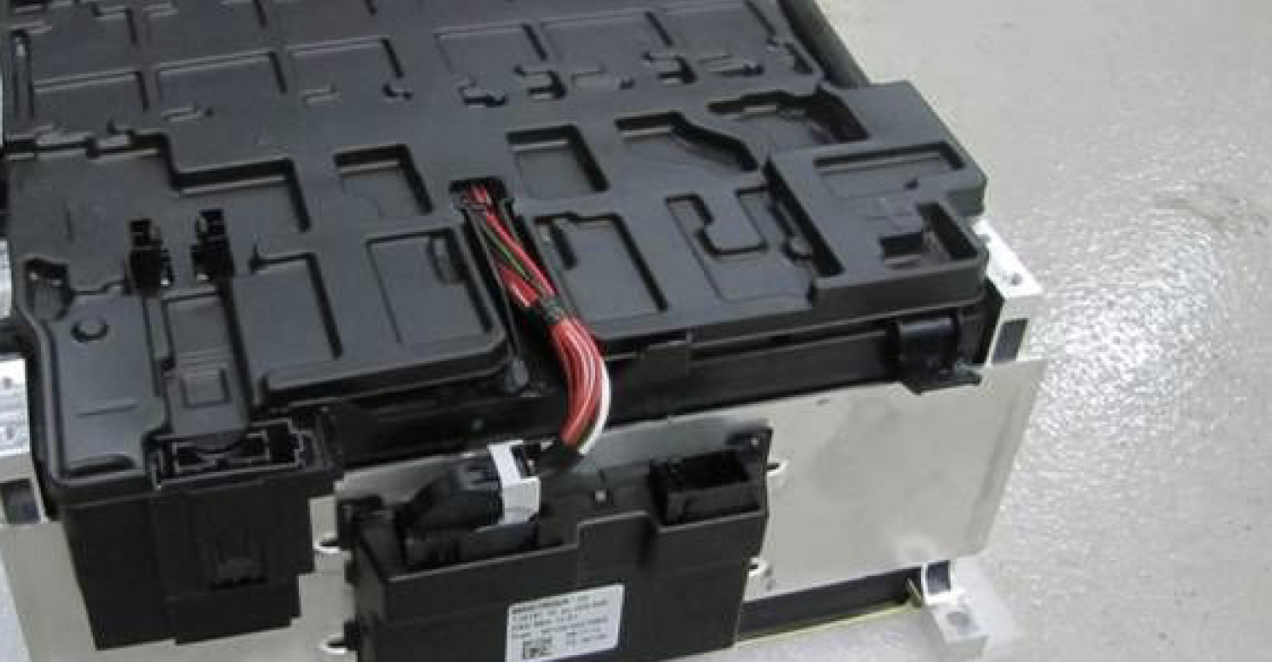
Value Stacking
The key to cost effective energy storage
DANNY JONES MIET
OFF GRID ENERGY LTD

Slide 2
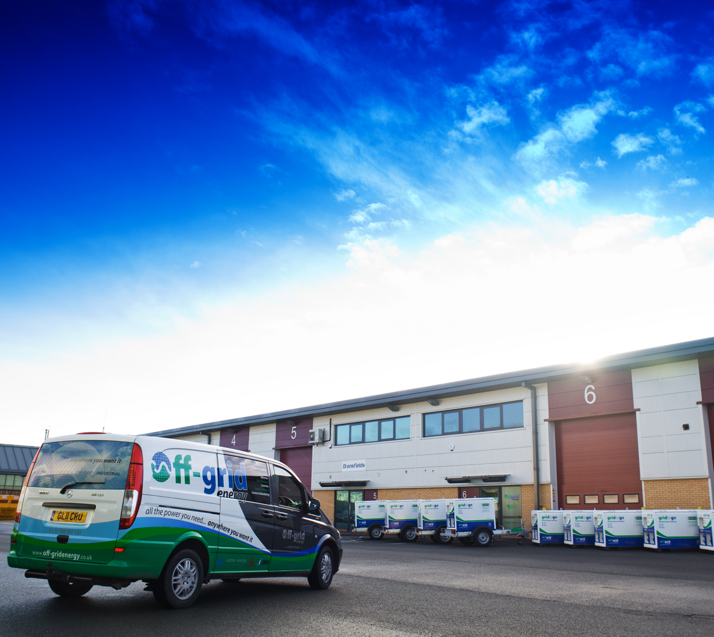
Company background
Established in 2009
Technology company based in Rugby
Design, manufacture and supply energy storage solutions
Temporary power, behind the meter storage, EV infrastructure, micro and mini grids

Slide 3
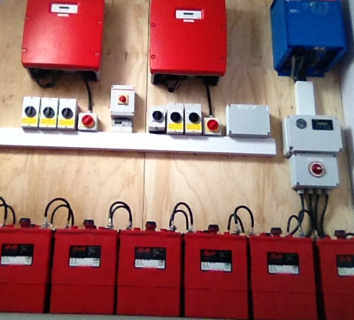
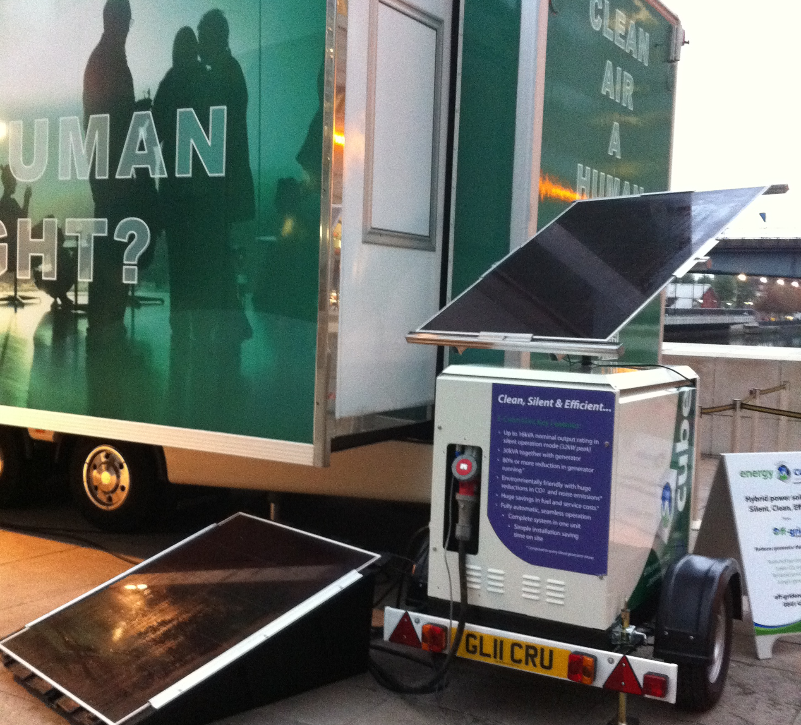
OGE Heritage - energy storage since 2010
2010
Storage + solar
2012 Li-Ion systems for utilities
2015 - established dedicated battery rental business, now at 130+ systems and growing
2017 larger scale BTM and hybrid power solutions
2011 UK’s first commercial hybrid
2013 supply to national plant rental partners

Slide 4
Customers & Countries
We export to:
Awards
“Product of the Year” award winner 2013
“Event Innovation of the Year” award winners 2013
“Environmental Impact” award winner 2015
“Commercial Innovation of the Year” finalist 2014
“Finalists in IET innovations and EDIE awards”

Slide 5
Energy storage “spectrum”
Storage can be used in many different applications on differing scale…..
"Grid scale” (MW’s) for grid balancing
To augment large scale (MW’s) renewables installations (PV & Wind)
Behind the Meter (BtM) for PV self consumption, energy exchange, re-enforcement etc
Mini and Micro grids for on and off-grid applications
Temporary power and EV charge infrastructure

Slide 6
What can battery energy storage do?
Grid re-enforcement
PV Self consumption
Energy exchange
DSR (V & Hz)
Demand shift
Peak shaving
EV charging infrastructure

Slide 7
Grid re-enforcement
Uses stored energy to temporarily boost a power supply of limited capacity
Avoid cost, disruption and delays associated with hard re-enforcement
Can be temporary or permanent solution
On balance sheet asset rather than sunken cost

Slide 8
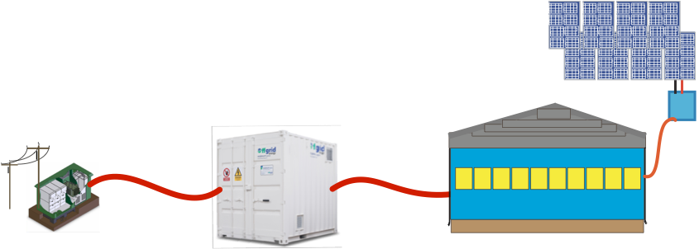
PV self consumption
Capture and store excess PV yield
Optimise PV RoI
Managed export
Maximise PV capacity (not limited by DNO)

Slide 9
Energy Exchange & DSR
Battery can absorb or inject energy from/to distribution network as and when needed (eg during period of high renewables production, scheduled periods of high network demand)
Battery can deliver voltage and frequency response
Asset can earn money from energy exchanged with network

Slide 10
Demand Shift and Peak shaving
Energy stored during periods of low demand at low cost
Energy consumed during periods of high demand & high tariff
Energy used to crop peak demand to avoid high availability charges
Levelling demand on standby generators

Slide 11
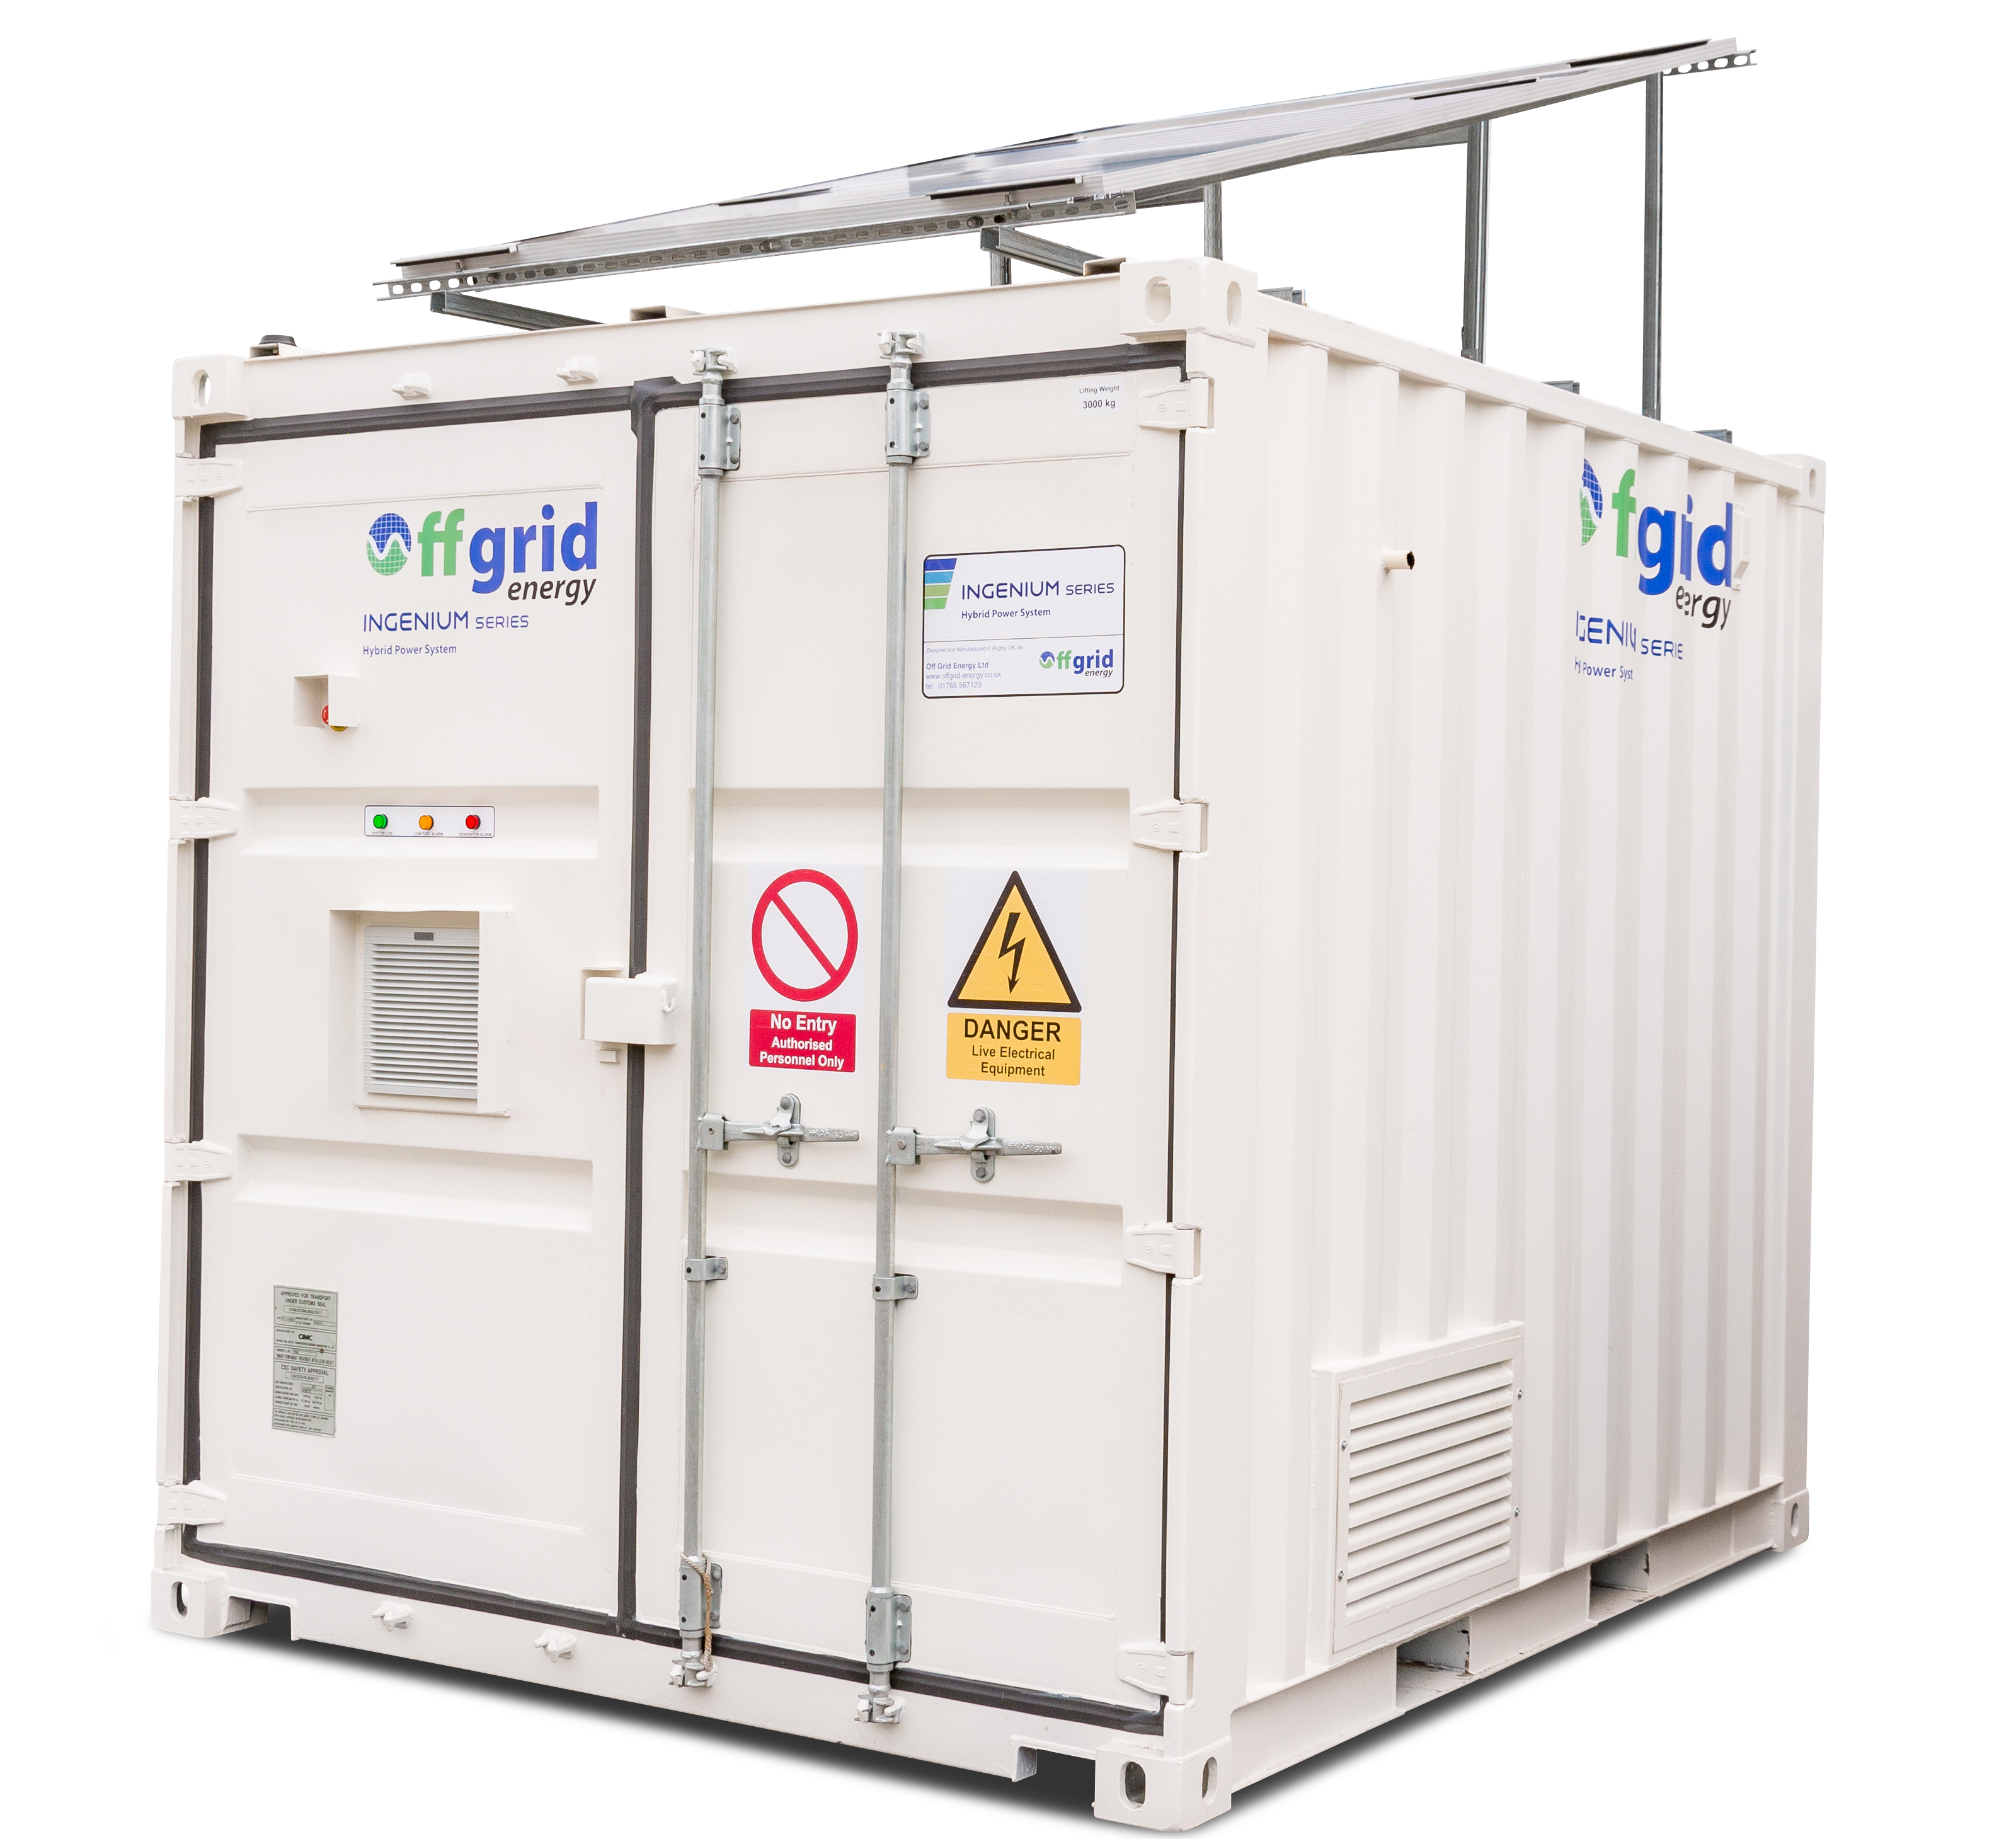
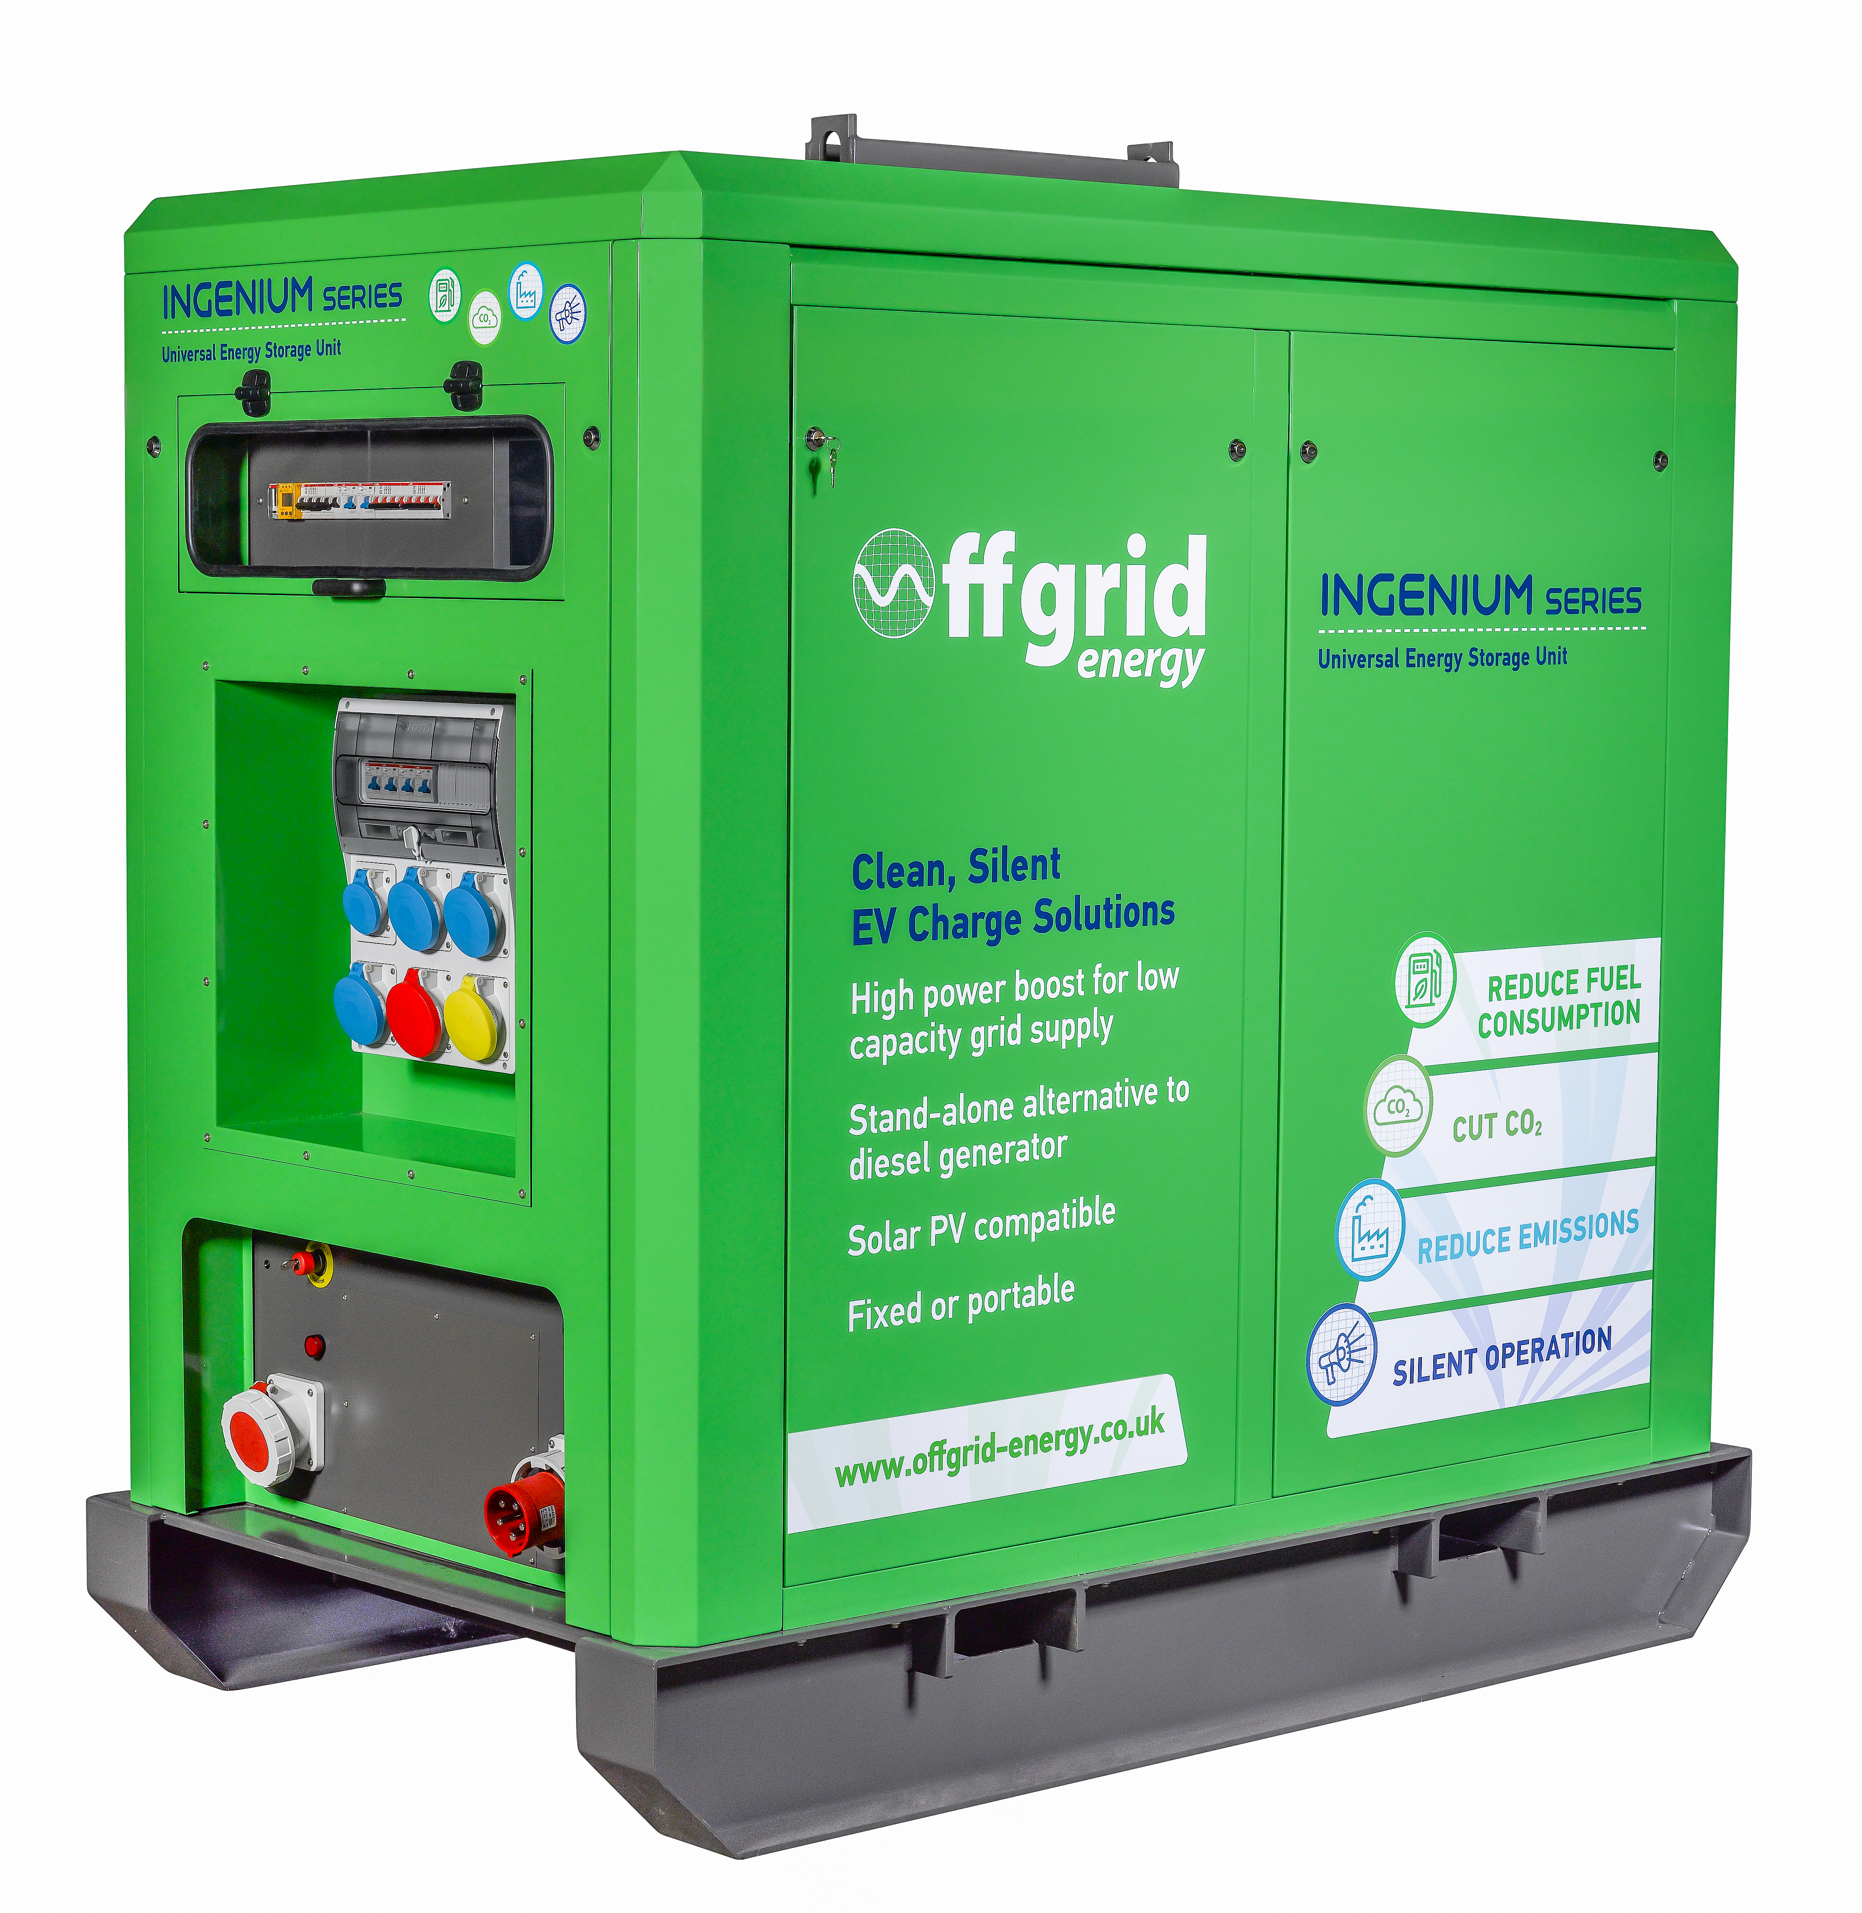
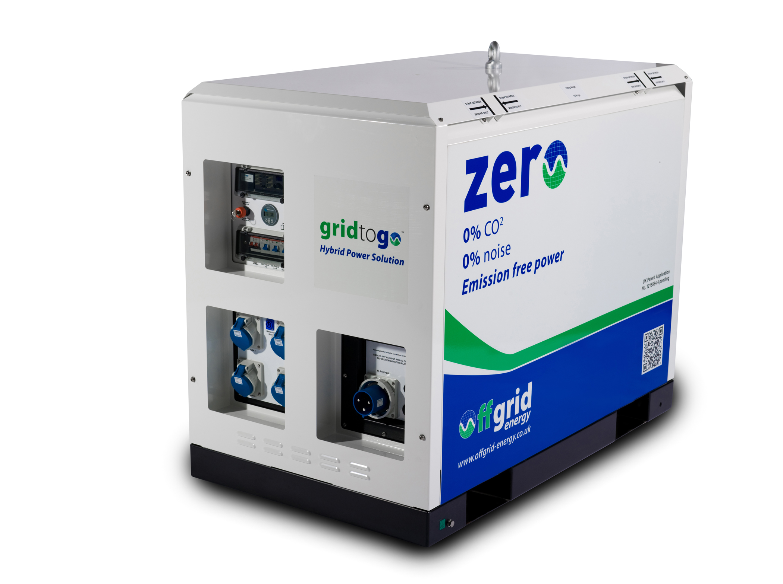
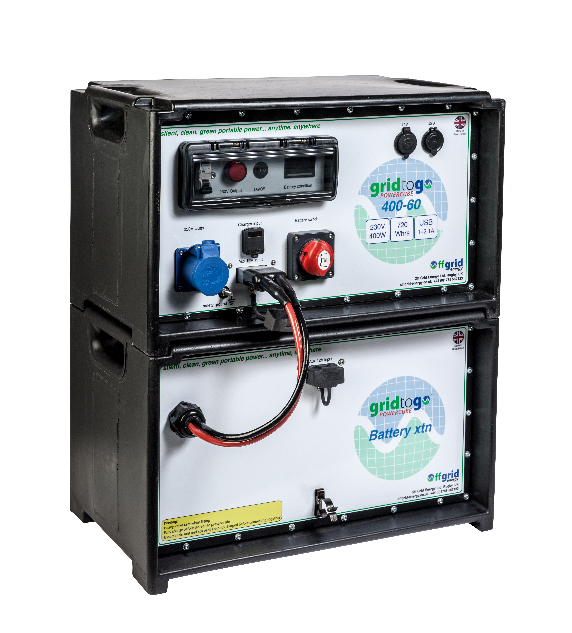
Product family
Nano
400VA to 2kVA
0.7 - 5kWhrs
Powercube
3kVA to 30kVA
10 - 100kWhrs
Ingenium
30kVA to 90kVA
60 - 200kWhrs
Ingenium Plus
66kVA - 1MVA
120kWhrs - 2MWhrs

Slide 12
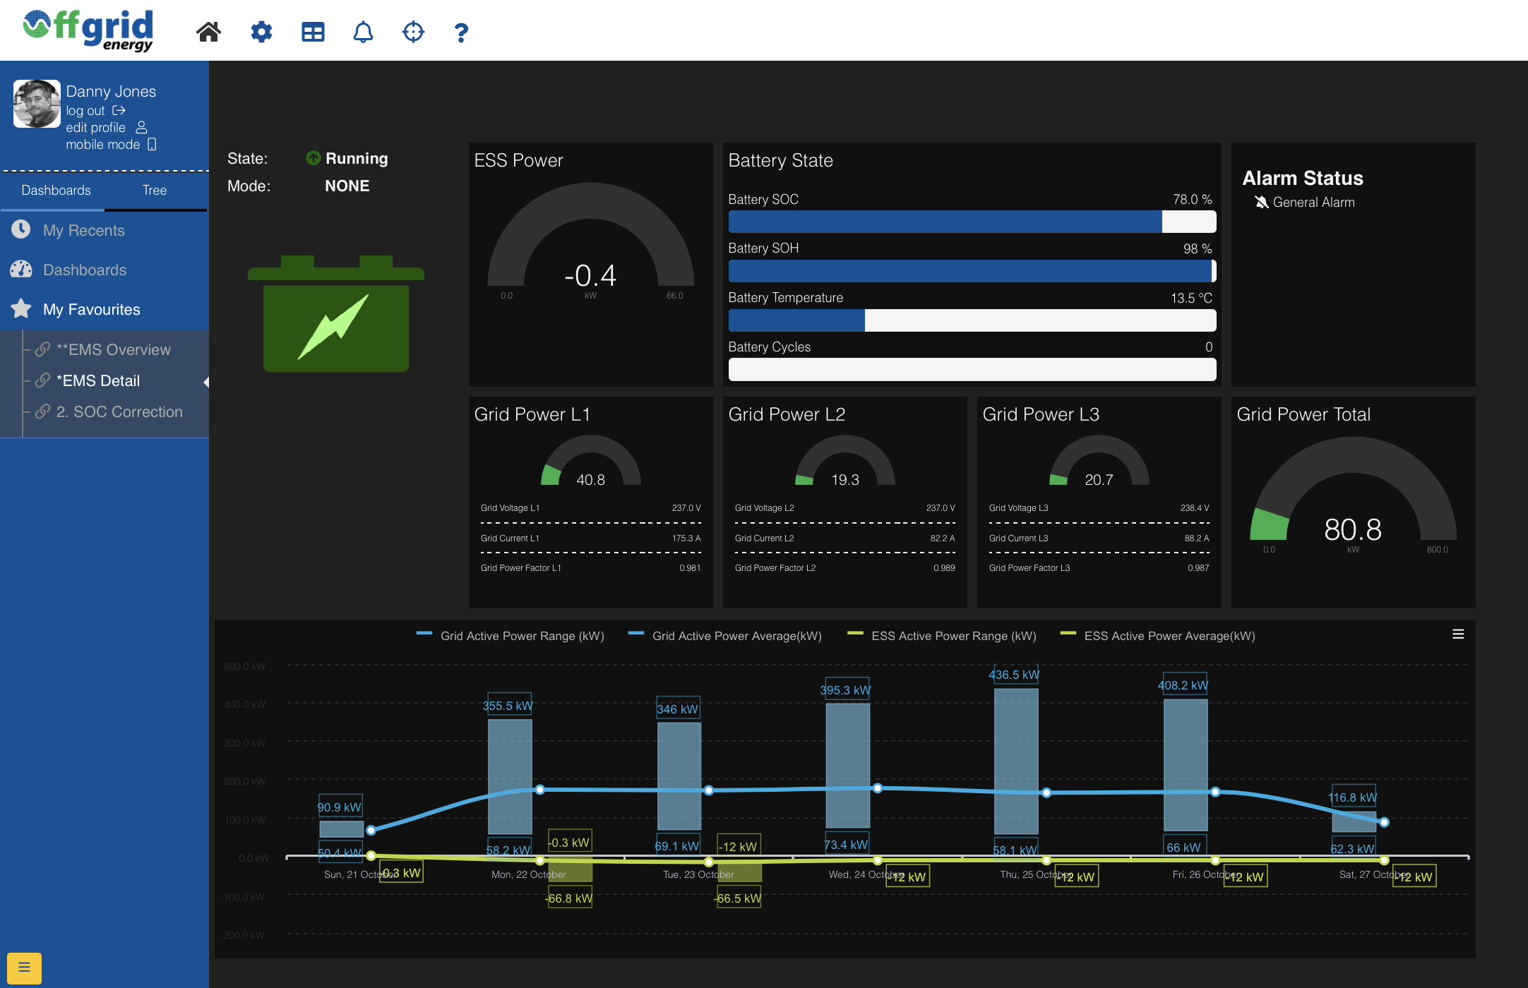
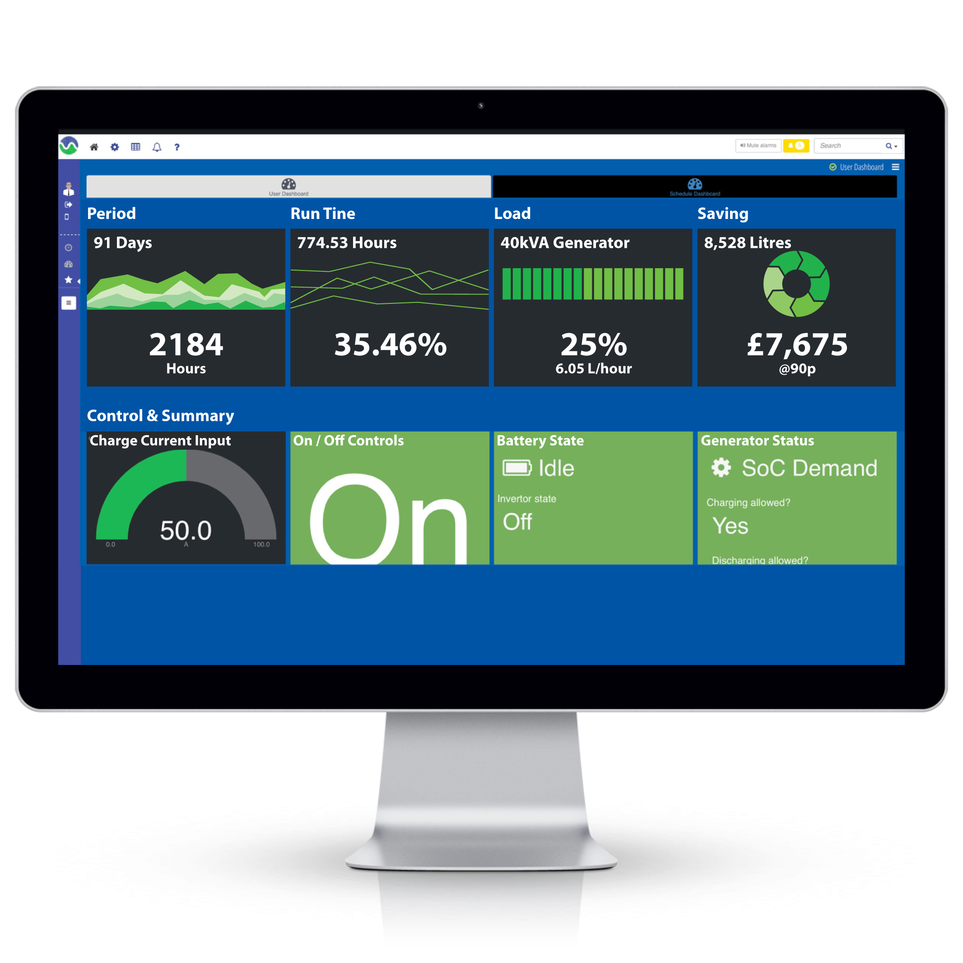
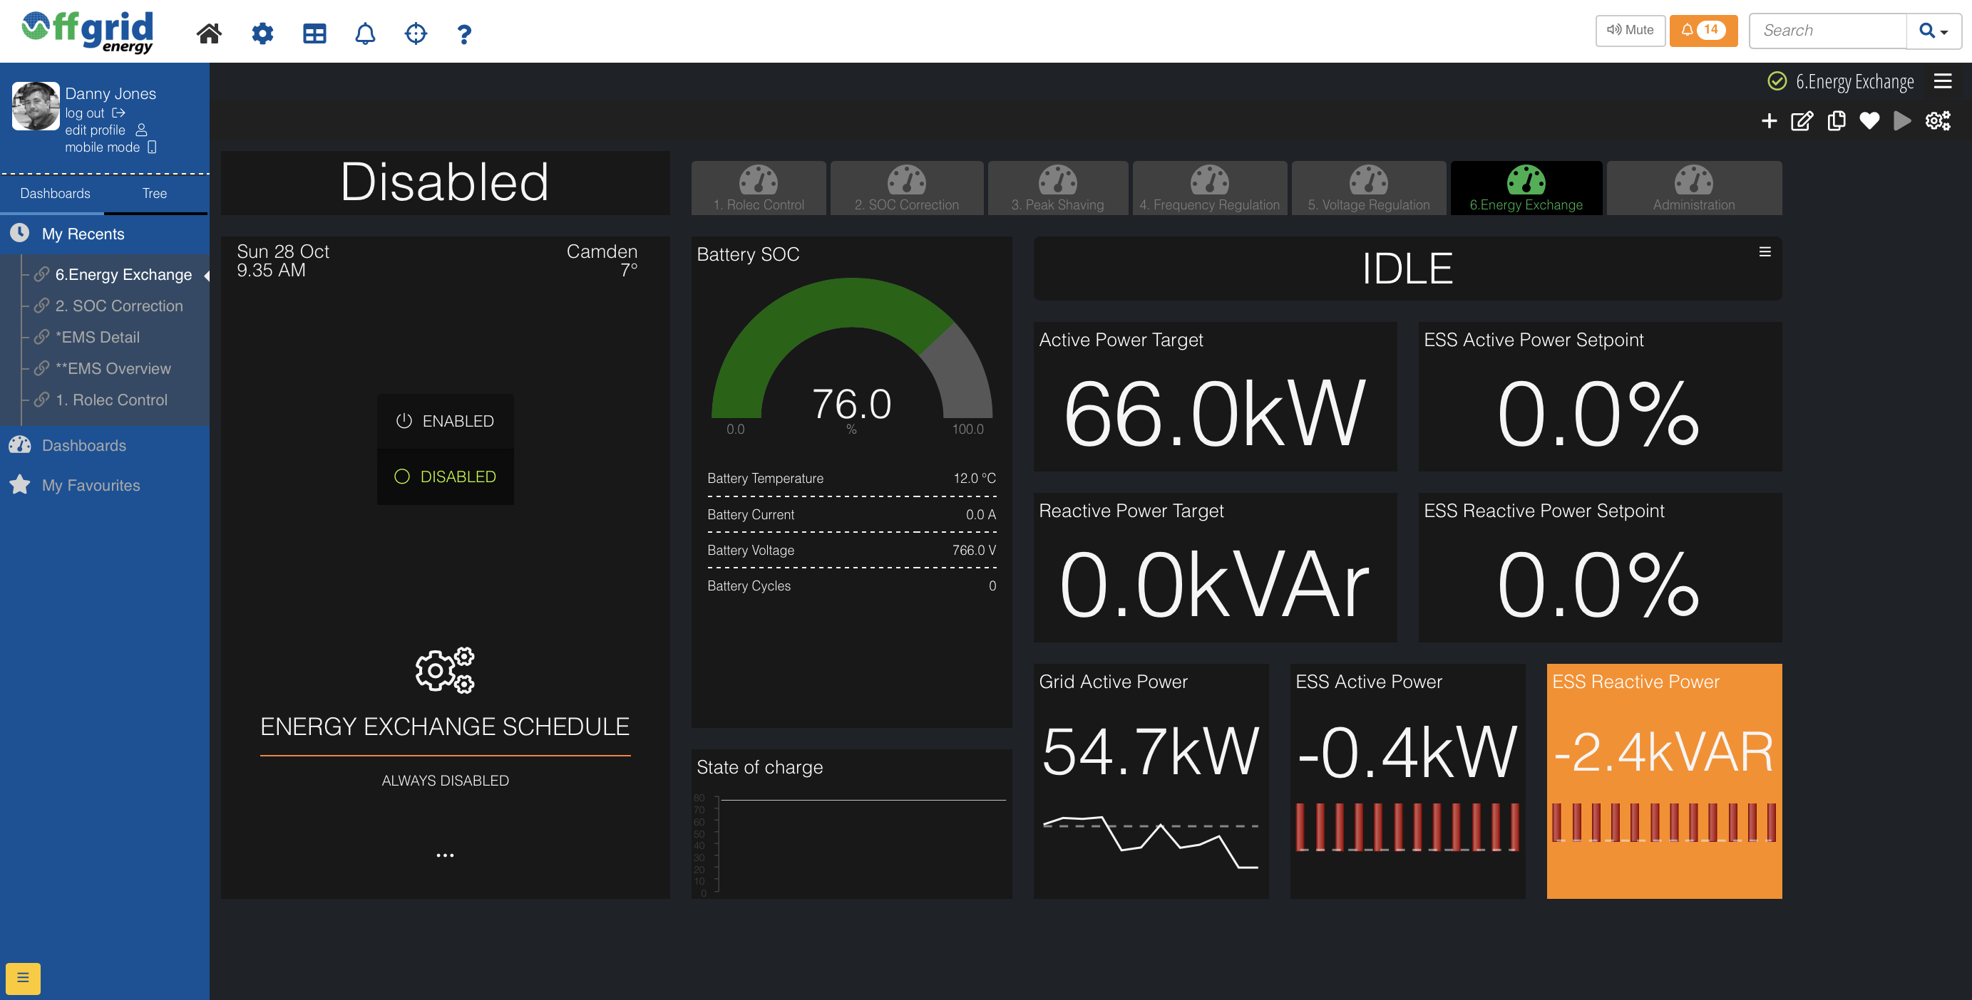
Knowledge is Power!
Remote monitoring through smart EMS provides real time vision on energy use with historical analytics to report savings and provide valuable data for future optimisation.

Slide 13
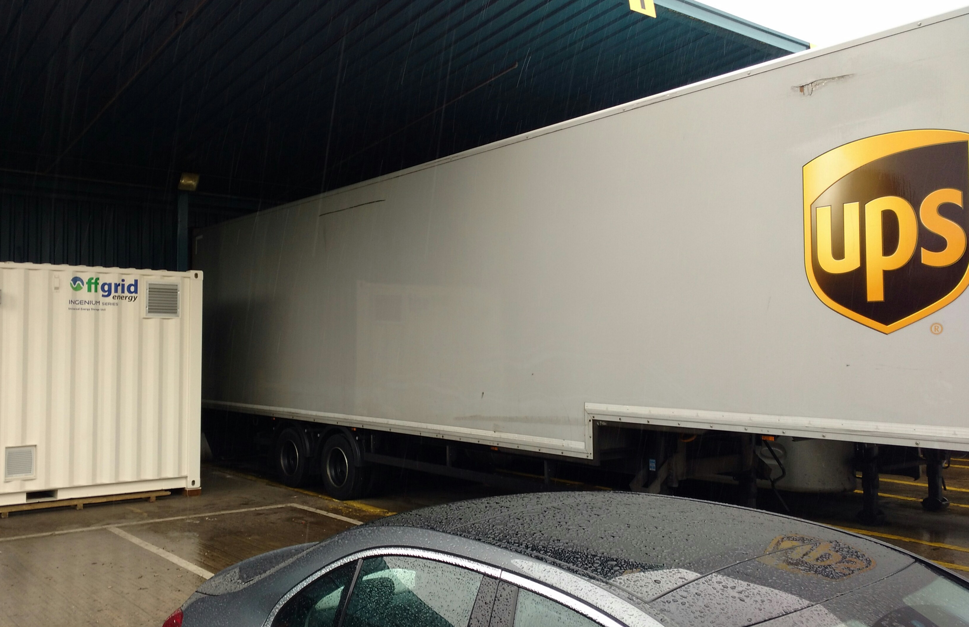
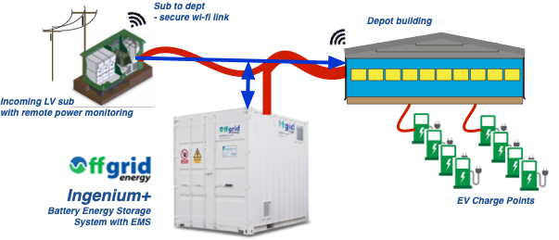
Case study:
UPS Camden
Introduction of 170 electric delivery vehicles
1.5MW gird supply not adequate (depot needs + EV charging requirements)
Local network constrained, cost & time for upgrade prohibitive
BESS + smart charging system at fraction of cost, 16 week delivery & installation
Delivery of grid support services (FR, VR, energy exchange)
Cost effective, stacked benefits, re-deployable asset.

Slide 14
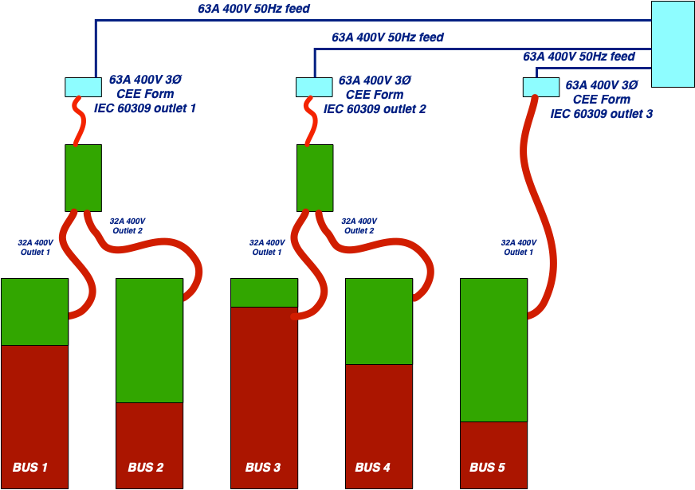
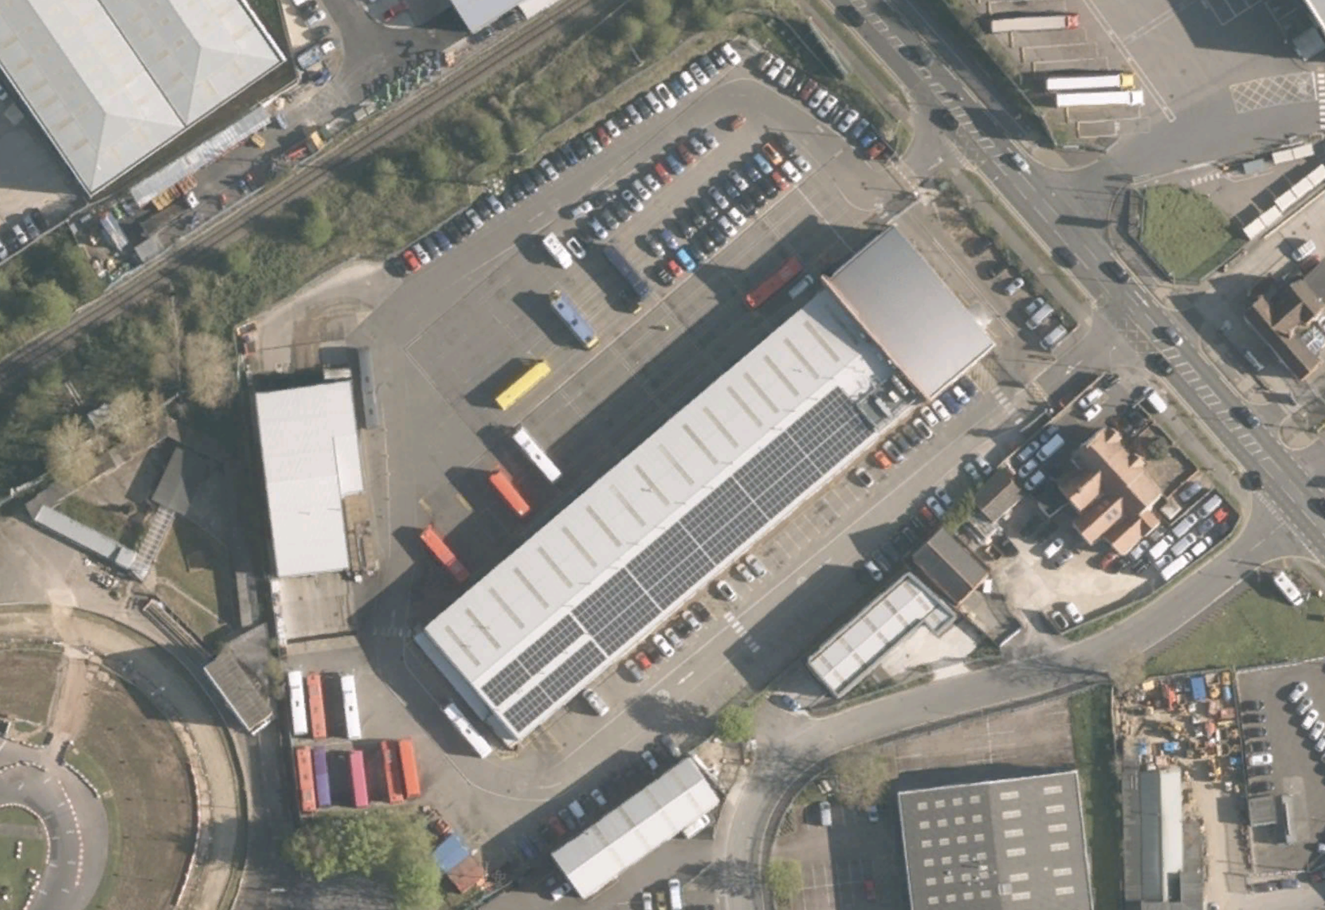
Case study:
Oxford Bus
System to support charing of electric tour busses
Alternative to sunken cost of new grid connection
Re-enforce minimum available supply
Immediate deployment
Can be re-deployed at later date
Solar PV self consumption with deferred charging + weather report integration
DSR functions

Slide 15
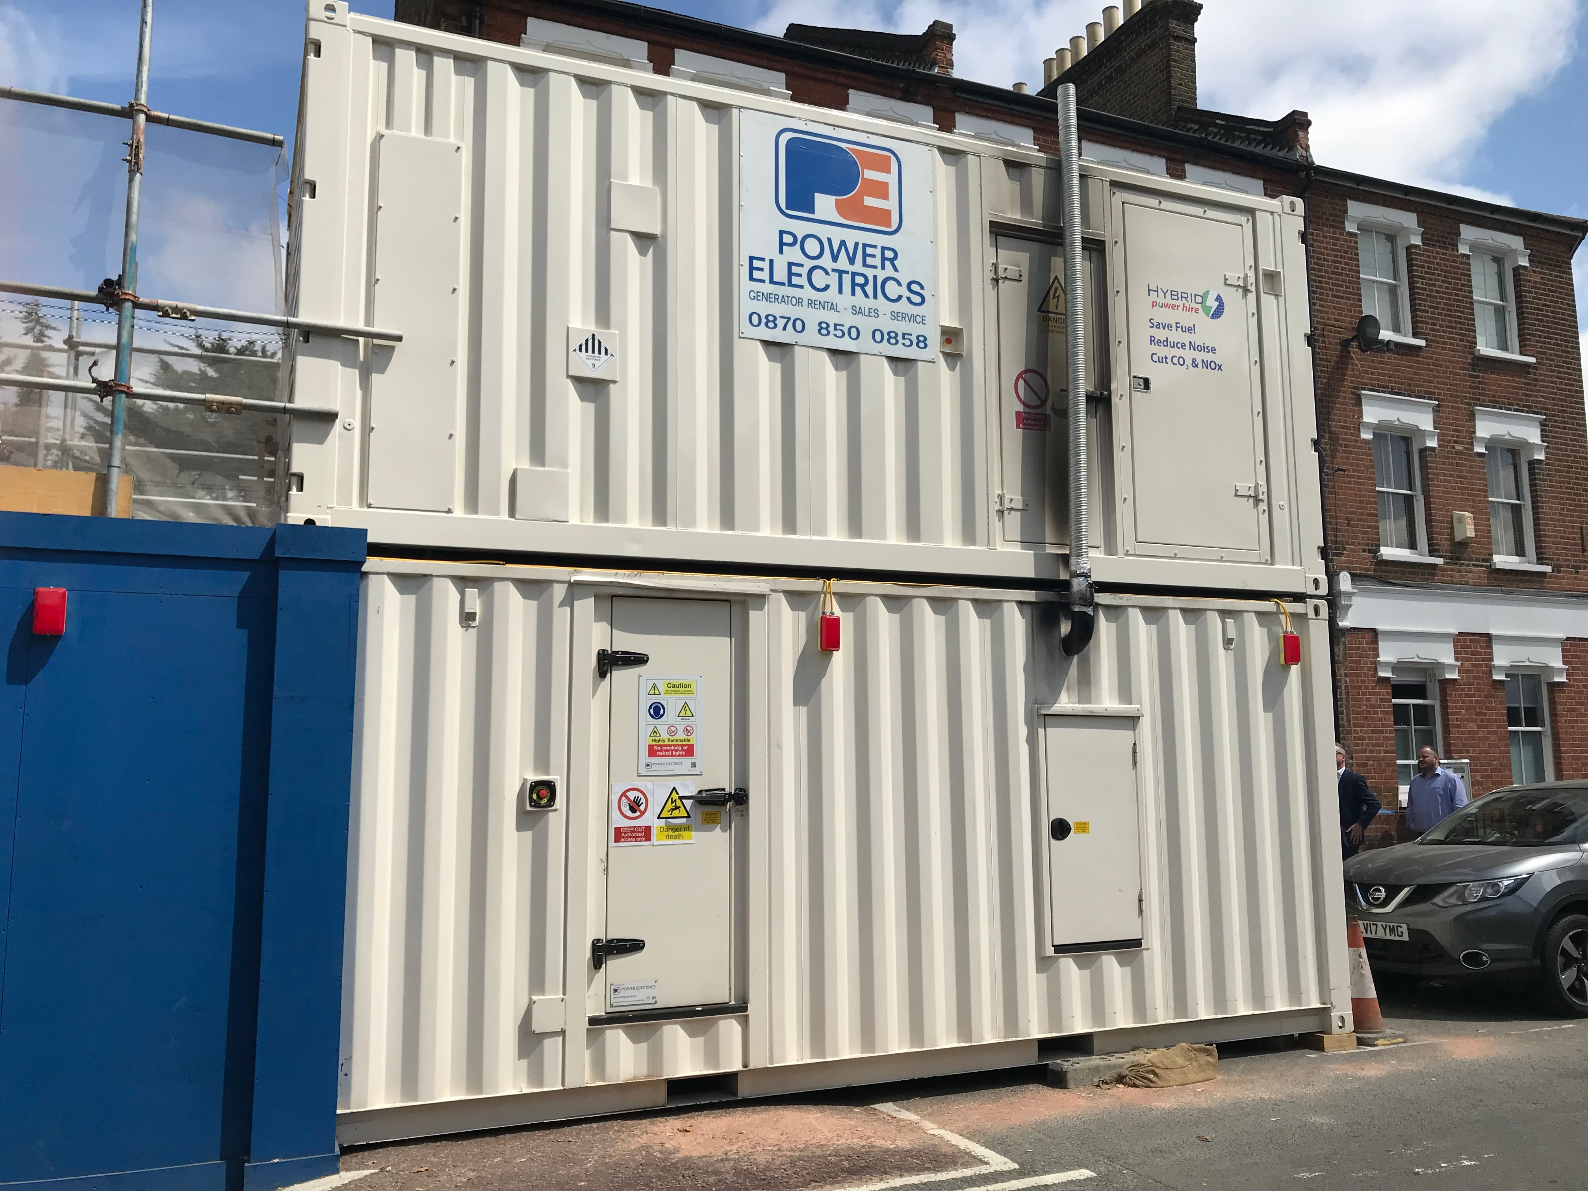
Case study:
Kennington tube stn.
200kVA, 350kWhr BESS
+ 300kVA EuroV bio-diesel generator
“The Off-Grid hybrid unit provided a great solution to our challenge of providing 24/7 power in a residential area where no mains connections were available.
The hybrid unit also gave us significant fuel savings over the 16 week period of around 66,000 litres, which equates to a carbon emission saving of approx. 160 TCO2e. The unit worked exactly as we hoped and was a great success.”
Environmental Manager at FLO
(Ferrovial Agroman Laing O'Rourke JV)

Slide 16
Case study:
Generator test facility
Capture energy from generator test cells
Capture energy from solar PV installation
Use stored energy to charge parts delivery vehicles and supply energy to customer’s private network
Back-up power resource in the event of disturbance or fault
Energy exchange capabilities within G99 ER (generator test cells cannot meet power quality standards)

Slide 17
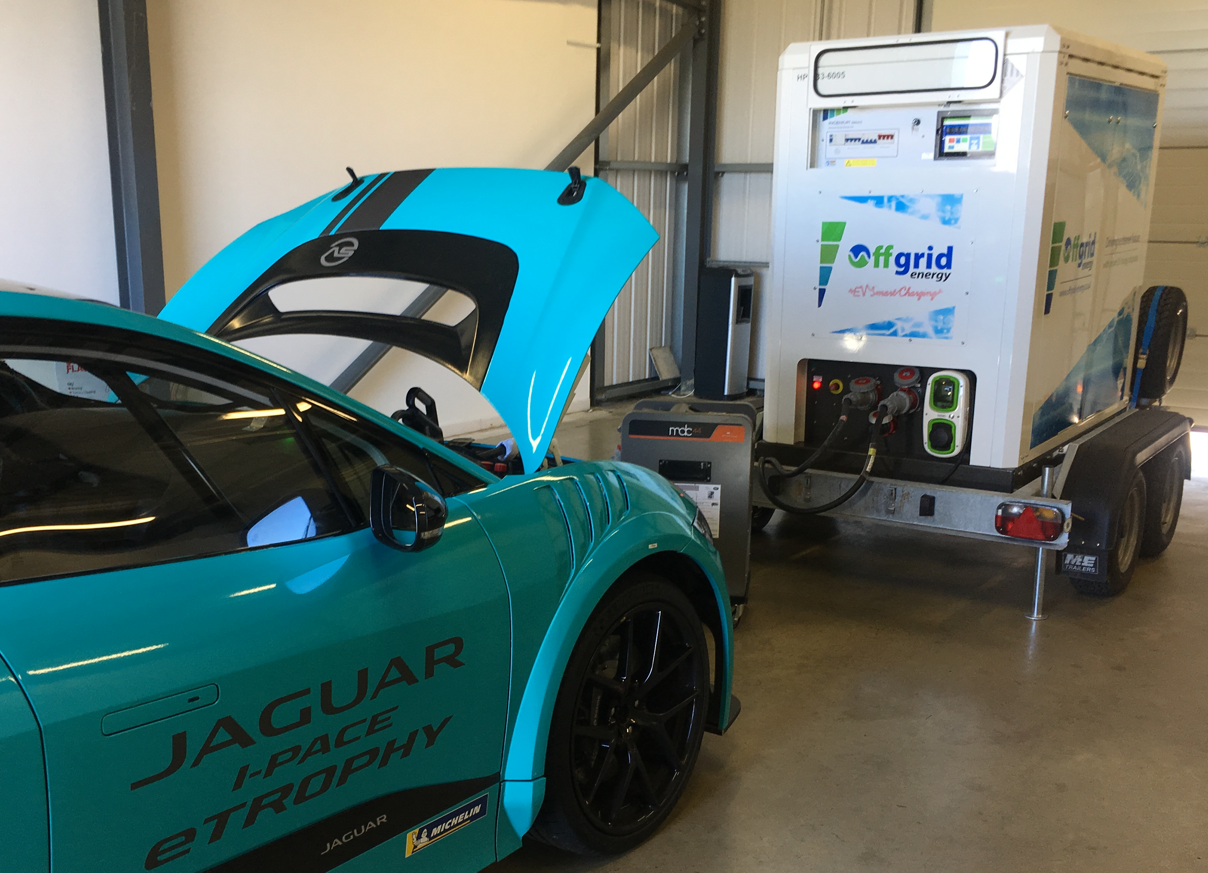
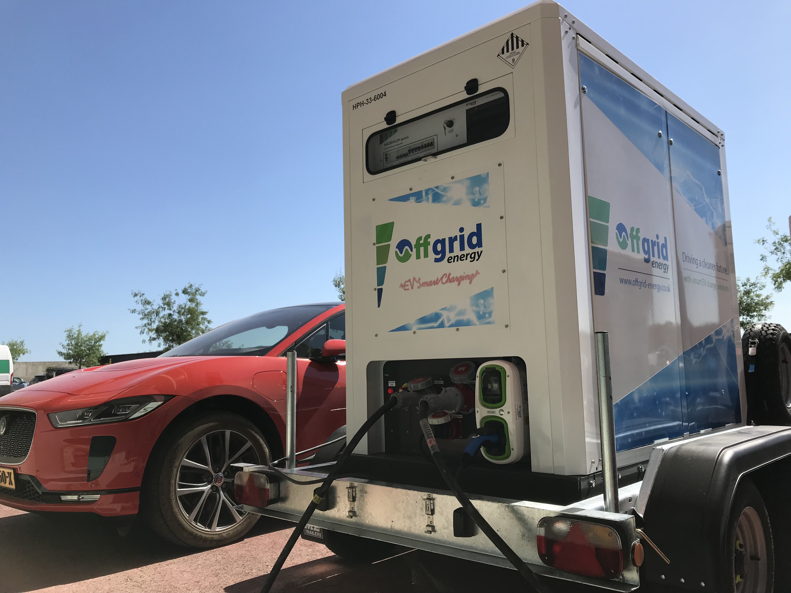
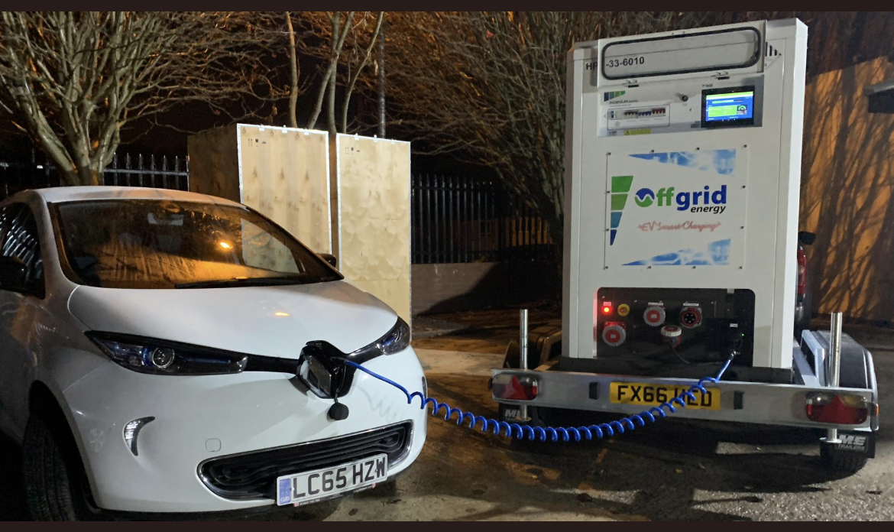
Case study:
EV launch events
Race track + rural circuit with limited capacity grid infrastructure, inadequate for high capacity EV charging
Use of generators with fuel management both expensive, hazardous and environmentally undesirable
High capacity, towable units with li-Ion battery systems provided flexible, clean and cost effective alternative to use of generators
Outcome: No Fuel, cost reduction, zero emissions

Slide 18
Off Grid Energy Ltd
Hybrid Power Hire Ltd
6 Pelham Road
Central Park
Rugby
CV23 0PB
+44 (0)1788 567123
danny.jones@offgrid-energy.co.uk
janene.dooler@offgrid-energy.co.uk
www.offgrid-energy.co.uk

