Slide 1
Before you start
Growing Careers for Positive Change
Home-learning KS3 lesson 2: Making a difference
To start, play this slideshow from beginning
Adapted for home learning with kind permission from the Environment Agency

Slide 2
Home learning lesson 2: Making a difference

Slide 3
We are learning:
About career choices and how we can make a difference.
We will be able to:
explain how shared values might influence where someone chooses to work.
explain the connection between people’s values, motivation and goals.

Slide 4
Need help?
Click here for some examples to choose from
A few examples of what you might consider to be important could include:
A sense of community or a friendly workplace
Sharing similar values
Good pay
A job that people admire or respect
Opportunities to learn or develop skills
A role that helps to protect the environment
Opportunities to change people’s live for the better
What do you think are the three most important things to think about when choosing a career or job?
Write this down and keep it safe! You will be returning to it at the end of the session.
Notes:
Examples:
A sense of community or a friendly workplace
Sharing similar values
Good pay
A job that people admire or respect
Opportunities to learn or develop skills
A role that helps to protect the environment
Opportunities to change people’s live for the better

Slide 5
Motivation and wellbeing
Feeling motivated is an important part of learning and our career decisions.
Read the next slide and consider the following questions:
How might Amara’s feelings and actions differ when she’s trying to complete her Spanish work compared to work for a topic she feels confident doing?
What advice do you have for Amara about how she spends her time after finishing her school work?
Can you think of any other projects Amara could take part in or goals she could set herself in relation to her ambitions?

Slide 6
Motivation and wellbeing
Luca’s suggestions:
Amara has finished her school work for the day and is looking for something to do at home this evening. She enjoyed most of the work, but found Spanish quite difficult as she was learning some new vocabulary she’s never come across before.
Yesterday she was daydreaming about what she’d like to do when she’s older. She was thinking about primary school when she learned about plastic pollution in the ocean, and she was fascinated when her Year 7 Geography teacher told her more about climate change and the environment. She’s pretty sure she’d like a job that helps raise awareness about these problems or even help to fix them when she’s older.
Amara told her best friend Luca that she was stuck choosing something to do and he’s suggested a few options.
We could have a video call and catch up. We’ll use as many of our new Spanish words as we can.
¡Hola!
We could both watch the same documentary about the oceans and learn a bit more about it.
We could both enter this art competition I found and use recyclable stuff in our house. There’s not really a prize but people might see what we make on TV.

Slide 7
Click on each question to reveal some ideas about how Amara might be feeling and what she might consider doing
How might Amara’s feelings and actions differ when she’s trying to complete her Spanish work compared to work for a topic she feels confident doing?
What advice do you have for Amara about how she spends her time after finishing her school work?
Can you think of any other projects Amara could take part in or goals she could set herself in relation to her ambitions?
Amara might have more positive feelings while completing work for a subject that she feels confident in. She might feel like she has the skills to tackle the work on her own.
This could mean she spends more time completing work for these topics or tries more challenging activities.
She might find it harder to stay motivated when completing her Spanish work, but if she practices with Luca this will help her to feel more confident in future Spanish work.
You may have agreed with one of Luca’s suggestions or you might have come up with a suggestion of your own.
Amara might like to practise Spanish so she feels more confident with this in the future.
Amara is already interested in the oceans so she could watch the documentary to find out more. She might also want to use art to share the issues that are important to her by taking part in the competition.
Amara has identified that she might like a career that helps to protect and raise awareness about the environment. She could take part in projects that give her the opportunity to practice skills related to this.
This might include:
Research projects related to the environment.
Writing about why these issues are important to her.
Setting herself goals such reducing single-use plastic in her own home.
Notes:
How might Amara’s feelings and actions differ when she’s trying to complete her Spanish work compared to work for a topic she feels confident doing?
Amara might have more positive feelings while completing work for a subject that she feels confident in. She might feel like she has the skills to tackle the work on her own.
This could mean she spends more time completing work for these topics or tries more challenging activities.
She might find it harder to stay motivated when completing her Spanish work, but if she practices with Luca this will help her to feel more confident in future Spanish work.
What advice do you have for Amara about how she spends her time after finishing her school work?
You may have agreed with one of Luca’s suggestions or you might have come up with a suggestion of your own.
Amara might like to practise Spanish so she feels more confident with this in the future.
Amara is already interested in the oceans so she could watch the documentary to find out more. She might also want to use art to share the issues that are important to her by taking part in the competition.
Can you think of any other projects Amara could take part in or goals she could set herself in relation to her ambitions?
Amara has identified that she might like a career that helps to protect and raise awareness about the environment. She could take part in projects that give her the opportunity to practice skills related to this.
This might include:
Research projects related to the environment.
Writing about why these issues are important to her.
Setting herself goals such reducing single-use plastic in her own home.

Slide 8
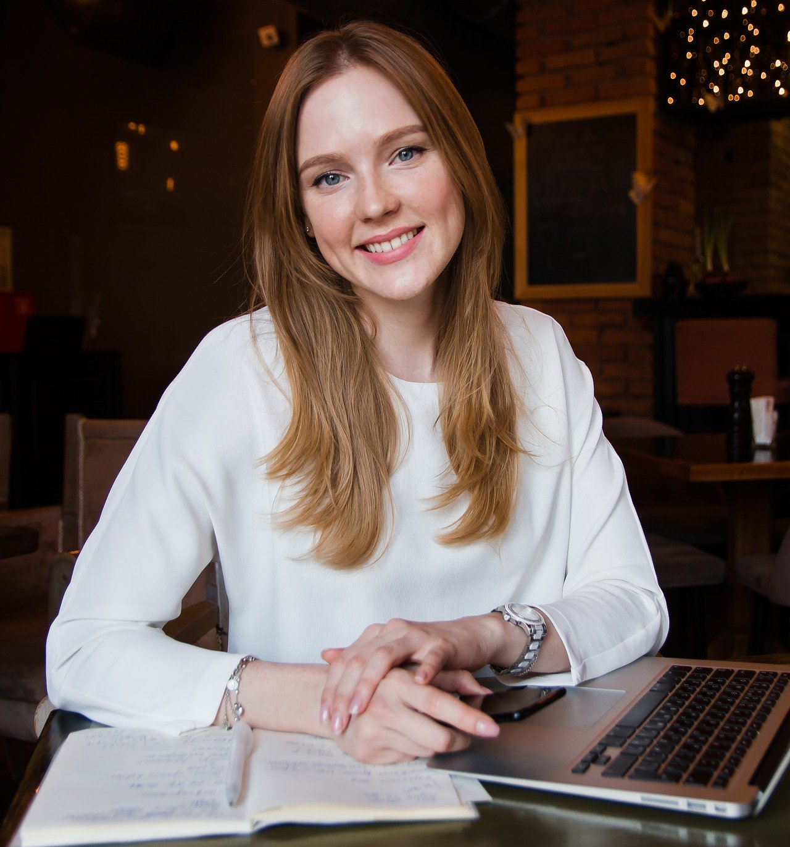
Organisations and values
We know that people hold a variety of values as individuals, but communities and organisations can hold shared values too. Sometimes when we share values, we feel more motivated and positive about our work.
Can you think of any values you share with an organisation or community? For example, your school’s values, religious values or the values of a sports club you belong to?
Nina has just graduated from university and is looking to start her career. Read the mission statements on the next slide and decide which organisation you think would be a good fit for Nina.
Nina
Nina has recently finished a Business degree. She’s looking forward to making some new friendships in her new workplace.
Nina enjoyed the sense of community she experienced while volunteering in her university’s student union. She regularly helped with volunteering opportunities, especially those that included helping to provide learning opportunities for younger people.
Click the picture
Notes:
Nina
Nina has recently finished a Business degree. She’s looking forward to making some new friendships in her new workplace.
Nina enjoyed the sense of community she experienced while volunteering in her university’s student union. She regularly helped with volunteering opportunities, especially those that included helping to provide learning opportunities for younger people.

Slide 9
Click each organisation to learn about their values
Keen Ideas
At Keen Ideas we host events and idea sharing opportunities so that people can learn from others’ experiences.
Our shared values are:
Building a sense of global community.
Helping people to build strong, respectful relationships.
Fantastic Child
At Fantastic Child we help to provide school supplies for children who need them by connecting different communities to help them share what they have.
Our shared values are:
Building connected communities.
Helping others to learn and develop skills.
Sustainabelle
At Sustainabelle we produce eco-friendly fashionwear. Our shared values are:
Protecting the environment by using sustainable materials for our clothing.
Making clothes that people enjoy and that follow the latest fashion trends.
Nutrious.ly
We deliver organic fruit and vegetables.
Our shared values are:
Making sure our customers have access to high-quality, healthy food.
Working with local farmers so to build community and reduce the distance food travels.
Notes:
Keen Ideas
At Keen Ideas we host events and idea sharing opportunities so that people can learn from others’ experiences.
Our shared values are:
Building a sense of global community.
Helping people to build strong, respectful relationships.
Fantastic Child
At Fantastic Child we help to provide school supplies for children who need them by connecting different communities to help them share what they have.
Our shared values are:
Building connected communities.
Helping others to learn and develop skills.
Sustainabelle
At Sustainabelle we produce eco-friendly fashionwear. Our shared values are:
Protecting the environment by using sustainable materials for our clothing.
Making clothes that people enjoy and that follow the latest fashion trends.
Nutrious.ly
We deliver organic fruit and vegetables.
Our shared values are:
Making sure our customers have access to high-quality, healthy food.
Working with local farmers so to build community and reduce the distance food travels.

Slide 10
Organisations, values and motivation:
When looking for a job, people can consider whether an organisation has values that match with their own.
People might find that they feel more motivated in a career that has values that they agree with.
People might get along well with colleagues that share similar values. They could work well as a team or make lasting friendships at work.
Shared values are one of a number of considerations people have when looking for a job. For example, they will also need to consider:
Whether they have the right skills for the job
If the money they will be paid meets their needs

Slide 11
Career case study
Read the case study on the next slide. This is a case study of a real person, Yianni, who has graduated from university and started a new career by joining a graduate scheme with the Environment Agency.
This means that Yianni gets to experience a range of different roles within the organisation, before joining the area that best suits his strengths, interests and ambitions.
After you have read the case study, move forward on to the following slide and answer the questions. These questions explore how Yianni’s experiences support his wellbeing and personal growth.

Slide 12
Yianni’s career journey
I was employed via the Environment Agency’s graduate scheme after I finished my university degree in Civil Engineering (the kind of engineering that helps to design and construct lots of different things such as bridges or buildings).
The graduate scheme means I try lots of different roles in the agency. I ask lots of questions in each role to feel more confident about what I need to do, and also to learn about what kind of role suits me best. People here are always willing to help!
Currently I am working with a team that help to build flood defences. I spend lots of time travelling around the UK and seeing how our projects help to support different communities all around the country.

Slide 13
Match each question to an answer
Click on each question to reveal the answers!
What opportunities does Yianni have to make his own choices about his career?
How is Yianni developing the skills and knowledge he needs to succeed?
How does Yianni’s career give him a sense of connection to communities and the wider world?
Asking questions when he’s not sure about something.
Visiting communities that he is doing work for and seeing the impact it has.
Identifying the role that suits him best and choosing to work in this area.
Notes:
What opportunities does Yianni have to make his own choices about his career? → Identifying the role that suits him best and choosing to work in this area.
How is Yianni developing the skills and knowledge he needs to succeed? → Asking questions when he’s not sure about something.
How does Yianni’s career give him a sense of connection to communities and the wider world? → Visiting communities that he is doing work for and seeing the impact it has.

Slide 14
Need help?
Click here for some examples
A few examples of values you might expect could include:
A sense of community within the organisation
Helping the wider community outside the organisation
Helping employees to learn and develop their skills
Helping to support employees health and wellbeing
Helping to protect the environment or reduce waste
Personal reflection
A few examples of values you might expect could include:
A sense of community within the organisation
Helping the wider community outside the organisation
Helping employees to learn and develop their skills
Helping to support employees health and wellbeing
Helping to protect the environment or reduce waste
We have explored how these values can be shared with an organisation.
What values would you expect, or look for, in an organisation you would want to work for?
Notes:
A few examples of values you might expect could include:
A sense of community within the organisation
Helping the wider community outside the organisation
Helping employees to learn and develop their skills
Helping to support employees health and wellbeing
Helping to protect the environment or reduce waste

Slide 15
Looking back at your list of important factors when choosing a job, has anything changed?
Need help?
Click here for some examples
A few examples of what you might consider to be important could include:
A sense of community or a friendly workplace
Sharing similar values
Good pay
A job that people admire or respect
Opportunities to learn or develop skills
A role that helps to protect the environment
Opportunities to change people’s live for the better
What do you think are the three most important things to think about when choosing a career or job?
Notes:
A few examples of what you might consider to be important could include:
A sense of community or a friendly workplace
Sharing similar values
Good pay
A job that people admire or respect
Opportunities to learn or develop skills
A role that helps to protect the environment
Opportunities to change people’s live for the better

Slide 16
Support
If you have questions or concerns about topics explored here, you can always speak to your parent or carer, or contact a teacher in school for more advice and support.
There are lots of places to get advice about career pathways:
For information, advice and guidance about a wide range of careers and education pathways, visit the national careers service.
nationalcareers.service.gov.uk
For information, advice and guidance about career options should you choose to go to university, visit prospects.
www.prospects.ac.uk

