Slide 1
Direct Work Resource Pack
INSERT LINK TO ONLINE DIRECTORY & published version
3. Direct Work Physical Resources
The following items have been identified as being useful to have in a physical toolkit to support direct work with adults.

Slide 2
Feelings Dice
These are good to pose questions around feelings, understandings, questions, allowing people to opt out of verbal answers, easily recognisable and understood within learning disability work and older age.

Slide 3
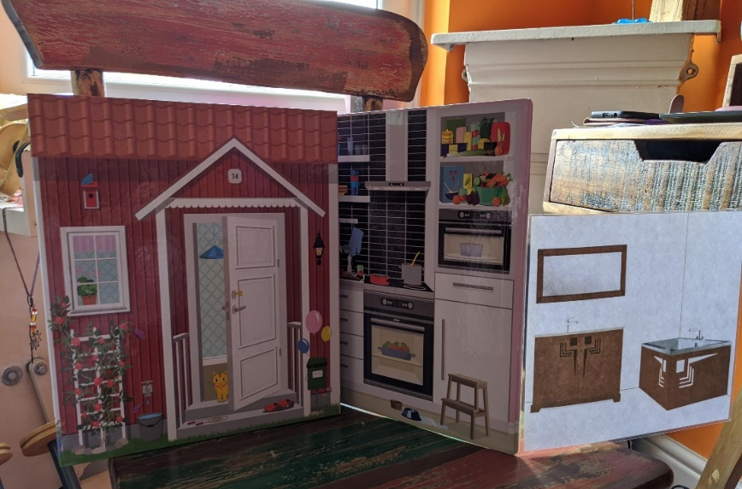
Home Book
This book is useful to stage questions around home, placements, wishes and feelings within assessments and Mental Capacity Assessments.
Light and slim to carry around and be portable. The concept of it can be easily reproduced to show reflection of the person’s current or future living environments.

Slide 4
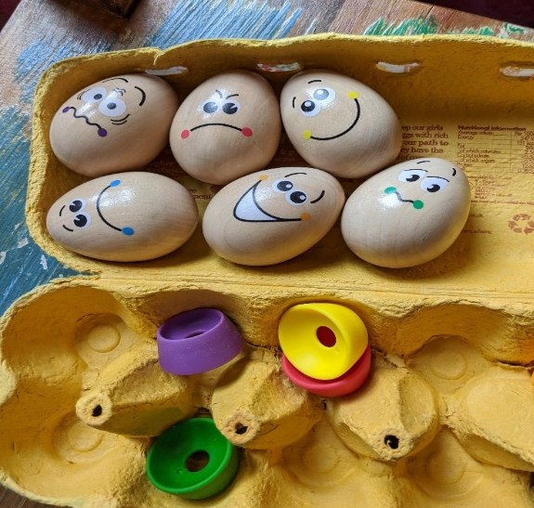
Emotions Eggs
Useful in emotions and reaction work, wishes and feelings, sharing lived experiences, reflection and asking opinions.

Slide 5
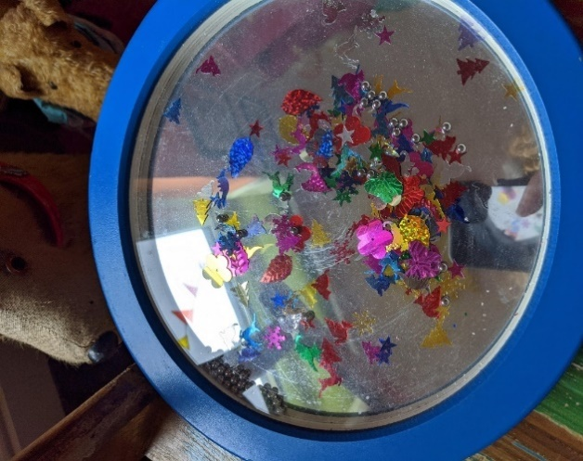
Fidget Toy
Great fidget toy but also good for people who struggle with concentration and direct engagement.

Slide 6
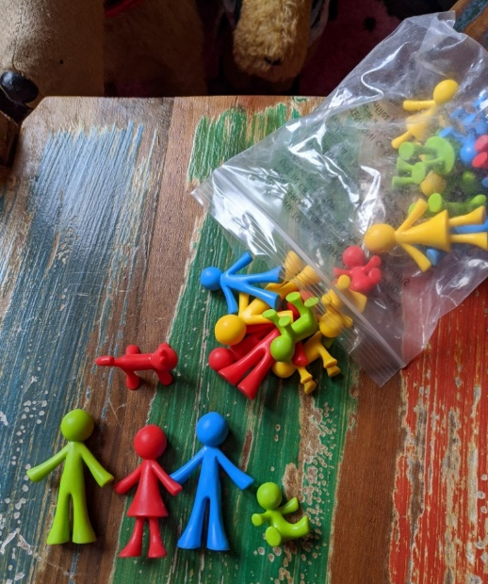
People figures
These are great when talking about self, others, families and planning work and group/MDT involvement.

Slide 7
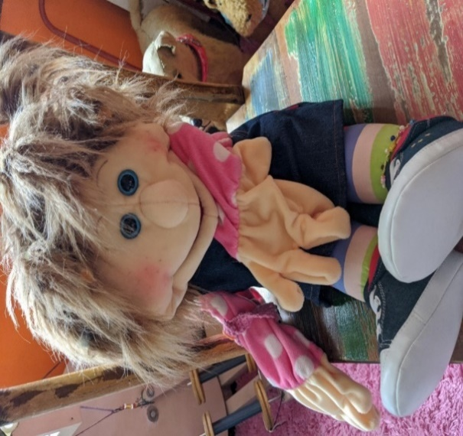
Puppet
Used in social story work, role play and conversations, turn taking and supporting expression of lived experiences.

Slide 8
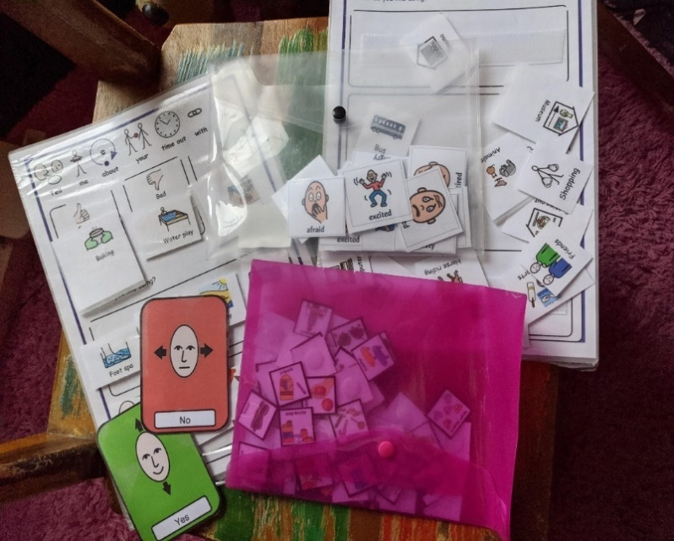
Communication cards
Used to support with communication, prompting, choice within Mental Capacity Assessments reviews and assessments.

Slide 9
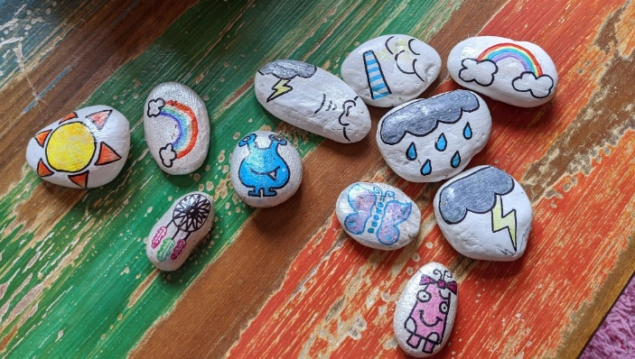
Story Rocks
Used with emotions, wishes and feelings, creating story space and understanding self-work. Can be made by yourself using permeant pens and stones which you could collect on a walk with your service user. Great for ice breaking sessions or no verbal conversations.

Slide 10
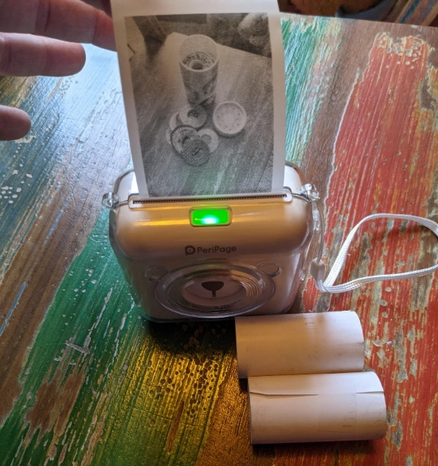
Thermal transfer printers
This is a quick and easy way of blue toothing over a photo to give during a home visit.
After completing a direct work session, or creating picture exchange cards as you go, or even leaving someone a copy of the assessment you have completed, these types of printers are portable, small and instant.
They require till receipt rolls and no ink and produce high quality photos in black and white. The printer requires a downloadable app on to your phone so that you can access the photos you wish to print.

Slide 11
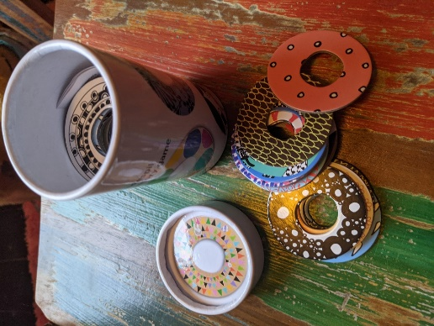
Memory cards
Age appropriate for use in adult services, helps create a shared activity space, ice breaking or allowing someone a chance to relax before an assessment process to build relationships.

Slide 12
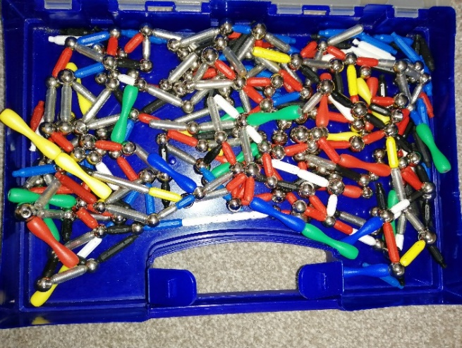
Magnets
Good for fidget toy and can be used to name and talk about strengths and build things with.

Slide 13
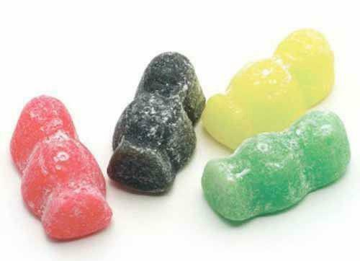
Coloured items
i.e., counters, magnets, coloured card, straws of sweets (smarties or Jelly Babies, be aware of allergies and diets)
Can be used ice breaker game/ questions. Can add and adapt to be person and situation specific, need to be willing to talk about yourself too (appropriately).
Red- something about yesterday or something like to do tomorrow
Orange – something you are good at
Yellow- something about where you live/ who you live with
Blue- something you learnt about
Brown- something you can’t live without
Green- something you watch/ listen to

Slide 14
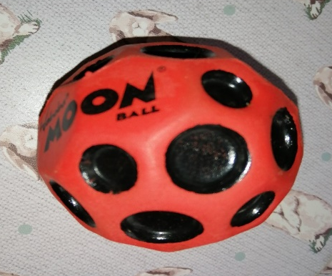
Balls
(soft/foam, bouncy space ball - but won’t break or hurt)
Can be used in various ways, play generally, to encourage playing together, joint attention/ co-operation, rolling to each other, or moving into person’s line of sight, supporting person to focus on something (might not want to look at me/you but will engage with ball and where that is going).

Slide 15
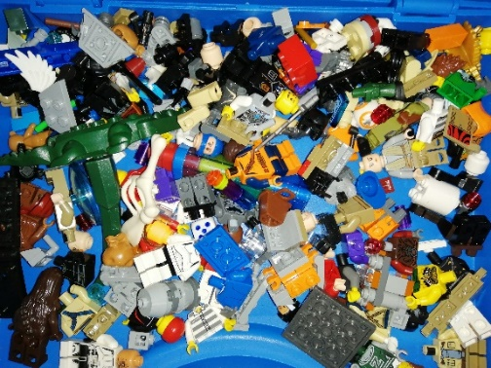
Lego
This is depending on whether the person is a Lego fan! Lots of adults like Lego, playing with Lego, building choosing mini figures and having busy hands and also conversation starters around aspirations, who have you made? What do you enjoy?

Slide 16
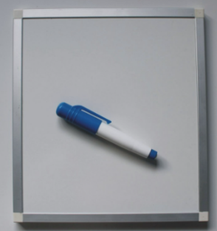
Portable Whiteboard
Useful if the person has a hearing impairment or finds it easier to draw what they wish to communicate. Having different coloured pens may help to get the messages across or differentiate between peoples writing.

Slide 17
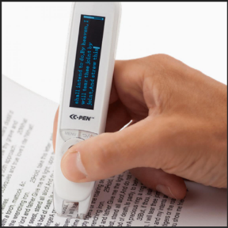
Text to Speech device
Comes in various styles and designed to support those who have a visual impairment or difficulties reading text. The device ‘reads out’ the passage of text that it is passed over.

