Slide 1
Direct Work Resource Pack
See ONLINE DIRECTORY & published version
4. Pictures & Photographs to Inform Decision Making
These are a set of pictures of the different Mental Health Units in Coventry and Warwickshire, which can be used to support understanding and decision-making various situations and scenario’s.
V21/05/21

Slide 2
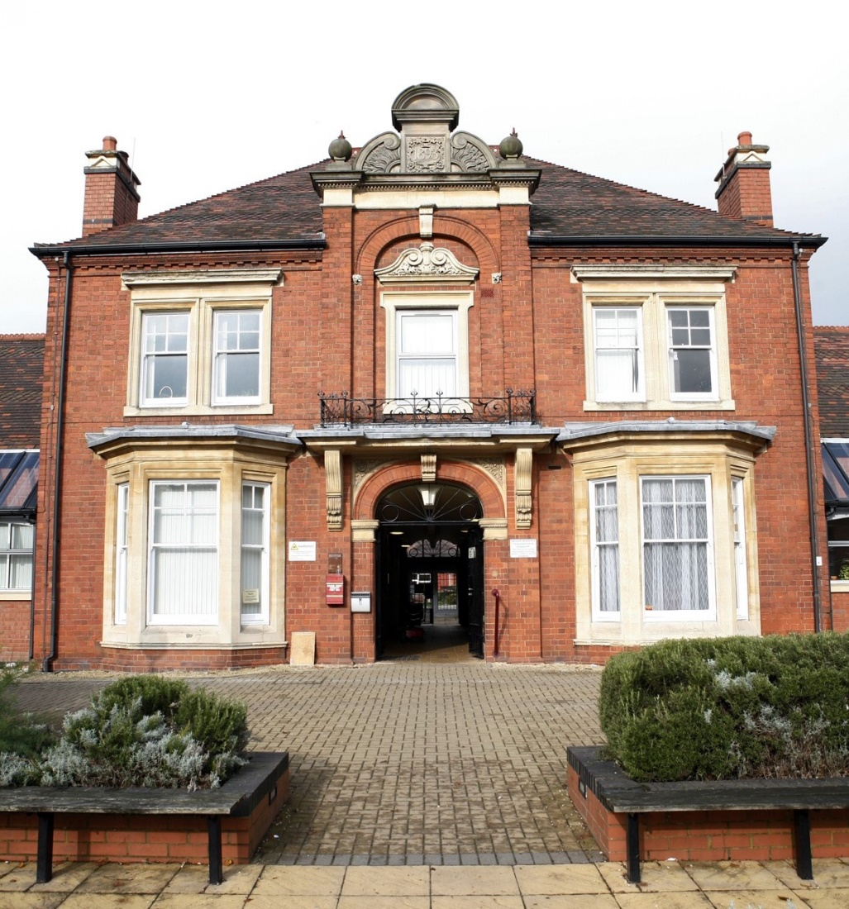
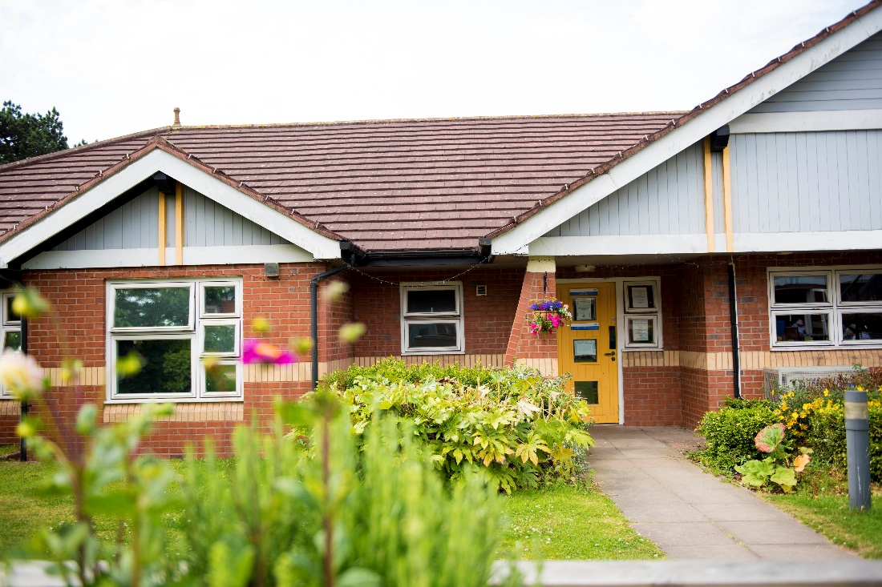
The Manor in Nuneaton
Stanley and Pemberton Wards

Slide 3
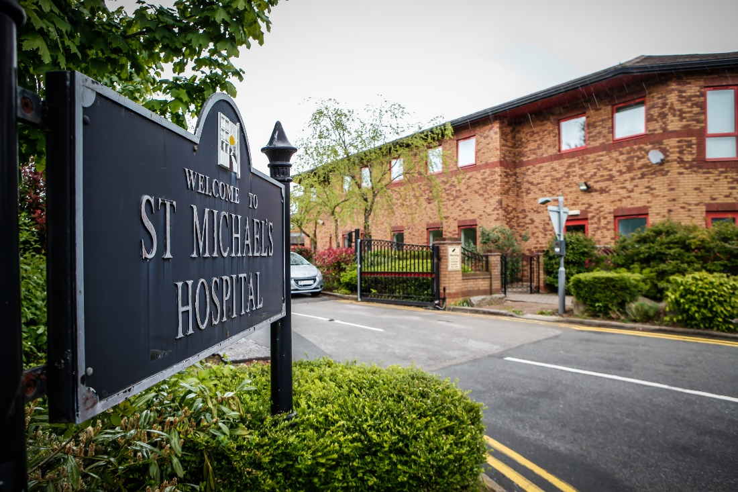
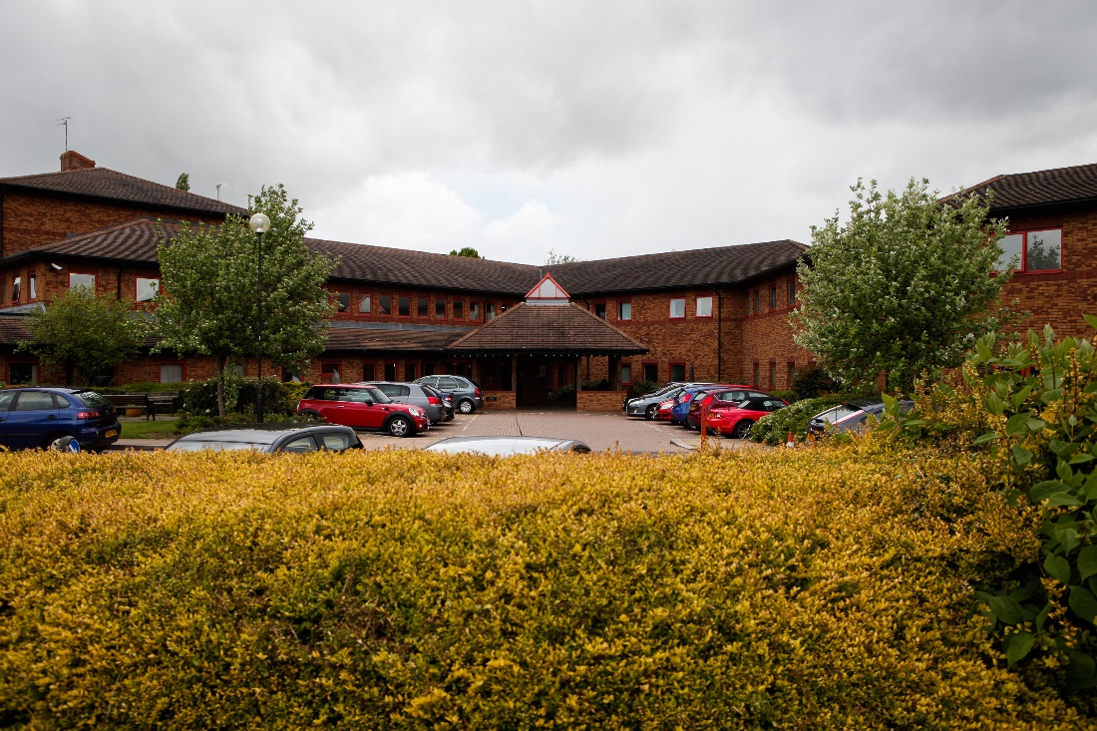
St Michaels Hospital Warwick

Slide 4
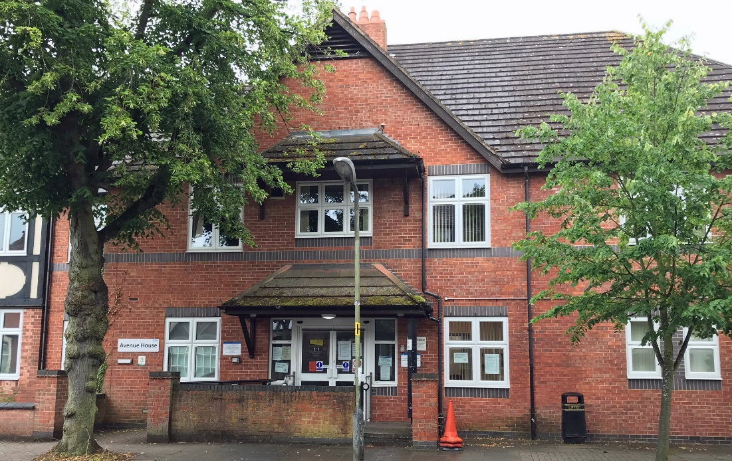
Avenue House Nuneaton

Slide 5
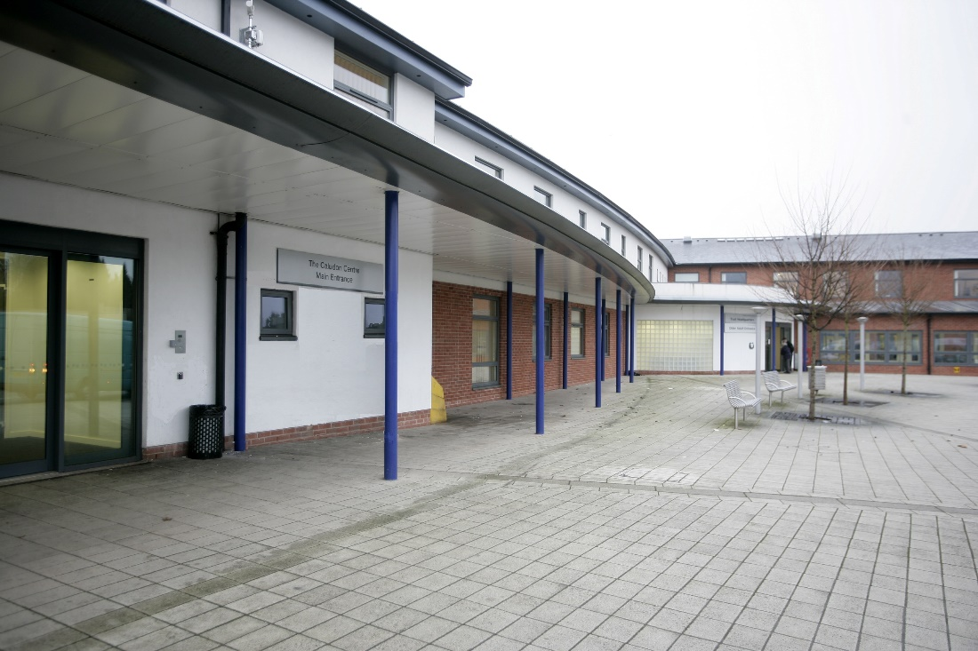
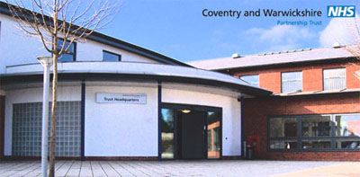
The Caludon Centre Coventry

Slide 6
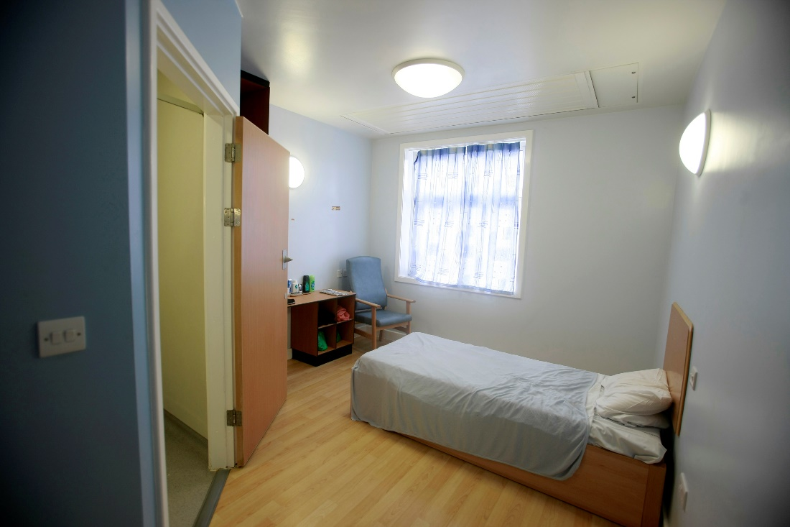
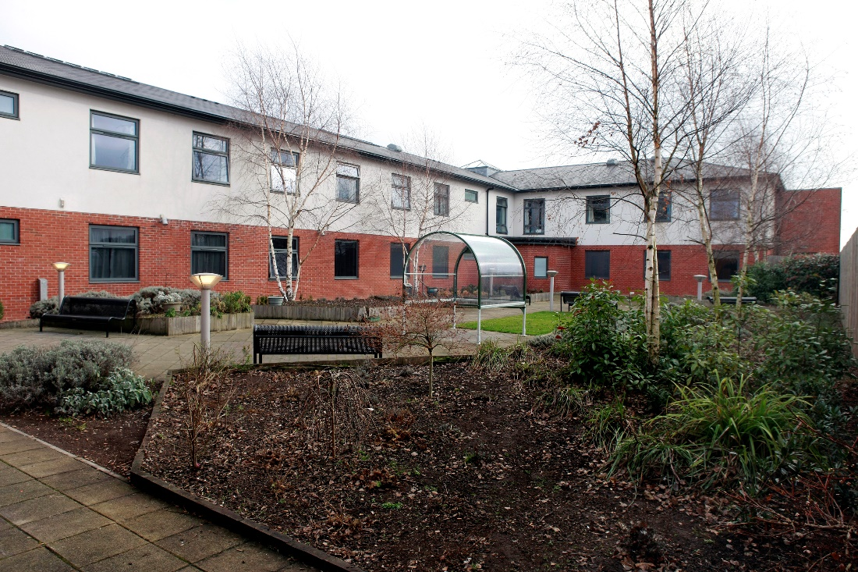
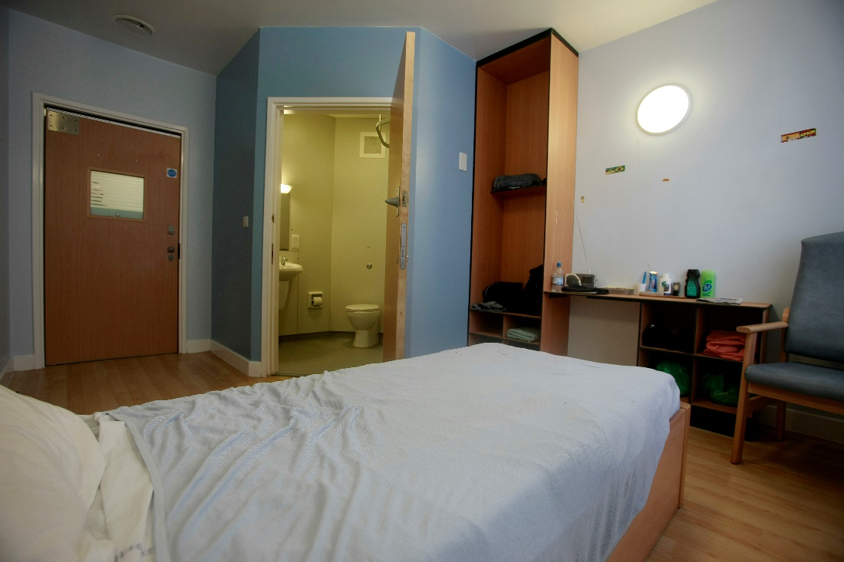
The Caludon Centre Coventry
Bedroom
view of the garden

Slide 7
Ashby House

Slide 8
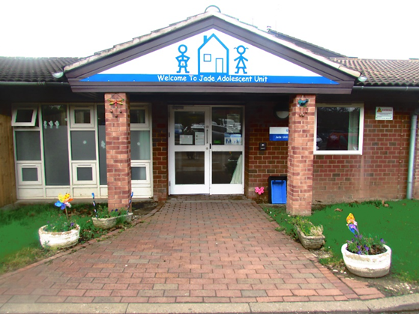
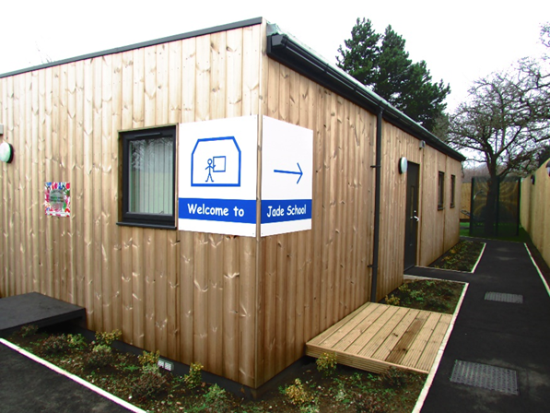
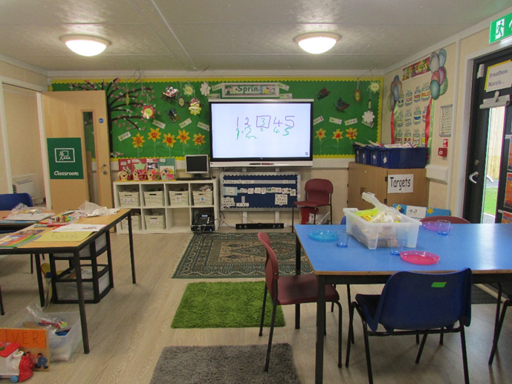
Jade Unit at Brooklands Hospital
Coleshill Road, Marston Green, B37 7HL

Slide 9
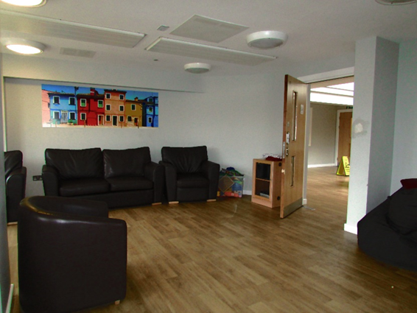
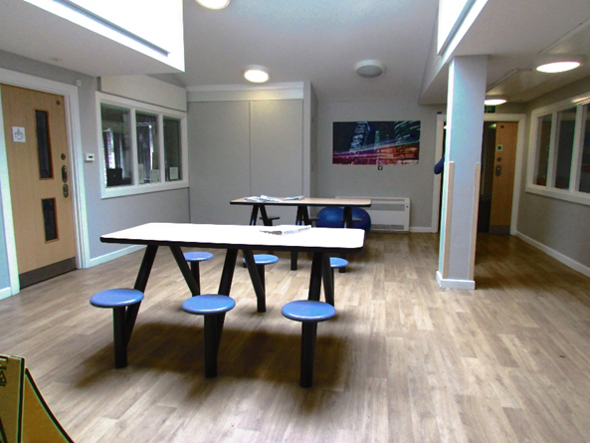
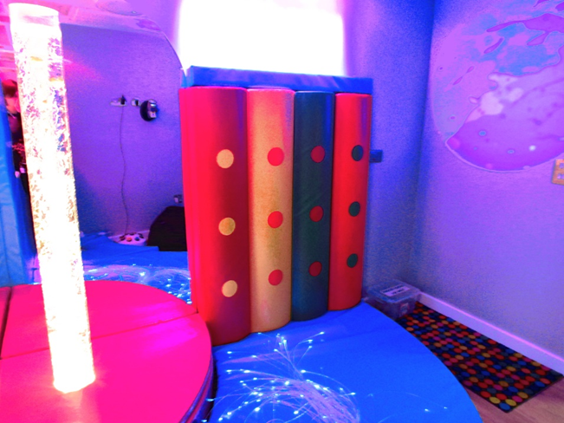
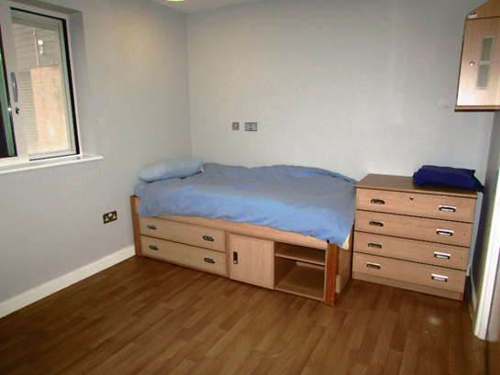
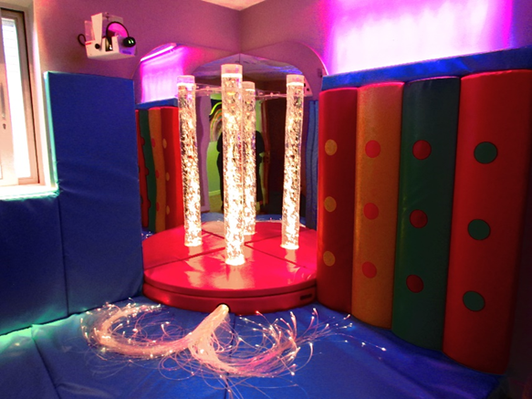
Jade Unit at Brooklands Hospital

Slide 10
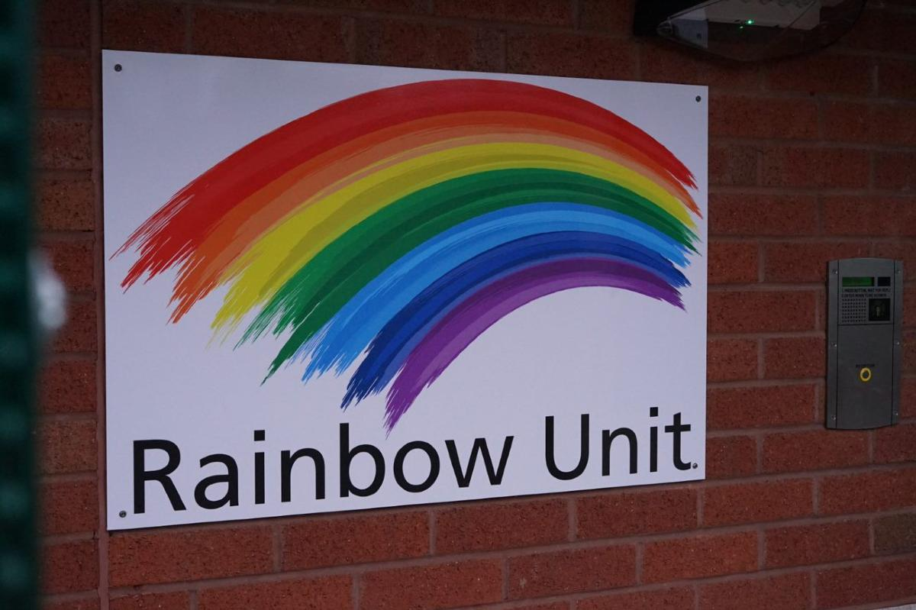
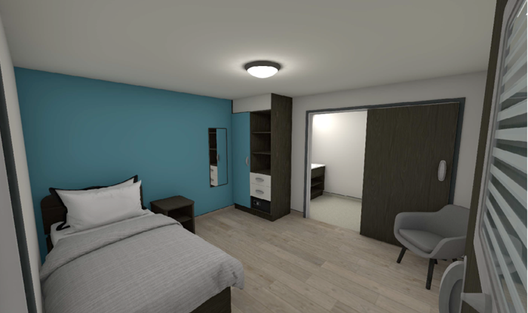
Rainbow Unit Brooklands Hospital

Slide 11
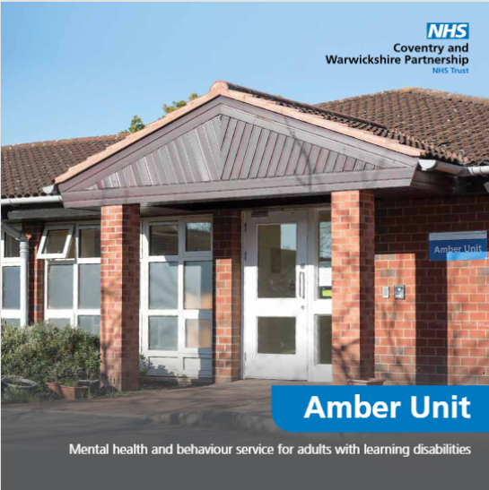
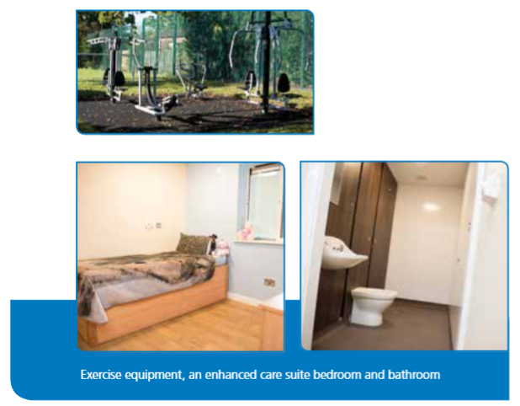
Amber Unit at Brooklands Hospital
Coleshill Road, Marston Green, B37 7HL
Also see: Amber Unit brochure

