Slide 1
Direct Work Resource Pack
See ONLINE DIRECTORY & published version
4. Pictures & Photographs to Inform Decision Making
These are a set of pictures of the different Care Homes and Supported Living Accommodations in Coventry and Warwickshire, which can be used to support understanding and decision-making various situations and scenario’s.
Click on the name below to go straight to the images:
Allambie House
Amber House
Avalon Court
Beechwood Gardens
Clarendon House
Cordelia Court
Eden House
Eric Williams House
Grove House
Herald Lodge
Lammas House
Lifeways
Knightlow Lodge
Melbourne House
Phil Mead House
Quinton Lodge
Selbourne Court
St Andrews House
St Judes Residential Care Home Ltd.
About Housing with Care
V19/11/21

Slide 2
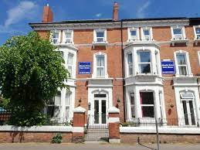
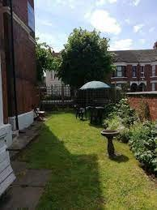
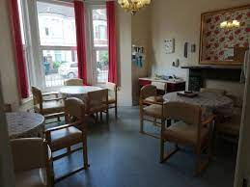
Allambie House Residential and Dementia Care Home
40-42 Coundon Rd, Coventry CV1 4AW

Slide 3
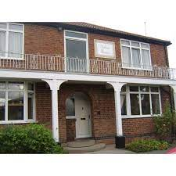
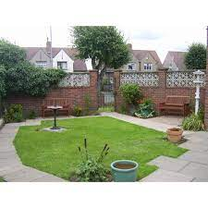
Amber House
11 Moseley Avenue, Coventry, CV6 1AE

Slide 4
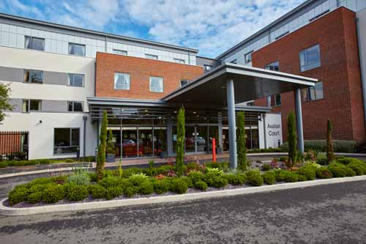
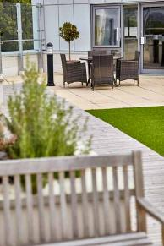
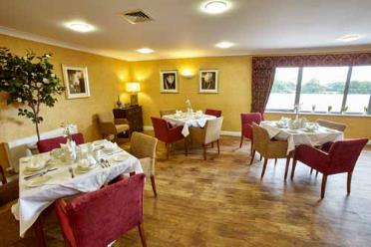
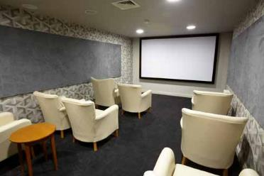
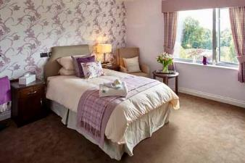
Avalon Court Care Home
Tile Hill Coventry
See link for a virtual tour:
https://www.youtube.com/watch?v=27ypQVEM92U&t=6s

Slide 5
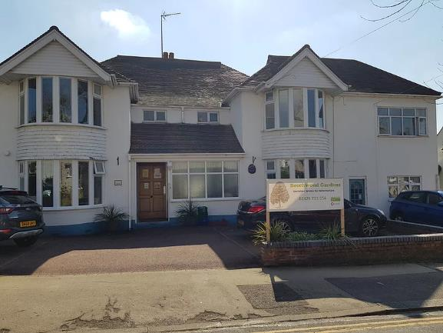
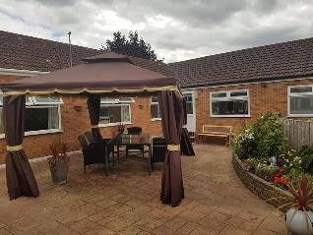
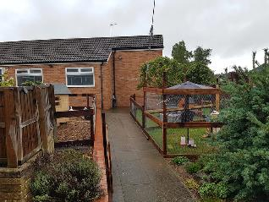
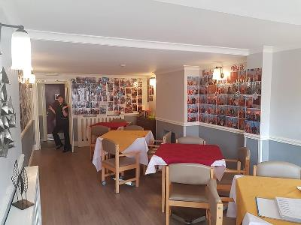
Beechwood Gardens
71-73 Rochester Road

Slide 6
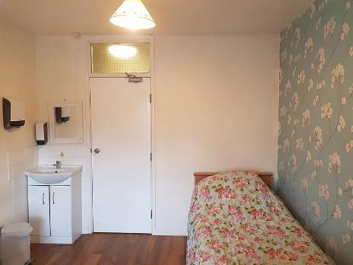
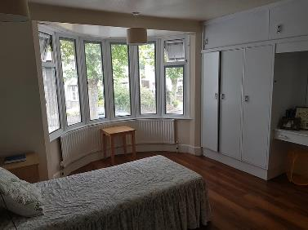
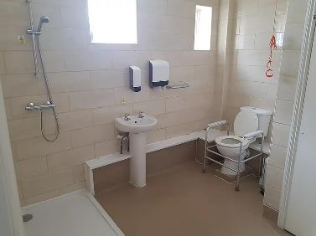
Beechwood Gardens
Standard bedroom:
Ensuite bedroom:

Slide 7
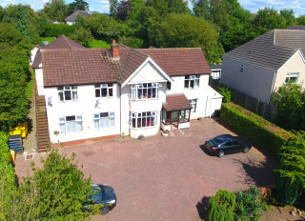
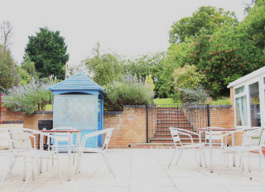
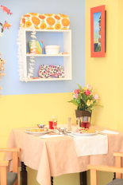
Clarendon House

Slide 8
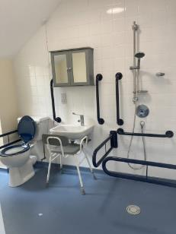
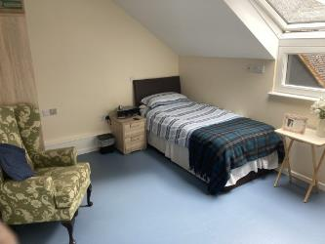
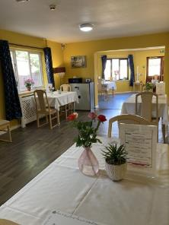
Cordelia Court
See link for a more photos including gardens:
http://cordeliacourt.co.uk/gallery.html

Slide 9
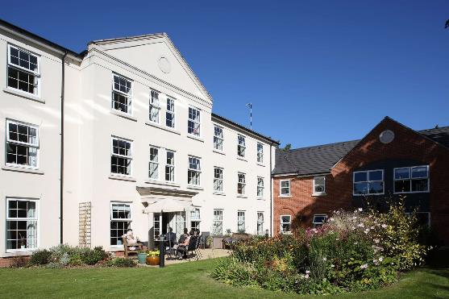
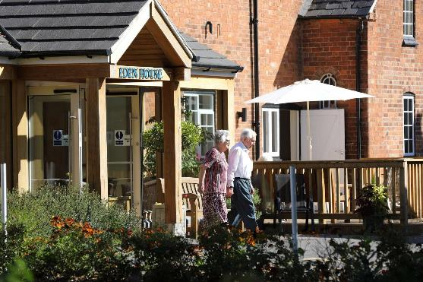
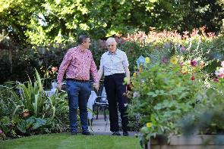
Eden House

Slide 10
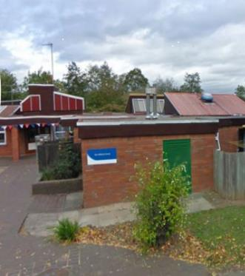
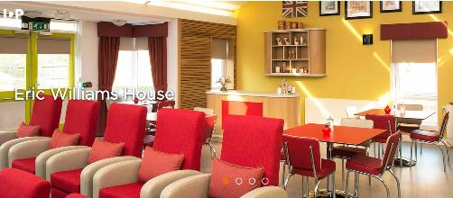
Eric Williams House

Slide 11
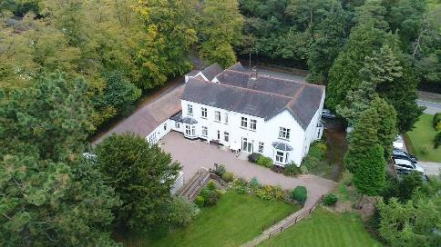
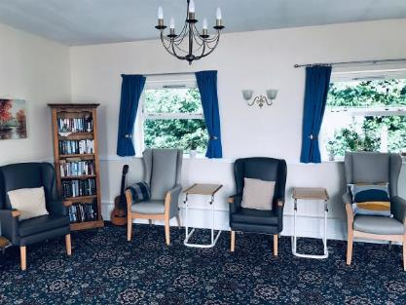
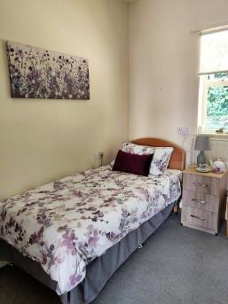
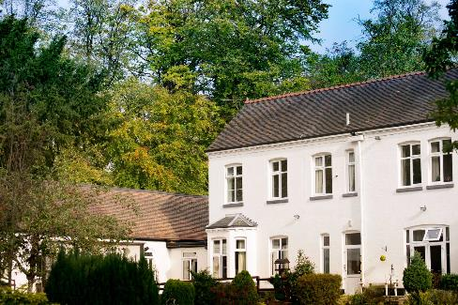
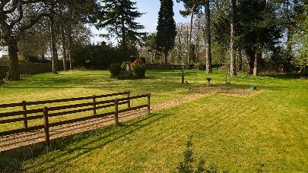
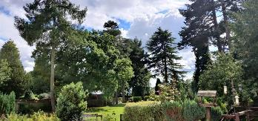
Grove House

Slide 12
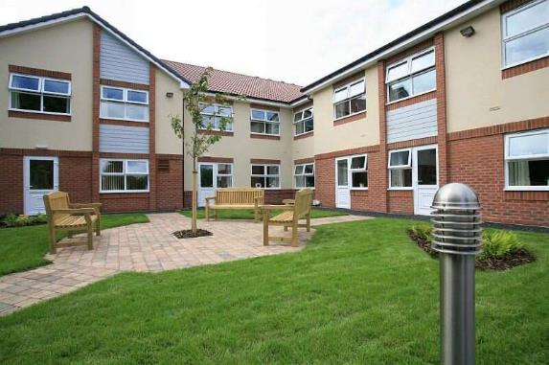
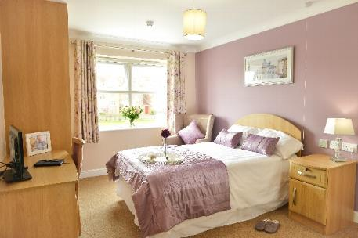
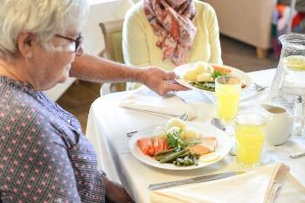
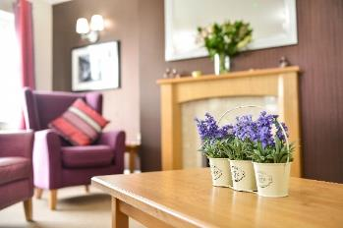
Herald Lodge

Slide 13
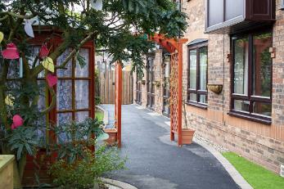
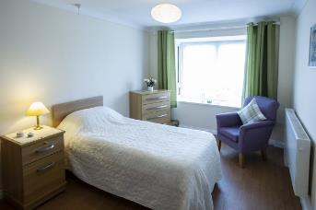
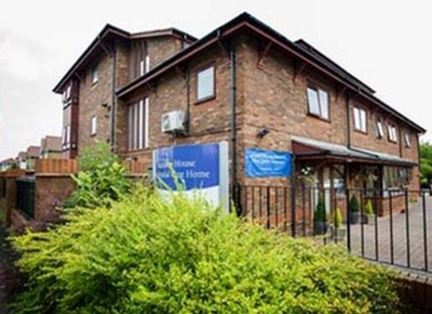
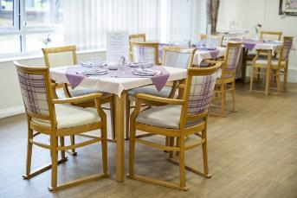
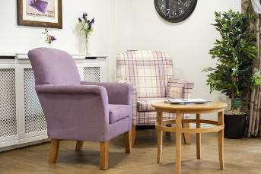
Lammas House
See link for a virtual tour:
https://www.carehome.co.uk/carehome.cfm/searchazref/10002502LAMA

Slide 14
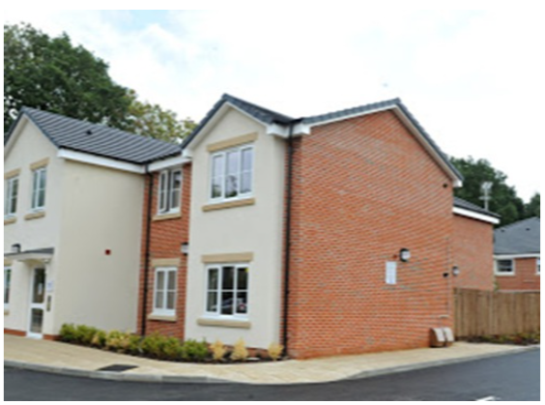
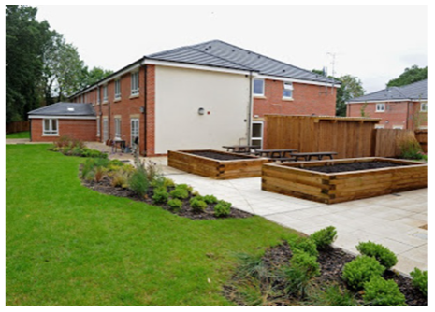
Lifeways
Tile Hill
Also see: Lifeways Communication Card

Slide 15
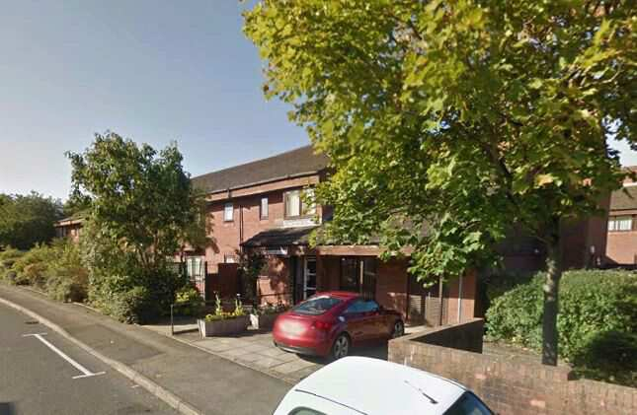
Knightlow Lodge, Coventry

Slide 16
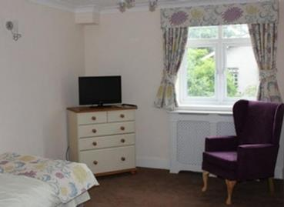
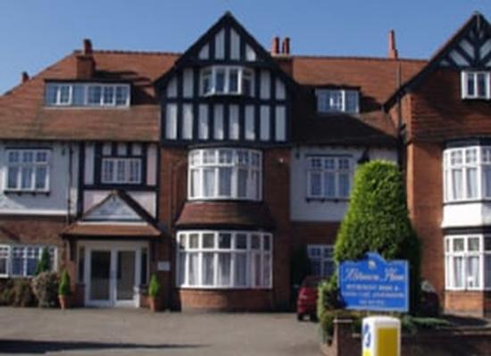
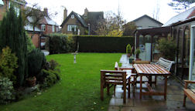
Melbourne House

Slide 17
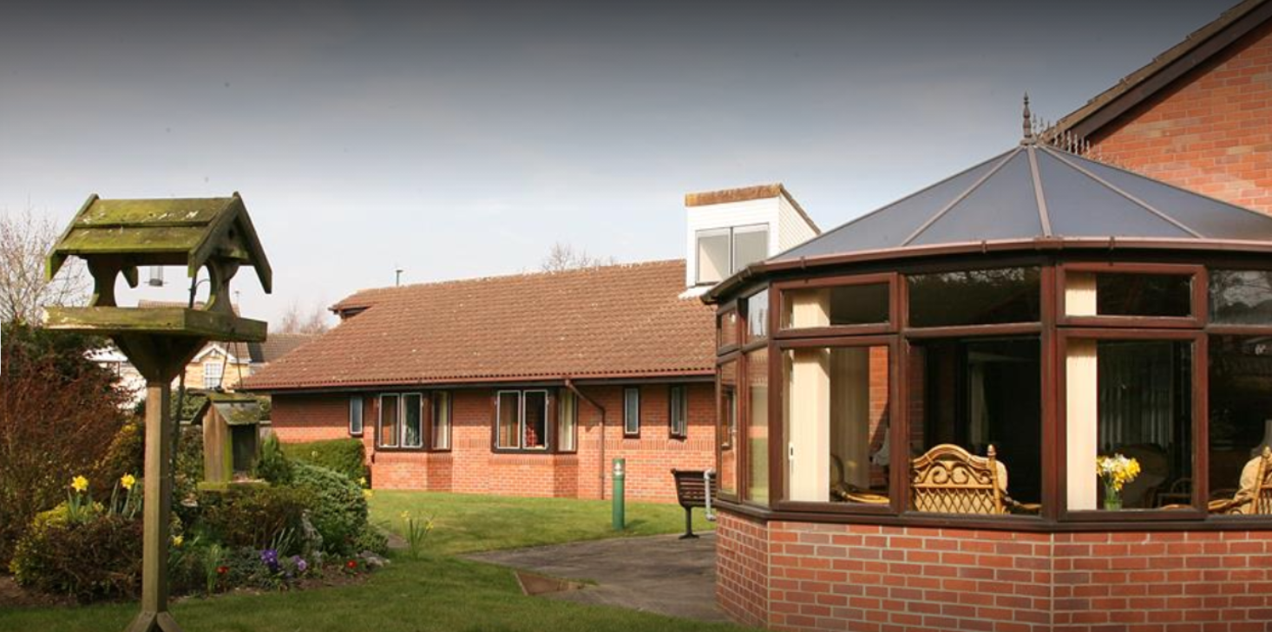
Phil Mead House
240 Bredon Avenue, Binley, Coventry, CV3 2FD
For more pictures see: https://www.abbeyfield.com/residential-care-homes/phil-mead-house-in-binley-at-cv3-2fd/

Slide 18
Quinton Lodge Housing with Care

Slide 19
Selbourne Court
110 Bull's Head Lane, Coventry CV3 1FS

Slide 20
St Andrews House
19 St Andrew S Road, Earlsdon, Coventry CV5 6FP
For more information see: http://standrewshouse.org.uk/

Slide 21
St Judes Residential Care Home Ltd.
44 Unicorn Lane, Coventry
For more information see: https://www.stjudesresidentialcarehomeltd.co.uk/

Slide 22
About Housing with Care
A short video describing the services delivered & offered in the Housing with Care Short Term Tenancies service: https://www.youtube.com/watch?v=nzSH86D0gnQ.
NOTE: this service is offered across a number of schemes in the city and the example shown in the video may not be where the citizen is actually placed.

