Slide 1
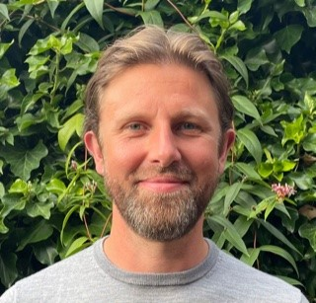
Supporting SMEs on their Net Zero journey
Jonathan Howl
Business Energy Advisor
Coventry City Council

Slide 2
Recent feedback:
Speaking to local businesses, we are finding that:
Most SME's feel they are coming out of COVID challenges and are now looking to the future
Concern over rising energy costs
Main business driver is cost savings, however there are others – companies wanting to gain the benefits of improved image and ability to win bids and tenders

Slide 3
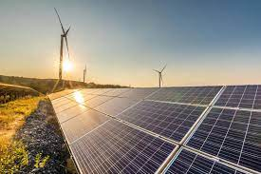
Shift in focus:
COP26 has increased overall awareness of the green agenda
So, while reducing operating costs is the main driver, awareness of wider issues is growing
Interest in renewable technologies increasing
i.e. ASHP (air source heat pumps) and solar PV

Slide 4
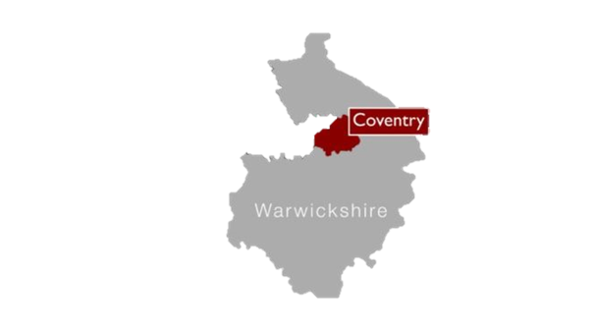
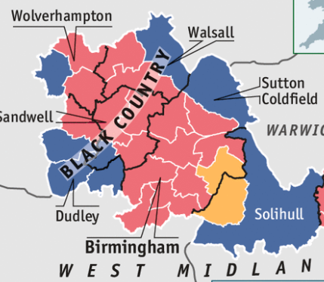
Green Business Programme – ERDF funded
Coventry & Warwickshire region
(please note also other schemes i.e. Low Carbon SME:
Birmingham, Black Country & Solihull)
- Basic SME eligibility:
Less than 250 employees
Turnover of less than €50 million
Have received less than €200k in public aid over 3 years
Have at least 50% of sales through business to business

Slide 5
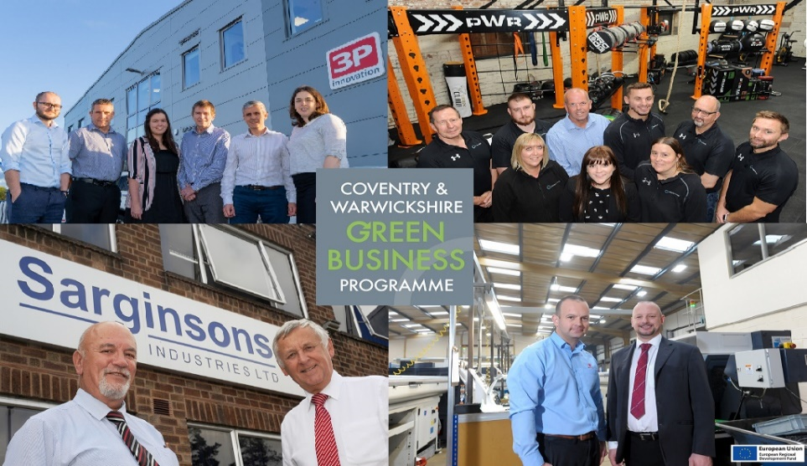
Aims of Scheme:
Help businesses reduce carbon
Provide advice & guidance re: energy efficiency measures
Access to grant funding to assist with capital expenditure

Slide 6
How the programme works:
Businesses provide us with 12 months energy bills (if available).
We carry out an on-site energy audit of the business; heating/lighting/processes/machinery/energy wastage.
The energy report is then created, with these objectives:

Slide 7
Objectives:
To assess energy use, associated costs and carbon outputs, helping to identify areas of highest inefficiency.
Energy efficiency improvement measures are then recommended; but no obligation to follow all of these.
Finally, what grant funding is available to support the capital investment required to implement these measures.

Slide 8
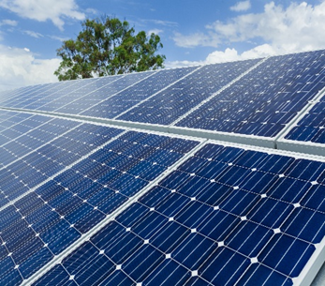
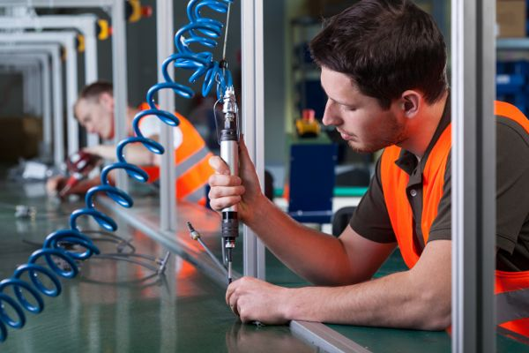
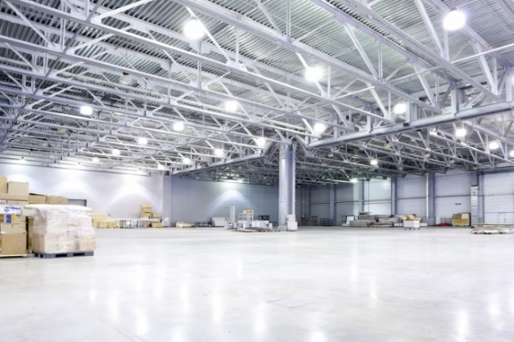
Example areas for recommendations:
Insulation
LED lighting
Glazing
Shutter doors
Solar PV
Heat Pumps
HVAC (Heating, Ventilation, Air Conditioning)

Slide 9
Programme outputs:
1. Energy audit (worth £840) carried out FOC
Carbon saving calculation
Maximising potential energy savings
Supports funding bids/compliance/etc
2. Grant funding: maximum of £50k and 40% subsidy
Must save at least 1 tonne CO2e per £1k of grant

Slide 10
Highlights:
Assisted 149 businesses during current phase
This has saved 1,836 tonnes of CO2e
Issued £1.57m in grant funding & have £690k remaining to allocate before the end of the programme in mid-2023
As a comparison, 1 x tonne of CO2 is equivalent to the emissions produced by a car in 6 months!

Slide 11
Green Business Network:
Membership is free and offers a range of benefits:
Events, workshops & webinars
Monthly e-newsletter – news, events, legislation, case studies
The opportunity to promote your news/projects
Expert advice with team of sustainability advisors
Enhance green credentials to secure new business
Networking and supply chain opportunities (join our Green Business Directory)
Currently 1,500 other organisations you can network with

Slide 12
For free energy advice, energy audits, plus funding support - get in touch:
Coventry & Warwickshire:
greenbusiness@coventry.gov.uk
Black Country, Greater Birmingham & Solihull:
smelowcarbon@aston.ac.uk

