Slide 2
What is Trauma?
How does Trauma impact on a child and their learning?
How does a school become a Trauma Informed School?
What does a Trauma Informed School look like on a day-to-day basis and how does this support your child?
Strategies to enable you to create a Trauma Informed environment
Why is it important that a Looked After Child attends a Trauma Informed School?

Slide 3
Context
A trauma informed school … What does this mean?

Slide 4
How does Trauma impact on a child and their learning?
https://www.youtube.com/watch?v=xYBUY1kZpf8

Slide 5
Childhood experiences
The experiences we have early in our lives and particularly in our early childhoods have a huge impact on how we grow and develop, our physical and mental health, and our thoughts, feelings and behaviour. Two important factors to think about when considering our mental wellbeing, are the quality of our attachment relationships and our experience of ACEs.

Slide 6
What is Attachment?
Attachment refers to the pattern of the relationships we have had with our parents or carers early in our lives. It is the emotional bond that forms between a parent and child from birth and has a huge impact on our development. The way a parent or carer responds to their child will impact on the child’s attachment style. This attachment style becomes a template for how we build future relationships with others in our lives, and also a template of how we feel about ourselves and other people. If we have experienced a relationship with a parent or carer which has been positive, we will develop a positive template for other relationships as well as positive feelings about ourselves and others.

Slide 7
What is Attachment?
But sometimes how children are cared for is not so positive, for various reasons, and this can make it harder for people to make and maintain positive relationships in the future, manage their feelings and behaviour, or feel good about themselves or others. When our early attachments have been negative and these lead us to go on to have difficulties with relationships and our mental wellbeing, this can sometimes be described as attachment difficulties.

Slide 8
What are Adverse Childhood Experiences?
Adverse Childhood Experiences (ACEs) are “highly stressful, and potentially traumatic, events or situations that occur during childhood and/or adolescence. They can be a single event, or prolonged threats to, and breaches of, the young person’s safety, security, trust or bodily integrity.” (Young Minds, 2018).

Slide 9
What are Adverse Childhood Experiences?
Examples of ACEs:
Physical abuse
Sexual Abuse
Emotional Abuse
Living with someone who abused drugs
Living with someone who abused alcohol
Exposure to domestic violence
Living with someone who has gone to prison
Living with someone with serious mental illness
Losing a parent through divorce, death or abandonment
How Common are ACEs?
In a 2014 UK study on ACEs, 47% of people experienced at least one ACE with 9% of the population having 4+ ACES (Bellis et al, 2014).

Slide 10
Impact of ACEs
Just like attachment, experiencing ACEs can have an impact on our future physical and mental health, and often ACEs can be barriers to healthy attachment relationships forming for children. Some of the effects of ACEs on our physical and mental health are:
An increase in the risk of certain health problems in adulthood, such as cancer and heart disease, as well as increasing the risk of mental health difficulties, violence and becoming a victim of violence.
An increase in the risk of mental health problems, such as anxiety, depression, and post-traumatic stress. 1 in 3 diagnosed mental health conditions in adulthood directly relate to ACEs.
The longer an individual experiences an ACE and the more ACEs someone experiences, the bigger the impact it will have on their development and their health.
Some of the other things exposure to ACEs can impact, are:
The ability to recognise and manage different emotions.
The capacity to make and keep healthy friendships and other relationships.
The ability to manage behaviour in school settings.
Difficulties coping with emotions safely without causing harm to self or others.

Slide 11
ACES
https://www.youtube.com/watch?v=7VI8ubxg5ac

Slide 12
Virtual School: Attachment and Trauma Informed Support for Schools
Coventry Virtual School is committed to promoting an awareness of Attachment and Trauma in schools
Across the last 6 years all Coventry Primary and Secondary Schools have been invited to attend ‘An introduction to Attachment’ training session
Schools are encouraged to familiarise themselves with The latest Attachment research e.g. via the Attachment Research Community (ARC)

Slide 13
Virtual School: Attachment and Trauma Informed Support for Schools
Thrive
Thrive is an approach that is used in several of our Primary and Secondary School.
The Thrive Approach to working with children draws on the latest research from current neuroscience, recent attachment research, current studies of effective learning and current models of child development to help teaching staff and other professionals to understand the needs being signalled by children's behaviour and provide targeted strategies and activities to help children and young people to engage with learning and life.
Thrive website – free resources and activities
https://www.thriveapproach.com/about-thrive/
https://www.thriveapproach.com/who-we-work-with/parents-carers/

Slide 14
What might this look like in a primary classroom?

Slide 15
How does a school become a Trauma Informed School?

Slide 16
Core Values

Slide 18
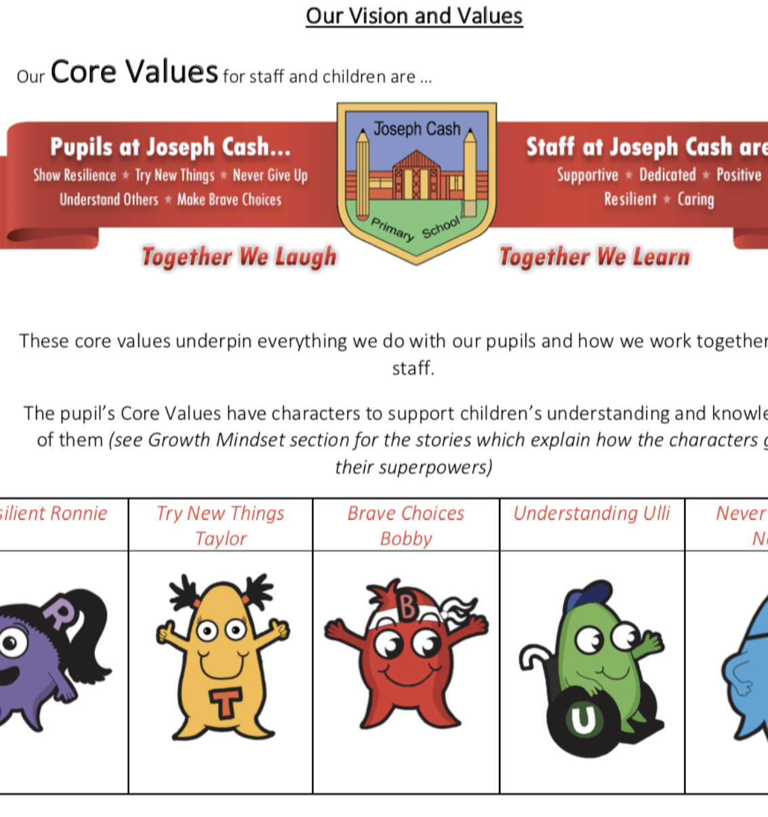
Values @ JCP
Growth mindset and strand gaps …. How can we develop resilience and an understanding of feelings?

Slide 19
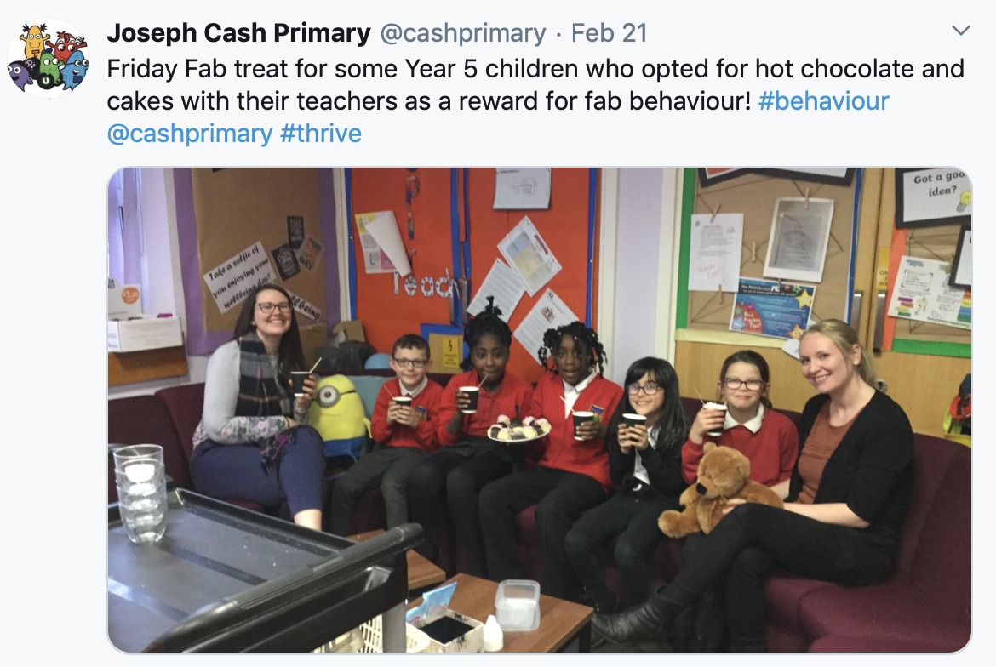
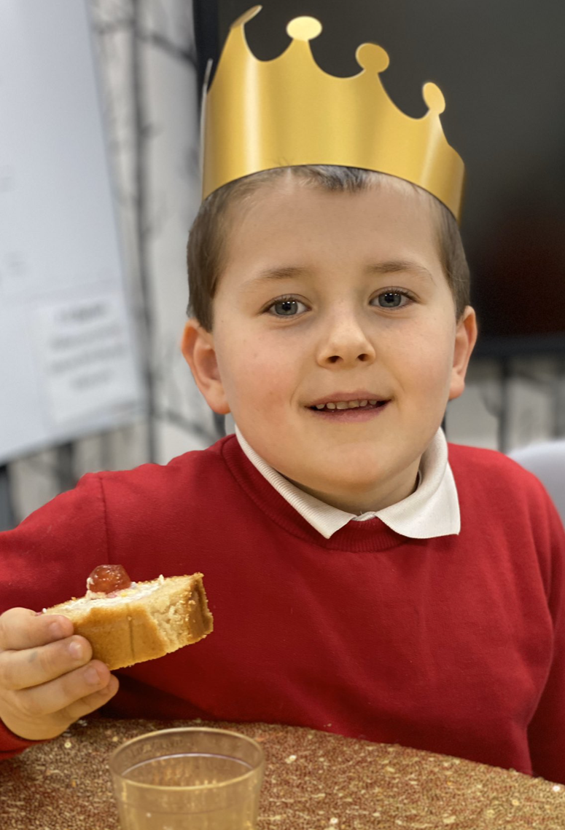
Recognition
How we treat children here…

Slide 20
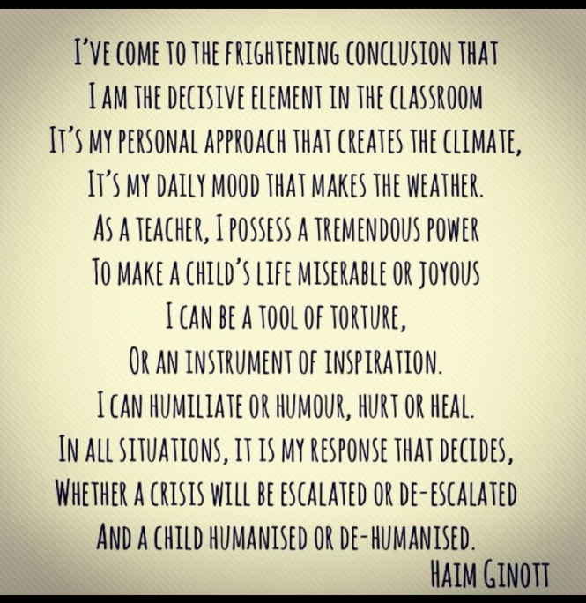
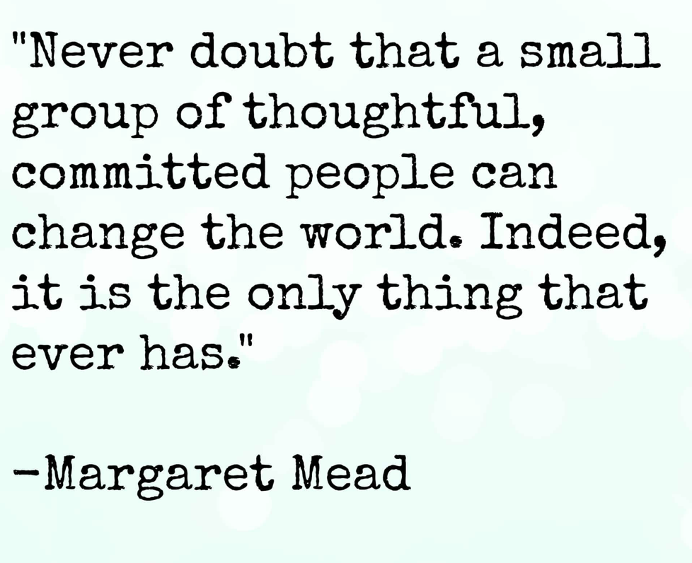

Slide 21
What is Thrive?
Programme which helps adults prepare children for life’s emotional ups and downs
Sets out age appropriate developmental tasks for children.
Provides strategies for dealing with any type of behaviour (freeze, flight or fight mode)
Helps the children engage with life and learning.

Slide 24
Activity
Scenario
Think of a time when you have lost something…. Phone, keys etc.
How did you respond? Physiological, Relational and Cognitive regulation
Notes:
Think of a time when you have lost something…. Phone, keys etc. How did you respond? Physiological, Relational and Cognitive regulation

Slide 25
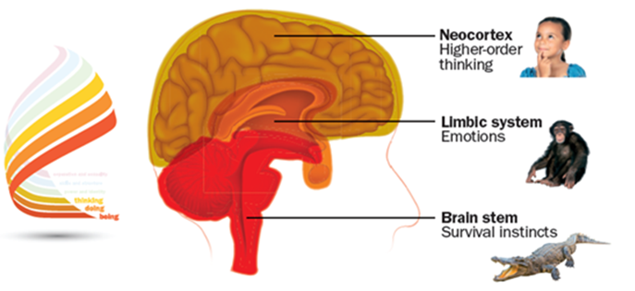
Understanding the brain…
Brain stem: -Amygdala constantly scanning the environment
Limbic: Hippocampus – memories and previous experience (Music)
Neocortex: Left– Creative and Right – Language
Notes:
Brain stem: Amygdala - constantly scanning the environment
Limbic: Hippocampus – memories and previous experience (Music)
Neocortex: Left– Creative and Right – Language

Slide 26
Being: the physiological
(body-based: calming the body’s physiological systems through slow breathing, rocking, soothing voice, touch, muscle relaxation)
Doing: the relational
(‘emotions in relationship’-based: regulating our emotions by seeking help from another who is able to catch, match, understand, regulate and name our feelings for us)
Thinking: the cognitive
(thought-based: recognising sensation, naming it; recognising emotion, naming it; being able to think about feelings and think while having feelings; sequencing, ordering, seeing consequence of actions; being able to predict what might happen based on memories of past experiences; being able to STOP and think between Feeling and Behaving).

Slide 27
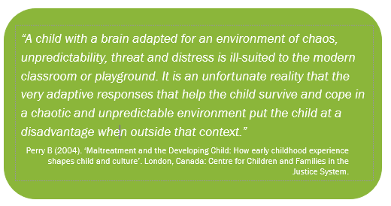

Slide 28
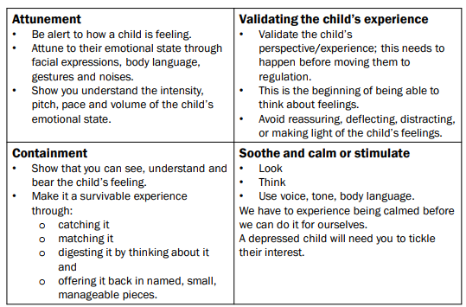
P A C E
Dan Hughes
Vital Relational Functions

Slide 30
Activity
Check in
Figure Metaphor
Describe your current mood using a biscuit?
Notes:
Using the Metaphor, ask the children to share how they are feeling (think, pair, share.)
For example, clothing:
I’m feeling sleepy so need to PJs on, feeling really happy like my bright wellies, the good feeling you get jumping in puddles!
For example, using the metaphor of the biscuits:
I’m feeling a bit weary like a soggy digestive. Feeling a bit bumpy like a cookie. I’m feeling good like my favourite biscuit a custard cream…

Slide 31
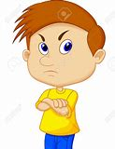
BEING - Feeling safe - Feeling special - Having needs met
What can YOU do to help?
Unable to soothe and calm
Unable to stay safe
Untrusting of relationships
Struggles to stay safe
Unaware of their own needs
Unable to signal distress or help
Low self esteem

Slide 32
DOING - Exploring and experimenting
- Experiencing options
- Initiating, engaging and doing
What can YOU do to help?
Unwilling to engage in new activities
Unable to join in
Strong dislike at getting messy
Distracted, wandering, unfocused
Rushing, unable to stay,
Extreme emotional response at not being able to do something

Slide 33
THINKING - Expressing a view
-Learning about cause and effect
-Feeling, thinking and problem solving
What can YOU do to help?
Gets confused and conflicted
Overwhelmed by feelings
Unable to think things through
Does not relate actions to consequences
Over reacts; can be explosive
Feels and acts – no thought or choosing

Slide 34
POWER AND IDENTITY - Developing an identity
- Distinguishing between
fantasy and reality
- Exploring power with
responsibility
What can YOU do to help?
Needs to adopt a way of being, rather than being themselves.
Uses abusive ways of being in powerful, rather than feeling secure with their power.
Has to cover up, lie or be sneeky.
Builds a ‘front’. What do others think of me.
Has a fixed and limited perspective about ways of dealing with feelings and situations.

Slide 35
SKILLS AND STRUCTURE -Motivation for developing
skills
- Developing morals and
values
- Understanding the need for
rules
What can YOU do to help?
Settled
Settled into not working
Acts as if they know it already
Unrealistic about time, effort or skill needed to do something
Obsess about a peer or adult
Unable to cope with values that challenge their ‘family’ view or values
Lacking a moral compass: uninterested in values exploration

Slide 36
The learning Environment
What would you expect to see?

Slide 37
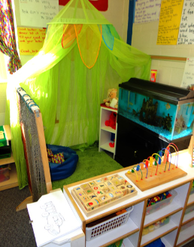
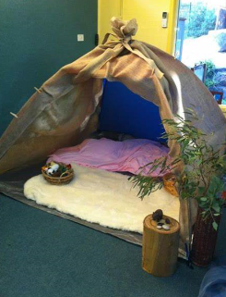
Thrive safe space in the classroom

Slide 38
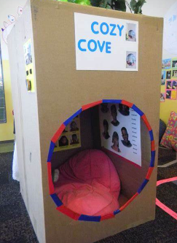
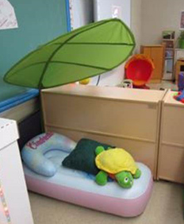
Box of items to support regulation

Slide 40
Our teaching staff have a common language and a ‘toolkit’ to support children within the classroom. They are looking at how they can build relationships, how to attune to behavior and how to repair and review things when they go wrong. They are aware of the importance of their response.
The fabric of our building allows children to seek ‘safe spaces,’ find key adults and access the things that they need.

Slide 41
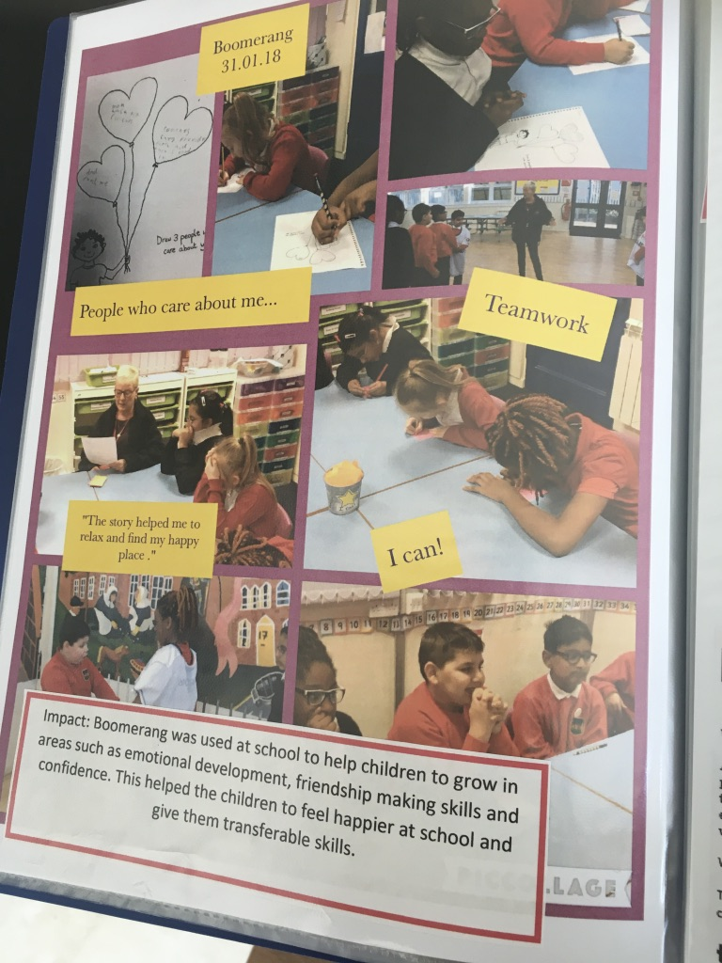
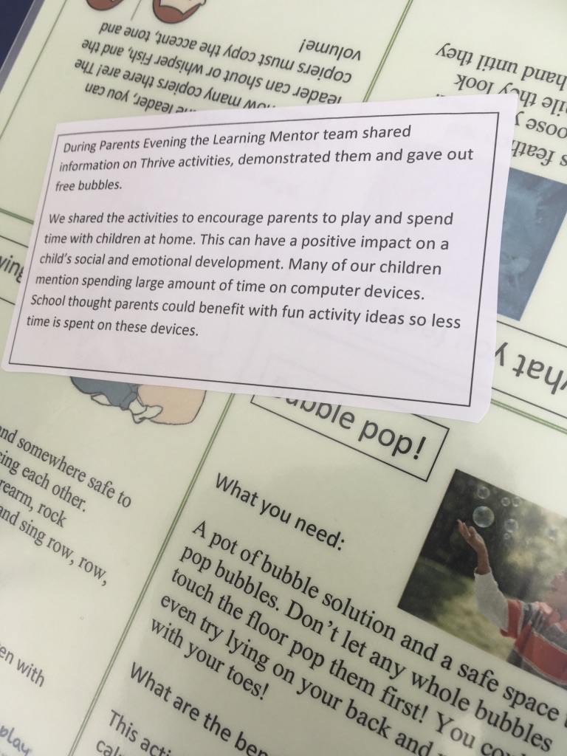
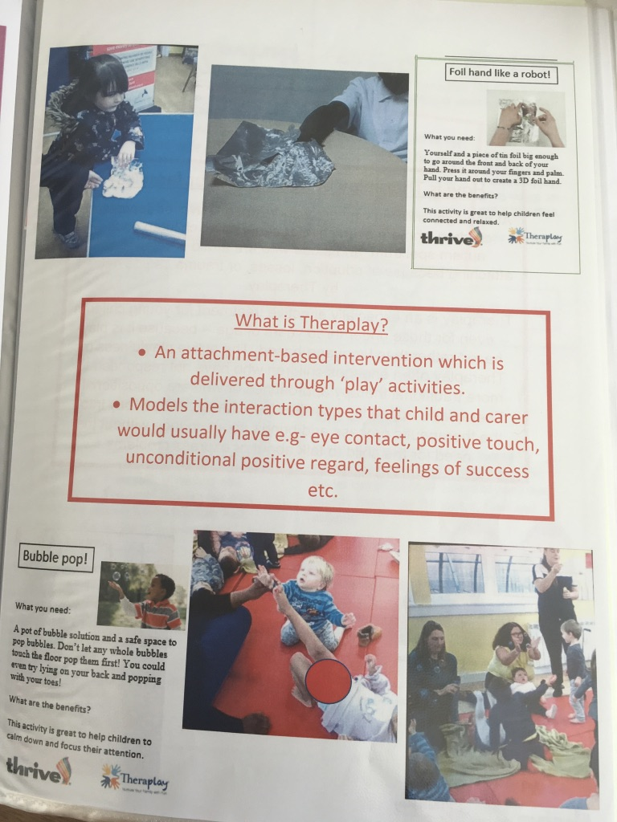
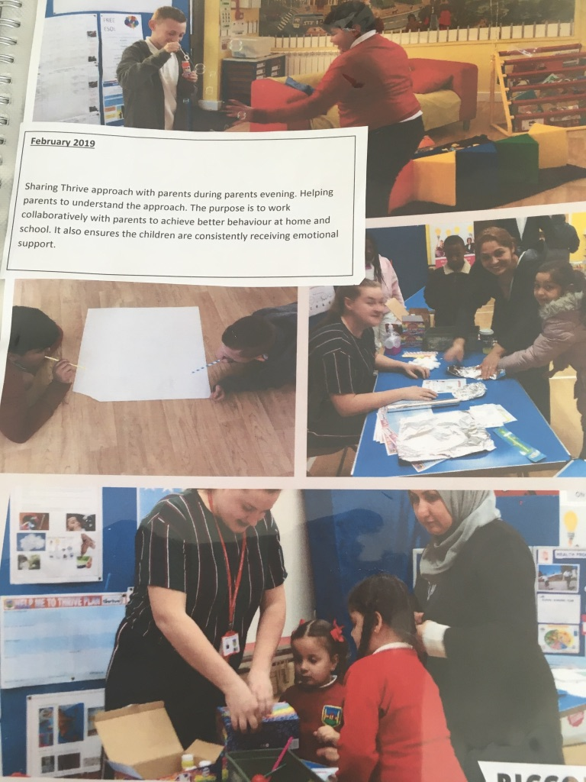
Wider Offer

Slide 42
Virtual School: Attachment and Trauma Informed Support for Schools
These are some questions you could ask the school to help determine whether it is Attachment and Trauma informed
What type of pastoral support do they offer?
Do they use Thrive, PACE and / or Emotion Coaching?
How does their Behaviour Policy address relationships?
Have the school received Attachment Training?
Does the school provide key workers for Looked After Children pupils?
Does the school have a counsellor?
Does the school exclude Looked After Children?
Do they use Restorative Justice when there are incidents?
Does the school have a safe space for their vulnerable students?

Slide 43
Virtual School
The Virtual School is a small team set up to help improve the attainment of looked after children.
The team is made up of Advisory Teachers, a Next Steps Mentor - Post 16 PEPs, an Engagement & Enhancement Officer and a Lead Mentor
The team works with schools, social workers, carers and anyone involved in the education of looked after children, including post 16 providers.
virtualschool@coventry.gov.uk 024 7697 5535

Slide 44
‘Relationships are the agents of change and the most powerful therapy is human love.’ Bruce Perry

Slide 45
Sara Scott
@cashprimary
sara.scott@josephcash.coventry.sch.uk

