Slide 1
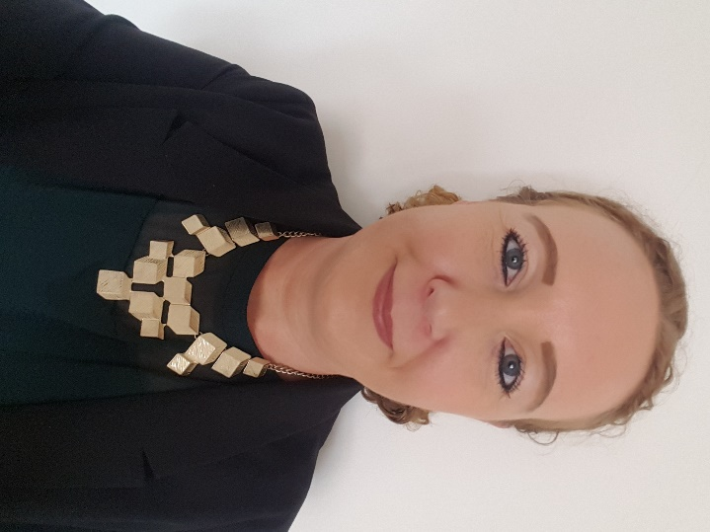
Green Business Programme
Bernie McCullagh
[Business Energy Advisor]
Coventry & Warwickshire’s
Green Business Programme

Slide 2
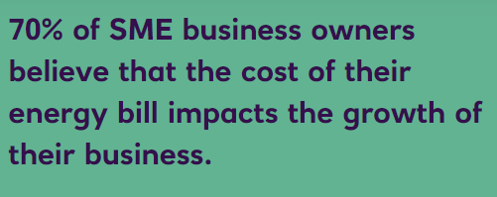
Energy crisis headlines:
Real concerns over rising energy costs and future-proofing/protecting their business premises & jobs.
SME’s already economically damaged from Covid.
Campaigns from business groups to support SME’s.
Natwest survey 2021

Slide 3
The Green Business Programme: specific feedback from businesses who have recently been quoted for new fixed price tariffs, as follows:
Utility | 2021 average price per kWh | 2022 quoted price per kWh
Gas | Ranged between 3p-5p | 10p (3 year contract) 15p (1 year contract)
Electricity | Ranged between 15p-20p | 25p (3 year contract) 40p (1 year contract)

Slide 4
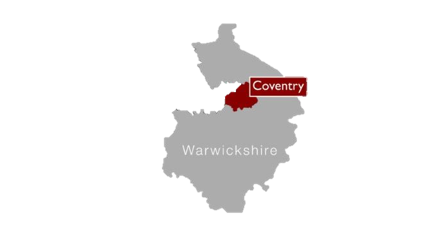
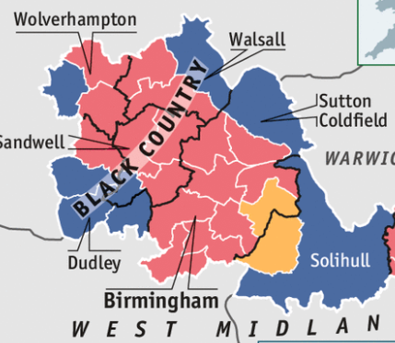
Green Business Programme
Coventry & Warwickshire region
(please note also other UK schemes i.e. Low Carbon SME:
Birmingham, Black Country & Solihull)
- Basic SME eligibility:
Less than 250 employees
Turnover of less than €50 million
Have received less than €200k in public aid over 3 years
Have at least 50% of sales through business to business

Slide 5
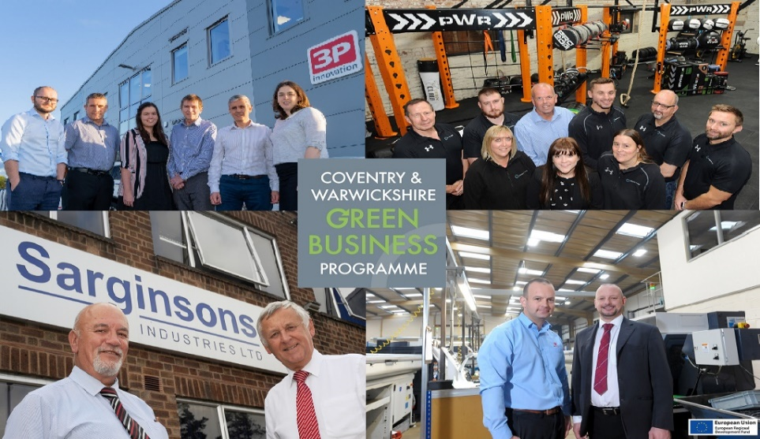
Aims of Scheme:
Help businesses reduce carbon
Access to grant funding to assist with investment
Provide energy efficiency advice and guidance

Slide 6
Ends Spring 2023
Grant funding; up to £50k max – 40% subsidy (minimum £1k). Must save at least 1 tonne CO2e per £1k of grant
2. Energy audit (worth £840) carried out FOC
Carbon saving calculation
Maximising potential energy savings
Supports funding bids/compliance/ISO14001

Slide 7
How the programme works:
Businesses provide us with 12 months energy bills (if available).
We carry out an on-site energy audit of the premises; heating/lighting/processes/machinery/energy wastage.

Slide 8
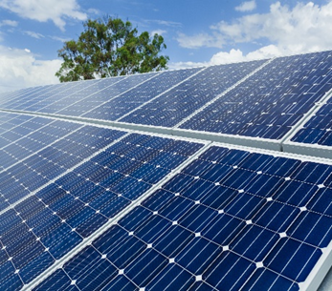
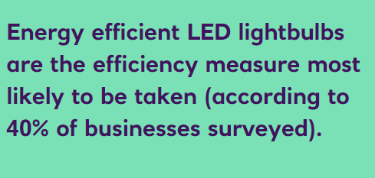
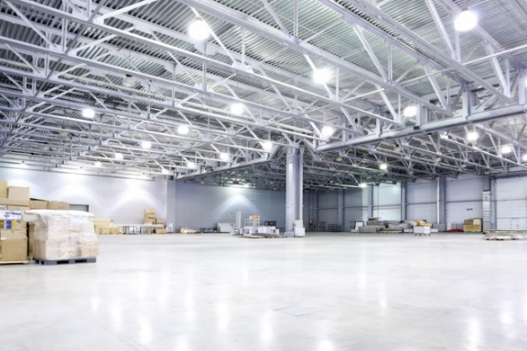
Example areas for recommendations:
Insulation
LED lighting
Heating
Glazing
Shutter doors
Solar PV
Heat Pumps
HVAC (Heating, Ventilation, Air Conditioning)
Natwest survey 2021

Slide 9
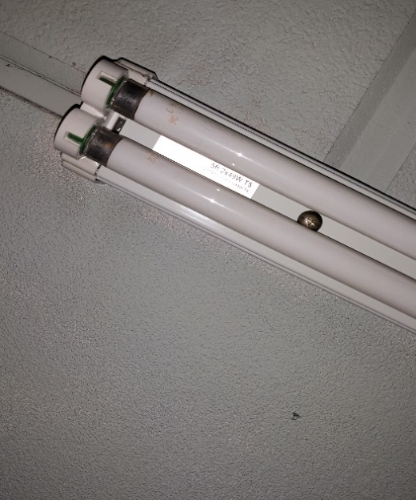
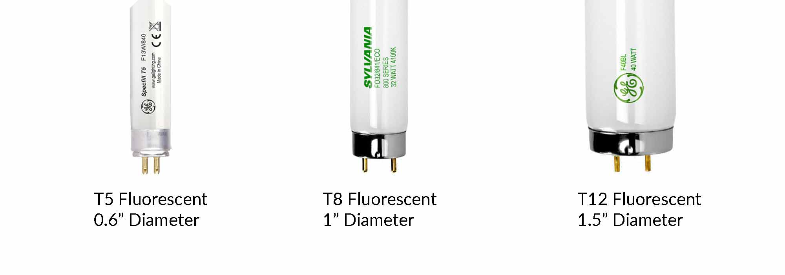
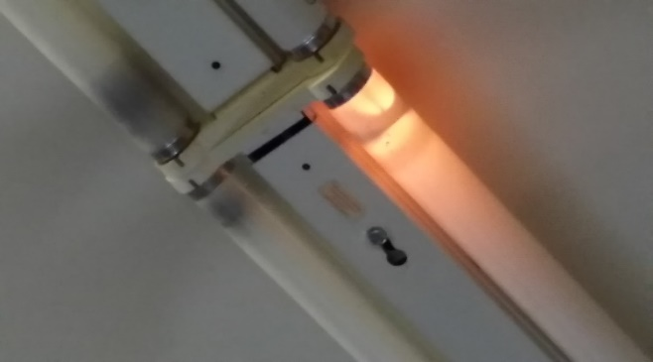
Lighting
Lighting: fluorescents, halogen, metal halide
Sensors, i.e. motion, daylight
Natural v artificial lighting

Slide 10
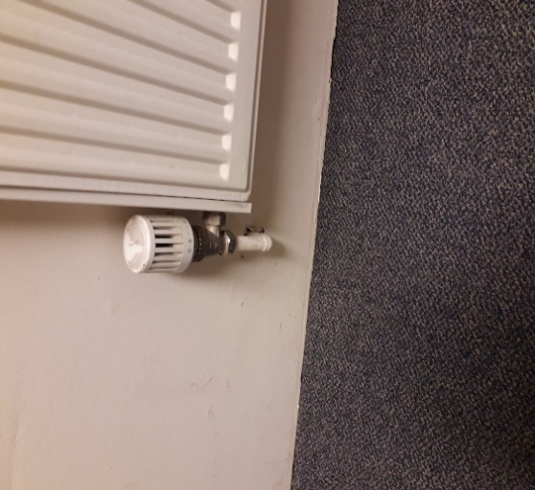
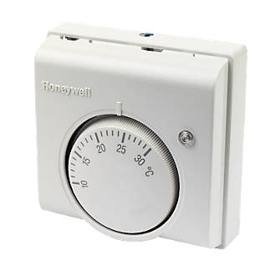
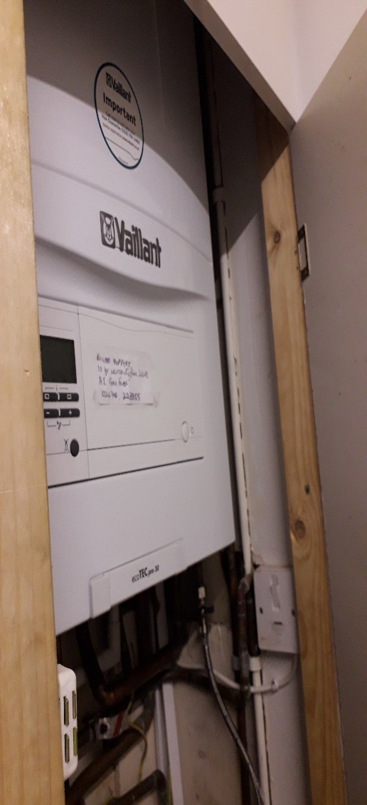
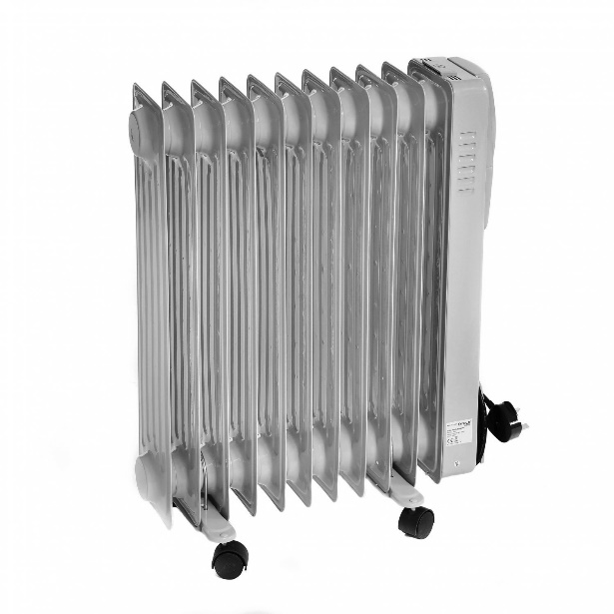
Heating, Cooling
& Insulation
Boilers/warm air units
Fans/air con
Timers/controls
Electric/oil portable heaters
Roof/ceiling/wall insulation
Infrared heaters

Slide 11
Green Business Network
Membership is free and offers a range of benefits:
Events, workshops & webinars
Monthly e-newsletter – news, events, legislation, case studies
The opportunity to promote your news/projects
Expert advice with team of sustainability advisors
Enhance green credentials to secure new business
Networking and supply chain opportunities (join our Green Business Directory)
Currently 1,500 other organisations you can network with

Slide 12
Other funding resources:
Various additional funding, resources and business advice is available within the region: specialist grants and business support.
In the first instance, contact the Growth Hub who will then guide you to the most appropriate resource -
CW Growth Hub: www.cwgrowthhub.co.uk
Birmingham Growth Hub: www.gbslepgrowthhub.co.uk

Slide 13
For free energy advice, energy audits, funding support - get in touch:
Coventry & Warwickshire:
greenbusiness@coventry.gov.uk

