Slide 1
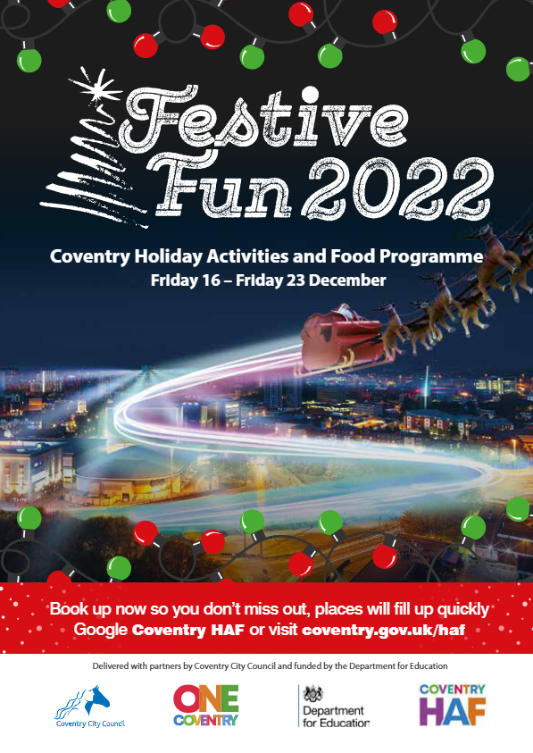
Coventry Holiday Activities and Food Festive Fun 2022 Coventry Schools HAF links November 2022

Slide 2
What is HAF?
Programme of activities and food – addressing holiday inequalities and holiday hunger in a context of cost of living crisis
Partnership approach - co-ordinated by Coventry City Council and funded by the DfE to March 2025 (Christmas, Easter and Summer school holidays)
HAF projects include: positive activities, a nutritional meal/food (normally hot), nutritional education for pupils and families* and signposting/information for families to wider services and support*
Eligibility criteria: school age children (reception to year 11 inclusive) and meet one or more of the following criteria: benefits-related free school meals, child in need, child protection plan, looked after, assessed (through an early help assessment) to be in financial hardship, part of the Ukrainian Family Scheme
To find out more about HAF, watch: What is Coventry HAF? Summer of Fun 2021 (scroll down to the Summer of Fun 2021 you-tube video)
*Face-to-face where possible, if not through leaflets or information on-line

Slide 3
Thank you
Thank you for the help of you/your school with Coventry HAF programme so far
Schools are significant partners in HAF
In summer 2022:
c.4,000 unique children benefitted (plus other family members) - up from approximately 2,000 unique children in summer 2021
c.17,000 meals provided
142 different clubs/activities
54 directly funded organisations plus over 50 other organisations were involved
93% would recommend to others

Slide 4
What is the Christmas HAF offer?
Over 70 different activities/clubs to be delivered by 33 delivery organisations
Wide range of activities for eligible children this Christmas: pantos, Coventry City FC match day experiences, The Wave, Winter Wonderland, ice skating, festive ball, trips, horse riding/stables, afternoon tea with Santa, Santa’s Grotto, Santa’s sleigh, outdoor nativity, trampolining, swimming, skateboarding, basketball, multi-activity clubs, cooking, music, Christmas arts and crafts, Christmas parties, photography, DJ-ing, creative dance, football and lots more…
Activities take place: Friday 16th – Friday 23rd December
Bookings opened on Monday 21st November and within 24 hours approximately 1,000 unique children booked on (as at: 24/11 - over 1,700)
Activities are inclusive and 15 activities/clubs are particularly focussed on children with Special Educational Needs and Disabilities
Watch the: Festive Fun 2022 promo

Slide 5
How do you find out which of your pupils are HAF eligible?
Names and HAF codes of all your schools eligible pupils were sent on 23/11 to your school via data-locker from ‘HAF Team’ to ‘Office contact’
Eligibility pupils criteria: school age children (reception to year 11 inclusive) and meet one or more of the following criteria: benefits-related free school meals, child in need, child protection plan, looked after, assessed (through an early help assessment) to be in financial hardship, part of the Ukrainian Family Scheme
All schools will be sent booking status position (i.e. which of your eligible child have/have not booked one or more HAF activities) through data-locker approx. 30th November. This will enable you to focus individual conversations on children who have not booked.

Slide 6
How is Festive Fun being promoted?
Letters and brochures sent to all eligible households, with translated versions available on HAF webpages
Electronic copies of letters and booklets to every school
Direct texts and messages to parents/carers
HAF promo-video – including shown at Coventry City FC matches
Briefing to wide range of professionals working with families
Christmas radio/media campaign
HAF, Coventry City Council and providers social media channels (e.g. HAF facebook )
By providers who have existing relationships with children/young people and families and have attended their sessions in previous holidays
HAF web pages (google Coventry HAF) and Coventry HAF webpages
Through Coventry schools (primary, secondary and special)

Slide 7
How are activities booked?*
Parent/carer books their child onto activities
Vast majority are booked on by their parents/carers using this route
Go to How to book and cancel step-by-step
Parents/carers set up a Coventry City Council “My Account” add their child(ren) to the HAF booking system, decide what to book, book and receive a confirmation email
Supported booking
Lack of IT access/IT literacy challenges
Where an organisation (e.g. provider, Coventry City Council, school etc.) books child(ren) onto activities on behalf of the parent/carers
Go to How schools can book children onto HAF activities for step-by-step supported booking instructions. Organisation representative needs to have Coventry City Council “My Account” set up (takes 2 minutes to do this).
*For Festive Fun 2022, each eligible child has an allocation of 4 credits (activities) of which 1 credit is for a Coventry Experience

Slide 8
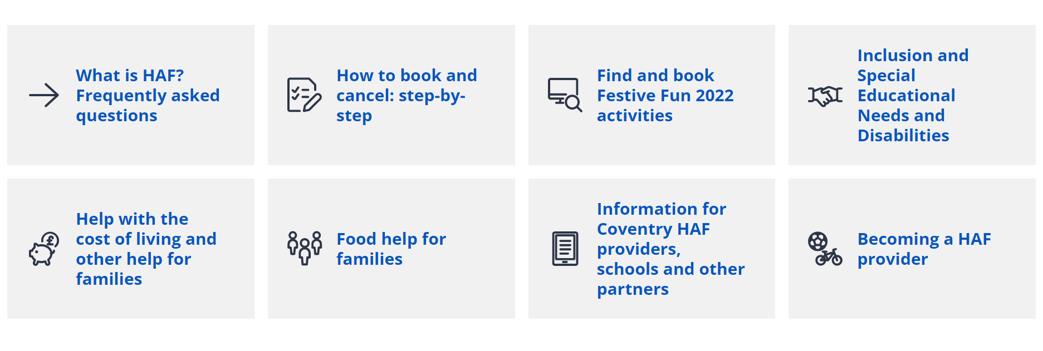
Coventry HAF landing page: https://www.coventry.gov.uk/haf

Slide 9
How can you promote Festive Fun?
HAF link/champion
Increase your own awareness of the Festive Fun HAF offer (google Coventry HAF including:
which activities may be best suited to your school/your pupils
how to book
eligibility etc.
Be aware of which pupils in your school are eligible for HAF (names to be sent via data-locker)
Resources for schools emailed on 25th November and uploaded onto HAF webpages
To your school staff team
Talk to staff colleagues about the Festive Fun HAF offer with staff colleagues so they can have conversations with pupils about HAF
Encourage them to watch the promo video and to look on the Coventry HAF website

Slide 10
How can you promote Festive Fun?
To your pupils and families
Send letters (electronic) to all parents/carers
Promote HAF in your school newsletters
Promote HAF on your school website
Invite local providers into your school to publicise
Conversations with pupils and parents
Use any other opportunities to promote HAF with pupils and parents/carers
Support parents/carers with bookings or signpost them to Family Hubs, libraries and Council helpline

Slide 11
School/HAF partnership
Let us know if your school is interested in hosting a HAF club for Easter 2023 and/or Summer 2023
Please let us know if your HAF school link contact changes
Please let us know any feedback you hear from parents/carers and children
Any other ideas for further HAF development and improvements

Slide 12
Feedback and questions
Do you have questions about Festive Fun 2022?
What has your experiences of HAF been so far?
What’s worked in your school context?
Positives?
Areas for improvement?

Slide 13
Coventry HAF key contacts
Adrian Coles – Programme Manager (HAF lead) – Adrian.Coles@coventry.gov.uk
Lorna Holland – Project Manager (HAF) – Lorna.Holland@coventry.gov.uk
Daisy Hollingsworth – Project Support Officer (HAF) – Daisy.Hollingsworth@coventry.gov.uk
James Courtney – Project Support Officer (HAF) – James.Courtney@coventry.gov.uk
Stella Rogers- Project Support Officer (HAF) – Stella.Rogers@coventry.gov.uk
HAF Team mail box – hafprogramme@coventry.gov.uk
HAF webpages - https://www.coventry.gov.uk/haf or google “Coventry HAF”

Slide 14
Coventry HAF Festive Fun 2022 delivery partners
All Saints C of E Primary School
Art Riot Collective
Aptitude
Ascension Dance Company
Barr’s Hill School
Cardinal Newman Catholic School
Canley Community Centre
Coventry Central SDA Community Services
Coventry Music
Coventry Outdoors
Coventry Rugby Community Foundation
Cre8fun
Creative Optimistic Visions
Culture Coventry Trust
CV Life
Empowr-U
Feeding Coventry
Guardian Ballers
Guiding Young Minds
Holbrooks Community Care Association
Koala Klubs
Longford Park School
My Activities
Moor Farm Stables
Positive Youth Foundation
Project number 5
SCCU/Epic Academy
SDH Academy
Sky Blues in the Community
St John the Divine Church
Staffordshire Winter Sports Club (Planet Ice)
Vanny Radio
WATCH/Hillz FM

Slide 15
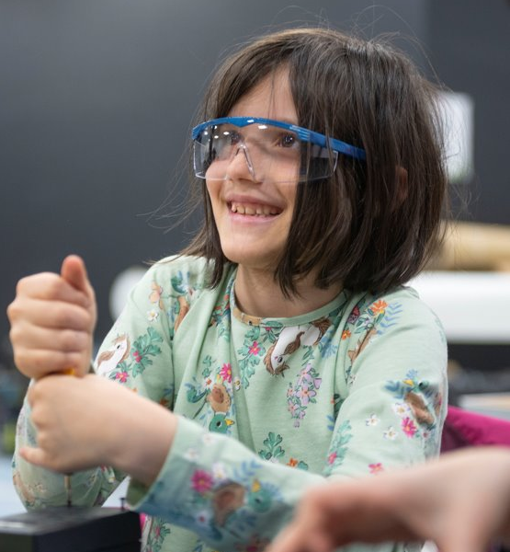
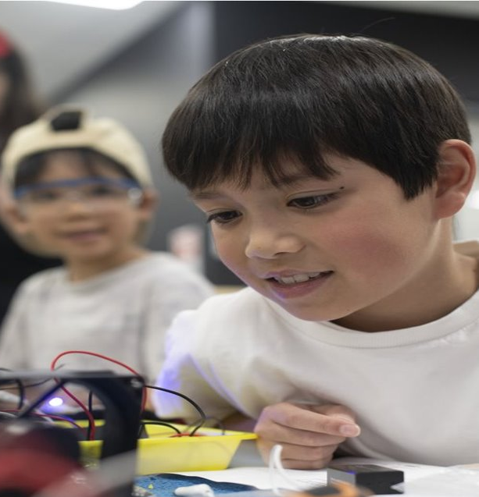
Coventry HAF Priorities
To increase the number of eligible children attending and booking each holiday (year-on-year basis)
To increase the quality and impact of HAF activities and experiences
To improve the value for money of holiday activities and experiences
To develop practitioners with children and young people
To put a smile on the faces of Coventry children and young people

Slide 16
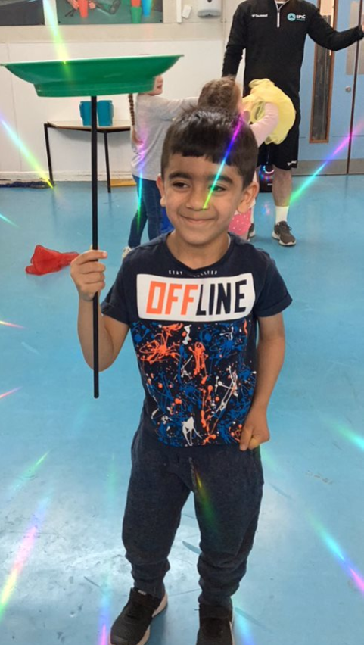
Thank you!

