Slide 1
Addressing Climate Change & Sustainability in Coventry
Bret Willers, Head of Climate Change & Sustainability,
Coventry City Council

Slide 2
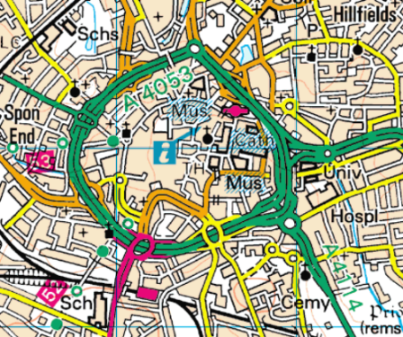
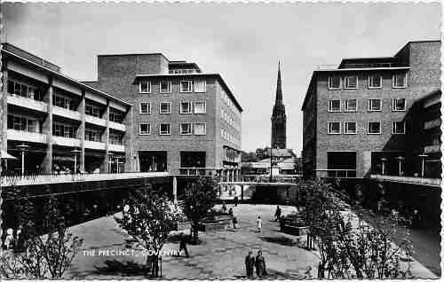
Coventry’s firsts …
The UK’s first smokeless zone (1948)
First pedestrianised shopping centre (1948)
First UK Ring Road (1973) – benefits for congestion and air quality
First climate change degree offered
Coventry was one of the first cities to produce a climate change strategy
One of first cities to recover power and heat from waste
First city to use electric vehicles in 1995
First city in the UK to trade carbon
Coventry has ‘Living Lab’ status which means we are one of the country’s leading centres for low carbon research
Notes:
Leading the way – and will strive to continue leading the way..

Slide 3
Some achievements to date…
One of the highest carbon reduction per capita of UK Cities
UK Battery Industrialisation Centre
Innovate UK funded the Regional Energy System Operator (RESO)
Highest number of Electric Vehicle Charging points outside of London
A Climate View Pilot City
Electric Bus City
Sustainable Food Places status
River Sherbourne Project Living Landscapes

Slide 4
UKBIC & GIGAFACTORY
SUPPORTING OUR BUSINESSES
UK’s largest Gigafactory to support transition to EV and battery innovation
Examples include Green Business and Business Sustain
SHERBOURNE VALLEY
PROJECT
DECARBONISING
TRANSPORT
Reconnecting the people of Coventry with the city’s river. Restoring the river for wildlife.
STRATEGIC ENERGY
PARTNER
Coventry’s very light rail (CVLR) system
All electric bus city
Urban Airport
Development of Coventry’s cycleways
EV infrastructure
Procuring a commercial partnership to deliver infrastructure for green and innovative solutions in Coventry
Future cities
CLEAN AIR HUB
SUPPORTING ENERGY EFFICIENT HOMES
Innovative zone for transport to support clean energy.
Affordable warmth, LADS, Social Housing Decarbonising Fund
SMART SOLUTIONS
Delivering high speed reliable digital services via 5G network with Project Sherbourne
RENEWABLE ENERGY
PARTNERSHIPS
Developing renewable energy generation for Coventry
Examples include Climate Change Board, Food Network, Coventry and Warwickshire Climate Change Conference

Slide 5
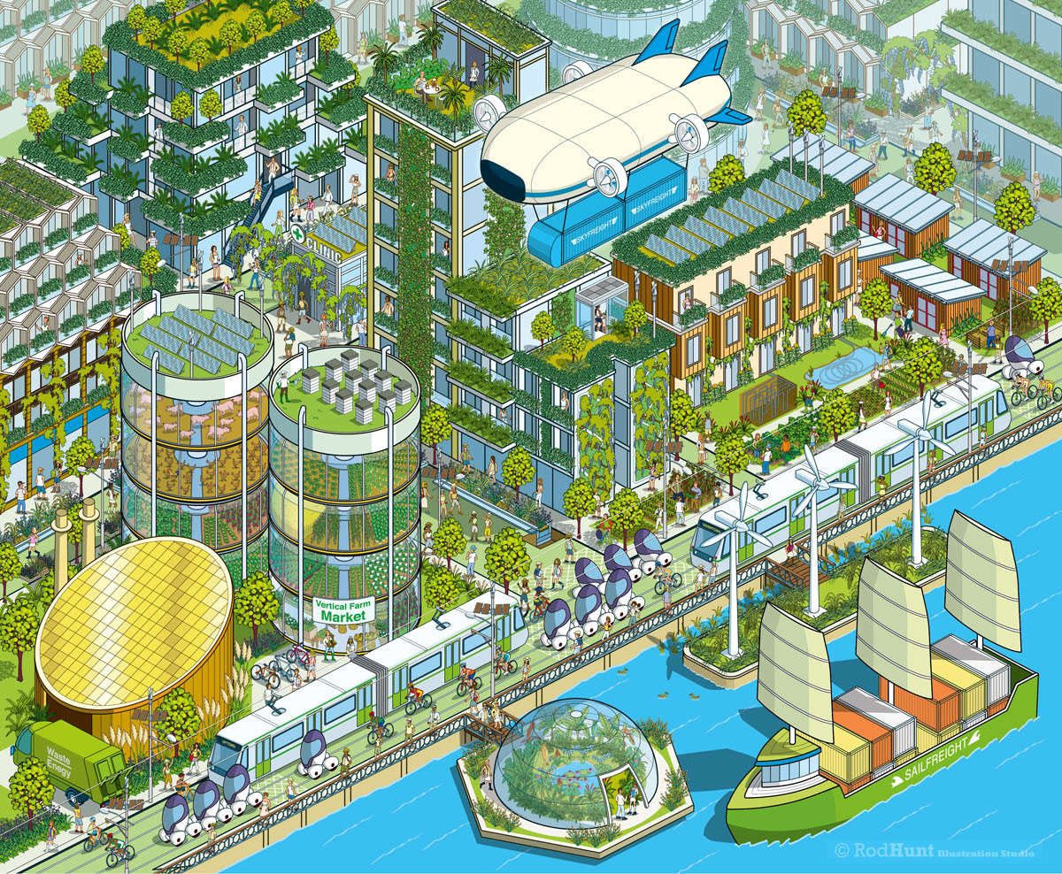
Creating a shared Vision for a sustainable City…
The 5 Holistic Pathways for working towards a Sustainable City

Slide 6
The low emission development pathway curbs climate change, creates new economic opportunities and improves the health of human and natural systems.
The nature-based development pathway protects and enhances the biodiversity and urban ecosystems, which underpin key aspects of local economies and the well-being and resilience of our communities.
The circular development pathway and new models of production and consumption build sustainable societies that use recyclable, sharable and replenishing resources to end the linear model of produce, consume, discard.
The resilient development pathway anticipates, prevents, absorbs and recovers from shocks and stresses, especially those brought about by rapid environmental technological, social and demographic change, and to improve essential basic response structures
Equitable and people-centered development builds more just, liveable and inclusive urban communities and addresses poverty.

Slide 7
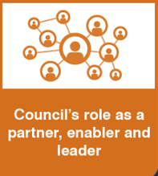
Changing Behaviours
Training & Skills
Monitoring
Performance
Outcomes
linked to
Quality of Life
New approaches
to
Finance &
Investment
Working
collaboratively
across divisions
Evidencing Need
Measuring
Quality of Life
& Sustainability
Assessing
Impacts
of policies
and actions
As well as delivering the specific projects in the plan, our role as a partner, enabler and leader will be key to changing behaviours
LEAN
Minimising
Waste
&
Maximising
Efficiency
Nurturing
Creativity & Innovation
‘The clock
is ticking’
Focused on
Milestones
and targets
A whole life
approach
to procurement & commissioning
Focused on
influencing
behaviour change
Learning
from others
outside
Coventry
Co-Production
with communities
Commercialisation
& Social
Enterprise
Lobby for change
Awareness
& Confidence
to challenge

Slide 8
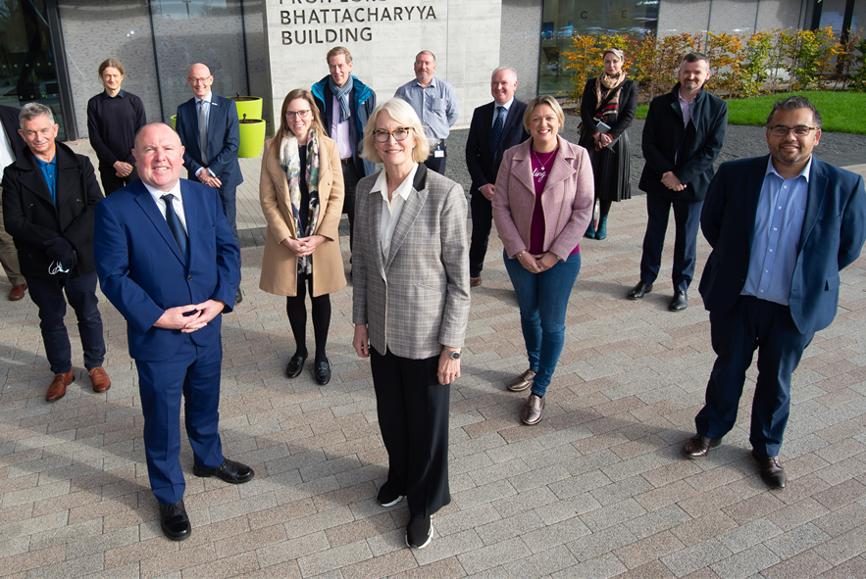
Climate Change Board
Coventry’s Independent Climate Change Board
Independent group of partners including academic institutions, utilities, emergency services and third sector organisations. Aim to contribute and shape the strategic direction of the board through collaboration and delivery of sustainability and net zero actions for the city.

Slide 9
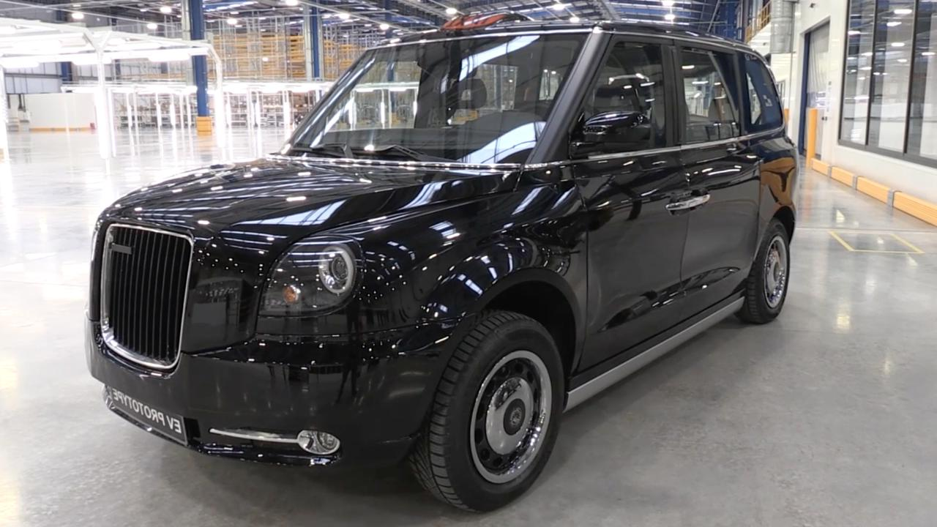
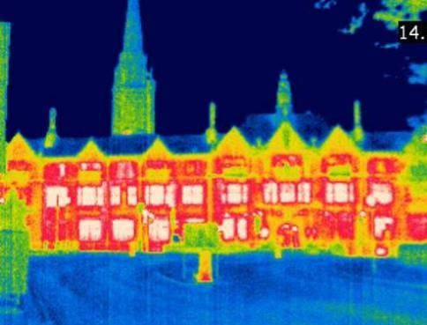
Supporting Business
Green Business Programme
Business Sustain
IEMA Member – developing training
Several Transport Initiatives
Notes:
Business Sustain covered in next slide – other two covered in next presentations

Slide 10
We help our clients with
Confidential environmental management assistance
Bespoke registers of environmental and health and safety legislation
Confidential site specific environmental legal compliance audits
Support with their environmental management systems to maintain ISO 14001:2015 certification
Notes:
Business Sustain are a team of sustainability consultants based within Coventry City Council providing national businesses of all sizes with environmental management assistance.
They provide bespoke registers of environmental and also health and safety legislation informing clients of the laws that need to be complied with
They conduct confidential site specific environmental legislation compliance audits, and also provide bespoke environmental consultancy to support clients with their environmental management systems to maintain ISO14001:2015 requirements, such as training, mentoring new environmental managers and conducting internal environmental audits.

Slide 11
Climate Change Strategy… A Green Future for Coventry
Climate Change & Sustainability Strategy
Draft under review, aiming for public consultation during summer
Zero Carbon Routemap
Underpinned by routemap; outlines pathway, cost and available options to net zero. Priority areas identified; housing & transport. More to follow soon…

Slide 12
Climate Change Strategy
Vision: ‘Through the strategy we aim to deliver a sustainable future in Coventry, maintain a healthy and prosperous zero carbon circular economy, provide a significant opportunity for enhancing quality of life, creating new jobs and employment whilst ensuring we minimise our adverse impacts upon the environment, biodiversity and sustainability.’
Coming soon…
… help to shape our future

