Slide 1
Active Travel Guidance for Business
Warwickshire County Council
Tim Snazell, Safe & Active Travel Officer
Sam Gehin, Safe & Active Travel Officer
Green Business Programme - 14.09.22

Slide 2
Safe & Active Travel at WCC
Warwickshire County Council
Our Safe and Active Programmes - Safe and Active Schools, Safe and Active Communities, and Safe and Active Workplaces - all aim to encourage modal shift, thus helping the County meet net zero commitments. We provide active travel options and solutions, and support people to make behavioural changes.
The work of the Road Safety Education Team links with the Council Plan 2020 - 2025. Our programmes, projects, interventions, and campaigns focus on supporting individuals and communities to live safely, healthily, and independently and supports decarbonisation by local businesses, organisations, and residents.

Slide 3
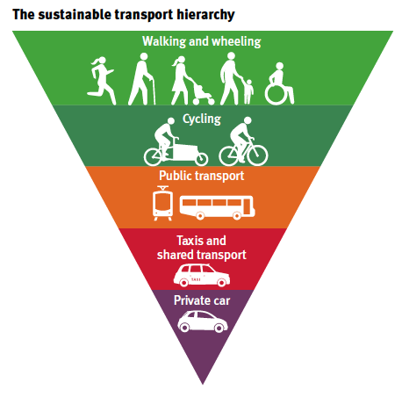
Jargon Busting
Warwickshire County Council
Active travel: Active travel refers to modes of travel that involve a level of activity. The term is often used interchangeably with walking and cycling, but active travel can also include trips made by wheelchair, mobility scooters, adapted cycles, e-cycles, scooters, as well as cycle sharing schemes
Sustainable travel: ​Any type of transport that doesn’t rely on the world’s natural resources to power it. ​Sustainable travel hierarchy – useful tool to help you think about improving the impact of your journeys. The higher up the hierarchy, the more sustainable and greener the travel option.
Modal Shift: In essence, a ‘modal shift’ means a change from one form of transportation to another, for example, switching a delivery van for an e-cargo bike. This is an important element of the discussion around creating a more sustainable transport system that benefits us all.

Slide 4
Campaign
Warwickshire County Council
Our #JustOneJourney campaign is focused on helping Warwickshire residents, workplaces and community groups to take the small steps towards their active travel goals.
As a part of the campaign, the Safe and Active Travel team have launched a pilot programme with two Warwickshire-based workplaces, with the aim to reduce the number of journeys made by single occupancy vehicles.
The pilot programme will consist of a number of interventions, including three active travel events over a twelve month period, continuous support and guidance, staff surveys, a site audit, and the delivery of a Active Travel Plan.

Slide 5
Warwickshire County Council
Formed this year with a £2 billion commitment to deliver a golden age of walking and cycling.
Active Travel England will play an important role in improving the health of the nation and it is vital to the government's commitment to achieve net zero carbon emissions by 2050.
Active Travel England has set an ambitious target, 50% of all journeys in towns and cities should be walked or cycled by 2030.

Slide 6
Warwickshire County Council
Local Transport Plan – LCWIP
Aim: ‘to create a safe and attractive environment for walking and cycling, so that they become the natural choices for shorter journeys and outdoor recreation in Warwickshire’.​
​
Includes network plans for walking and cycling and a 10-year programme of prioritised improvements​
Links with policies in new Local Transport Plan and Active Travel Strategy, and will be integrated with new Rights of Way Improvement Plan​
Provides opportunity to unlock future funding, including from Active Travel England and developers​
Reflects local demand for better facilities. Consultation on draft LCWIP in Summer 2022 generated over 1,000 responses. These are now being reviewed. Hope to publish final version by end of 2022.​

Slide 7
What steps can my business take to enable and promote active travel?
Warwickshire County Council
Find out how your staff travel to work
Survey your workplaces with a site audit
Review your policies
Map the routes to work
Provide information
Encourage car-sharing and bike buddying for new cyclists
Cycle training and bike maintenance at work
Consider financial and practical support
Create opportunities to become part of a wider movement
Active Travel Business Groups

Slide 8
Find out how your staff travel to work
Warwickshire County Council
Carry out a survey to get a clear understanding of people’s travel choices.
What are the barriers that currently prevent people from walking, cycling, using public transport or car-sharing?
A simple active travel survey is an excellent starting point for understanding your workforces current travel behaviours.
Your survey does not have to be complicated!

Slide 9
Survey your workplace with site audit
Warwickshire County Council
Build up a picture of how easy your workplace makes it for those who want to walk, cycle or use public transport, and identify areas for improvement.
Site audits do not need to be complicated, nor do you need the technical expertise to complete one. Simply walk around your site and take a snap shot of the current travel behaviours.

Slide 10
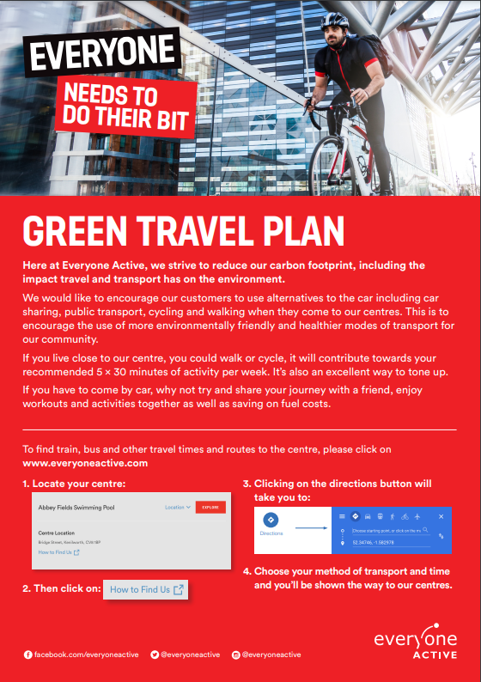
Review your policies
Warwickshire County Council
Do your organisation’s policies support walking, cycling and public transport use?
Clear company guidelines offering support for staff are crucial in changing organisational culture.
Everyone Active have a very light green travel plan (only one page) but it encourages those who visit their sites to walk and cycle, with a link to Google maps that puts the destination as an everyone active site of your choice.

Slide 11
Map the route to work
Warwickshire County Council
Provide travel directions to your office in the healthiest order to encourage new staff and visitors to travel more actively.
Start with walking and cycling, then public transport and finally travelling by car.
Make sure you include car-share options.

Slide 12
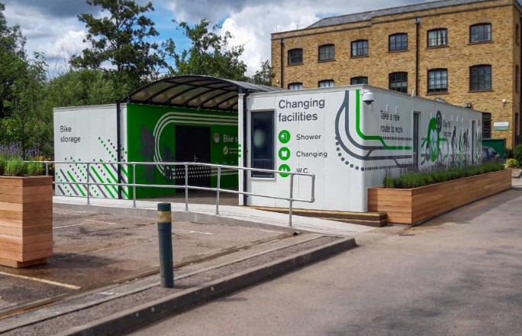
Warwickshire County Council
Convenience
Making active travel as easy as possible is key to its success.
Bike parking should ideally be located as near to the entrance as possible.
Shower and changing facilities located in a convenient and accessible space near the entrance.
Provide dedicated car share parking spaces.

Slide 13
Provide Information
Warwickshire County Council
Gather and distribute local walking, cycling and public transport information.
Provide new employees with a starter pack containing active travel advice and contact details for active travel champions.
The WCC Safe and Active Travel website has updated cycling maps staff can use for day to day trips and weekend leisure routes.

Slide 14
Encourage car-sharing and bike buddying for new cyclists
Warwickshire County Council
Find out more about car-sharing or investigate car club membership options in your area.
You can also help staff to set up bike buddy programs where an experienced cycle commuter shows a new cyclist the best way to get to work.
Liftshare - a great option for staff who are unable to travel actively. Car sharing will help staff save money and reduce congestion.
Warwickshire Cycle Buddies - a new initiative which launched this year with WCC Greenshoot Funding. Cycle Buddies connect novice or returning cyclists with experienced riders to build confidence cycling around Warwickshire.

Slide 15
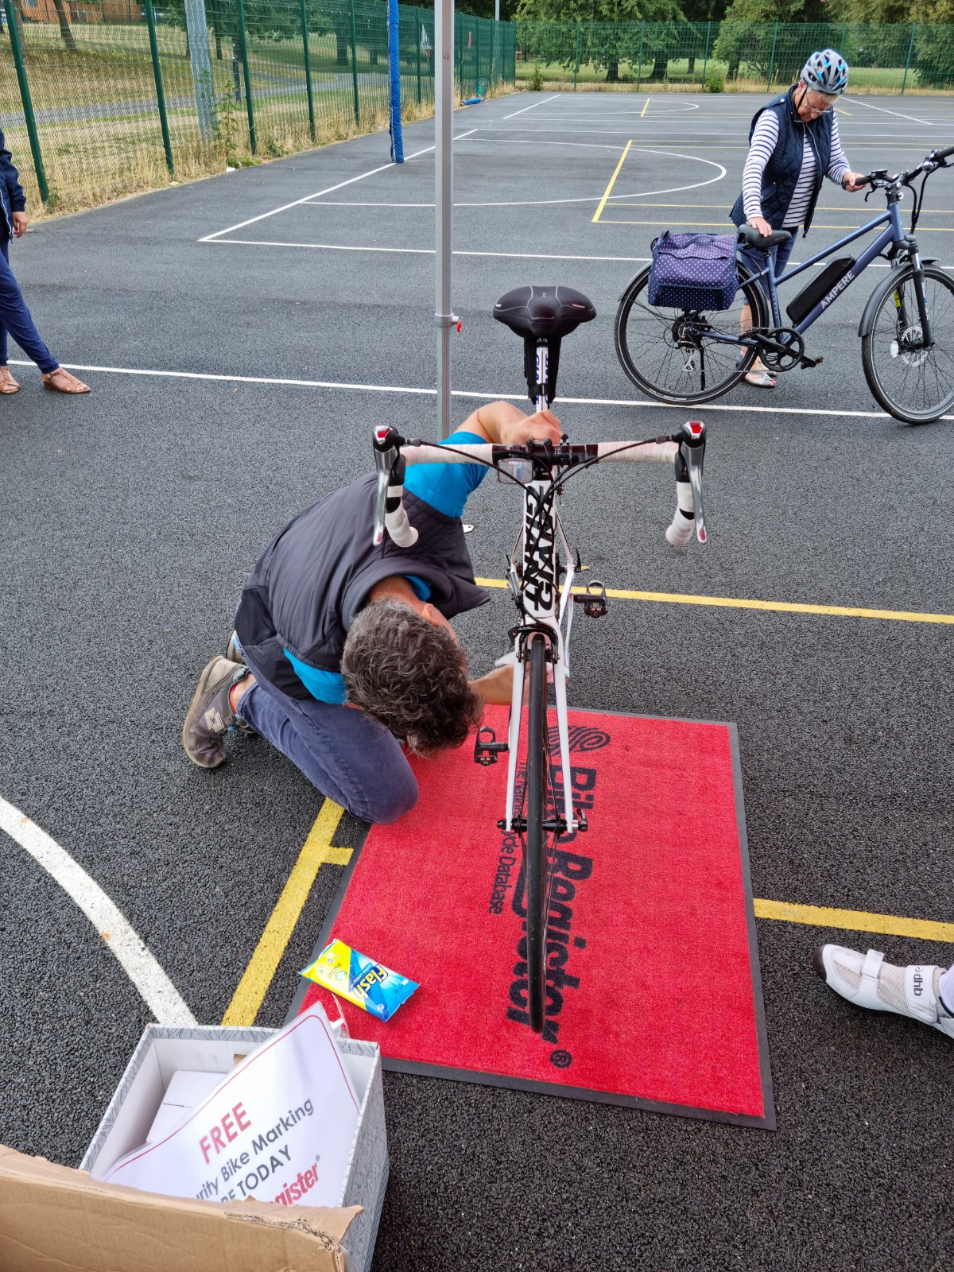
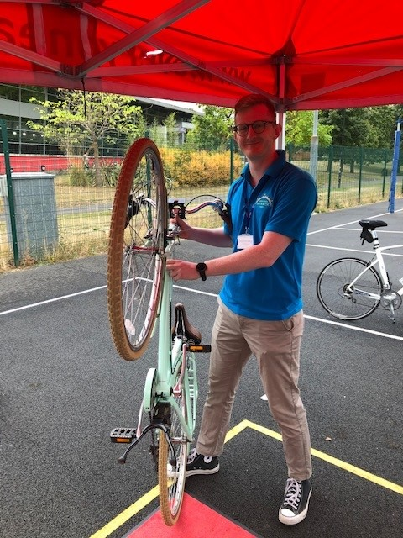
Cycle training and bike maintenance at work
Warwickshire County Council
Organise cycle training, bike maintenance sessions and group rides.
WCC offers free bike maintenance sessions.
We also offer free security bike marking sessions to all Warwickshire residents. Bikes are registered on the National Cycling Database

Slide 16
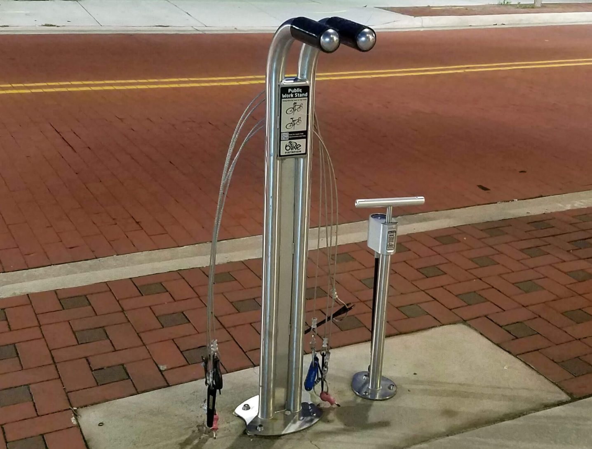
Consider financial and practical support
Warwickshire County Council
Register for the Cycle to Work scheme to help your staff spread the cost of a new bike over 12 tax-free instalments.
You may want to consider offering monthly loans for public transport season tickets.
You could purchase a small fleet of pool bikes and stock the office with spare locks and puncture repair kits for cyclists.
Walkers will always appreciate a supply of umbrellas for rainy days!

Slide 17
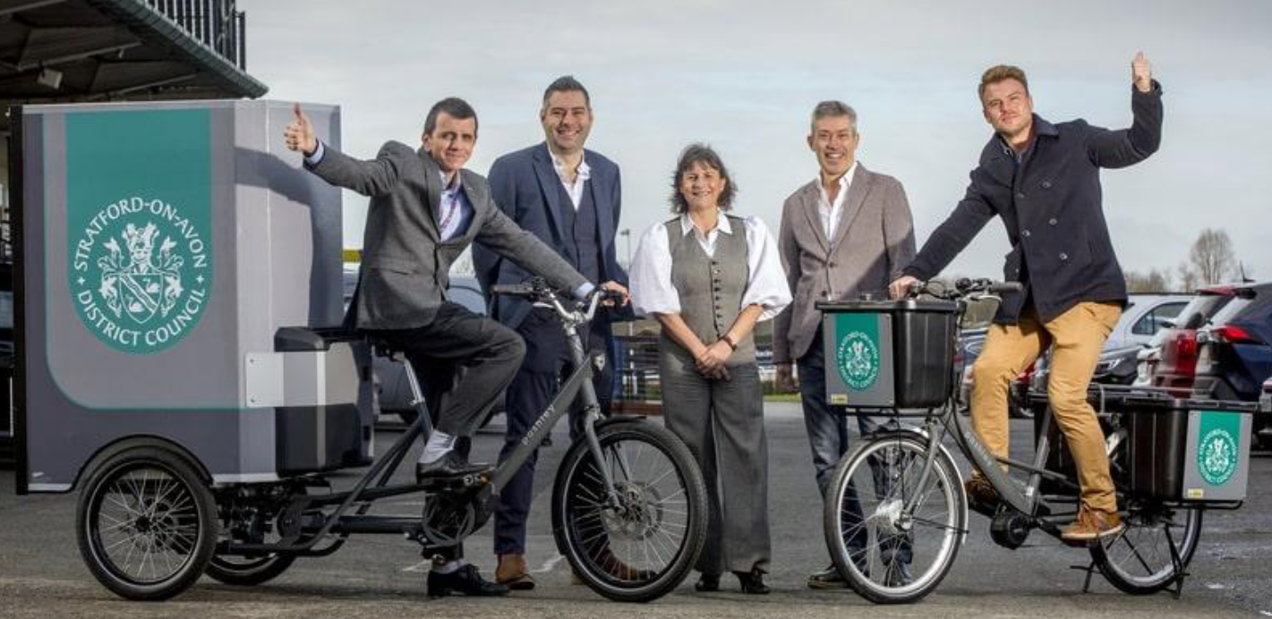
Warwickshire County Council
Stratford E-Cargo Bike Scheme
In April 2022, Stratford DC launched a free trial scheme.
Stratford District Council has ten e-cargo bikes including 5 bikes and 5 trikes.
The bikes are available for free for up to 3 months.
If you are interested, please email ecargobikes@stratford-dc.gov.uk.

Slide 18
Create opportunities to be part of a wider movement
Warwickshire County Council
Being part of a group makes it easier for individuals to change their own habits, so join up with national events like Bike Week, Cycle to Work Day and Lift Share Week, or create your own organisation-wide challenge.
Warwickshire County Council has recently partnered up with Love to Ride. Love to Ride is a cycling encouragement platform that is designed to encourage people to start, continue and increase their miles in the saddle.
Warwickshire residents, community groups and workplaces can sign up for free and participate in the platforms campaigns. Love to Rides flagship campaign is Cycle September.

Slide 19
Warwickshire County Council
Active Travel Business Groups
Work together with local businesses to share experiences and provide peer support.
Create a shared Bicycle User Group that meets up quarterly or more often if required.
Business groups can utilise collective buying power to secure better deals for shared active travel infrastructure.
Workplaces coming together to form cycle groups will have greater power to influence change.

Slide 20
Warwickshire County Council
If you wish to find out more about the services that we can offer your business, please visit our website at: https://www.warwickshire.gov.uk/warwickshire-safe-active-travel or get in touch at: travelplan@warwickshire.gov.uk
How will you make yours?

