Slide 1
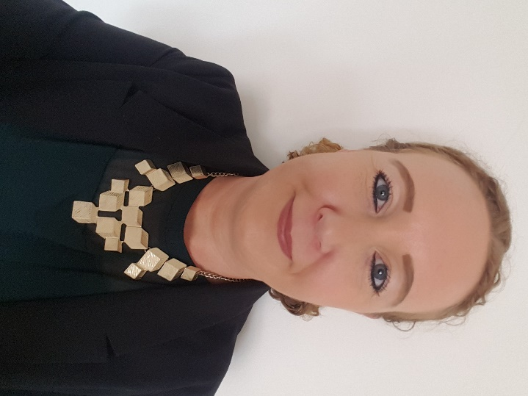
Green Business Programme
Bernie McCullagh
Business Energy Advisor

Slide 2
Agenda
The energy context
Govt & GBP support
Energy audits
Legislation advice

Slide 3
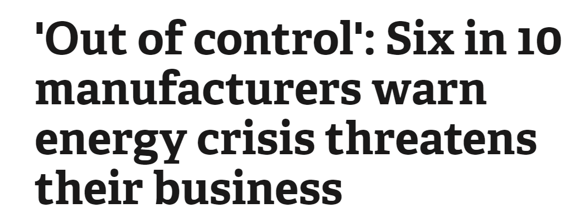

Slide 4
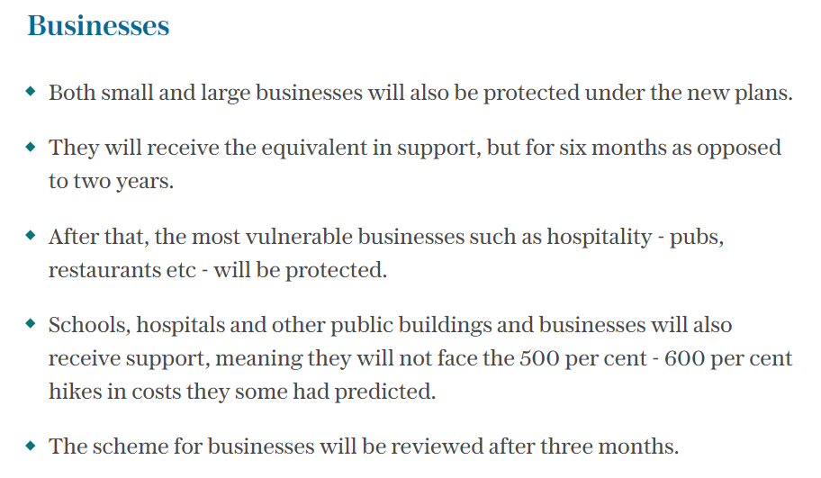
Govt support
Specific business price cap unclear at the moment?

Slide 5
Discussion:
How is this affecting your business?
What do you think of the govt support so far?

Slide 6
GBP support
COVENTRY & WARWICKSHIRE
GREEN BUSINESS
PROGRAMME
A free of charge
energy audit, worth £840
Lighting
LED, controls, sensors
Recycling and waste
compactors, balers
and crushers
Ventilation
fans, distribution
We may be able to offer eligible businesses grants of between £1k and
£20k to fund up to 40% of energy efficiency measures.
Insulation
Heating
Replacement boilers/ burners, install heat pumps
N.B. first come first served, if and when any further funds are confirmed
Renewable
technologies
Refrigeration
Compressors

Slide 7
Wider benefits
Green Business Programme is part of
SMEs engaged in the programme experience a variety of benefits, namely:
Started in
2016
Reduced energy bills and maintenance costs
Reduced carbon emissions
Reduced waste disposal costs
Improved working conditions
Increased competitiveness, profitability,
and efficiency
ERDF funded scheme

Slide 8
Energy audit process
COVENTRY & WARWICKSHIRE
GREEN BUSINESS
PROGRAMME
We attend:
a site visit is conducted at your business premises by one of our Business Advisors
We discuss:
operating hours, number of staff, age of building etc
We review:
your energy bills for the last 12 months
We identify:
areas or items where efficiency improvements can be made: heating, lighting, insulation, machinery etc.
We explain:
how the programme works, how to claim, etc
We deliver:
an energy audit report which includes analysis of current energy use alongside energy efficiency recommendations; the report and also identifies grant value and payback periods for each recommendation.
We support you:
your allocated Business Advisor will offer support and advice throughout the whole process

Slide 9
Energy audit benefits
Carbon Trust 10% savings: basic energy management actions
Payback periods of circa 2 years for solar PV (due to the current energy crisis)
Helps to focus your investment: carbon/staff/money
Identify any energy wastage
Builds an internal business case
Since 2018,
30 events have been hosted by the programme

Slide 10
Energy audit examples
External audit costs v GBP/range & quality
Company X initially requested solar PV; during visit additional recommendations made (i.e. lighting, sensors, heating, air compressor, controls, PFC, insulation)
Company A (retail): £43k cost & 13t carbon savings
Company B: (solicitor): £6k cost & 4t carbon savings
Company C: (manufacturing): £23k cost & 11t carbon savings
Case study: GRM Consulting podcast (see website for details)
Since 2018,
30 events have been hosted by the programme

Slide 11
We help our clients with:
Environmental Management advice
Registers of environmental and health and safety legislation and legal compliance audits
Support to achieve and maintain accreditations i.e. ISO14001, ISO45001 & ISO9001 certification
UK-wide and non-SME support
Since 2018,
30 events have been hosted by the programme

Slide 12
Tel: 02476 972 026
businesssustain@coventry.gov.uk
www.coventry.gov.uk/businesssustain
Business Sustain carry out a questionnaire to establish legislation that is relevant to your business, and provide a concise summary via a web portal.
Any changes to legislation will automatically update all clients’ registers instantly.
2023 legislative change due:
Environmental legislation ‘Producer Responsibility’: relating to packaging that your organisation handles.
The current threshold is 50 tonnes a year, with a turnover >£2m: the govt is reducing the threshold to 25 tonnes.
There will be more packaging categories and additional data requirements.
They will include more details of this topic in a future seminar or webinar.
Since 2018,
30 events have been hosted by the programme

Slide 13
GBP contact details:
Coventry & Warwickshire Green Business Programme:
greenbusiness@coventry.gov.uk
Since 2018,
30 events have been hosted by the programme

