Slide 1
Business Support in Coventry and Warwickshire
From Coventry & Warwickshire Growth Hub and Warwickshire County Council
September 2022

Slide 2
Coventry and Warwickshire LEP Growth Hub
Jim Clark
Account Manager
Stratford Upon Avon District
CWLEP Growth Hub

Slide 3
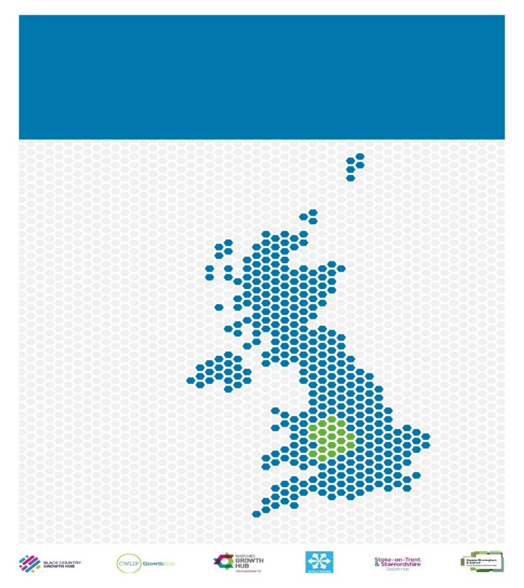
Coventry & Warwickshire LEP Growth Hub Greater Birmingham & Solihull LEP Growth Hub The Black Country Growth Hub Stoke-on-Trent & Staffordshire Growth Hub The Marches Growth Hub Worcestershire Business Central
Working together as a region to deliver consistent, local SME support.
West Midlands Growth Hubs
Notes:
These are the Growth Hubs that make up the WM cluster, there are 38 GH’s in total around the country

Slide 4
Typical Areas of Growth Hubs support
Access To Finance
Private and Public sector inc. Covid-19 support
Inward Investment
People & Skills (recruitment, training, apprenticeships, Kickstart)
Commercial Property (finding new, expanding existing, planning issues)
Innovation (new products and processes)
Business Support (business planning, diversification, sales & marketing, export, IP etc.)
Added Value (e.g. Intertrading, explore new sectors)
Business Collaboration (Targeted B2B introductions)
Supply Chain & Procurement Opportunities
Access to national & regional business support programmes
Notes:
Some of the main areas This would include getting businesses prepared to bid on public sector opportunities

Slide 5
How to Engage…
CONTACT AREA ACCOUNT MANAGER
EVENTS
FINDITINCW
NEWSLETTER
LEGAL & PROFESSIONAL SERVICES
Notes:
These are the initial priority non-clinical categories outlined by Amar to focus on for local procurement

Slide 6
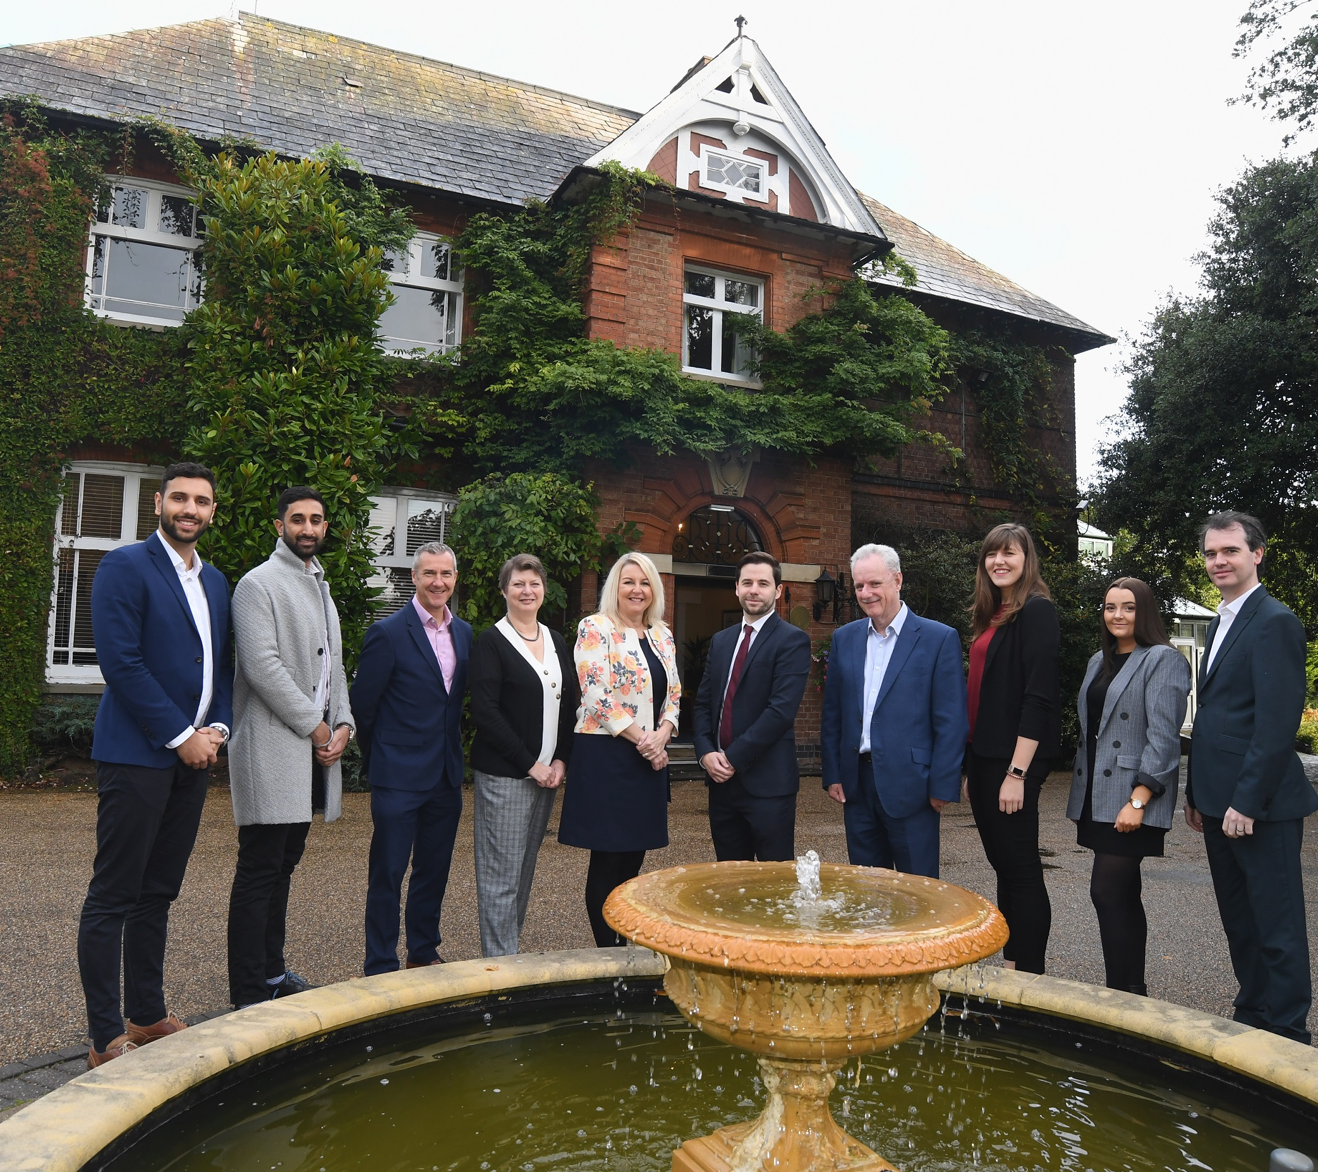
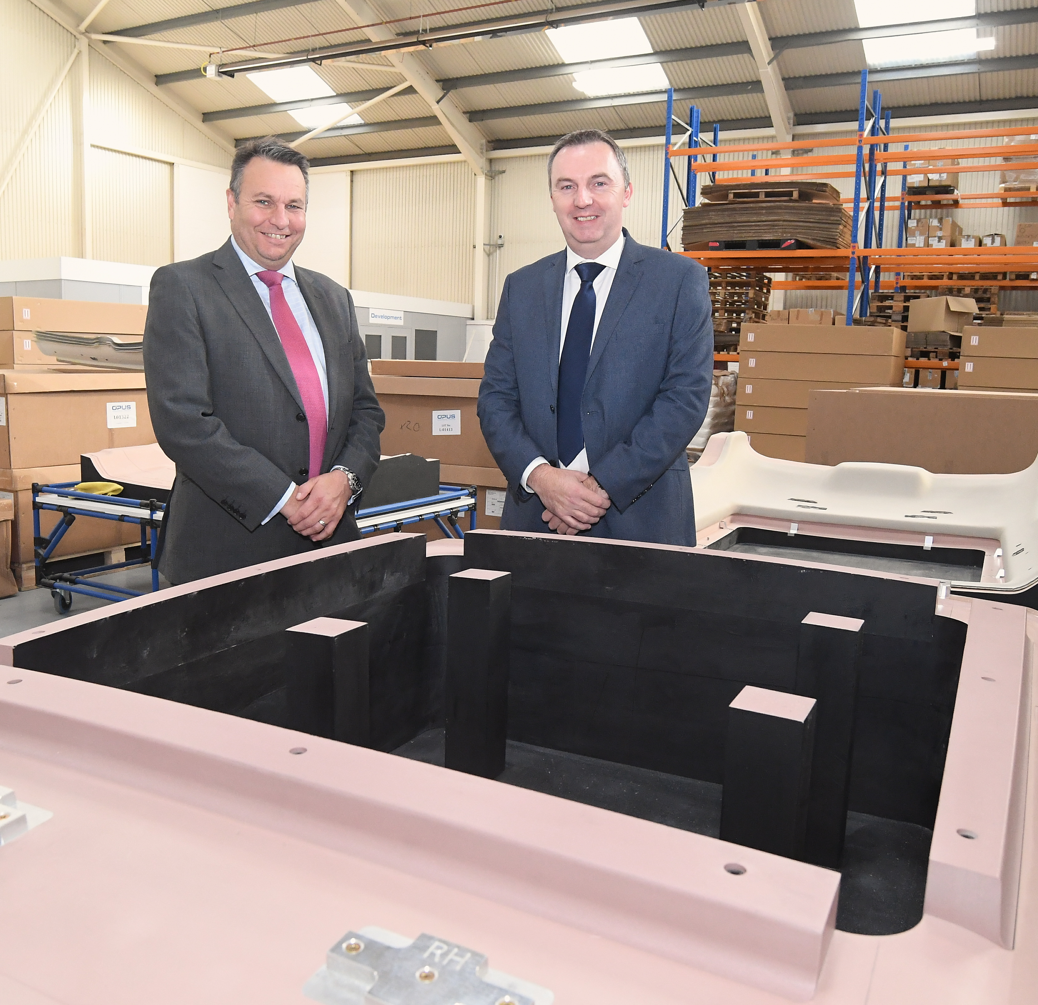
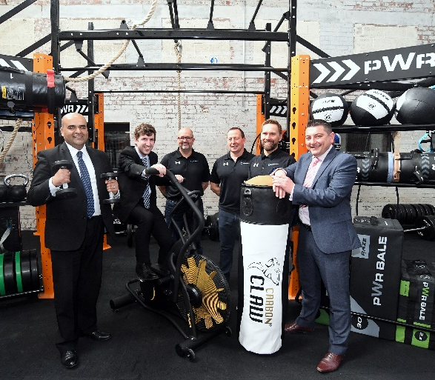
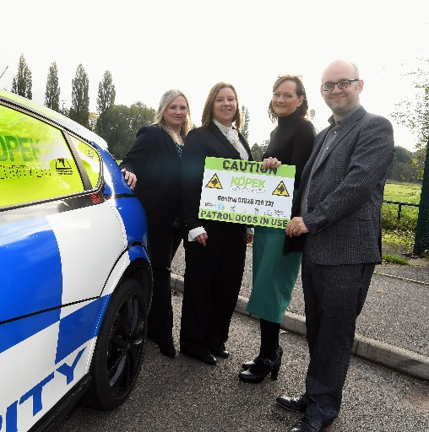
Face-to-Face support tailored to your business
Step 1: Initial contact and diagnostic of your business needs
Step 2: Meeting or phone call to discuss your business and growth ambitions in depth
Step 3: Assess what support opportunities are available to suit your needs
Step 4: Refer to the relevant people that can provide you with the right tools
Step 5: On going support, building a relationship between the client and the Growth Hub

Slide 7
Examples of Growth Hub Referrals

Slide 8
Warwickshire County Council Economy & Skills
Joanna Smith
Business Advisor
Economy & Skills
Warwickshire County Council

Slide 9
Support from Warwickshire County Council Economy & Skills
Warwickshire Skills Hub
Business skills reviews, apprenticeship support, recruitment filming, and access to local talent pools.
Invest in Warwickshire
Help with resizing, relocation, and soft-landing support in Warwickshire.
Business Centres
Managed offices and light industrial space in Nuneaton, Bidford-on-Avon, and Rugby.

Slide 10
CW Business: Start, Grow and Scale
Start-up
Delivered by Coventry and Warwickshire Chamber of Commerce
Offers support to businesses within their first 24 months of trading and potential entrepreneurs, looking to start a business in Warwickshire.
Business Ready
Delivered by University of Warwick Science Park
Offers support to High Tech, High Growth businesses, in Coventry and Warwickshire, from early stage to growth focussed businesses.
Project Warwickshire
Delivered by Coventry and Warwickshire Chamber of Commerce with Shake spears England
Offers support to existing Warwickshire based businesses in the Tourism, Leisure and Hospitality sectors.
Business & Investment
Delivered by Warwickshire County Council
Offers access to finance support to businesses based in Coventry and Warwickshire.

Slide 11
Examples of Current Finance Programmes in Coventry and Warwickshire
WCC Small Capital Grants – Grants of up to £35k towards costs of capital investments
C&W Duplex Fund – Combined loan and grant towards costs of capital investments. Loans of up to £150k and grants of up to 40% of costs. (Managed by CWRT)
CW Innovation Fund – grants of up to £75k for development of innovative new products and services.
Coventry & Warwickshire Green Business Programme –energy resource efficiency audits & green business grants.
Warwickshire Recovery and Investment Fund (WRIF) – New £140m fund. Debt finance for Warwickshire businesses.

Slide 12
Open
Loans of between £0.5 and £10m
Open
Loans of up to £100k
Managed by CWRT
Opening soon
Loans of between £0.5 and £10m

Slide 13
Applying for Grants – Hints & Tips!
Read the eligibility criteria (Location, size of company, sector, capital/ revenue) – speak to a business adviser at earliest opportunity
Understand intervention rates! Very rare to get 100% grant
Ensure you have all information (e.g. Business plan, costed project plan, historic accounts, company ownership documents, planning permission, etc)
Answer the questions!
Do you have the match funding in place? And evidence of it.
Obtain quotes for purchases (usually at least 3 per item)
Be aware of the procurement rules! Don’t buy before you get the grant offer letter
Complete all information required – be honest!

Slide 14
Thank you!
Coventry & Warwickshire LEP Growth Hub
Phone: 0300 060 3747
Email: jim.clark@cwgrowthhub.co.uk
Web: www.cwgrowthhub.co.uk // Twitter: @CW_GrowthHub
Warwickshire County Council Business Investment Delivery Team
Phone: 01926 412709
Email: business@warwickshire.gov.uk
Web: https://www.warwickshire.gov.uk/businesssupport

