Slide 1
Hello and Welcome
Turn your video off
Mute yourself to reduce background noise, but unmute to ask questions
You can also use the chat function to ask questions
The webinar will be recorded
There is a Q & A session at the end so please interact

Slide 2
Energy efficiency for SMEs - low-cost methods to reduce energy consumption
Agenda
2.00pm – 2.05pm Welcome and housekeeping
2.05pm – 2.20pm Adam Bastock - Starting you net zero journey
2.20pm – 2.25pm Q&A
2.25pm – 2.40pm Bernadette McCullagh, Energy Advisor, Green Business Programme - Energy efficiency advice
2.40pm – 2.45pm Q&A
2.45pm – 3.00pm Dr. Sarah Otner, Senior Lecturer in Organisational Behaviour at Kingston Business School - How to motivate staff to use less energy within the workspace
3.00pm – 3.05pm Q&A
3.05pm – 3.15pm Green Business Programme overview, energy audits and grants
3.15pm – 3.30pm Q&A and discussions
3.30pm - end.

Slide 3
Starting you net zero journey
Adam Bastock
Founder, Small99

Slide 4
Starting you net zero journey
Energy efficiency for SMEs

Slide 5
Introduction
The 5 buckets of your emissions
What emissions look like and what are the common sources
Overview of measurement
Your first steps towards net zero
Small99 overview

Slide 6
The 5 buckets of emissions

Slide 7
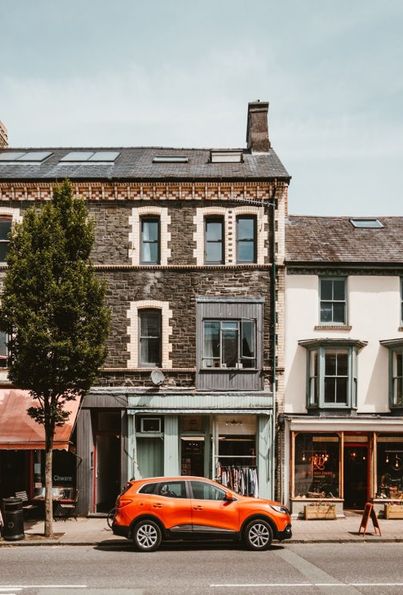
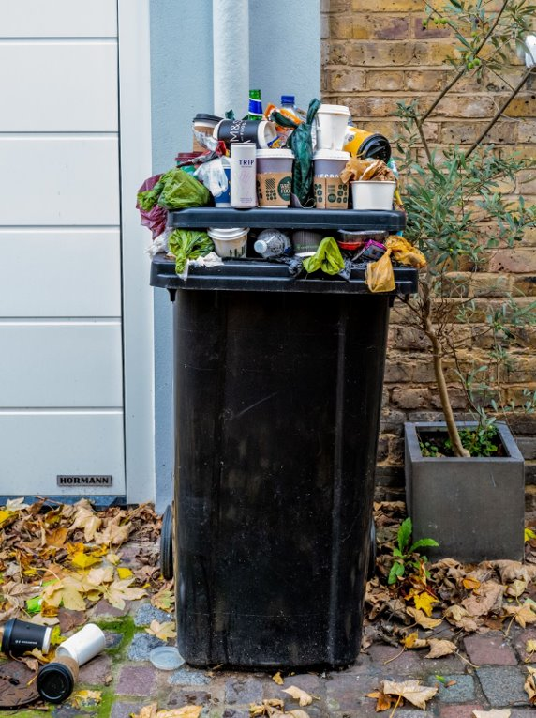
Energy
& Buildings
Transport
Water
Suppliers
Waste

Slide 8
More Formally
Scope 1 - Vehicle Fuel and Gas
Scope 2 - Electricity
Scope 3 - Buy, Sell, Throw Away

Slide 9
What emissions look like & common sources

Slide 10
Energy & Buildings
Lighting
Heating
Devices & Machinery
Cooking
Air Conditioning / Cooling

Slide 11
Transport
Staff commuting
Customer travel
Business travel
Owned vehicles
Subcontractors
Flights & Trains

Slide 12
Suppliers
Anything you spend money on
Ingredients
Products
Packaging
Services you purchase
Services you sell
Buy, Sell Or Throwaway

Slide 13
Waste
Raw Materials:
Glass
Paper
Cans
Food Waste
Processed goods:
Products made,
Returns

Slide 14
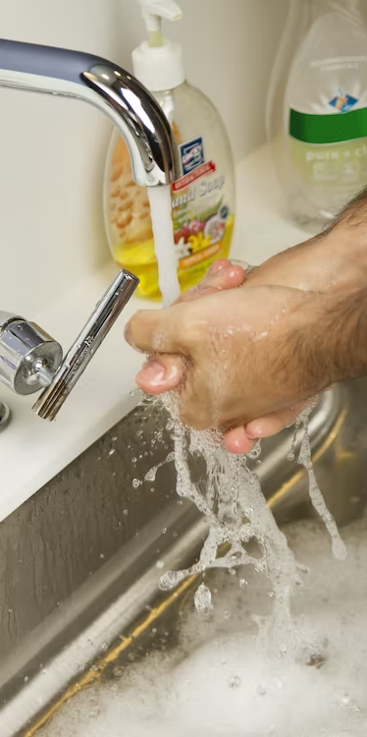
Water
Toilets
Cleaning
Washing machines

Slide 15
Overview of measurement

Slide 16
It’s a Scale
0%
20%
40%
60%
70%
80%
95%
100%
0%
General Guidance
Spend Based
Activity Based
100%
No measurement
Wait for tech and data to improve. 3 / 5 years away
Your Journey

Slide 17
Emissions Examples

Slide 18
Energy: Activity Based
20,000kWh on Electricity
1kWh = 0.21kg
Total is 4,246kg CO2e, or 4.2 tCO2e

Slide 19
Transport: Activity Based
4 Members of Staff
8 miles each
5 Days a week, 48 Weeks a year
~15,360 Miles a year
Small Petrol Car: 3.2t
Electric Car: 1.1t
Train: 0.8t

Slide 20
Sandwiches: Spend Based
Currently they spend £20,000 a year on meat for Sandwiches and lunch items.
This is around 12 Tonnes CO2e

Slide 21
Sandwiches
Swapping to a new menu design, they have more vegetarian options available.
£15,000 Veg 2.8T
£5,000 Meat 2.4T
12 down to 5.2
7 Tonnes Saving!

Slide 22
Where to Start:
Actions

Slide 23
Energy & Buildings
Install Solar Panels
Install LEDs
Get a smart plug
Schedule your usage - timers
Insulate if possible!

Slide 24
Transport
Get an eBike
Get an eCargo Bike
Join a Car Club
Salary Sacrifice Scheme
Go Electric
Lobby the council for more infrastructure

Slide 25
Suppliers
Can you repair, reuse or refurbish used goods from someone else to resell?
Do your suppliers have strong sustainability policies? Pick 3 and check!
Make a list of your sustainability actions and make it public!

Slide 26
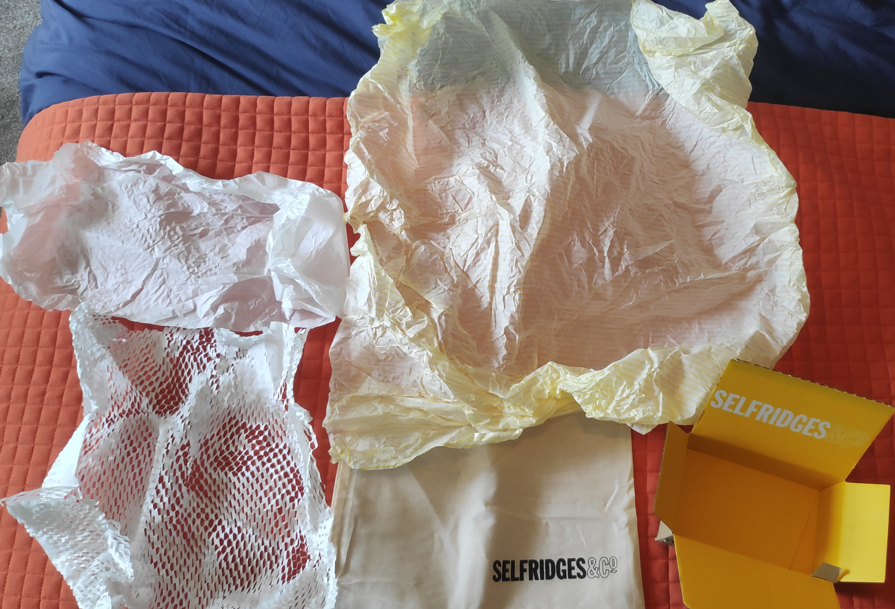
Suppliers: Packaging
Not just about the packaging! What are you putting inside it?
Reduce, reduce, reduce
Delight customers with thoughtful unboxing experiences
Reuse existing packaging

Slide 27
Waste
Segregate Waste
Reduce waste produced
Measure waste produced
Work with a waste management company
Work with suppliers to reduce excess packaging
Do other businesses want your waste?
Recycle, if you have to

Slide 28
Water
Get free water saving devices from your supplier
Reduce usage down
Introduce monthly monitoring of bills
Install rainwater harvesting systems for greywater usage e.g. van washing

Slide 29
About Small99

Slide 30
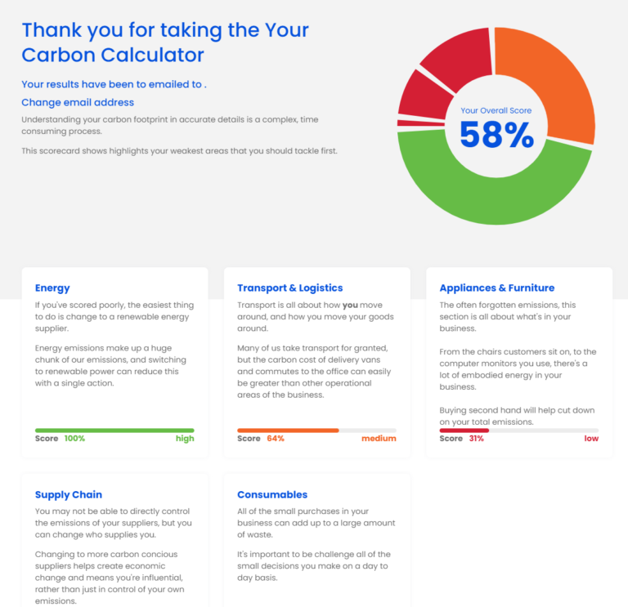
Net Zero Scorecard
3 minute impact of what your emissions look like
Not technical
Gets you started!

Slide 31
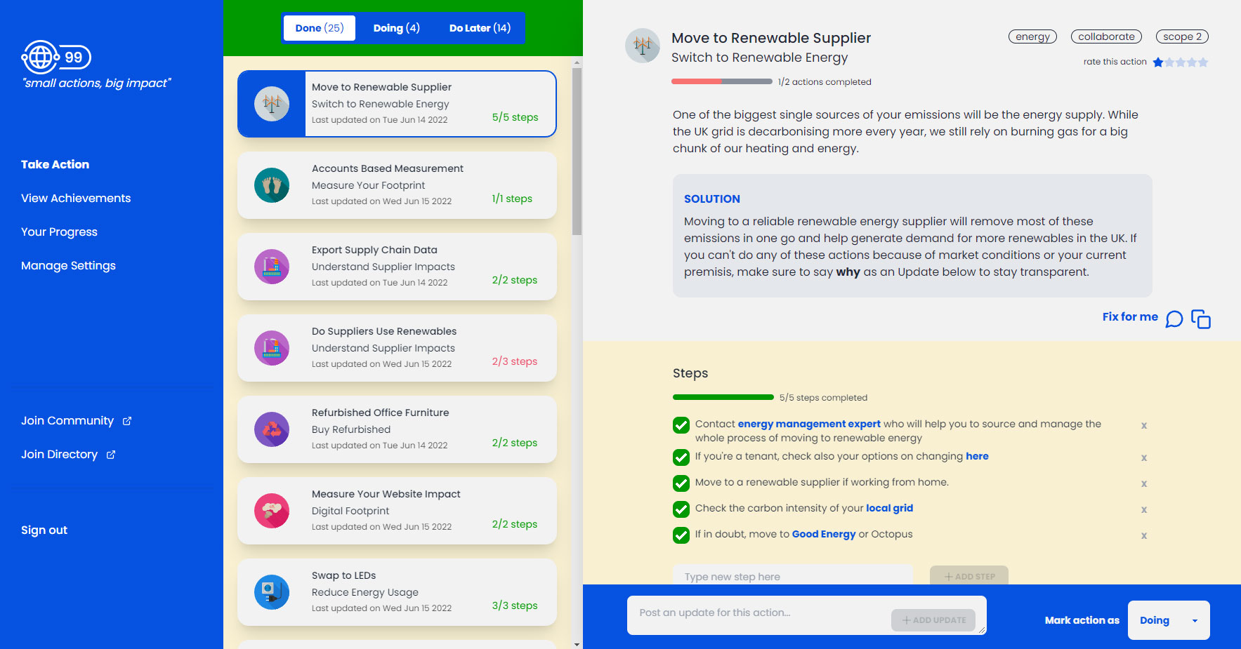
Hero
It provides a personalised pathway to Net Zero based on yourindustry.
Each action is broken down into simple steps.
As actions are completed, this automatically builds a sustainability page.

Slide 32
Workhops
Run workshops with
eBay
Univerisities
Councils
Chambers of Commerce

Slide 33
5 Mins
Now
What changes are within your control and you can make immediately?
Next
What can you do by June 2023?
Later
How can you start preparing for the future changes that are coming?
2023
2025
2022
2024

Slide 34
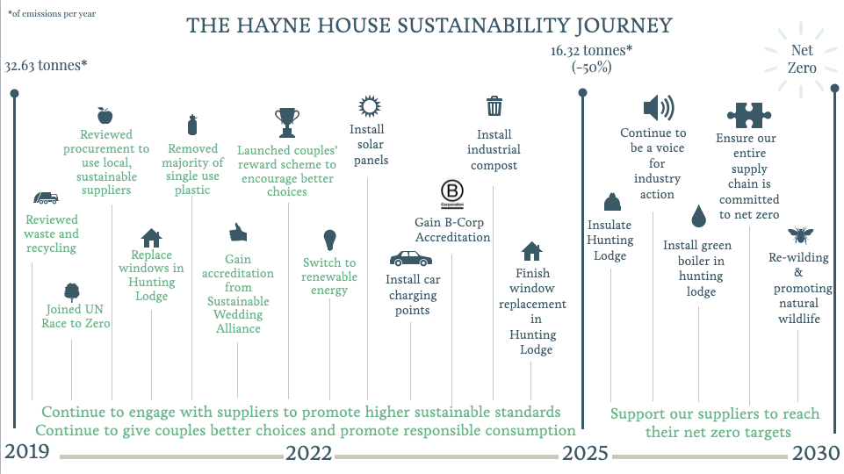

Slide 35
Q&A

Slide 36
Low-cost methods to reduce energy consumption
Bernadette McCullagh, Energy Advisor Green Business Programme

Slide 37
Energy efficiency advice
Bernie McCullagh
Business Energy Advisor
Coventry & Warwickshire Green Business Programme

Slide 38
Agenda
Energy crisis
Low-cost energy saving tips
Medium/higher cost
How to motivate staff
How to avoid energy wastage

Slide 39
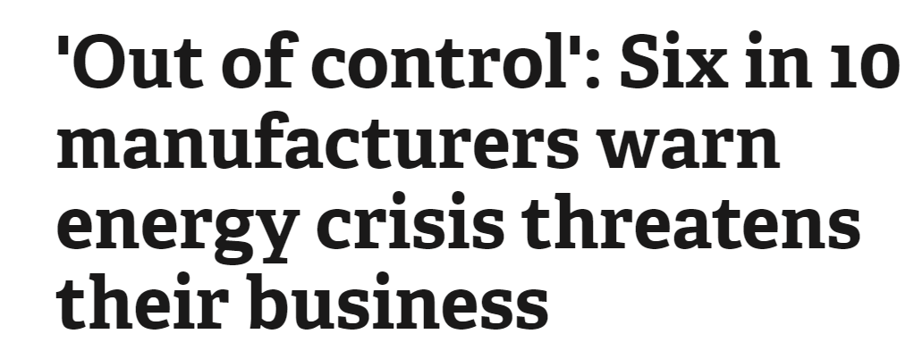
Energy crisis
Global issues; fuel & energy
Energy cost increases
Energy-Bill-Relief-Scheme 6 months (1st Oct – 31st March)

Slide 40
Low-cost energy saving tips

Slide 41
Turn off non-essential lighting/equipment
Replace lighting with LEDs & add PIRs
Set timers correctly OOH
Add a heat exchanger to reduce waste heat
Swap kettles for instant hot water taps
Add Power Factor Correction
Ask for a smart meter/energy audit
Add VSD to air compressor(s)
Potential payback within 1 year:

Slide 42
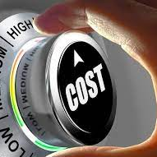
Medium/higher cost measures
Solar PV
BMS (Building Mgt System)
Equipment replacement
Heating upgrade
Insulation/glazing

Slide 43
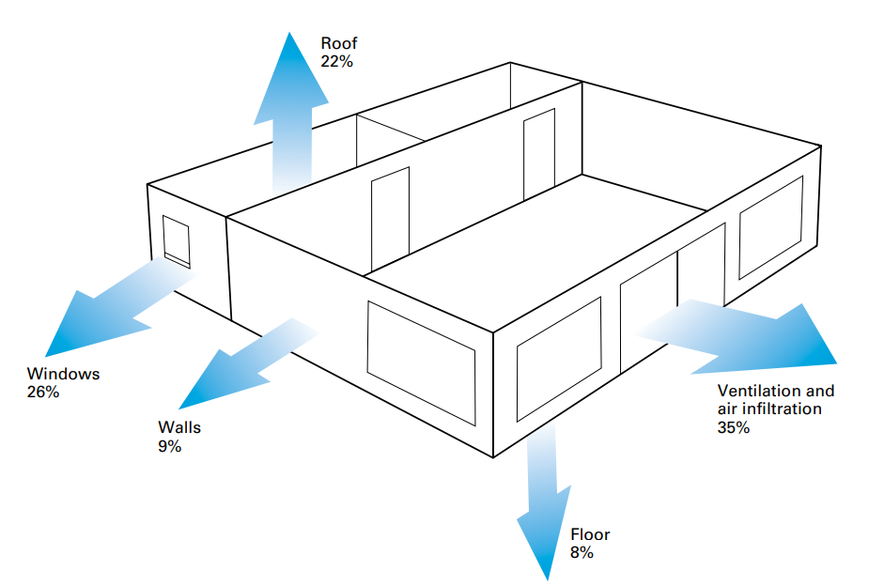
Building heat loss:

Slide 44
How to motivate staff

Slide 45
3 ways to motivate staff
3. Communicate
1. Get staff involved
2. Explain the benefits
Ask for suggestions.
Challenge staff: inventive ideas to save energy.
Ask staff to review their own work area or practices.
Consider including energy saving in JDs.
Benefits: cost savings, carbon footprint, healthier/more comfortable workplace.
Could help with retaining or attracting staff & enhances business reputation.
Save energy at home / in the workplace.
Link to campaigns i.e. Big Energy Week, World Environment Day etc.
Monitor energy use and communicate achievements.
Encourage new ideas, refresh messages. Incentives?

Slide 46
How to avoid energy wastage

Slide 47
UK businesses will waste enough energy in 2022 to power Greater London for more than seven years! Source: eEnergy based on government data, including the latest UK energy statistics (DUKES).
Specialists estimate that, on average, 30% of all purchased energy is currently wasted in commercial buildings, alongside manufacturing and educational facilities.
Really evaluate your bills
Do an out of hours energy check
Can auto-shut off be incorporated?
Have staff got any suggestions?

Slide 48
Carbon Trust sector-specific energy saving guides & other advice:
Ofgem/energy-advice-businesses
CitizensAdvice/your-small-businesss-energy-supply
Retail
Hospitality
Manufacturing
Office
Events
Warehousing & logistics
Creating an awareness campaign
Energy-Bill-Relief-Scheme
EnergySavingTrust/business-advice

Slide 49
Summary:
Turn off!
Ask for a smart meter
Get staff involved
Check your bills
Book (or conduct) an audit
Ask for help & focus your investment!

Slide 50
Q&A

Slide 51
How to motivate and engage your staff
Dr Sarah Otner
Senior Lecturer in Organisational Behaviour at Kingston Business School

Slide 52
Green funding opportunities
Sara Ballinger
Business Advisor
Green Business Programme,Coventry City Council

Slide 53
Green Business Programme
Sara Ballinger
Business Energy Advisor

Slide 54
Agenda
GBP support
Energy audits
Further support

Slide 56
GBP support
COVENTRY & WARWICKSHIRE
GREEN BUSINESS
PROGRAMME
A free of charge
energy audit, worth £840
Lighting
LED, controls, sensors
Recycling and waste
compactors, balers
and crushers
Ventilation
fans, distribution
We may be able to offer eligible businesses grants of between £1k and
£20k to fund up to 40% of energy efficiency measures.
Insulation
Heating
Replacement boilers/ burners, install heat pumps
N.B. first come first served, if and when any further funds are confirmed
Renewable
technologies
Refrigeration
Compressors

Slide 57
Wider benefits
Green Business Programme is part of
SMEs engaged in the programme experience a variety of benefits, namely:
Started in
2016
Reduced energy bills and maintenance costs
Reduced carbon emissions
Reduced waste disposal costs
Improved working conditions
Increased competitiveness, profitability,
and efficiency
ERDF funded scheme

Slide 58
Energy audit process
COVENTRY & WARWICKSHIRE
GREEN BUSINESS
PROGRAMME
We attend:
a site visit is conducted at your business premises by one of our Business Advisors
We discuss:
operating hours, number of staff, age of building etc
We review:
your energy bills for the last 12 months
We identify:
areas or items where efficiency improvements can be made: heating, lighting, insulation, machinery etc.
We explain:
how the programme works, how to claim, etc
We deliver:
an energy audit report which includes analysis of current energy use alongside energy efficiency recommendations; the report and also identifies grant value and payback periods for each recommendation.
We support you:
your allocated Business Advisor will offer support and advice throughout the whole process

Slide 59
Energy audit benefits
Carbon Trust 10% savings: basic energy management actions
Payback periods of circa 2 years for solar PV (due to the current energy crisis)
Identify any energy wastage
Builds an internal business case
Since 2018,
30 events have been hosted by the programme

Slide 60
Energy audit examples
External audit costs v GBP/range & quality
Company X initially requested solar PV; during visit additional recommendations made (i.e. lighting, sensors, heating, air compressor, controls, PFC, insulation)
Company A (retail): £43k cost & 13t carbon savings
Company B: (solicitor): £6k cost & 4t carbon savings
Company C: (manufacturing): £23k cost & 11t carbon savings
Case study: GRM Consulting podcast (see website for details)
Since 2018,
30 events have been hosted by the programme

Slide 61
Business Sustain
We help our clients with:
Environmental Management advice
Registers of environmental and health and safety legislation and legal compliance audits
Support to achieve and maintain accreditations i.e. ISO14001
UK-wide and non-SME support
Since 2018,
30 events have been hosted by the programme

Slide 62
Tel: 02476 972 026
businesssustain@coventry.gov.uk
www.coventry.gov.uk/businesssustain
Business Sustain carry out a questionnaire to establish legislation that is relevant to your business, and provide a concise summary via a web portal.
Any changes to legislation will automatically update all clients’ registers instantly.
2023 legislative change due:
Environmental legislation ‘Producer Responsibility’: relating to packaging that your organisation handles.
The current threshold is 50 tonnes a year, with a turnover >£2m: the govt is reducing the threshold to 25 tonnes.
There will be more packaging categories and additional data requirements.
They will include more details of this topic in a future seminar or webinar.
Since 2018,
30 events have been hosted by the programme

Slide 63
GBP contact details:
Coventry & Warwickshire Green Business Programme:
greenbusiness@coventry.gov.uk
Since 2018,
30 events have been hosted by the programme

Slide 64
Q&A

Slide 65
Final
Q&A and discussion

Slide 66
Thank you all for joining!
The presentations and a recording for this webinar will be sent out to you shortly.
Please take a minute to complete our survey to let us know how we can improve our events.

