Slide 1
Coventry HAF Spring Fun 2023 Provider briefing sessions 23rd February & 1st March 2023

Slide 2
Providers*
All Saints C of E Primary School
Aptitude
Ascension Dance Company
Barr’s Hill School
Cardinal Newman Catholic School
Canley Community Centre
Coventry Boys and Girls Club
Coventry Outdoors
Coventry Rugby
Cre8fun
Creative Optimistic Visions
Culture Coventry Trust
CV Life
Edgewick Primary
Empowr-U/Energ!se
Epic Academy/SCCU
Feeding Coventry
Guardian Ballers
Guiding Young Minds
Highly Sprung
Holbrooks Community Care Association
Holy Family Primary School
My Activities
Onside Coaching
PlayPals (St Christophers)
Rising Stars
SDH Academy
St John the Divine Church
Sky Blues in the Community
Staffordshire Winter Sports Club (Planet Ice)
Vanny Radio
WATCH/Hillz FM
*In addition, some providers delivering in partnership with other organisations not listed here

Slide 3
Spring Fun 2023 overview
c. 90 (tbc) different activities, clubs, experiences, diverse programme across Coventry – delivered by c.32 providers
Continued momentum of Coventry HAF - target of 2,800 beneficiaries (up by c.30% on Spring Fun 2022 figure of 2,130) and continued increase in quality standards
Supported by Coventry Building Society

Slide 4
Quality standards: 2023+
Funding where continued track record of the following factors:
Safe and inclusive environment – safeguarding, additional needs/SEND, insurance (on time) etc.
100% or as close to 100% attendance as possible
Reasonable finances – cost/per child/hour
Anchored to the local community – all year involvement (e.g. school, community groups etc)
Matches geographical profile of eligible children
Quality engaging and enriching activities
Food provision meets School Food Standards

Slide 5
Quality standards: 2023+
Funding where continued track record of the following factors:
Nutritional education for children/young people (including food preparation)
Nutritional education for families (including family cooking sessions)
Support to, and engagement with, families
Continued improvement and development of HAF agenda
Engagement with children, young people and parents/carers about what activities they would like to see offered moving forwards
Responsiveness to, and partnership with, the HAF team – including meeting deadlines

Slide 6
Coventry “HAFF” quality framework
Culture
Activities
Activities should be enriching, engaging, exciting, developmental and diverse
Support for Families
Activities should have signpost and engage families with support
(e.g. cost of living information). Develop plan improving provider engagement with families.
Food
Provision
Meals should be hot and nutritional.
Snacks and drinks should be healthy.
Ensure deliverers who are less strong on food are partnered with approved food providers.
Hospitable
Each activity should be safe, inclusive (SEND inclusion session, re), friendly, welcoming, professional.
Food
Education (parents)
Activities should have nutritional (food) education for parents/families embedded within them
Food
Education (children)
Activities should have nutritional (food) education for children embedded within them

Slide 7
Next steps*
Thank you for Spring Fun EOIs/applications – we’ve prioritised these
We will move onto consideration of Summer Fun and Festive Fun applications next, where we haven’t got back to providers
Grant Aid Agreements (Spring Fun) sent out - please sign/return these ASAP to enable payments to be progressed
Delivery Plan – on line – to be completed by 17th March
Risk Assessments – to be completed by 17th March
Teams sites – please upload information
Training: book onto on-line training (safeguarding, managing challenging behaviour, cost of living etc.)
Liaise with your HAF team link about any challenges/support to achieve HAF quality standards etc.
*See go-live dates in Marketing information

Slide 8
Information in Application Forms
Information in application form gets directly pulled through to:
HAF booking system
HAF printed brochure
HAF web-directory
Accuracy at this stage minimises noise for providers and HAF programme team when brochures and sent out and booking goes live etc.

Slide 9
HAF programme marketing
Marketing assets sent to providers (27th February)
Early prompt to HAF school champions & Council/partner stakeholders – including translated letters (1st March)
Target letters and brochures land on door-mats (16th March)
Spring Fun promo video goes live (11th March)
Spring Fun promo-video played at CCFC home game (11th March)
Target bookings go-live (16th March)
Texts and emails to parents/carers (mid-March to mid-April)
Web pages refreshed including your “adverts”/web-directory (13th March)
Electronic copies of letters and booklets to every school – HAF champions (14th March)

Slide 10
HAF programme marketing
Brochures available at libraries, family hubs and other venues (15th March onwards)
Further communications to HAF school champions & Council/partnership staff who work with children & families (15th March)
Marketing on Council screens throughout Coventry (13th March onwards)
Further text and email prompts to parents/carers (throughout March)
Social media (Facebook) activity (throughout March)

Slide 11
Provider marketing
Strong awareness of HAF marketing - including Coventry HAF webpages (google “Coventry HAF”)
Maximising use of HAF team/central marketing approaches and assets
Proactive marketing of clubs and activities (word of mouth, existing contacts, social media, flyers, radio, face-to-face, websites, media, schools etc.)
Good image/video capture (e.g. close-ups of children’s faces enjoying activities, gender and ethnic diversity, showing groups of children, venue etc.)
Image/video capture posted on social media, used for future marketing and made available to the HAF team for wider HAF marketing and promotion

Slide 12
Improving attendance
Attendance at Festive Fun 2022 was up 30% compared to Festive Fun 2021.
Impact of sickness, but this meant that for every 100 places that the HAF programme had bought, 32 were not taken up
This meant that if an activity planned cost HAF £20 per child per hour, in reality it cost £26.40 per child per hour
Some HAF areas (local authorities) pay based on performance (i.e. only pay for the numbers who actually attend) and this is an option for Coventry
Coventry would rather a collaborative approach with agreed approach and standards for how we approach attendance

Slide 13
Improving attendance
Clear narrative to parents/carers about attendance (extract from letter to parents/carers)
On the basis of historic no-shows, the HAF team will set your bookable places at 125% (except for trips). (e.g. funded for 20 places - set at 25 places; funded for 30 places – set at 38 places; funded for 40 places – set at 50 places etc.)
Children/young people (HAF) that you have an on-going relationship may be more likely to be committed to attend.
Can consider the option of designating some of your places as “private” (i.e. not available to book universally). If you do want to chose this option, the condition is that you will need to book these children on yourself (supported booking) and without delay
“What if my child has booked onto activities and cannot attend? We understand that there are times when a child has booked onto activities, but subsequently cannot attend. Please can you let us know about this as soon as possible. Without this communication another parent/carer cannot take up this HAF activity for their child, which is a missed opportunity. If you have booked and realise that your child cannot attend, please enable another child to attend by either: letting the activity provider know, going to www.coventry.gov.uk/haf to cancel or by calling 08085 834 333.

Slide 14
Improving attendance
Regular prompts and communication with families
Before delivery starts and if not showing up
Texts/messages/whatsapps, phone calls etc.
Inclusive and affirmative language and communications

Slide 15
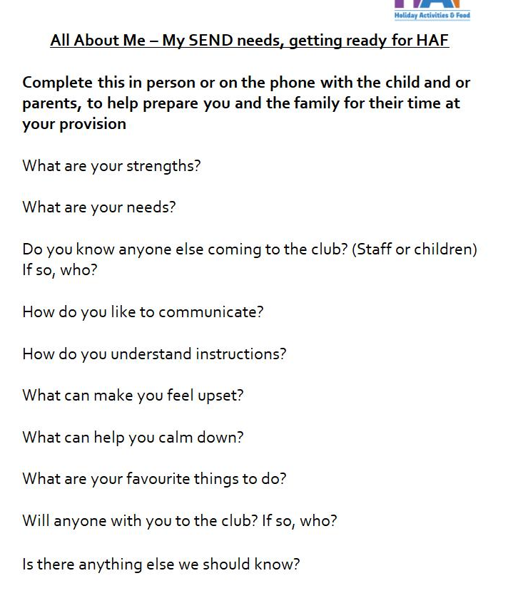
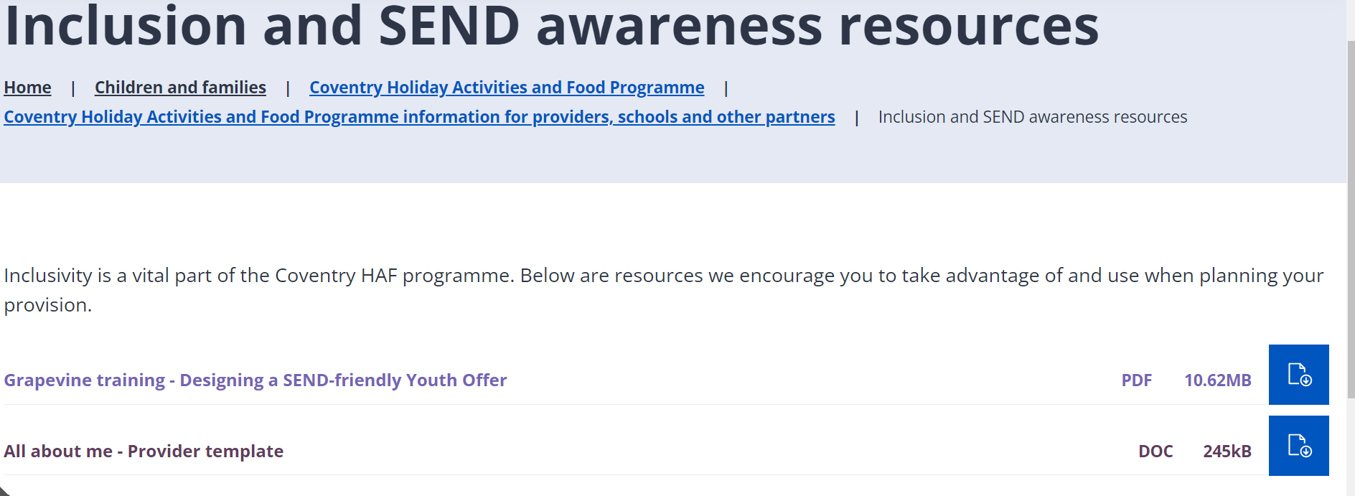
Inclusion and SEND
Use the “All About Me” template – where parent/carer identifies additional needs as part of booking
Contact your HAF team link if additional support/staffing is needed to enable a child/young person with additional needs to attend
Review the Grapevine awareness training

Slide 16
Supporting Families
Context of cost of living crisis and challenges that families are facing
Making the most of positive HAF experiences to raise awareness with families of the range of support that is available in Coventry that they can access

Slide 17
Supporting Families
Every organisation will be sent Z-cards (“wallet sized”) and leaflets to hand out to every child/parent who attends
Consider giving these out as part of a pack of any other freebies

Slide 18
Supporting Families
Family help and support leaflet

Slide 19
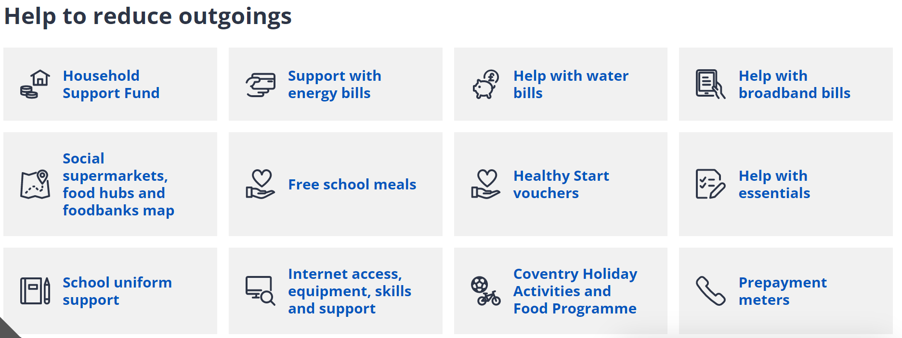
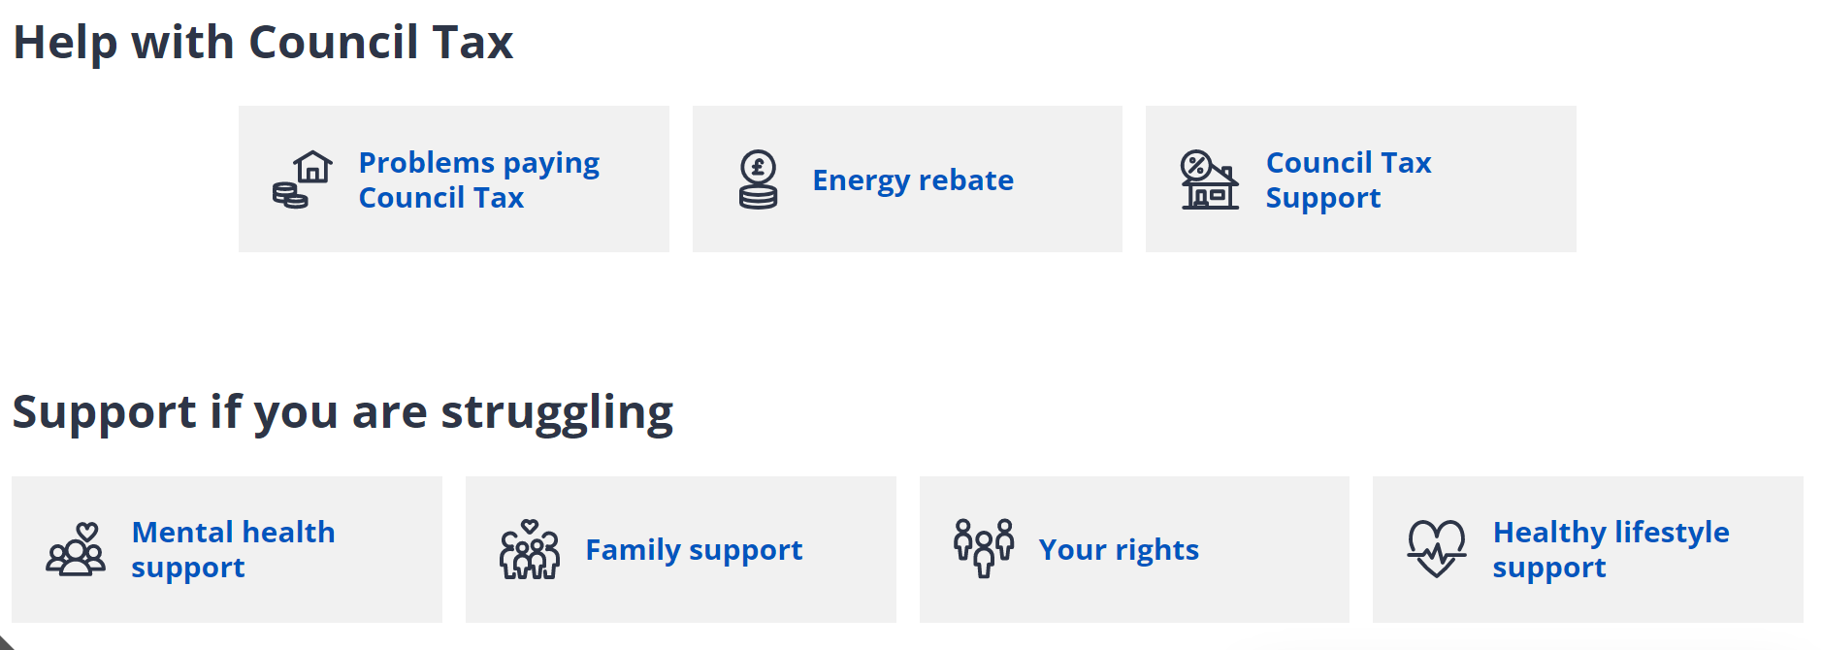
Supporting Families
Send the following links to parents/carers in your communications (texts/whatsapps, emails etc.)
Help with cost of living: https://www.coventry.gov.uk/costofliving

Slide 20
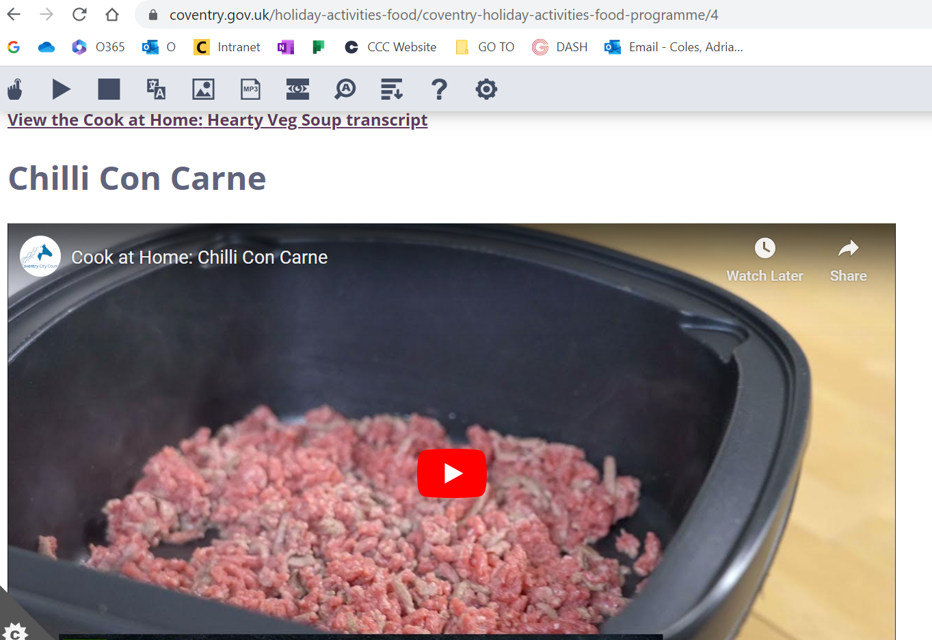
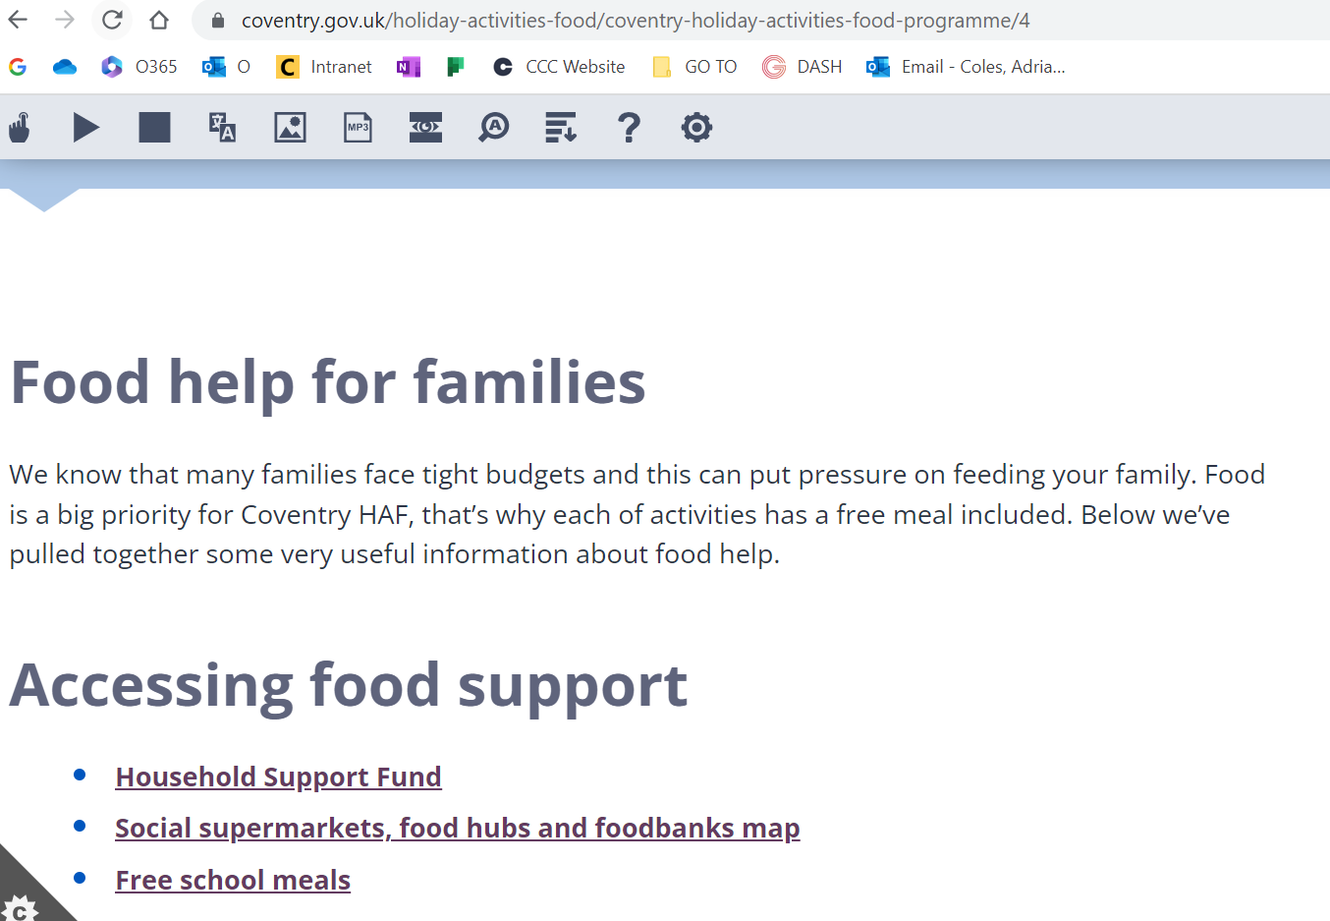
Supporting Families
Send the following links to parents/carers in your communications (texts/whatsapps, emails etc.)
Food help for families: https://www.coventry.gov.uk/holiday-activities-food/coventry-holiday-activities-food-programme/4

Slide 21
Supporting Families
Other forms of engagement with families include:
Inviting them to arrive early for session
Performances/show and tell at the end of a session or week
Informal coffee/tea with other providers available in a low-key way to talk

Slide 22
Delivery in the Easter holidays
Visits from HAF team and other colleagues
Please let your HAF team contact know of any issues that arise during delivery (e.g. parents/carers, children, attendance etc.)
Image capture – photographs/video clips (number of these shared with HAF team has dropped in recent holidays)

Slide 23
Post-delivery – key dates
Friday 28th April - final accurate attendance data, completion of provider feedback form, submission of Statement of Grant expenditure and final invoice
Tuesday 9th May – Provider Celebration Event (9.45am for 10am start through to 11.30am/12pm)
Wednesday 10th May – Friday 19th May – Provider de-brief and summer meetings

Slide 24
Payments (second payment)
From Provider Guide:
Following delivery, providers can submit an invoice for the outstanding amount (i.e. up to 15%). If you have an underspend, your outstanding amount may be less than 15%.
The grant is offered on a cost-recovery basis only. Any monies not spent in line with the grant aid agreement are therefore returned.
Payment of the second (up to) 15%, will be made where providers have demonstrated delivery and partnership working. This includes the following:
the delivery plan has been completed as per the template and has been received no less than 1 week prior to delivery
risk assessments have been completed and submitted on time
attendance at provider orientation and celebration event
accurate attendance data has been submitted
an accurate expenditure report has been submitted
completion of provider survey and
the provider has made every effort to maximise attendance.
It is not the expectation of the HAF team that grant will be held back or clawed back. If any of the above conditions have not been met, then the 15% (or a proportion of this) may not be able to be paid. If conditions in the grant aid agreement are not met, components of the first 85% may need to be clawed back. If this were the case proper dialogue will take place between the HAF team and provider and then the HAF team will decide on the appropriate and reasonable level of grant being held back or clawed back.

Slide 25
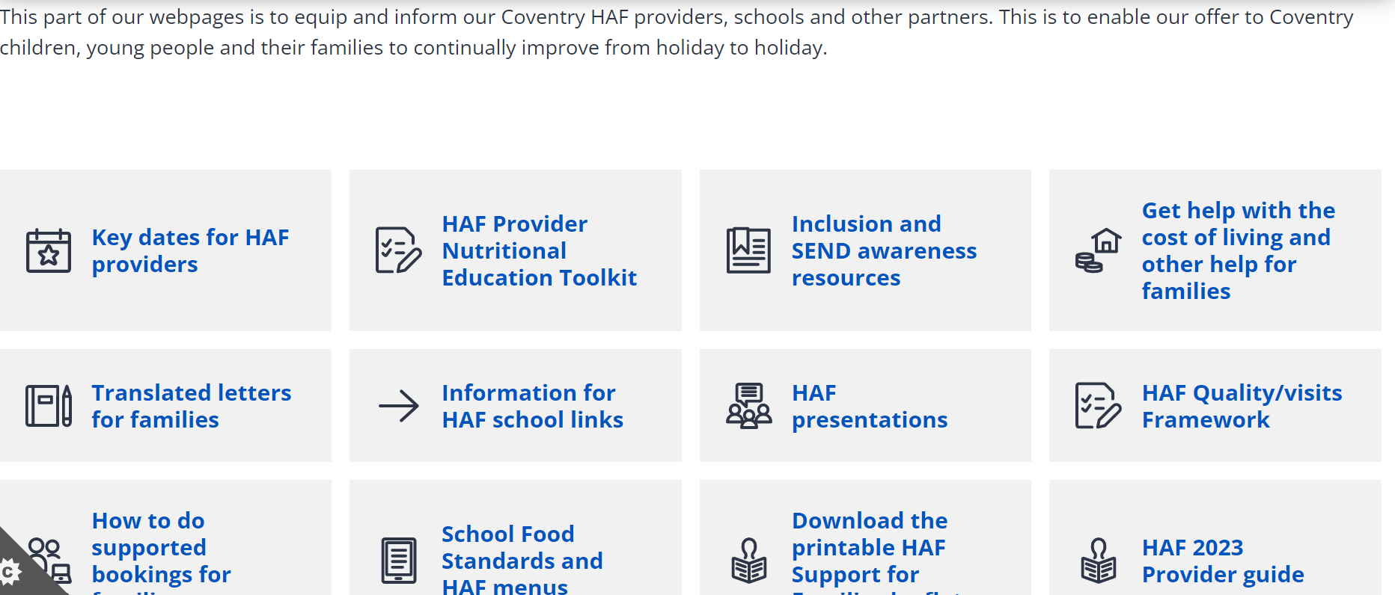
HAF web-pages – google Coventry HAF

Slide 26
HAF team
Every organisation has a dedicated link on the HAF team to build relationship with for any questions about your HAF delivery
Your HAF team link is: James Courtney, Stella Rogers or Lorna Holland (covering Daisy Hollingsworth's providers)
For email contact please use the HAF in-box: haf@coventry.gov.uk

Slide 27
Questions, comments and feedback

