Slide 1
Coventry HAF workshop

Slide 2
Starter activity
Write down on your label one fun activity you like to do in Coventry (Don’t show it to anyone)
Notes:
1 minute

Slide 3
What is HAF?
What do you know about HAF?
What does H, A & F stand for?

Slide 4
H – Holiday A – Activities F - Food

Slide 5
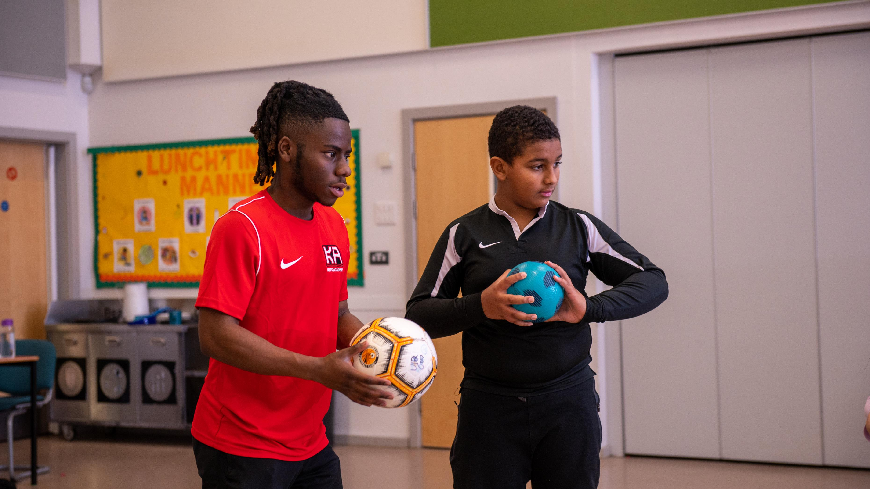
Memorable activities, through which we can learn new things and make new friends

Slide 6
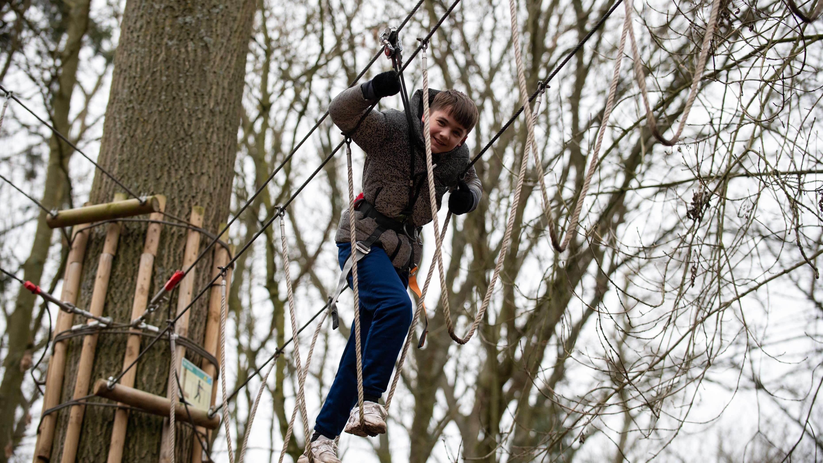
Clubs and activities all over the city and sometimes day trips all over the country

Slide 7
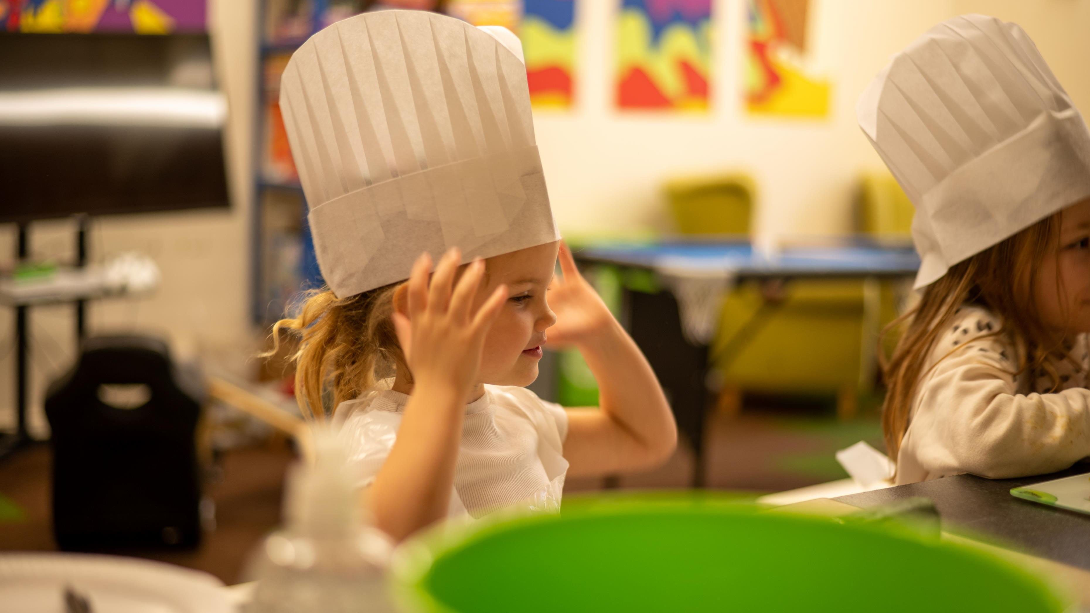
Learning about cooking and healthy eating (sometimes with family)

Slide 8
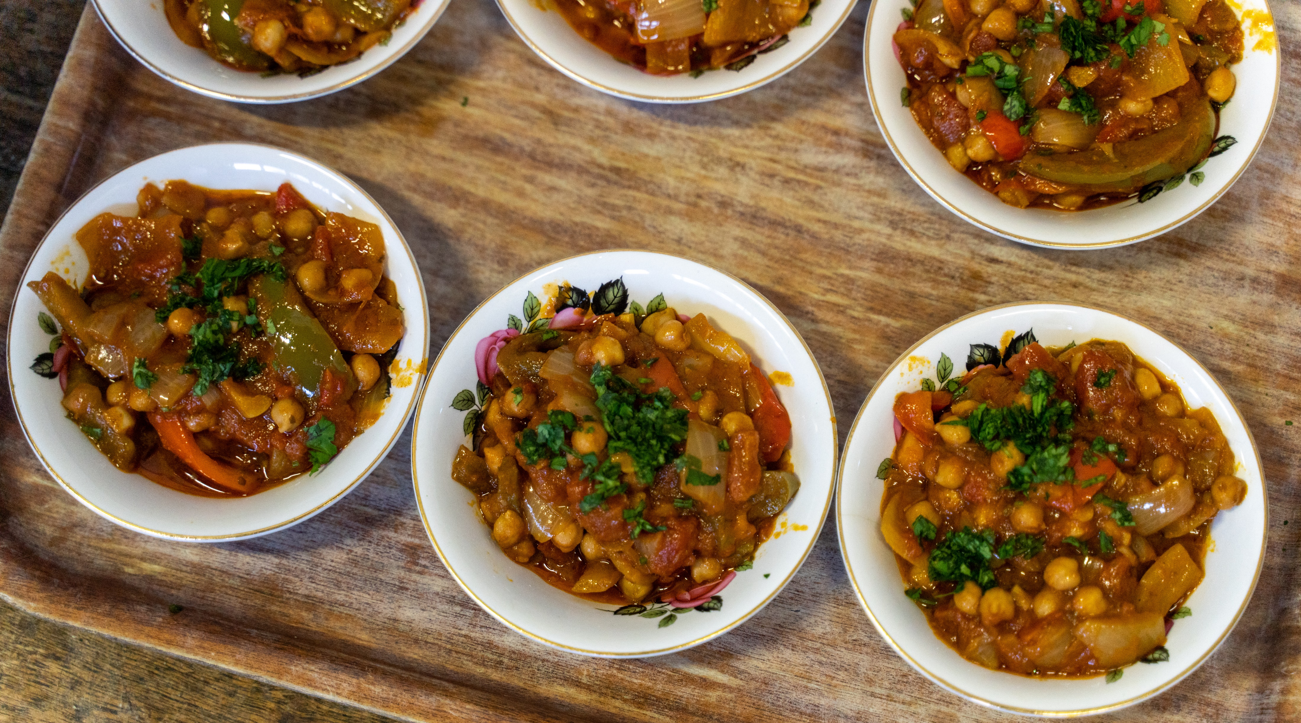
A hot, healthy meal – different every day, could be a trip to a restaurant, could be cooked by the children

Slide 9
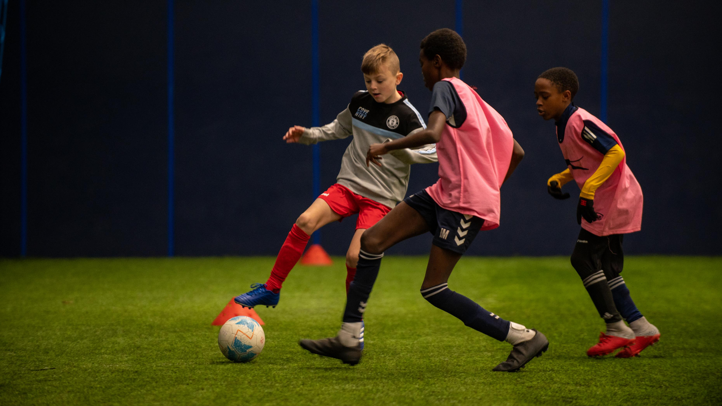
Being fit – exercising every day

Slide 10
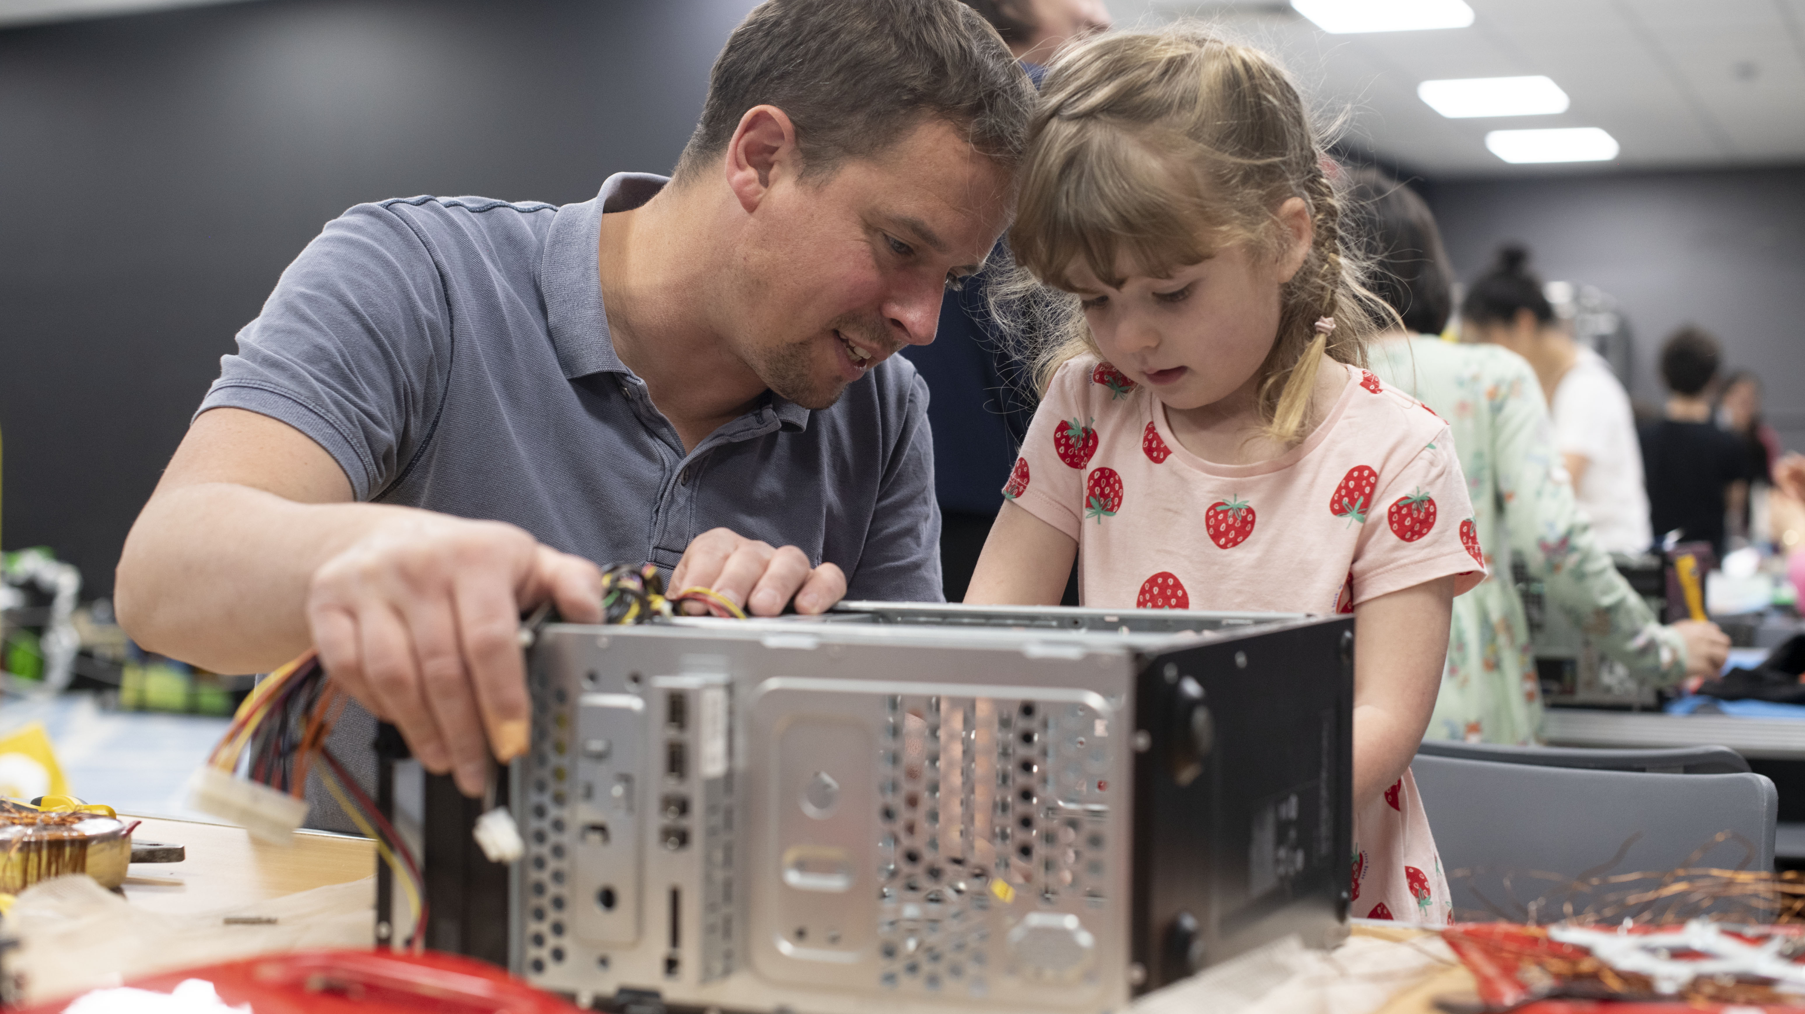
Helping families find support for cost-of-living challenges

Slide 11
HAF Festive Fun 2022
Notes:
Daisy – 2 minutes

Slide 12
Starter activity
Place the label on your neighbour's forehead (make sure they don’t look at it)
01
Stand up, move around the room, you can ask up to 1 question to each person with a yes/ no answer
02
Sit down when you think you know what your activity is
03
Notes:
Need to add a timer in

Slide 13
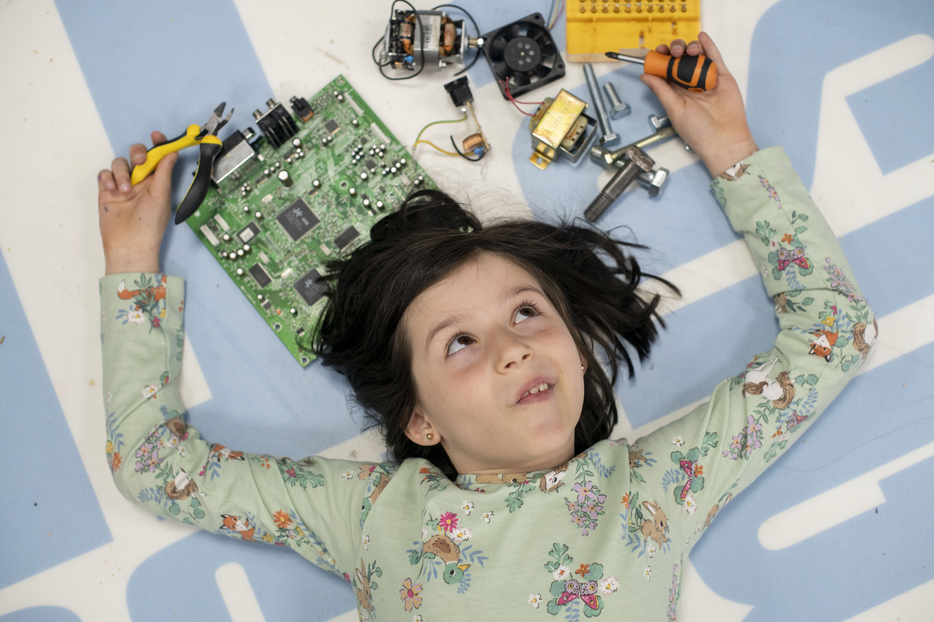
My dream HAF activity week
Imagine you a planning the HAF programme – what would you do?
Notes:
Daisy – explanation 5 minutes
Activity – 15 minutes
Pitch your activity as a group in a minute
Total 35 minutes

Slide 14
HAF week template
 | Monday | Tuesday | Wednesday | Thursday
Activity: | Outdoor forest camp: Archery/ camp building / rock climbing | Arts and crafts workshop and cooking class | Sports tournament | Trip to horse-riding stables
Food: | Jacket potatoes with choices of fillings and salad | Chicken or vegetable curry with rice | Make your own healthy pizzas with fruit kebabs | Sausage or vegetable sausages with mash and vegetables
One hour exercise: | Rock climbing | A one hour tennis practice | Multi-sport classes throughout the whole day | Taking part in the horse-riding lesson
Outcome: | New skills learned and teamwork | Learning how to cook healthy meals | Making new friends and teamwork | New experience and learning new skills
Pitch your week in one minute to the room

Slide 15
What have we learned today?

