Slide 1
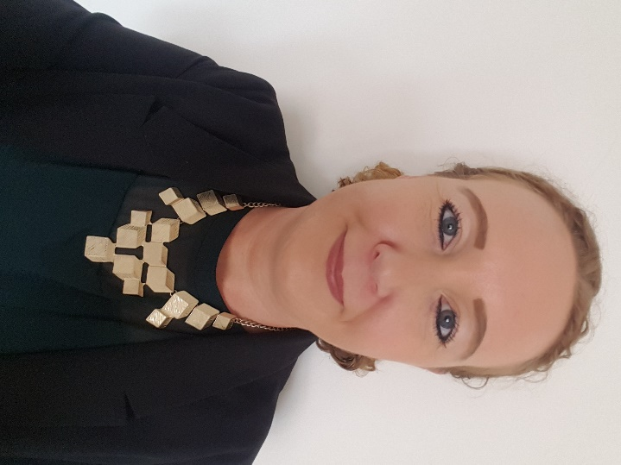
Green Business Programme
Bernie McCullagh
Business Energy Advisor:
Coventry City Council

Slide 2
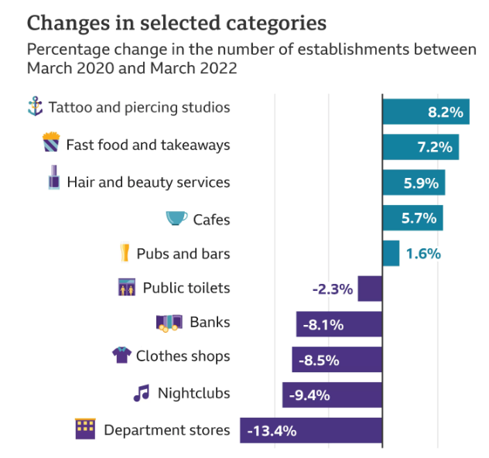
Business impacts: energy
Energy-Bill-Relief-Scheme
31st March 2023

Slide 3
Timing & grant
COVENTRY & WARWICKSHIRE
GREEN BUSINESS
PROGRAMME
Grants of between £1k and £50k to fund up to 40% towards energy efficiency measures.
Lighting
LED, controls, sensors
Recycling and waste
compactors, balers
and crushers
Ventilation
fans, distribution
Insulation
Free of charge energy audit, worth £840
Grant needs to be spent:
Heating
Replacement boilers/ burners, install heat pumps
Only 3-4 months left of EU-funding!!
Renewable
technologies
Refrigeration
Compressors

Slide 4
Eligibility criteria
COVENTRY & WARWICKSHIRE
GREEN BUSINESS
PROGRAMME
Are you eligible to access the Green Business Programme? What you need:
50%
12
Trading minimum 12 months. BUSINESS PREMISES
B2B
‹€50
Have an annual turnover of less than €50m
Have at least 50% of sales through business to business
(can be flexible)
Also, see WCC for B2C offer
Received no more than 200,000 euros of De Minimis public aid over a three year period
Employ fewer than 250 people
Operation not under a franchise business model
Located within Coventry & Warwickshire

Slide 5
Grant application process
COVENTRY & WARWICKSHIRE
GREEN BUSINESS
PROGRAMME
40%
1
2
3
4
5
6
7
Reduce energy costs/carbon/
reach Net Zero etc
SME registration form
Check eligibility - potentially refer to WCC
Energy audit: assessment of business premises
Recommendations & grant application
Offer letter confirming grant & start date
Project costs: claim back after work completed

Slide 6
Top-up grants
We can also potentially offer top-up grants to businesses we’ve already worked with, i.e.
You’ve received a grant offer but haven’t yet completed all of your claims:
add a new energy saving item in
Since 2018,
30 events have been hosted by the programme

Slide 7
Contact details:
Coventry & Warwickshire Green Business Programme:
Email: greenbusiness@coventry.gov.uk
Website: Coventry-Warwickshire-Green-Business-Programme
See also WCC:
Warwickshire.gov.uk/greengrants (B2C, micro businesses)
Since 2018,
30 events have been hosted by the programme

Slide 8
Any questions?
Since 2018,
30 events have been hosted by the programme

