Slide 1
Coventry Holiday Activities and Food Festive Fun 2022 Briefing: visits to HAF activities December 2022

Slide 2
Thank you
Thank you for your help with the Coventry HAF programme so far
Thank you for your help with visiting activities this Christmas school holiday (Festive Fun 2022)
In summer 2022:
c. 4,000 unique children benefitted (plus other family members) - up from approximately 2,000 unique children in summer 2021
c.17,000 meals provided
142 different clubs/activities
54 directly funded organisations plus over 50 other organisations were involved
93% would recommend to others

Slide 3
What is HAF?
Programme of activities and food – addressing holiday inequalities and holiday hunger in a context of cost of living crisis
Partnership approach - co-ordinated by Coventry City Council and funded by the DfE to March 2025 (Christmas, Easter and Summer school holidays)
HAF projects include: positive activities, a nutritional meal/food (normally hot), nutritional education for pupils and families* and signposting/information for families to wider services and support*
Eligibility criteria: school age children (reception to year 11 inclusive) and meet one or more of the following criteria: benefits-related free school meals, child in need, child protection plan, looked after, assessed (through an early help assessment) to be in financial hardship, part of the Ukrainian Family Scheme
To find out more about HAF, watch: What is Coventry HAF? Summer of Fun 2021 (scroll down to the Summer of Fun 2021 you-tube video)
*Face-to-face where possible, if not through leaflets or information on-line

Slide 4
What is the Christmas HAF offer?
Over 70 different activities/clubs to be delivered by 33 delivery organisations
Wide range of activities for eligible children this Christmas: pantos, Coventry City FC match day experiences, The Wave, Winter Wonderland, ice skating, festive ball, trips, horse riding/stables, afternoon tea with Santa, Santa’s Grotto, Santa’s sleigh, outdoor nativity, trampolining, swimming, skateboarding, basketball, multi-activity clubs, cooking, music, Christmas arts and crafts, Christmas parties, photography, DJ-ing, creative dance, football and lots more…
Activities take place: Friday 16th – Friday 23rd December
Bookings opened on Monday 21st November and within 24 hours approximately 1,000 unique children booked. Current figure up to c. 2,400 unique children booked on (1 week of activities compared to 6 weeks in the summer)
Activities are inclusive and 15 activities/clubs are particularly focussed on children with Special Educational Needs and Disabilities
Watch the: Festive Fun 2022 promo

Slide 5
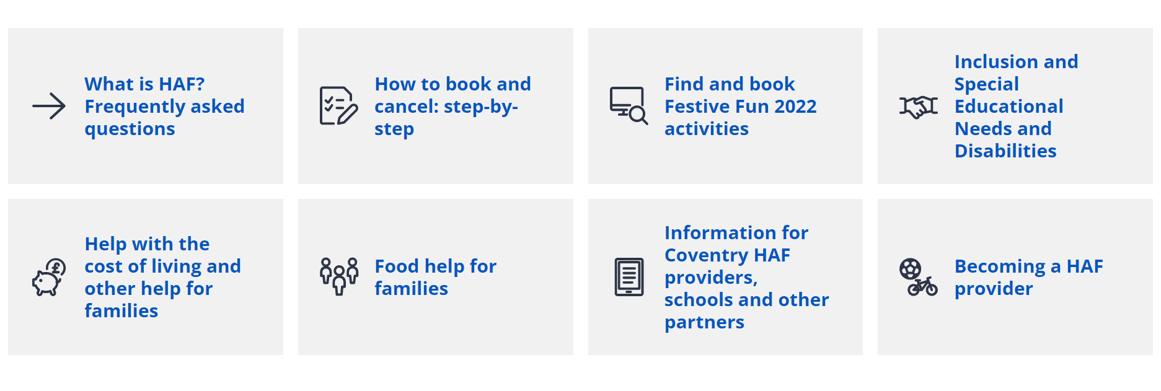
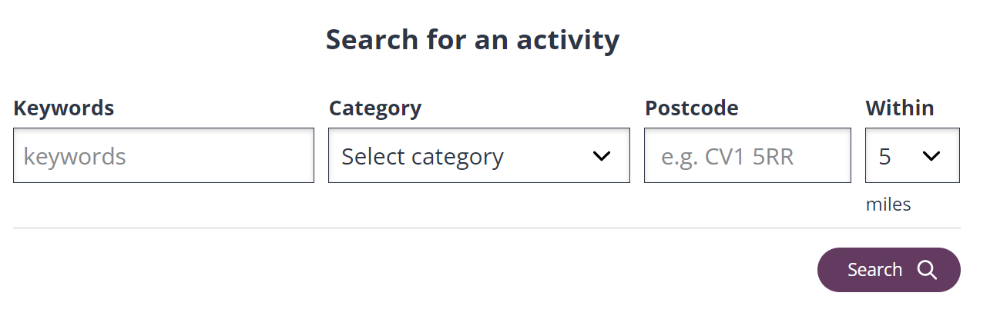
Coventry HAF landing page: https://www.coventry.gov.uk/haf

Slide 6
Purpose of HAF visits
To encourage and thank projects on behalf of Coventry City Council and the HAF team
To find out from activity leads and others at the activities what has been going well, any challenges they have faced and any improvements
To provide insights into the quality of provision being delivered in the context of the HAF quality framework
This is to enable the quality of activities to continue to be raised across Coventry HAF

Slide 7
Before your visit
The HAF team will contact every provider/club explaining our approach to visits, arrangements and the name of every visitor on Tuesday 13th December
Following this, please contact the provider/club directly to confirm when you will go and the arrangements for meeting up
Please read about the activity you are visiting by going to HAF activity searcher and typing the name of the organisation you are visiting in the “Keywords” searcher

Slide 8
Visit framework – HAFFF!
Providing insights into the following – through conversations with the activity leader,
staff/helpers, children/young people, parents/carers etc and observation:
Hospitable
(Culture, inclusion & health/safety)
Feedback
Positives
Challenges
Improvements
Families
(Food education, signposting,
cost of living)
Activities
(Creative, engaging, physical)
Food
(Provision, education for pupils & families)

Slide 9
Capturing your insights
Trialling a new visit template approach as part as continuous improvement/quality
Approach and template to be shared with providers and on HAF webpages
Spreadsheet has comments section plus scoring approach (Yes=2, Maybe=1, No=0 against simple questions)
Visitor scores are indicative and are looked at alongside HAF team perspective, feedback from families and from provider self-assessment and feedback.
Coventry HAF team reports on the total programme scoring to DfE (not naming or showing scores for individual activities)
After Festive Fun 2022 there will be a feedback meeting with every provider to discuss how FF22 went and to look forward to 2023 delivery

Slide 10
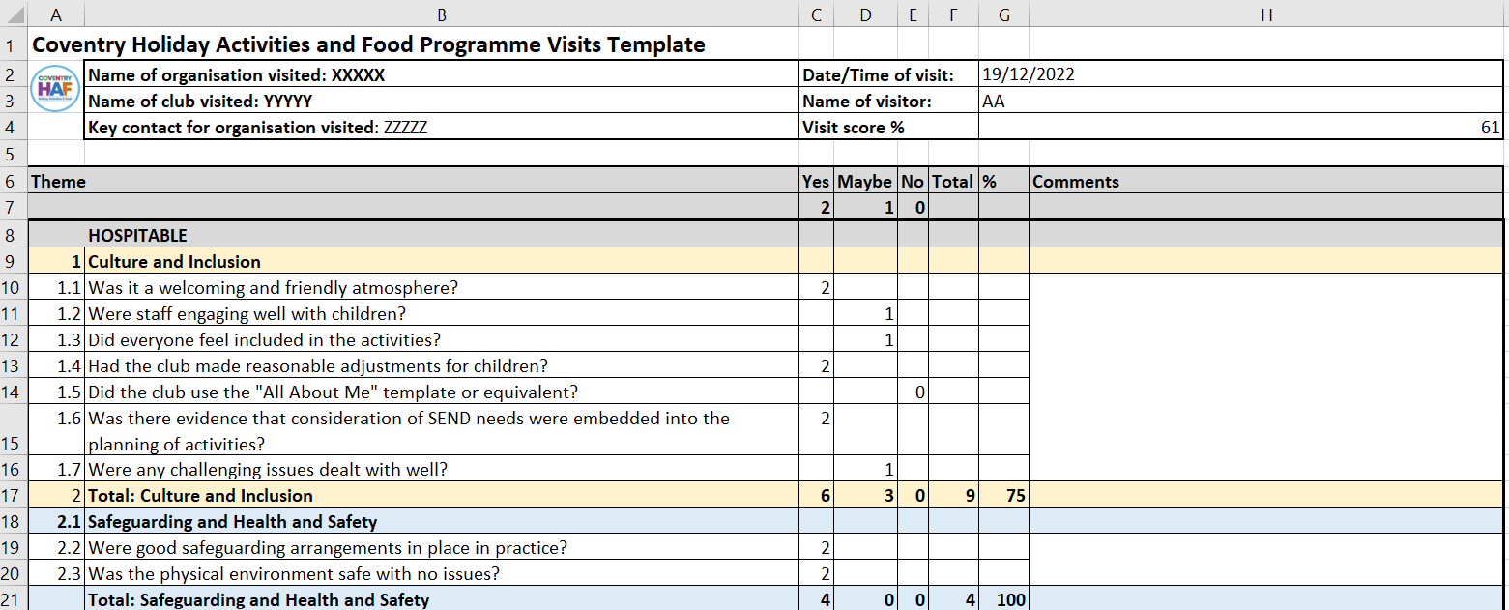
Visit Template - Hospitable

Slide 11
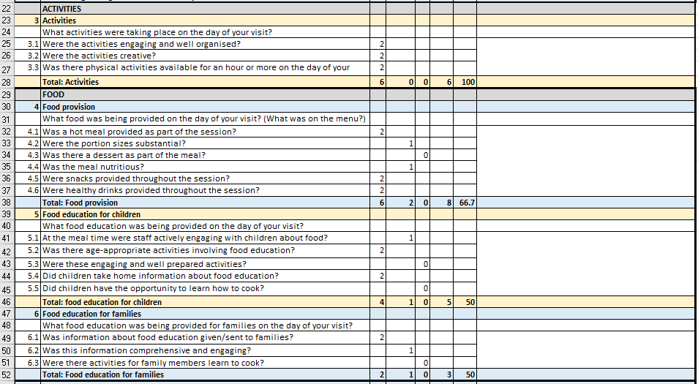
Visit Template – Activities and Food

Slide 12
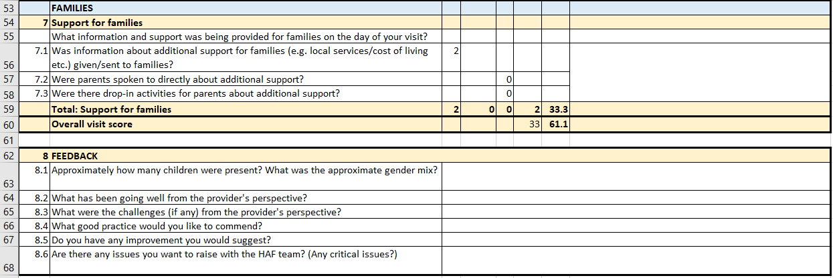
Visit Template – Families and Feedback

Slide 13
Capturing your insights
Please complete the template as soon as possible after your visit and send to hafprogramme@coventry.gov.uk
If you were to spot any critical issues (e.g. safeguarding, health and safety) raise these with the provider and report these immediately to: Lorna.Holland@coventry.gov.uk or Adrian.Coles@coventry.gov.uk (0771 222 9818).
De-brief meeting on 5th January, 1pm-1.30pm (MS Teams)
You are invited to come to our HAF celebration event on 2nd February (9am-12pm) in Friargate

Slide 14
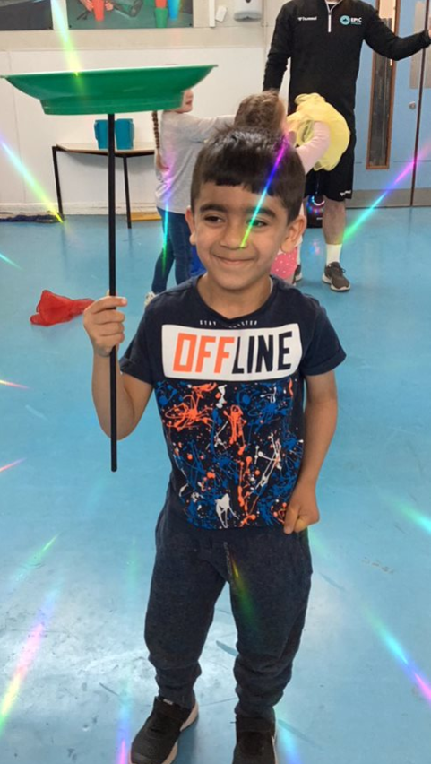
Questions
and
comments?

Slide 15
Thank you!

