Slide 1
Green Business Programme
Bernie McCullagh
Business Energy Advisor
Coventry & Warwickshire Green Business Programme

Slide 2
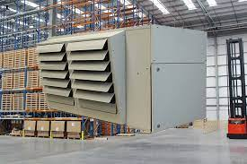
Agenda
Heating efficiency tips
Staff engagement tips
Funding & timing
GB Network

Slide 3
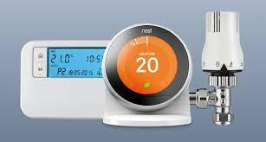
Heating efficiency top tips:
Simple controls, i.e. TRVs
Turn off/timers
BMS/smart controls
Insulation & draught-proofing
Suited to the space
Heat exchanger

Slide 4
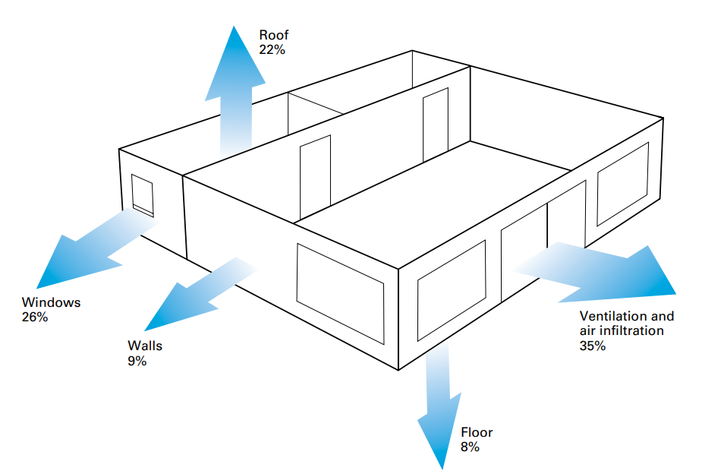
Building heat loss:

Slide 5
Staff engagement top tips:
a) Where possible, automate!
3. Positive messaging: achievements/goals
b) Explain the direct & indirect benefits

Slide 6
1. EU Green Business scheme
2 x funding options:
Still accepting applications
(new & top-ups)
£1k-£50k max & 40% intervention
Only 6-8 weeks left
SMEs in Cov & Warks
At least some B2B

Slide 7
2. WCC Green Business Recovery
Micro-businesses
At least 50% B2C
Trading before Covid
Applications up to June 23
Works completed by November 23

Slide 8
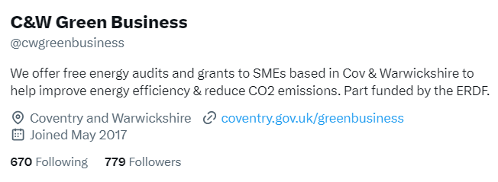
Green Business Network benefits
* Expert technical assistance
* Free networking events and webinars
* Free workshops with Coventry University
* Networking and supply chain opportunities
** Monthly e-newsletter
* Showcase your organisation’s eco credentials
** Share good practice & get up to date news via social media platforms
* Opportunity to speak at our webinars
* Use of the network logo for marketing

Slide 9
Further info & contact details:
Coventry & Warwickshire Green-Business-Network
Warwickshire County Council Business Green Recovery

