Slide 1
Gain A Competitive Advantage With Carbon Reduction
Notes:
All my notes

Slide 2
Housekeeping
Hello and Welcome!
Please turn your video off
Mute yourself to reduce background noise, but unmute to ask questions
You can also use the chat function to ask questions
This webinar will be recorded
There is a Q & A session at the end so please interact
The slides and the recording will be sent out to all the attendees
We will also send out a feedback form, please let us know how we did!

Slide 3
On Today's Agenda
Discussion Points
About me: Jonathan Howl
Why is carbon reduction needed for SMEs?
Energy Audit: The first step towards achieving carbon reduction
Energy efficiency measures and examples
Energy report and cost/carbon savings
Decarbonisation Net Zero Programme: Grants and support available
Q & A

Slide 4
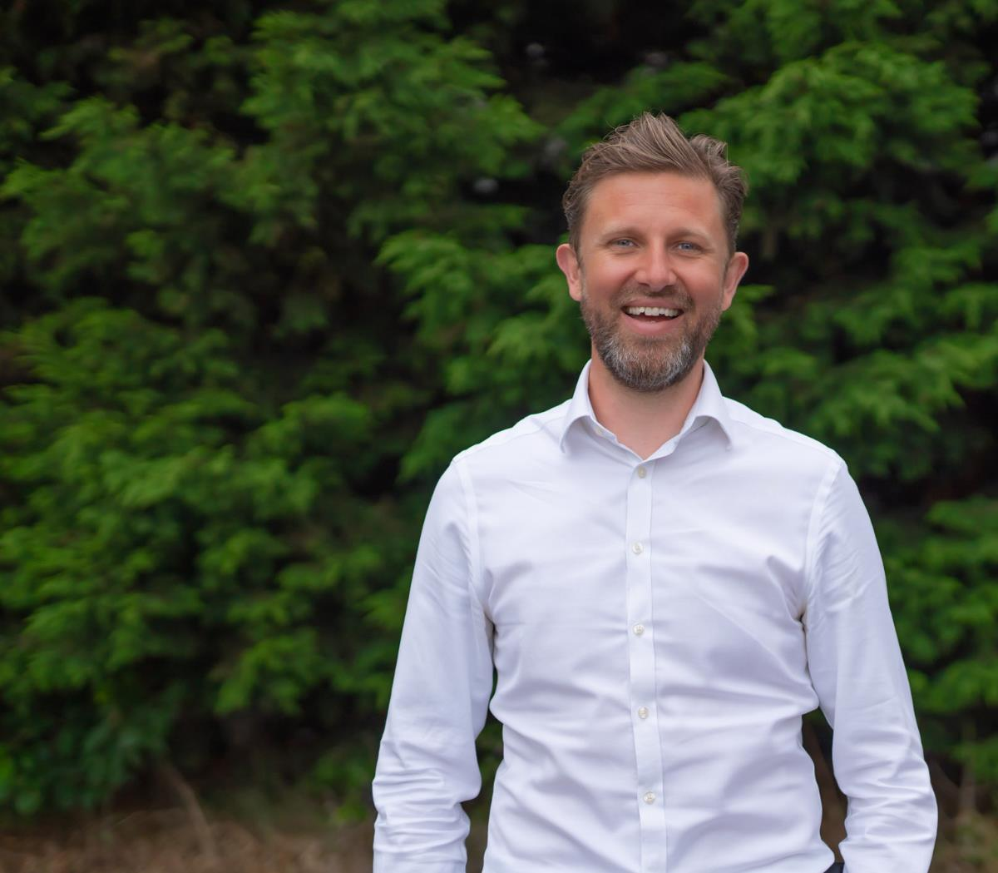
About me
Jonathan Howl
Energy Efficiency Advisor, CCC
Holds a BSc in Geography
MSc in Sustainability and Environmental Management
Practitioner IEMA member
22-year career in the telecoms and IT industries
Started working for Coventry City Council in 2021, since then Jonathan has helped over 200 businesses reduce their carbon footprint and energy expenditure

Slide 5
Why is carbon reduction needed
SMEs account for 99.9% of UK enterprises and are responsible for between 43% and 53% of UK business emissions (around one-third of total UK emissions). (Source Energy Trust Website
It is essential that all businesses play their part in combating climate change.
The energy price increase puts extra pressure on UK businesses, a carbon reduction plan can help businesses significantly reduce their energy bills and save thousands of pounds a year, and sometimes even a month!
Notes:
Also perception as a green business & win tenders etc from within their supply chain. Competitive advantage, not only cost savings. If you are not doing this then I guarantee that your competitors are

Slide 6
Energy Efficiency Measures and Examples

Slide 7
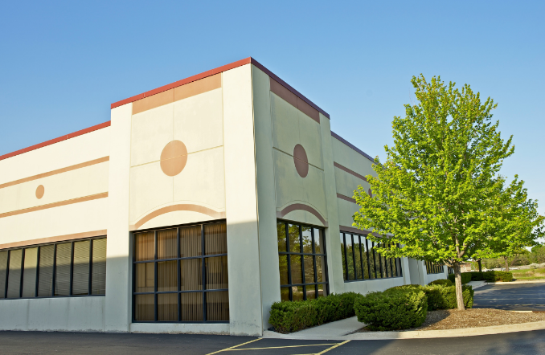
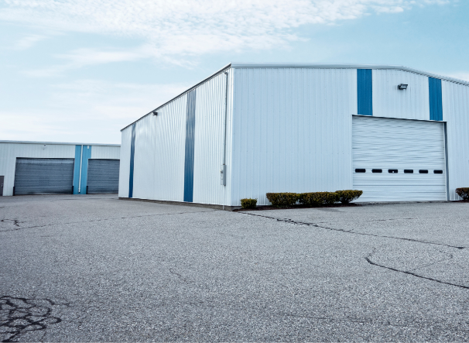
The first step of achieving carbon reduction: Energy Audit
Today’s virtual energy audit: ManuElectros Ltd*
By using this example we will talk you through the steps of energy audit
Areas which can be improved
Recommendations
Examples from real businesses
*ManuElectros is not a real business and serves as an example for the purpose of this presentation
Notes:
Expand on various sectors - i.e an office survey will need a different approach to a manufacturing business

Slide 8
Energy Audit
First step: A discussion
Our energy audits are carried out using ISO50002 methodologies.
This energy audit can’t help you with:
Your EPC rating & certification
ESOS/ISO14001 certification
Notes:
ESOS – energy savings opportunity scheme. Over 250 employees, t/o more than £44 million

Slide 9
Energy Audit
First step: A discussion
The first step of an energy audit is a conversation with the business representative. This conversation will focus on:
Business goals
Current baseline energy consumption
The support required
Priorities
Overall sustainability plan
Notes:
Baseline - if you can’t measure it, you can’t manage it. So need bills prior ideally. Also gives us the energy rate, which has a massive bearing on the ongoing savings and payback periods.
My favourite part of my job is meeting different business owners, learning how they operate and then seeing where we can help Ownership of the building (has a bearing on measures with longer payback). Where the business sees their capital best allocated.

Slide 10
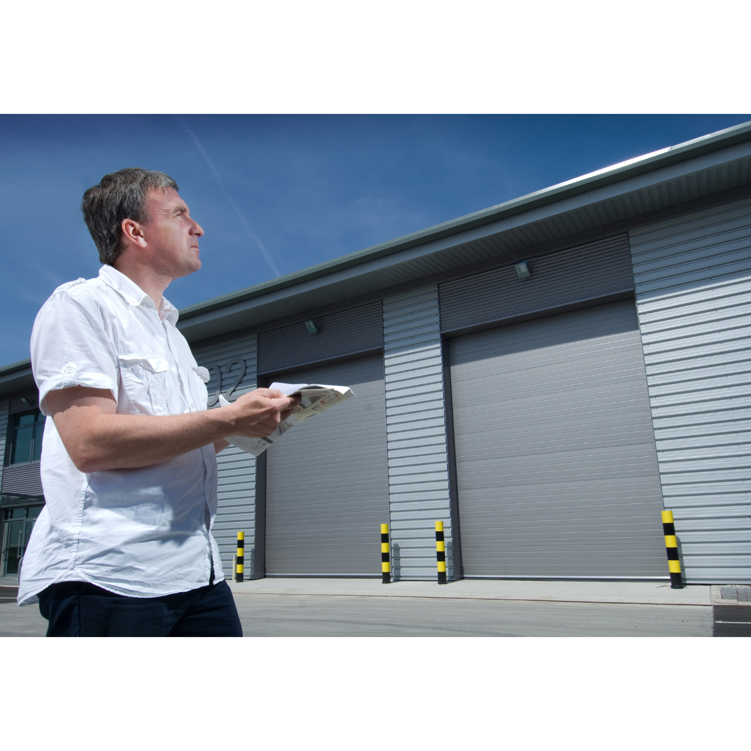
Energy Audit
Second step: A walk around your business premises
During this step your Business Energy Advisor will try to identify:
Where energy is being wasted
How energy can be saved
How the energy produced can become greener
Savings are benchmarked against annual energy consumption
Notes:
Walk around site. Not rocket science, take notes and pictures. Energy consumption v important

Slide 11
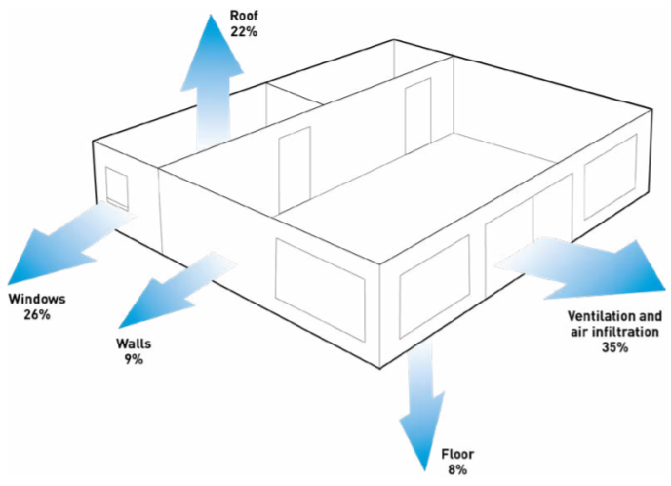
Energy efficiency
Windows and doors
Replace inefficient single-glazed windows and doors
New double-glazing should have U-value of 1.6 or below
Carbon Trust states efficiency gains of 26%
Notes:
Walk you through things I typically identify and what the potential efficiency gains are

Slide 12
Example:
Measure | Indicative project cost (£) | Indicative annual savings (£) | Payback period excl. funding | Carbon saving (tCO2e)
Double glazed windows | £3000.00 | £845.53 | 3.5 years | 3.31
Notes:
Important to state that throughout, an indicative cost will be used. You MAY already have a quote in, we can easily use this. But it is

Slide 13
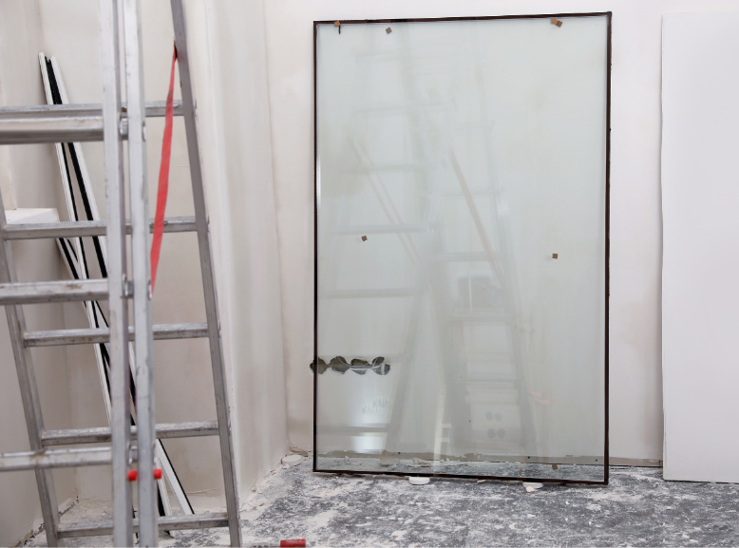
Example: Learn2 Group
The Learn2Group received a grant of £2,670 to invest in:
A new heating system upgrade
A lighting upgrade as well as the installation of double glazing
Based in Coventry, the company provides high-quality, accredited and standardised training to organisations throughout the Midlands.
The upgrades will lead to a reduction of 2.4 tonnes CO2e per year and will reduce the company's annual energy spend by 30%.
Additional benefits include improved thermal comfort, reduced maintenance from changing lightbulbs and an improvement in the light quality.
30% save:
Lighting upgrade
Heating system
Double glazing

Slide 14
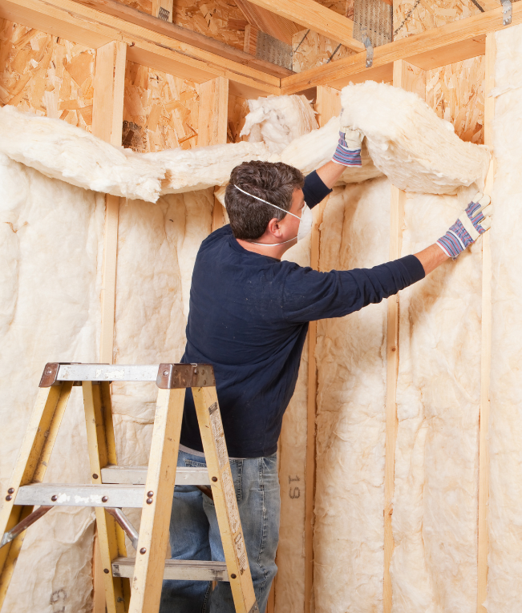
Energy efficiency
Insulation
Insulating walls and roof space in order to reduce heat loss
Carbon Trust states efficiency gains of 9% for walls and 22% for roof insulation

Slide 15
Example:
Measure | Indicative project cost (£) | Indicative annual savings (£) | Payback period excl. funding | Carbon saving (tCO2e)
Roof insulation | £3000.00 | £2051.33 | 1.5 years | 6.31
Notes:
Important to state that throughout, an indicative cost will be used. You MAY already have a quote in, we can easily use this. But it is

Slide 16
Energy efficiency
Roller shutters
Replacing manual closing and uninsulated shutter doors
New doors should be rapid closure and insulated to minimise heat loss
Carbon Trust states efficiency gains between 9% and 18%
Notes:
Efficiency savings vary depending on installation. Ones I’ve helped with can also improve security

Slide 17
Example:
Measure | Indicative project cost (£) | Indicative annual savings (£) | Payback period excl. funding | Carbon saving (tCO2e)
Rapid closure & insulated shutter doors | £30,000 | £9625.00 | 3 years | 18.70
Notes:
Important to state that throughout, an indicative cost will be used. You MAY already have a quote in, we can easily use this. But it is

Slide 18
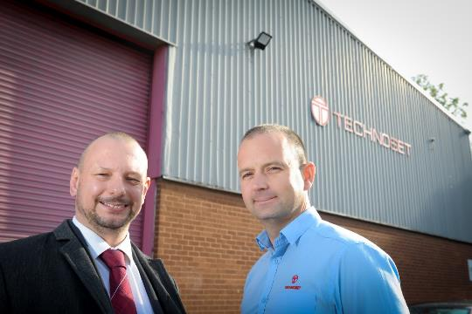
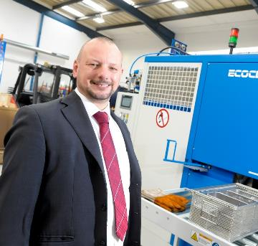
Example: Technoset Ltd
Technoset Ltd specializes in the machining of high precision components and assemblies for Aerospace Defence, Medical Telecommunications, Sensors, Motorsport and Lasers Quality Commercial Components sector.
Managing Director of Technoset decided to invest £117k in energy-efficient measures. The measures have included:
Installing LED energy efficient lighting throughout the factory and offices
Extension of the heat ducting
Installing a shut-off switch on the roller shutter door
Installing a new solvent-based component cleaning machine.
With the improvements, Technoset anticipates to see their energy bills drop by 33% and the organisation is helping to reduce 62 tonnes of CO2 emissions per year.

Slide 19
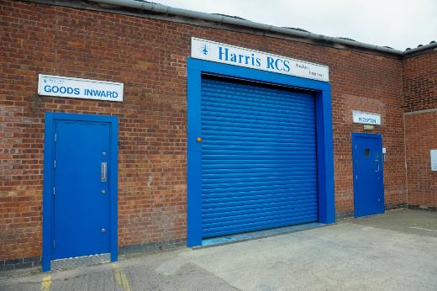
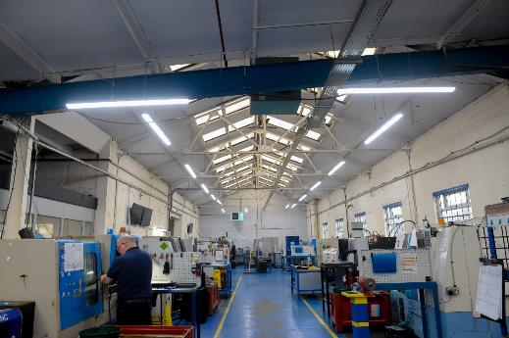
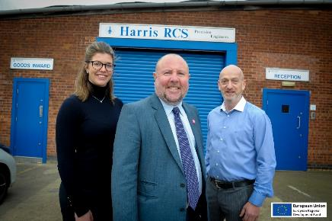
Example: Harris RCS
Harris RCS has been providing CNC machined parts for the aviation and commercial industries for well over 40 years from their site on Bayton Road Industrial Estate in Exhall, Nr. Coventry. The family-owned business managed by Graham Harris and Deborah Walters has invested £28k in a series of measures to achieve energy efficiency savings at their premises.
The measures have included:
Cutting edge sensor-controlled LED lighting throughout
Construction of an insulated internal wall to minimise heat loss
Replacement of a roller shutter door
All external steel security doors with new insulated doors and a fast action roller shutter door
Electricity and gas consumption dropped by 60%
Reduced 31 tonnes of CO2 emissions per year.

Slide 20
Energy efficiency
Lighting
Replacing traditional fluorescent and halogen lighting
Efficiency gains vary (Carbon Trust calculator)
Most common energy efficiency improvement measure
Other benefits: better light quality
Notes:
Very bespoke depending on site, usage etc. still use Carbon Trust methodology. Old style bulbs are expensive and will soon be phased out.

Slide 21
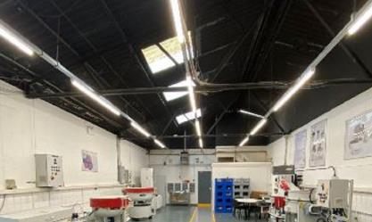
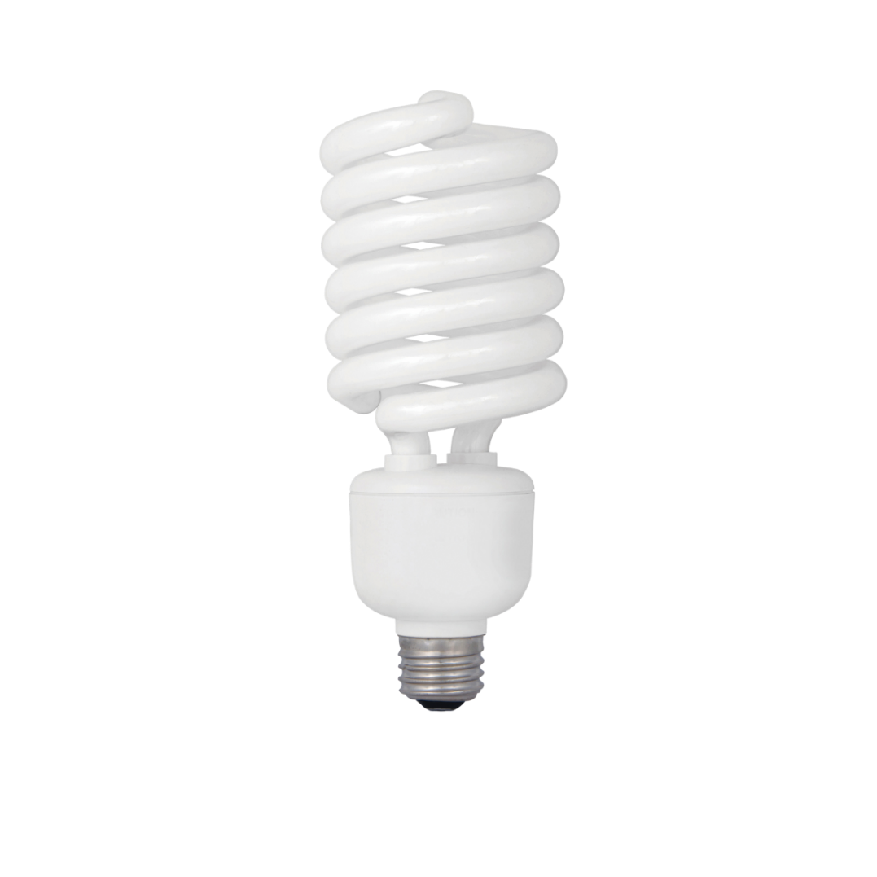
Examples
Middlemarch Environmental Coventry (Source) | ActOn Finishing Coventry (Source) | Gennaro Organic (Source)
A natural environment consultancy, based in Coventry. | Which is the UK’s leading surface finishing technology provider in the healthcare, aerospace, automotive and motorsport sectors. | Hair & Beauty in Bedfordshire.
After receiving an energy and resource efficiency audit the company applied for funding and was awarded £2,761 towards the cost of replacing an old lighting system with a more efficient, low energy LED system. The grant also funded improvements to their heating system. | ActOn Finishing applied for £9,000 from the Coventry and Warwickshire Green Business Programme, which is partly funded by the European Regional Development Fund (ERDF), which resulted in the conversion of all lighting throughout the site to LED lighting to improve the visual aspects within many of their production processes | They introduced LED lightbulbs, installed heating and air conditioning timers and reviewed their energy tariff.
The benefits of these improvements are reflected in the energy bills which are expected to be reduced by almost £3,000 a year | leading to around 32 tonnes of Co2 emission savings per year and reduced energy costs. | This made them a more energy efficient business and saved an estimated 30-50% on their bills.

Slide 22
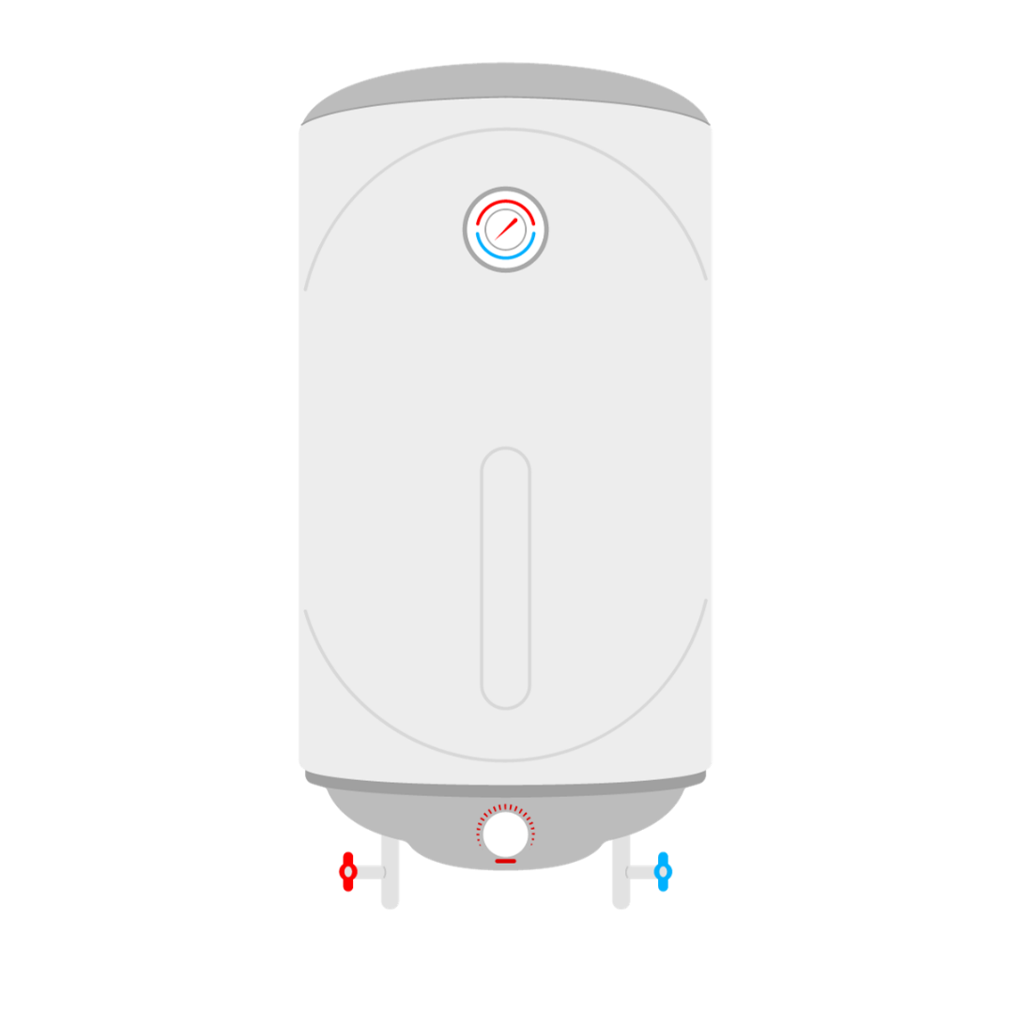
Energy efficiency
Heating
Heating is usually the most significant energy cost in a workplace, accounting for up to 40% of energy use in a non-domestic building.
Often the improvement measure with the most different options
Notes:
Very bespoke per site and per sector. I will give guidance on support I’ve given. We have done whole sessions on this in the past

Slide 23
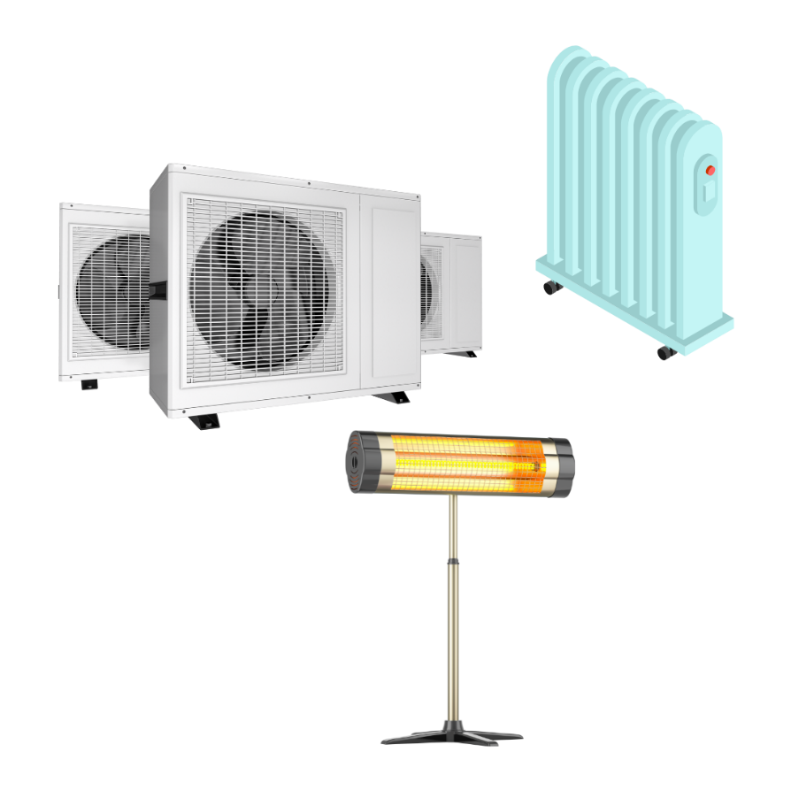
Energy efficiency
By replacing old, inefficient gas boilers with new model savings of up to 30% can be achieved. New models need SAP seasonal efficiency rating of c90%
Electric radiators or IR heaters can ‘heat the man, not the space’
Destratifcation fans can reduce heat consumption by 20% in industrial units where space heaters are used
Heat pumps are significantly more efficient, especially if used with solar PV
Notes:
Simple - upgrade gas boiler BUT still fossil fuel. Can swap out boiler for IR/elec rads and hot water points. Can use heat pumps or A/C. For manufacturing sectors they often have large space heaters - yet to see a suitable ‘renewable’ alternative for this (when we do I will do a specific session on it) but destrat fans work well – make what’s in place work more efficiently

Slide 24
Example:
Measure | Indicative project cost (£) | Indicative annual savings (£) | Payback period excl. funding | Carbon saving (tCO2e)
High efficiency boiler | £15,545.00 | £1958.93 | 8 years | 10.87
Notes:
Important to state that throughout, an indicative cost will be used. You MAY already have a quote in, we can easily use this. But it is

Slide 25
Example: Margaret Hills
Margaret Hills, a health food store based in Kenilworth, and Protek Engineering a manufacturing company, based in Bidford-on-Avon, have also been awarded grants of £2,544 and £3,220.
Improvements made to their lighting and heating systems will allow each one of these SMEs to slash the cost of their energy bills by almost £2,500 a year.

Slide 26
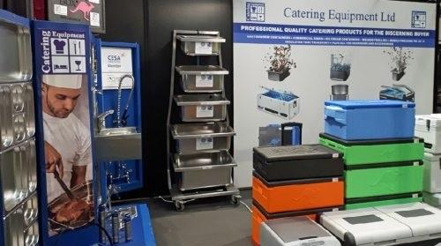
Example: Catering Equipment Ltd
Catering Equipment Ltd moved from 5,000 sq ft premises in Tyseley, Birmingham, to a 25,000 sq ft unit in Grendon Road, Polesworth, in May 2019. Catering Equipment Ltd invested £8,800 at its new premises supported by an additional £3,500 Green Business Programme grant.
Improvements made:
A new combination boiler
Air conditioning units
Radiant heater
These lead to around 47.3 tonnes of carbon dioxide emission savings per year and reduced energy costs.

Slide 27
Energy efficiency
Machinery
Replace machinery with more efficient model, both in terms of energy consumption and productivity
Improve manufacturing processes
Notes:
Eg CNC machines – produce more in quicker time and have a lower consumption. Metalwork Processes – centrifuge - cut down on oil passing through the washer reduced washer operation time AND allowed the oil to be re-used

Slide 28
Example: Area 51 Design and Sarginsons
Area 51 Design | Sarginsons
Area 51 Design has been supplying creative props, décor, entertainment and shows for over 20 years from its 10,000 sq ft base on the Hurley Hall Industrial Estate in Atherstone Lane, Hurley. | Sarginsons Industries Ltd is a lightweight castings business based in Coventry, supplying products for a range of major companies - such as Aston Martin and Jaguar Land Rover.
Area 51 Design successfully applied for a grant of £12,702 towards an energy efficient CNC lathe and Polurea Spray Gun as well as the installation of LED lighting. | The company has invested £130,000 in new energy efficiency measures. he measures installed include two new gas furnaces, a new air compressor system, a power factor correction capacity along with new LED lighting across its facility, designed to dramatically reduce carbon footprint
- 61 Tonnes carbon per year
£4,600 Savings Per month

Slide 29
Energy efficiency
Air compressor
Variable speed compressors are significantly more efficient than traditional models
Leakages are the most significant source of energy waste in older compressed air systems, with a leakage point as small as 3mm costing an estimated £980/week in wasted energy.
If compressors are left running unloaded after working hours, they still use as much as 25% of the energy consumed at full load.
Notes:
Most compressor companies will give a detailed efficiency analysis as part of the proposal

Slide 30
Example:
Measure | Indicative project cost (£) | Indicative annual savings (£) | Payback period excl. funding | Carbon saving (tCO2e)
Variable speed compressor | £49,500 | £20,500 | 2.5 years | 23.3
Notes:
Important to state that throughout, an indicative cost will be used. You MAY already have a quote in, we can easily use this. But it is

Slide 31
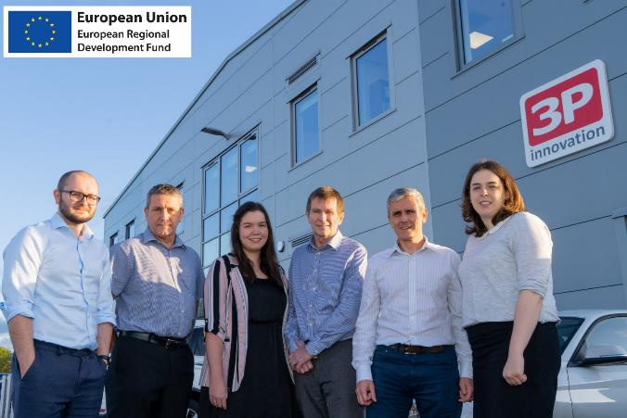
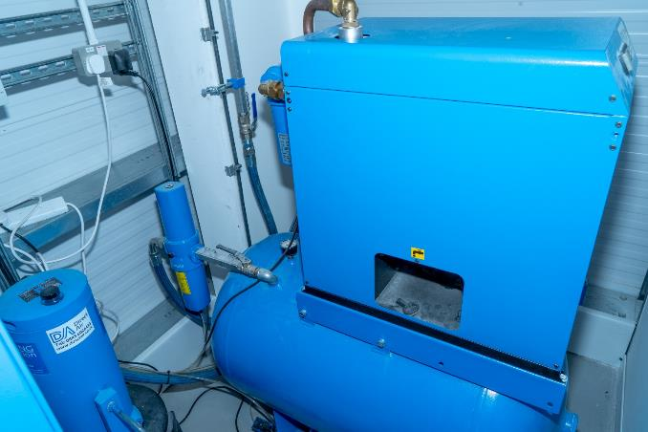
Example: 3P innovation design
3P innovation design, manufacture and support high-end production equipment and machinery, from lab-scale to commercial scale which allows their clients to launch new products faster and at lower cost, with high productivity and reliability from the start.
3P innovation estimates to see a reduction of 153.3 tonnes of CO2 emissions per year with 290,000kWh of energy usage having been reduced.

Slide 32
Green energy
Solar Pv
Typically, each solar panel generates around 200 - 350W of energy in strong sunlight.
Solar energy can be one of the most reliable sources of natural energy that you can use to power your business.
Solar panels generate free and green electricity during the daytime that can be used on-site.
Notes:
We are all very pro-solar. I have seen paybacks of between 9 months to 3-4 years for a standard installation. The main funding we have cannot be used to support a solar install however I would always discuss it during the audit and provide payback details and guidance. Grant or no grant, it is worth considering, especially if you own the building. Also allows you to promote yourself as a ‘green’ business

Slide 33
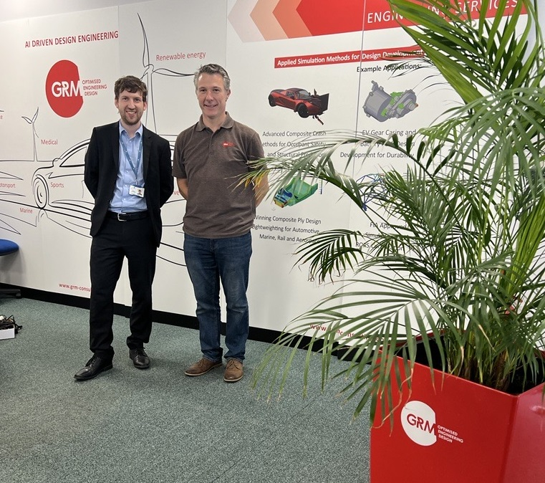
Example: GRM Consulting
GRM Consulting, a small design engineering consultancy based in Leamington started their Net Zero journey in early 2021 when they pledged to become carbon neutral by 2040. The support offered to GRM Consulting consisted of a free energy and resource efficiency audit and a grant worth £10,000 towards the cost of a new LED lighting system, roof over-cladding and a solar PV system.
These improvements will help the firm save over £5,000 a year in the costs of energy bills and reduce their carbon footprint by over nine tonnes of CO2 emissions per year.

Slide 34
Energy Management
Behavioural Changes
The Carbon Trust estimate that companies can save up to 10% on energy costs by no cost measures. Good housekeeping measures which include:
Ensure all lights are switched off when not in use
Ensure all PCs and monitors are switched off when
not in use (at the plug).
Switch drinks fridges off fully at the plug when not required
(a timer switch could be installed to bring the contents
back up to temperature when required for customers).

Slide 35
Energy Management
Behavioural Changes
Ensure external doors are closed when not in use – This is to prevent heat escaping through the open doors.
Move equipment away from radiators as equipment acts as a heat soak.
Monitor thermostatic radiator valve settings ‘TRVs’ and reduce settings in unoccupied spaces.
Electricity is metered half hourly and data should be available from the electricity supplier.

Slide 36
Energy Report
Measure | Indictive project cost (£) | Indicative annual savings (£) | Payback excl. funding | Carbon saving (tCO2e)
DG windows | £3,000 | £845 | 3.5 years | 3.31
Roof insulation | £3,000 | £2,051 | 1.5 years | 6.31
Roller shutters | £30,000 | £9,625 | 3 years | 18.70
Boiler | £15,545 | £1,958 | 8 years | 10.87
Air compressor | £49,500 | £20,500 | 2.5 years | 23.3
Energy management | £FOC | £10,000 | Immediate | 10
TOTALS | £101,045 | £44,980 | 2.25 years | 72.49
Allows business to prioritise measures based on cost savings and business need
Shows estimated capital costs and paybacks. Business will then need to obtain their own quotes for the work
Further detail on each recommendation is given
Business can then engage with chosen suppliers for confirmed costs and expert advice
Notes:
Again – reiterate that this is for guidance only - suppliers will give confirmed capital price, offer more specialised advice - EG in regards to heating once a supplier has been to site a totally different installation has been suggested - this is fine and can still be supported. Cannot stress this enough - Our time is free, the audit is free and the grant is a grant - but you will need to engage with expert, reputable suppliers

Slide 37
DNZ PROGRAMME
The Decarbonisation Net Zero Programme aims to provide information and expert advice and support to businesses enabling them to make significant decarbonization and money-saving changes to their business.
This Programme is part of the wider West Midlands Business Support activity funded through the UK Shared Prosperity Fund (UKSPF).
Introduction
Notes:
Grant support - up to 50%, grants between £1k - £100k.

Slide 38
OBJECTIVES
What We Aim to Achieve?
Support decarbonisation efforts in local businesses while improving the natural environment
Align with the UK government's legally binding climate target to reduce carbon emissions to
Net Zero by 2050
Provide immediate support to businesses to enhance their competitiveness and sustainability

Slide 39
Our Commitment
A Sustainable Future
We are fully committed to delivering Energy Audits for small and medium-sized enterprises (SMEs) by March 2025
Our commitment includes supporting a wide range of small businesses, from sole traders and micro-businesses to manufacturing companies in the Birmingham, Solihull, Coventry, Black Country and Warwickshire regions *depending on eligibility

Slide 40
The Journey Ahead
What to Expect in Your Decarbonisation Journey?
Energy Assessment
Register
Audit Triage
Recommendations
Grant Application
Start by completing the registration form on BGWM’s website or by contacting our team.
After registration, our Business Engagement Managers will reach out to you to complete the audit triage and check your eligibility.
We will then conduct a FREE assessment, examining your energy usage and operations.
Based on the assessment, we'll provide you with recommendations for cost-effective energy saving measures.
Your business has the opportunity to apply for grants of up to £100,000 to implement the energy efficiency recommendations.
Notes:
V important – QUOTES needed - you will need to get 3 quotes. This ensures best value you can use your preferred supplier). Important to state you have to apply for the grant BEFORE starting any work, and the grant is paid out following install and claim

Slide 41
Other Resources

Slide 42
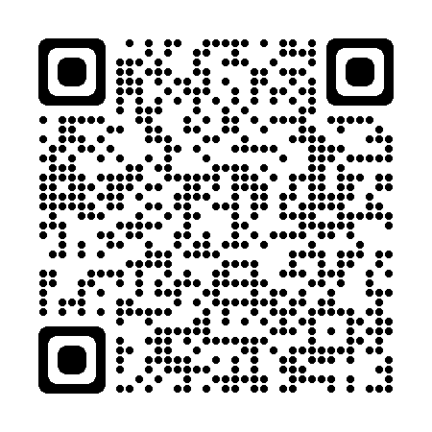
Other resources
Green Business Network
The Green Business Network allows businesses to come together, share ideas and promote energy, resource, waste and water efficiency as well as engage on low carbon, environmental and green sustainability initiatives.
Free to join
2900 members
Networking opportunities
Free newsletter
Be the first one to find out more about events and grant support opportunities
Join now
Use this QR code to join

Slide 43
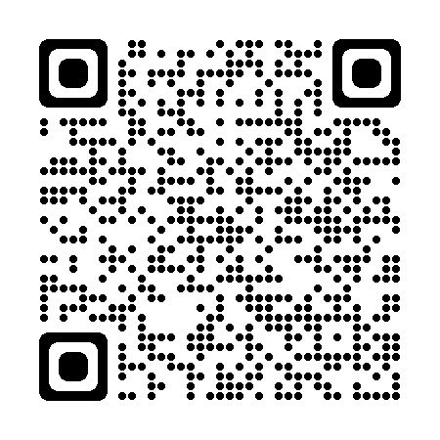
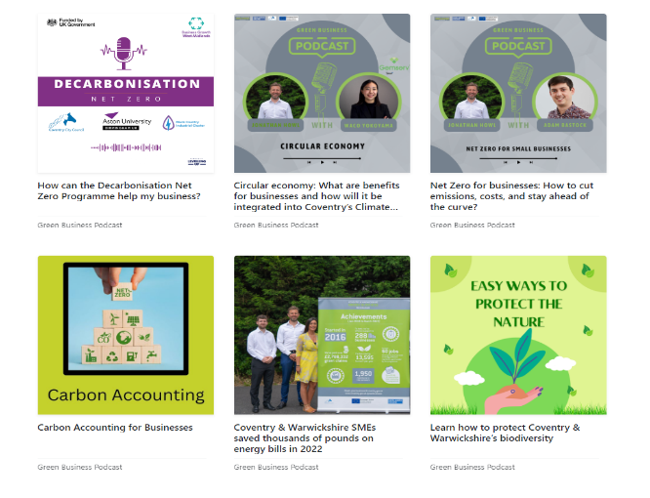
Other resources
Green Business Podcast
Listen to our monthly podcast to learn more about energy, resource, waste and water efficiency as well as engage in low carbon, environmental and green sustainability initiatives.
New episodes every month
Over 10 episodes so far discussing solar PV, heat pumps and sustainable business practices
Use the QR code or this link to subscribe

Slide 44
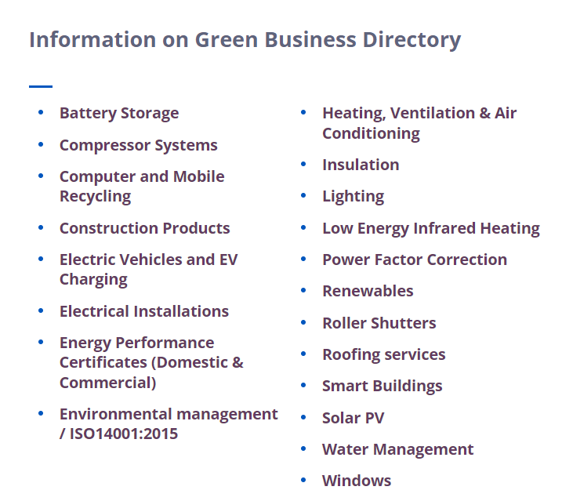
Other resources
Green Business Directory
Find a list of local suppliers and installers who can help you improve your business .
Over 100 companies
20 categories including solar PV, roofing services and water management
If you are a local installer or supplier please get in touch and we will add you to the directory
Notes:
As a local council we have to stay impartial………

Slide 45
Is Your Business Ready to Make the Change?
EMAIL ADDRESS
decarb@aston.ac.uk
decarb@aston.ac.uk
PHONE NUMBER
0121 204 4828
0121 204 4828
TO REGISTER
West Midlands: bit.ly/DNZ-Audit-Register
Warwickshire: https://bit.ly/3skX34q
West Midlands: bit.ly/DNZ-Audit-Register
Warwickshire: https://bit.ly/3skX34q
Learn more about the programme
Learn more about the programme

Slide 46
Q & A

Slide 47
Thank you all for joining!
The presentations and a recording for this webinar will be sent out to you shortly.
Next events:
Webinar: Renewable energy: What are the costs and the savings?
Face-to-face event [Coventry Businesses] Decarbonisation & Net Zero: Grant funding and expert guidance for Coventry

Slide 48
www.businessgrowthwestmidlands.org.uk
Twitter: @decarbprogramme
LinkedIn: Decarbonisation Net Zero Programme

