Slide 1
Efficient Lighting Upgrades
Smart Systems UK

Slide 2
Expense Saving ideas for Small Businesses
Andy Hogston

Slide 3
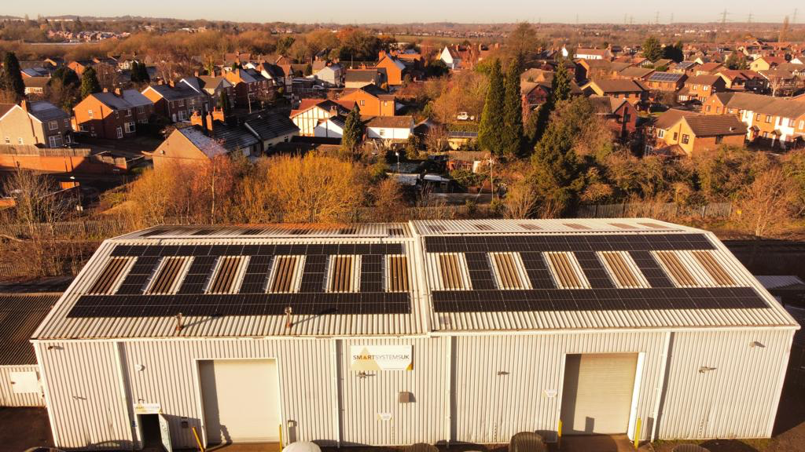
Who are we?
Established 2000
Factory, warehousing and administration in Longford, Coventry
25 staff

Slide 4
What do we do?
LED lighting for commercial and industrial applications
Bespoke LED gear trays for upgrading old technology lighting to LED
Replacement lighting components for the FM and end-user market
Emergency lighting
Lighting controls
Renewables division launched December 2022:
Solar PV | Battery & Heat Pump design and install

Slide 5
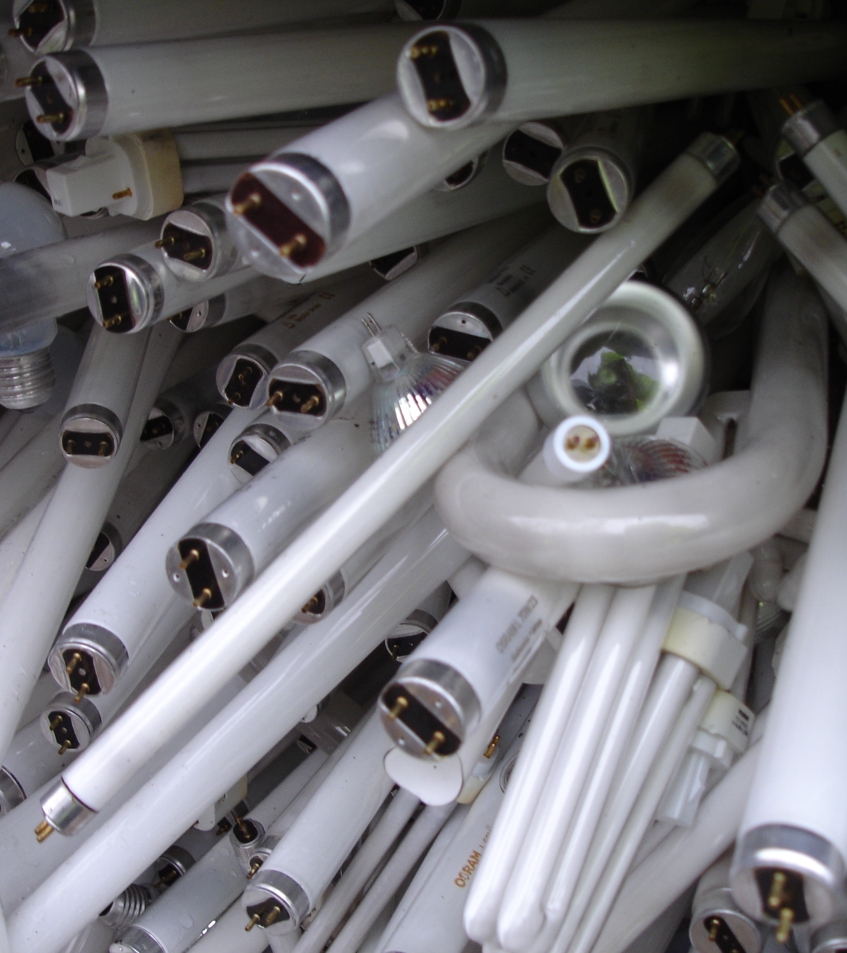
What’s happening?
Fluorescent tube and lamp ban in-line with EU RoHS Directive (restriction of use or hazardous substances)
Mercury is widely used in the manufacture of the lamps
BAN in effect as of Feb 2024.

Slide 6
The LIA’s Guide to the latest announcement on RoHS

Slide 7
Why should you change now?
Lamps and the control gear for operating them are already being phased out
Supply chain will slow down, and prices will increase significantly
COST
Carbon Footprint

Slide 8
Example of running costs
Standard 5ft fluorescent light fitting
58W tube operates at 65 watts due to the control gear losses and age
So; assume 10 hours running each day, 5 days per week, gives us 2600 hours each year.
Let’s get the kilowatt hours: 2600 x 65W = 169,000 Watts
169 kWh at £0.34p is £57.46 per year
This is just for ONE light

Slide 9
Is LED the answer?
50% LESS energy THAN EQUIVALENT fluorescent (minimum)
75% Plus SAVINGS ACHIEVEABLE WITH CONTROLS
LED products have longer life expectancy than fluorescent
Over time LED lighting will cost significantly less to run in terms of maintenance & electricity

Slide 10
What now?
Receive audit and R.O.I calculation
Get on with it and start saving money!
Make contact with an established, reputable supplier of LED lighting products
Initiate a FREE survey of your premises

Slide 11
Finally….
EPC ratings changed as of April?
Landlords must have an EPC rating of at least Grade E to continue leasing
By 2027 this will increase to Grade C
By 2030 Grade B
Upgrading old lighting can have a significant impact on improving EPC ratings

Slide 12
Computer Sustainability
David Abosch - Managing Director at Cognition Cloud

Slide 13
Sustainable. Smart. Secure.
Call 0345 120 0360
Email info@cognition-cloud.com
Web www.cognition-cloud.com
Email info@recognition-circular.org
Web www.recognition-circular.org
Notes:
Cognition Cloud is a business that advises organisations on how to deliver and embed circular and sustainable business model innovations, this includes helping them to make their Information technology more sustainable.
ReCognition Circular is a CIC not for profit social enterprise. We provide digitally excluded and other people with specific training on how to repair and refurbish computers and mobile devices.
We help get people into work or further education by providing skills in computer and mobile device repair - at the same time, working to tackle the e-waste problem.
Today I am going to speak about the impact of ICT on the environment, and how to reduce it.

Slide 14
Emissions as % of Global Total
Approx.
1,500 Mt
4%
[1] Fossil CO2 emissions of all world countries - 2020 Report
[2] CO₂ and Greenhouse Gas Emissions, Our World in Data
3.9 %
[3] Emissions from computing and ICT could be worse than previously thought
1,125 Mt
3%
2.8 %
750 Mt
2%
375 Mt
1%
0.87 %
0.96 %
1.85 %
1.8 %
1.7 %
1.9 %
0%
Italy
UK
Germany
ICT
Shipping
Aviation

Slide 15
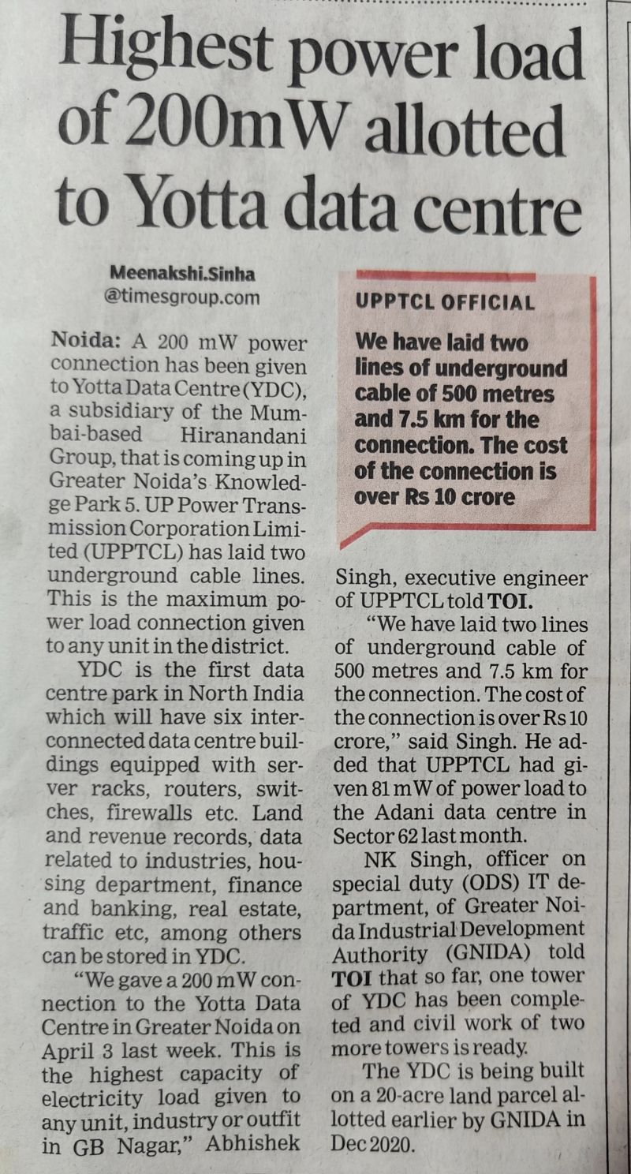
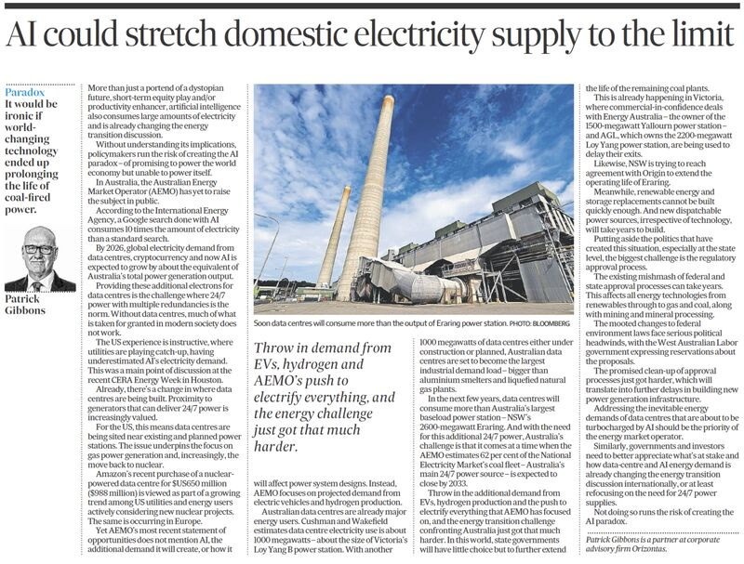
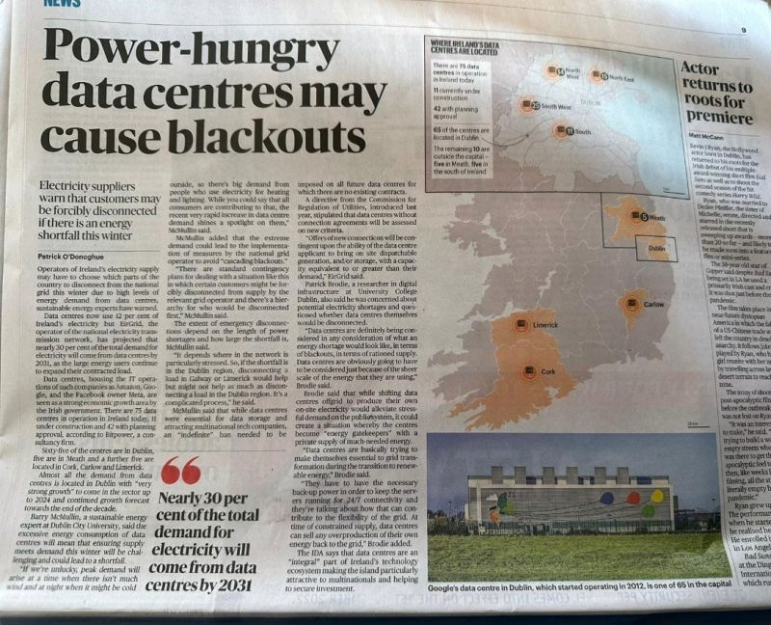

Slide 16
Estimated Data Centre Emissions
Scope | Emissions Source | Estimated Annual Emissions (tons CO2e) | Percentage of Total Emissions
Scope 1 | Backup Generators | 1,250 | 1%
Scope 2 | Purchased Electricity | 20,000 | 9%
Scope 3 | Other Indirect Emissions | 192,750 | 90%
PUE of 1.5 and grid emissions factor of 200 g CO2/kWh are assumed.
Scope 3 Emissions e.g. manufacturing, transportation, and disposal of data centre equipment, embodied emissions in data centre construction

Slide 17
End User Emissions

Slide 18
IT Emissions by Source
Malmodin (2020)

Slide 19
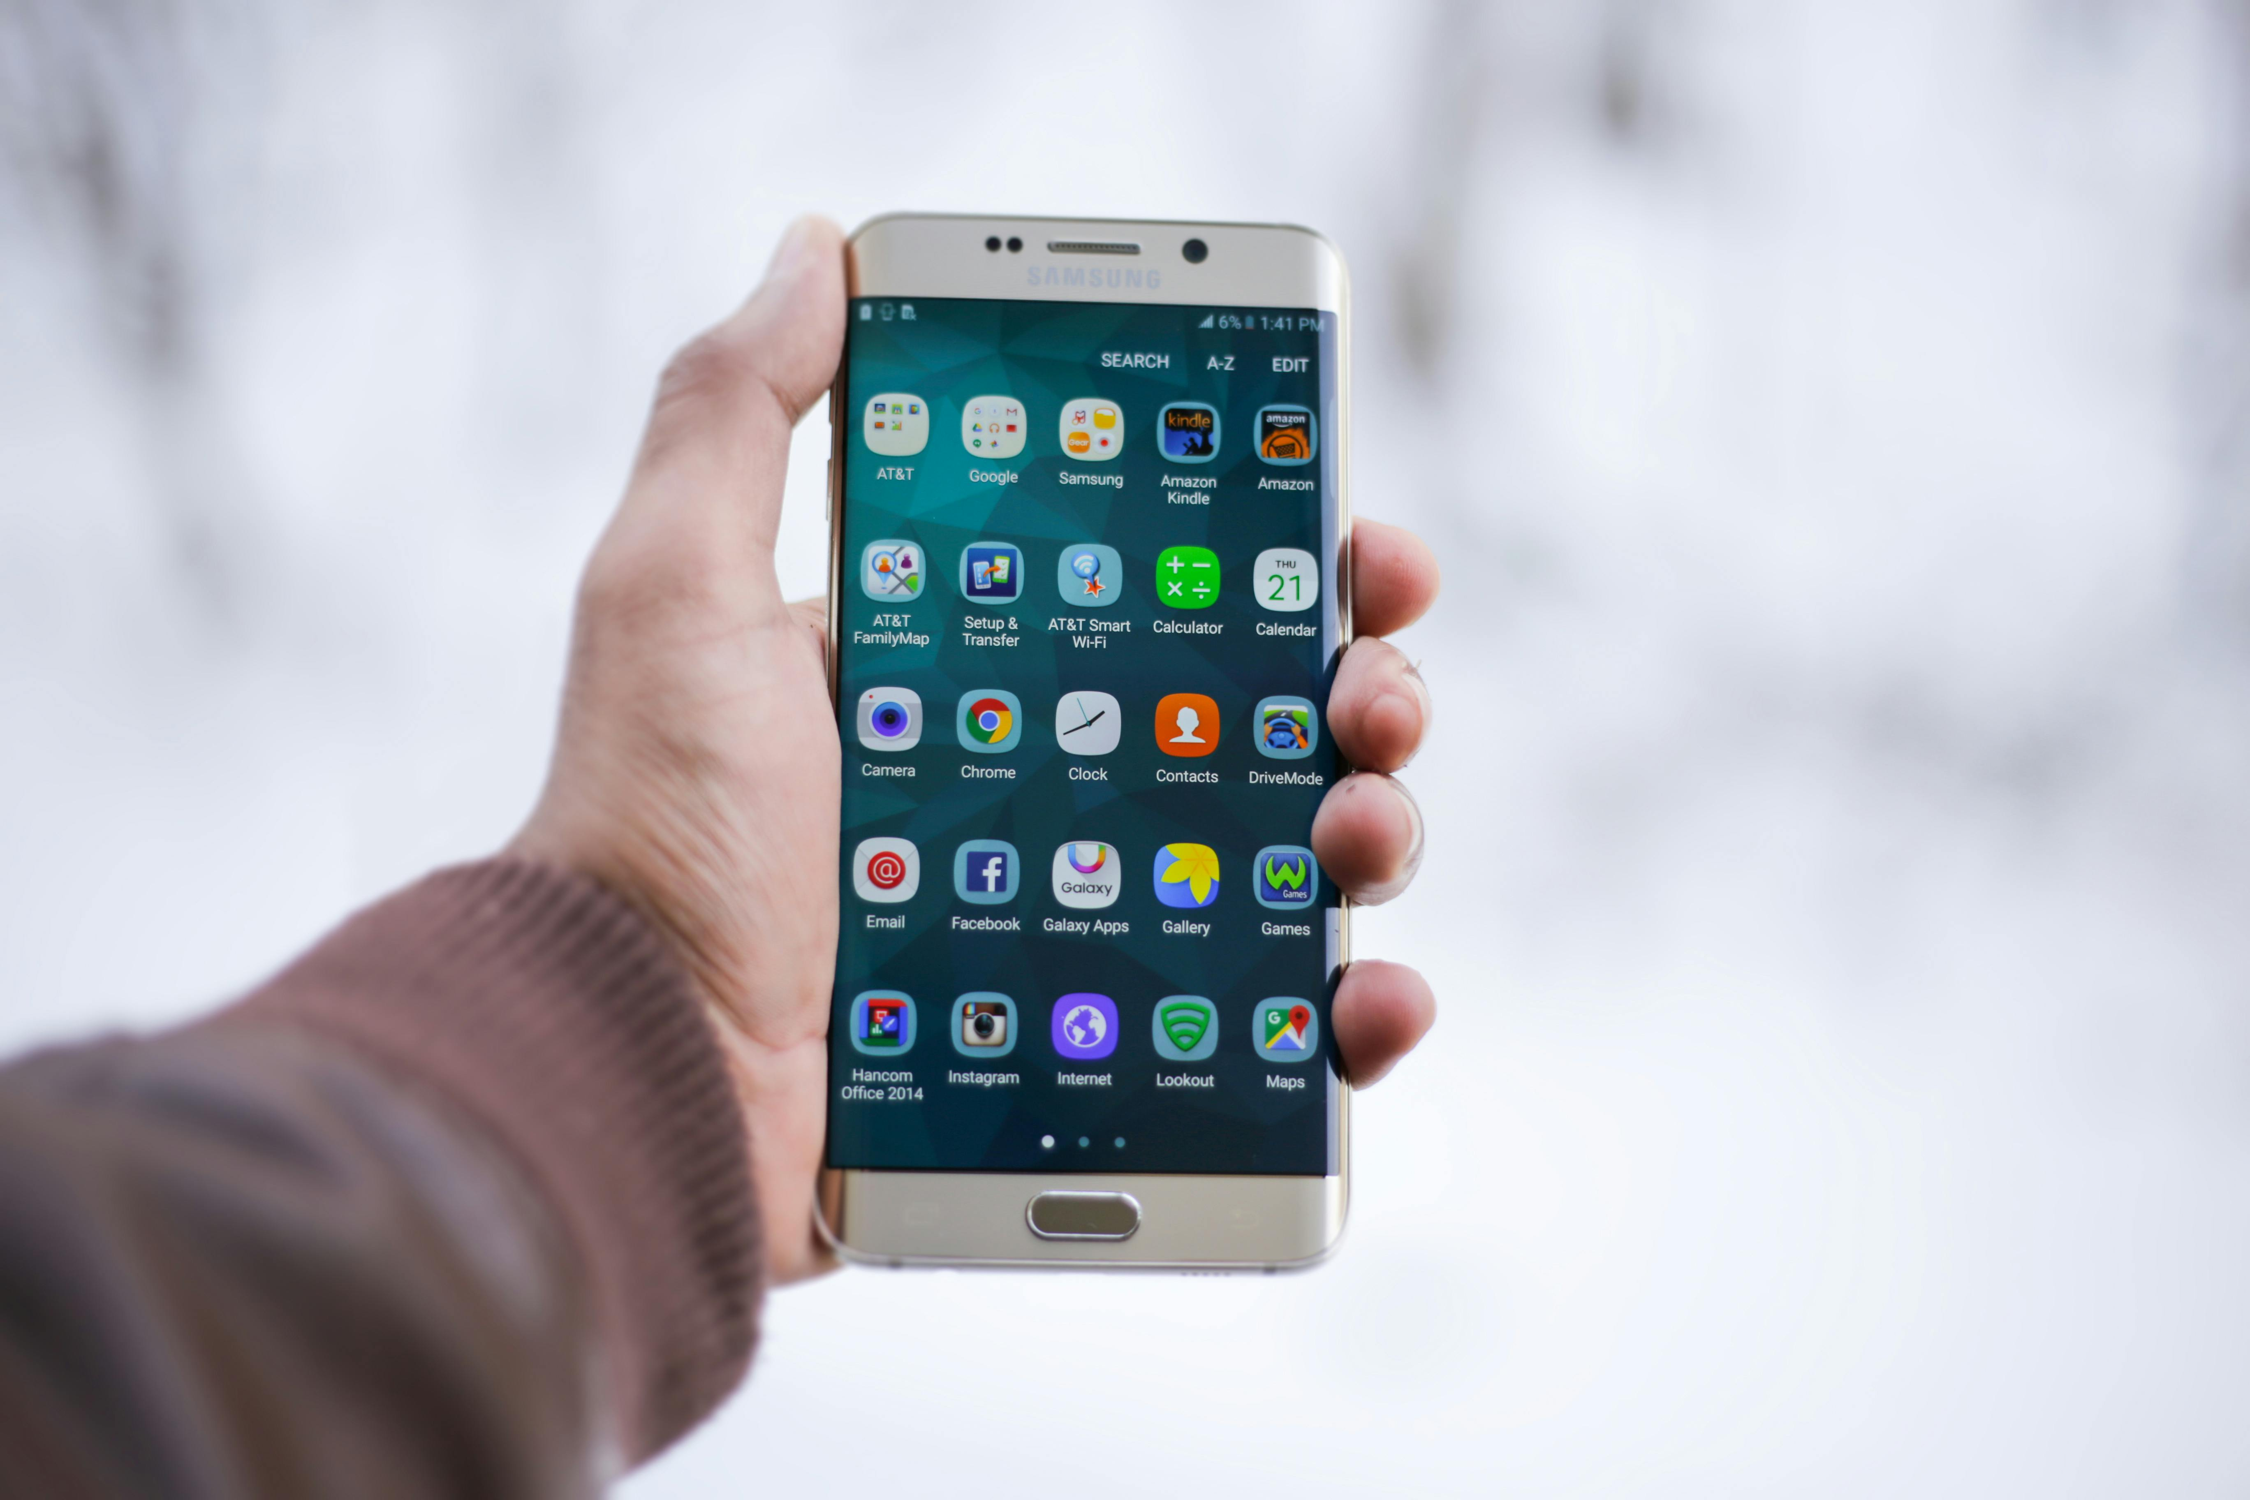
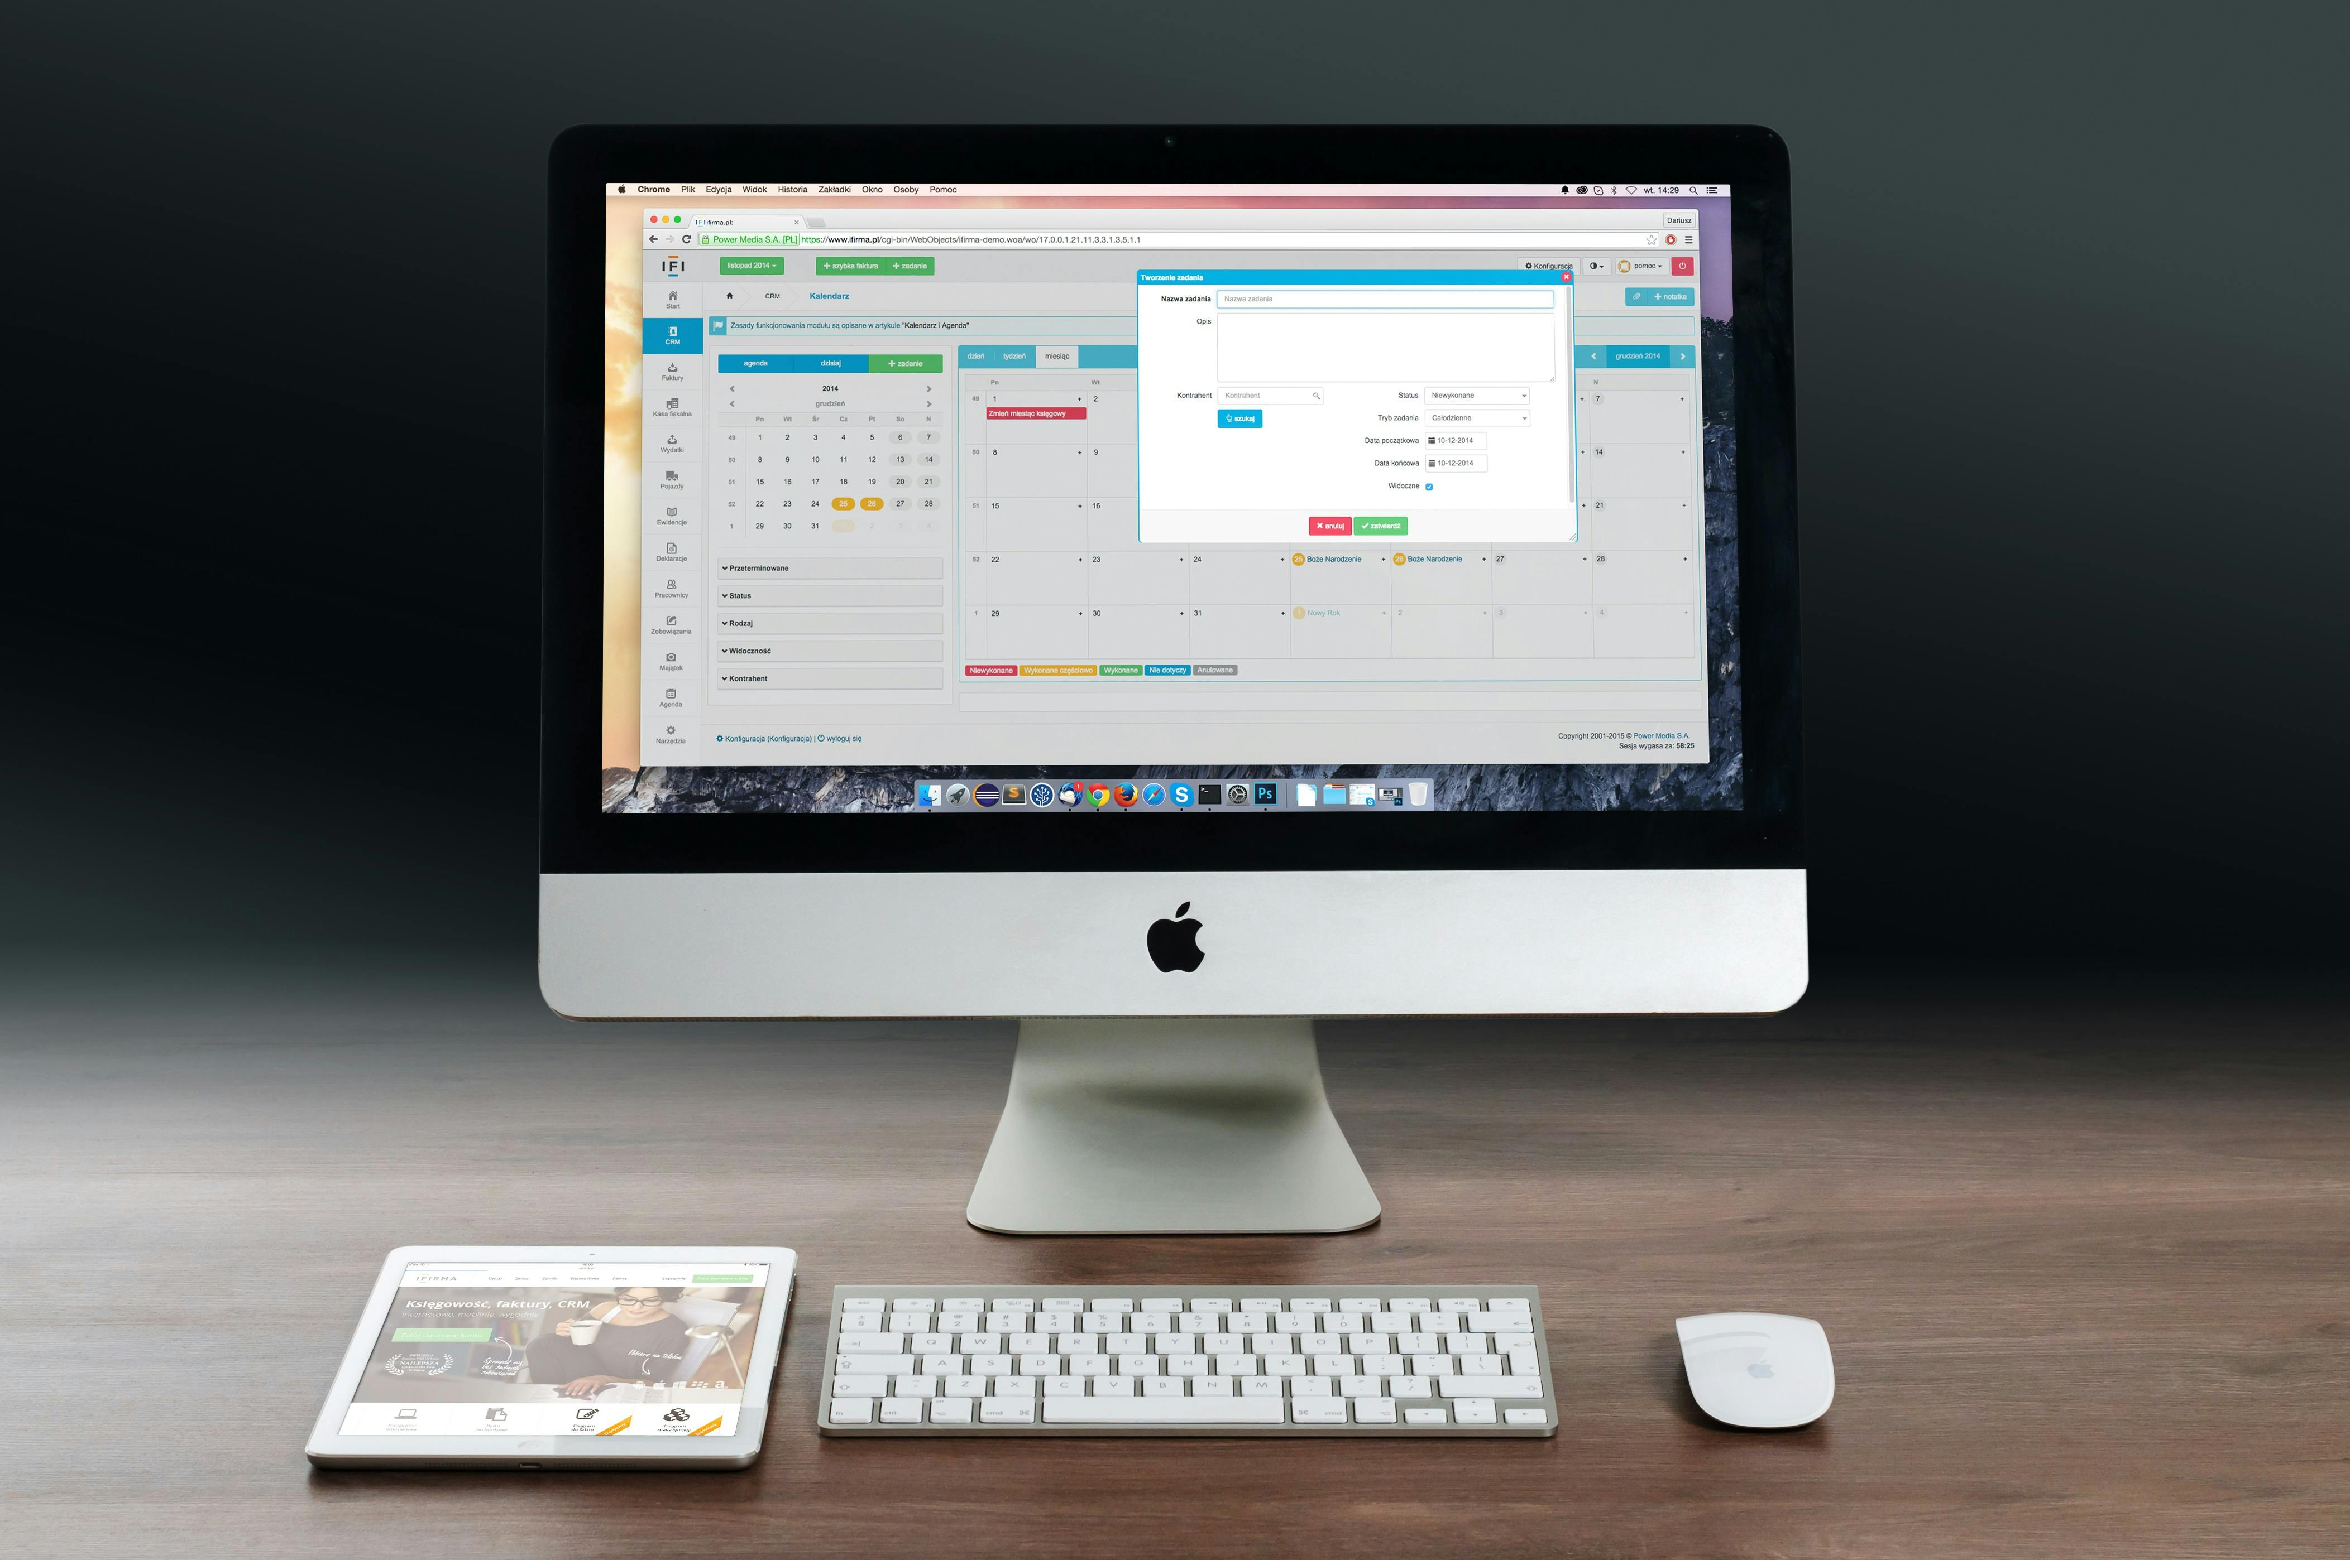
Annual Production
1.3 – 1.5bn units
250 – 300m units
Notes:
The reason for this is the sheer scale of production and consumption of these devices.
The average lifespan of a laptop is typically between 3-5 years.
Most users replace their phones every 2-3 years.
This drives constant demand for new devices

Slide 20
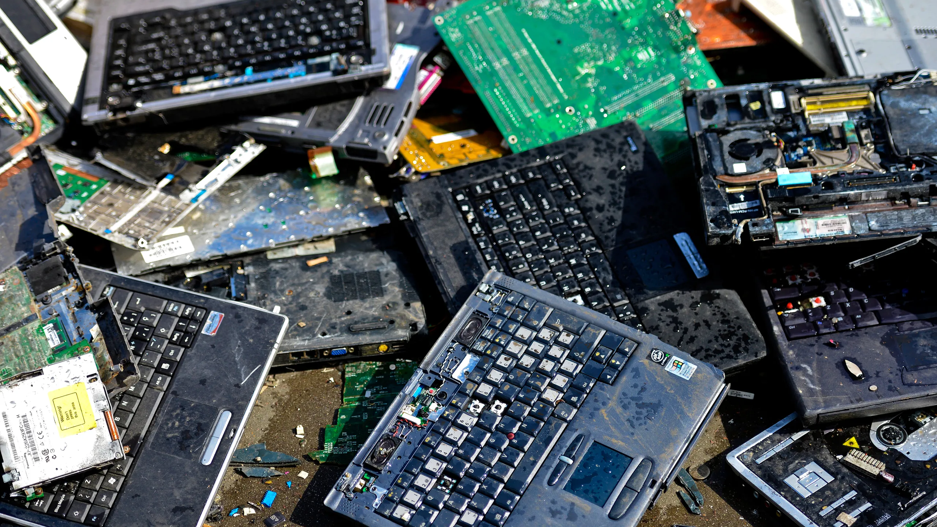
Notes:
As a result we create a mountain of e-waste
In the UK alone we throw away an estimated 36m devices a year

Slide 21
Notes:
We live on a planet of finite resources
We simply cannot sustain this level of consumption

Slide 22
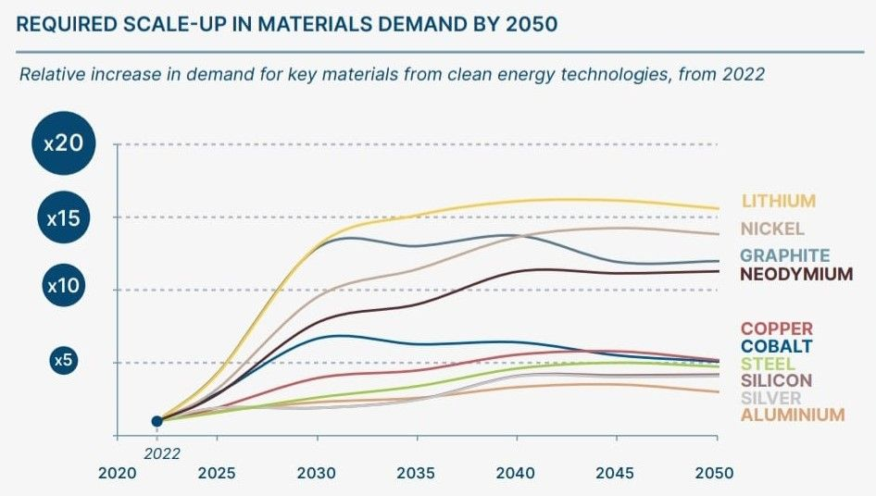
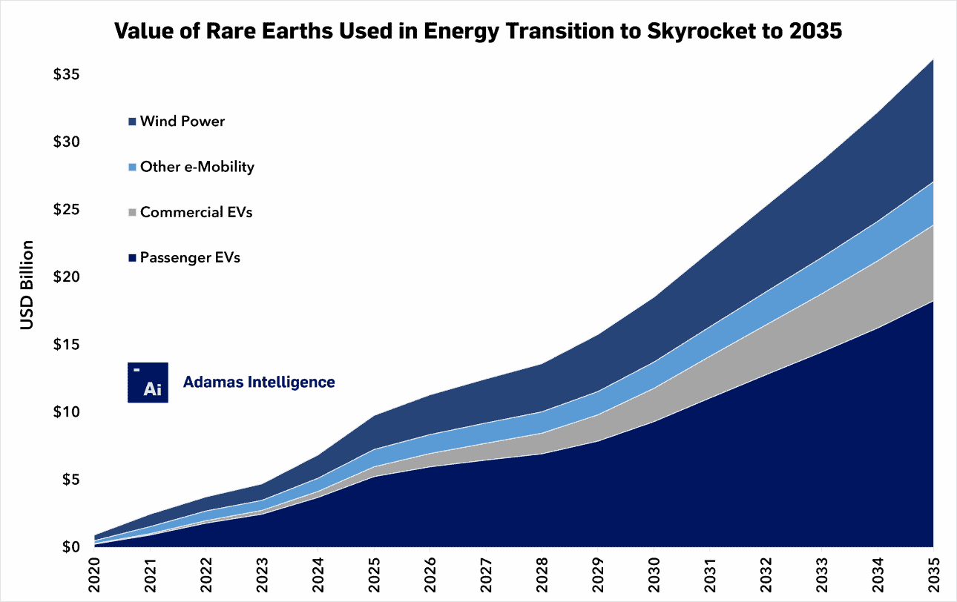
Resources to Drive the Energy Transition
Notes:
As demand for these devices grows and resources become increasingly scarce, prices are forecast to increase dramatically
That is likely to feed into the price of the devices we buy
Rapid replacement cycles are not only bad for the environment, they are are going to become increasingly costly

Slide 23
What Can I Do About It?

Slide 24
Don’t Buy New
NEW
REFURB
XPS-13
Processor: Core™ Ultra 5 125H
Screen Size:13.4”
RAM:16GB
Storage:512GB SSD
Processor: i7-1250U
Screen Size:13.3”
RAM:16GB
Storage:512GB SSD
£999
~£500
297 kgCO2e
<30 kgCO2e
Notes:
Remember, your physical IT assets have the biggest impact on your carbon footprint.
If you change your procurement strategy to buy refurbished or remanufactured devices you will pay about 1/2 the price for the equivalent computing power
There is also a potentially huge carbon savings

Slide 25
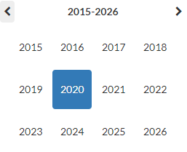
Use Your Computers For Longer
This Photo by Unknown Author is licensed under CC BY-NC-ND
Notes:
The most sustainable computers are the ones you already have.
If you can double the life of your existing computers, you will cut your emissions from them in half.
Skipping a replacement cycle can also save you a significant amount of money.
If you provide a laptop and a mobile phone to your employees and they have their own devices for personal use – then you have twice the number of devices you need and double the carbon footprint

Slide 26
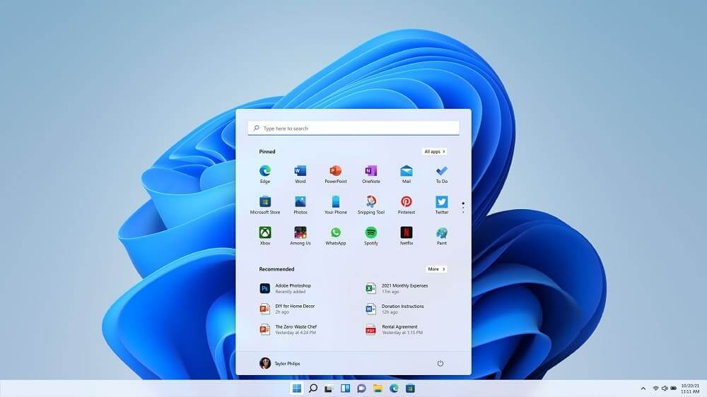
No security updates after Oct ‘25
Minimum hardware requirements
e.g. TPM 2.0 8th-gen Core CPU
450 to 500 million computers worldwide to become obsolete
Notes:
Planned obsolescence is a tactic employed by linear economy producers in order to drive replacement sales. Here is an example from the world of IT.

Slide 27
Alternative Options
Same familiar Windows experience
Easily flex up and down
No dependence on end-point (PC) hardware
Can be complex to administer/maintain
Potentially higher cost
’Cloud Native’ OS
Easy to manage/administer
Superior security
Can be installed on older/lower spec machines
Windows apps available via VDI
Different user experience/requires change management and adoption
Potentially complex technical change depending on the environment
Open source
Can be installed on older/lower spec machines
Highly flexible
Free to use
Lack of enterprise grade admin and support
Less support for popular software, although apps can be delivered via VDI

Slide 28
Takeaways
Think resources
New devices = new resources.
Resource extraction is responsible for 50% of global GHG emissions and 80% of biodiversity loss
80-90% of IT emissions are embodied in physical hardware – even if they’re in the cloud
End-user devices have more impact than datacentre/cloud
The most sustainable devices/computers are the ones you already have!
For maximum impact
Focus your efforts on your end-user devices
Don’t buy new - buy refurbished/remanufactured
Consider Bring Your Own Device (BYOD)
Use your devices for longer
Repair and maintain
Ditch Windows – or virtualise it
I am here to help, get in touch!

Slide 29
Sustainable. Smart. Secure.
Call 0345 120 0360
Email info@cognition-cloud.com
Web www.cognition-cloud.com
Notes:
Background - business/IT consultant.
Helping large global enterprises implement digital transformation, post-merger integration and other business change initiatives.
That experience is now focused on advising organisations on how to deliver business model innovations to make them more sustainable.
Today I am going to speak about the impact of ICT on the environment, how to measure it and how to reduce it.

Slide 30
Decarbonisation Net Zero Programme
Sara Ballinger – Business Energy Advisor, Coventry City Council

Slide 31
Introduction
DNZ PROGRAMME
The Decarbonisation Net Zero Programme aims to provide information and expert advice and support to businesses enabling them to make significant decarbonization and money-saving changes to their business. This Programme is part of the wider West Midlands Business Support activity funded through the UK Shared Prosperity Fund (UKSPF).
Grant funding for energy efficiency varies by region, however, for businesses in WMCA and Warwickshire, we can offer grants between £1K to £100K based on up to 50% intervention. Unfortunately, Warwickshire does not offer support for renewable energy under this programme.
Notes:
Grant support - up to 50%, grants between £1k - £100k.

Slide 32
The Journey Ahead
What to Expect in Your Decarbonisation Journey?
Energy Assessment
Register
Audit Triage
Recommendations
Grant Application
Start by completing the registration form on BGWM’s website or by contacting our team.
After registration, our Business Engagement Managers will reach out to you to complete the audit triage and check your eligibility.
We will then conduct a FREE assessment, examining your energy usage and operations.
Based on the assessment, we'll provide you with recommendations for cost-effective energy saving measures.
Your business has the opportunity to apply for grants of up to £100,000 to implement the energy efficiency recommendations*.
Notes:
V important – QUOTES needed - you will need to get 3 quotes. This ensures best value you can use your preferred supplier). Important to state you have to apply for the grant BEFORE starting any work, and the grant is paid out following install and claim

Slide 33
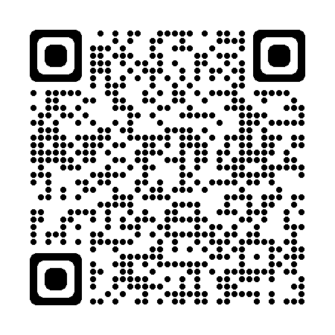
Other resources
Green Business Network
The Green Business Network allows businesses to come together, share ideas and promote energy, resource, waste and water efficiency as well as engage on low carbon, environmental and green sustainability initiatives.
Free to join
2900 members
Networking opportunities
Free newsletter
Be the first one to find out more about events and grant support opportunities
Join now
Use this QR code to join

Slide 34
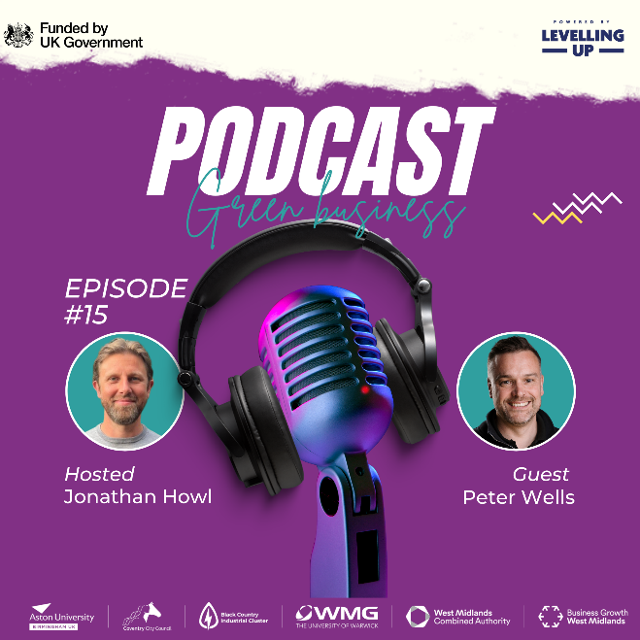
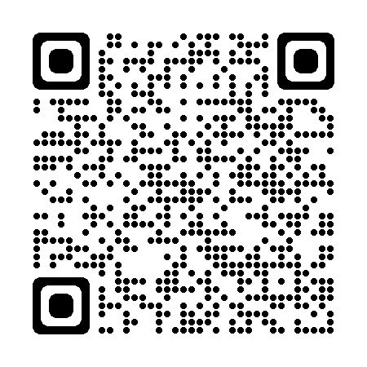
Other resources
Green Business Podcast
Listen to our monthly podcast to learn more about energy, resource, waste and water efficiency as well as engage in low carbon, environmental and green sustainability initiatives.
New episodes every month
Over 10 episodes so far discussing solar PV, heat pumps and sustainable business practices
Use the QR code or this link to subscribe

Slide 35
Is Your Business Ready to Make the Change?
EMAIL ADDRESS
decarb@aston.ac.uk
PHONE NUMBER
0121 204 4828
TO REGISTER
West Midlands: bit.ly/DNZ-Audit-Register
Warwickshire: https://bit.ly/3skX34q
PLEASE NOTE: Due to different funding streams, we are currently offering grants towards renewable energy for West Midlands businesses only.
Learn more about the programme

