Slide 1
Sustainability West Midlands Impact of climate change on West Midlands businesses
10 October 2024
Anna Bright
anna.bright@swm.org.uk
07751 923671

Slide 2
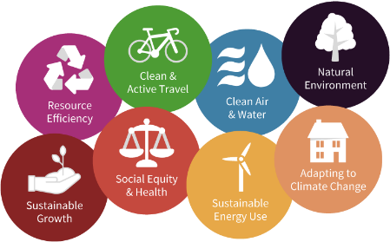
About Us – Our why?
Our purpose: Making the West Midlands region more sustainable, fairer and greener for all
Our vision: The West Midlands is leading in contributing to the national target of net zero greenhouse gas emissions by 2050 whilst addressing health inequality and driving inclusive growth
Coordinate and monitor the only existing regional Sustainability Roadmap; a framework to 2030
Established 22 yrs in Birmingham covering the region, and beyond!
Independent, not-for-profit company working across all sectors

Slide 3
About us
Membership
200+ members
Promotion through our channels (website, LinkedIn, Newsletter)
Access to exclusive LinkedIn group
Consultancy
Independent, expert advice
Expertise across all areas of sustainability through our team and partnerships
Engagement
Focussed on storytelling and sharing best practice
Strong networks throughout the public, private and third sectors
Notes:
Membership: We’re a cross-sector membership organisation with over 180 members including large and small businesses (which make up the greatest proportion of our members), local authorities, universities and colleges, and charities. We connect, promote, and prioritise our members throughout everything we do.
Consultancy: We provide independent, expert advice across all sectors and areas of sustainability. We act as a critical friend to organisations and help them to define their approach to sustainability (often via a Sustainability Strategy) as well as supporting with delivery (often by developing a Sustainability Action Plan or Roadmap). Our team has expertise across all areas of sustainability and, where necessary, we also work with associates and partner organisations, to add strength to our team. We work mainly in the West Midlands but nationally too.
3. Engagement: We use the power of storytelling and sharing of best practice to inspire action on sustainability. We use our communications, events and networks as platforms for engagement. Our website, newsletter and social media platforms (LinkedIn) allow us to engage easily with 1,000’s of cross sector organisations. Our networks are well established and provide opportunities for representatives from the public, heath, education and private sectors to come together and collaborate on sustainability-related activities.

Slide 4
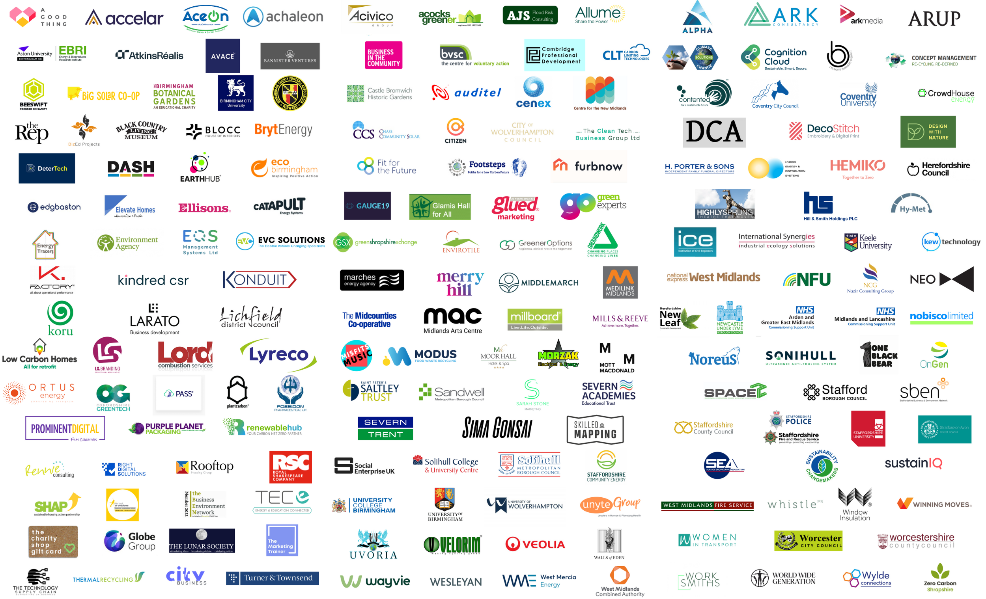
#SWMConference

Slide 5
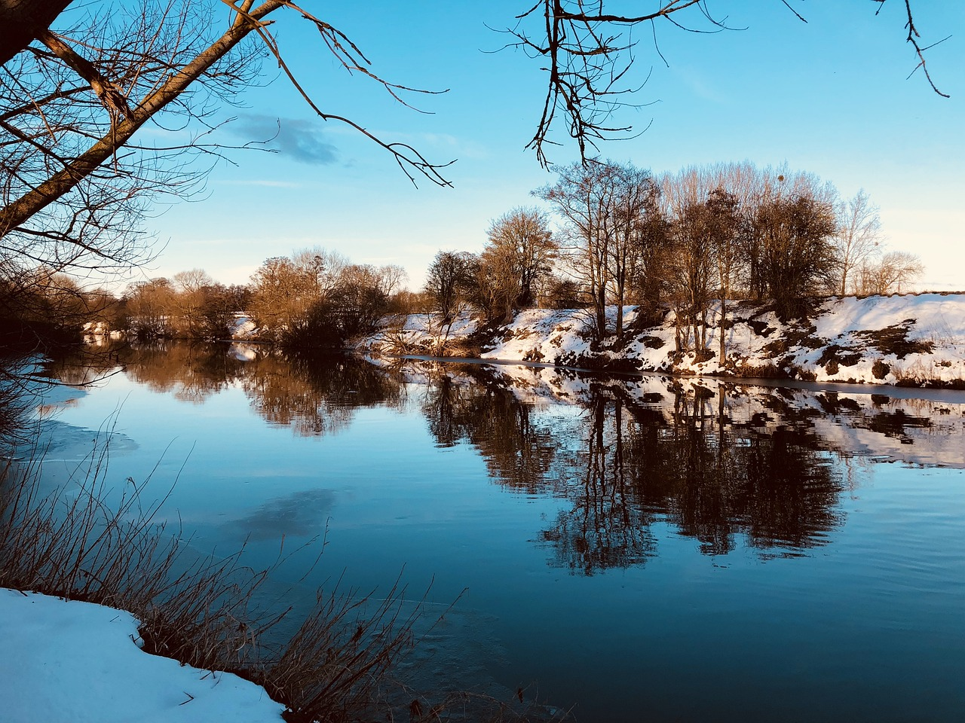
Impacts of climate change, & adaptation
Key things to expect:
More intense/prolonged heatwaves
More frequent and intense flash flooding
More frequent flooding of water courses
More extreme events (e.g. storms).
Longer periods of drought.
Adaptation is about protecting our assets, buildings, businesses, people, environment and society from the worst projected impacts of climate change.
Impacts will still happen regardless of our efforts with Net Zero / carbon reduction.
Making radical changes – like we did for the Covid-19 pandemic.

Slide 6
2023 - 2024
2023 was the second warmest year on record for the UK*
UK recorded its warmest June on record*
30°C recorded in Sept on seven consecutive days for the first time on record*
2023 was the seventh wettest year on record for the UK*
Storm season had its most active start with 7 named storms Sept to Dec*
Victoria Park observatory, Swansea recorded more than its entire September average rainfall on 06.09.24 with 87mm falling, 44 mm in one hour⁺
On 25/26.09.24, surface water flooding closed major roads and flooded care home in Shropshire⁺
*State of the UK Climate 2023: https://rmets.onlinelibrary.wiley.com/doi/10.1002/joc.8553
⁺ Met Office
Notes:
This is for the West Midlands as a whole. We will be putting together an equivalent table for Herefordshire. RCPs represent different climate models which factor in possible emissions projections – i.e. a better and worse case scenario.

Slide 7
The future
The WM is expected to experience hotter, drier summers and warmer, wetter winters as a result of climate change
Notes:
This is for the West Midlands as a whole. We will be putting together an equivalent table for Herefordshire. RCPs represent different climate models which factor in possible emissions projections – i.e. a better and worse case scenario.

Slide 8
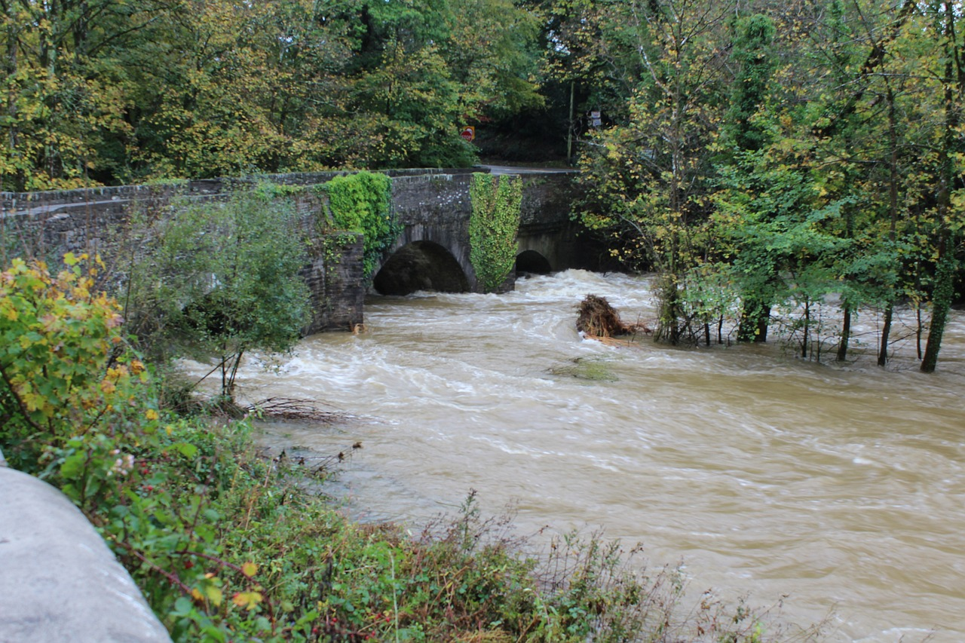
Impacts we could see
Without adaptation:
Excess heat deaths could triple by 2050 (from 2,000pa)
1.9m people currently exposed to flooding; could double by 2050
Risk to business productivity, supply chain disruption and UK financial instability
Changes in energy demand patterns and risk to energy infrastructure failures
Cascade failure across infrastructure and disruption to transport, ICT, water, energy networks
Productivity losses from poorer soil health
Health & social care assets unsuitable for extreme weather leading to health problems
Notes:
This is UK wide but they could all be relevant to Herefordshire – but bold ones are especially relevant

Slide 9
Impacts across the region - Infrastructure
Notes:
This is UK wide but they could all be relevant to Herefordshire – but bold ones are especially relevant

Slide 10
Summary
Climate change mitigation means avoiding and reducing emissions of heat-trapping greenhouse gases (e.g. carbon dioxide) into the atmosphere to prevent the planet from warming to more extreme temperatures. How can you reduce your impact?
Climate change adaptation means altering our behavior, systems, and—in some cases—ways of life to protect our families, our economies, and the environment in which we live from the impacts of climate change. How can you plan and prepare?
The key is – we need to do both.
The more we reduce emissions right now, the easier it will be to adapt to the changes we can no longer avoid….

Slide 11
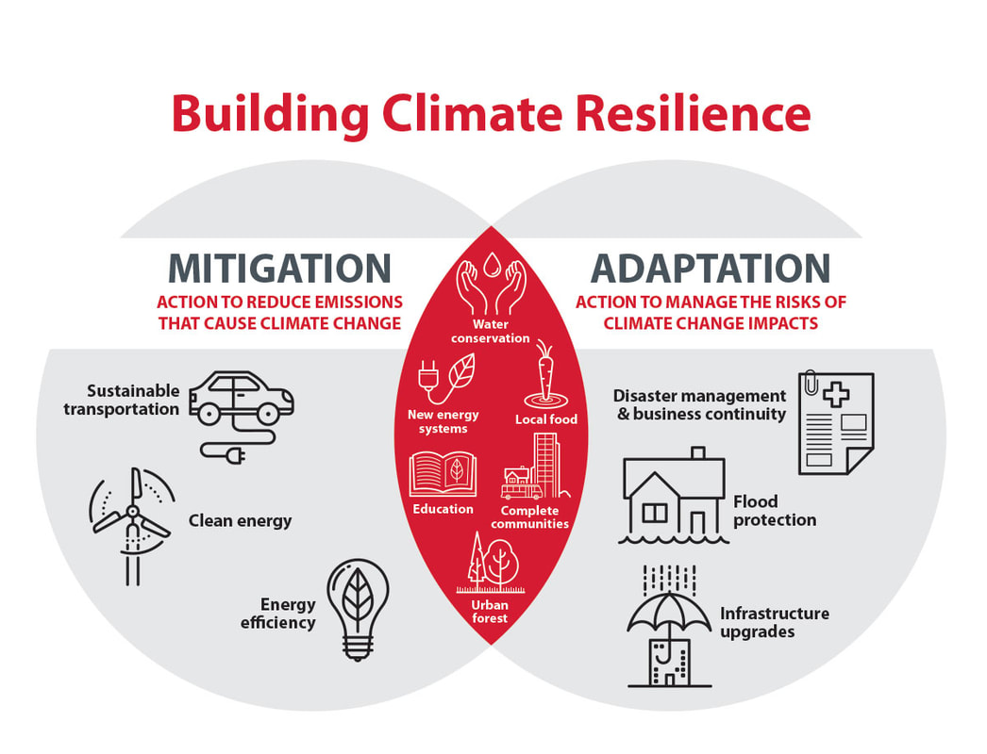
Image from https://www.calgary.ca/UEP/ESM/Pages/Energy-Savings/Climate-Change.aspx?redirect=/climateprogram
Notes:
I’ll talk more about why adaptation is important in another presentation later on… but the key message here is that actions to aid adaptation should be carried out hand in hand with actions to reduce GHG emissions.

Slide 12
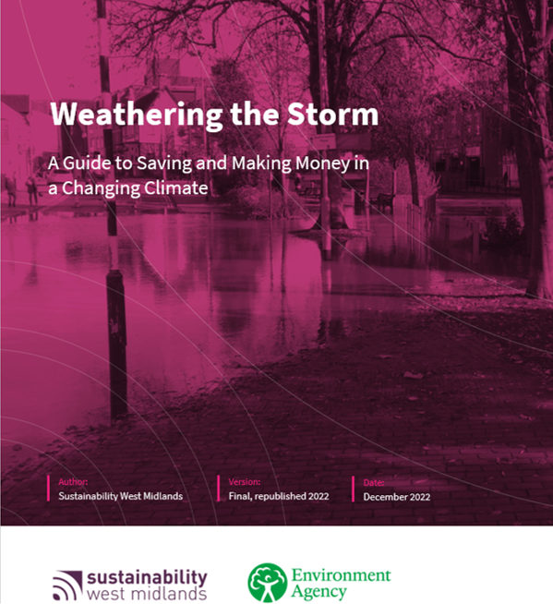
Support available
Link here!
Guide for SMEs in the West Midlands.
Will help you understand how you could be affected by weather, including extreme events, and how you can improve your chances of a quick recovery.
Sets out business opportunities from responding to a changing climate and provides useful tools and contact information to help you become more resilient.
Includes information on how to enhance your resilience to other shocks too, such as those related to the economy, pandemics and cyber security.
Also, practical guides and toolkits for:
Farmers and land managers
NHS and health sector

Slide 13
Sustainability West Midlands Impact of climate change on West Midlands businesses
10 October 2024
Anna Bright
anna.bright@swm.org.uk
07751 923671

