Slide 1
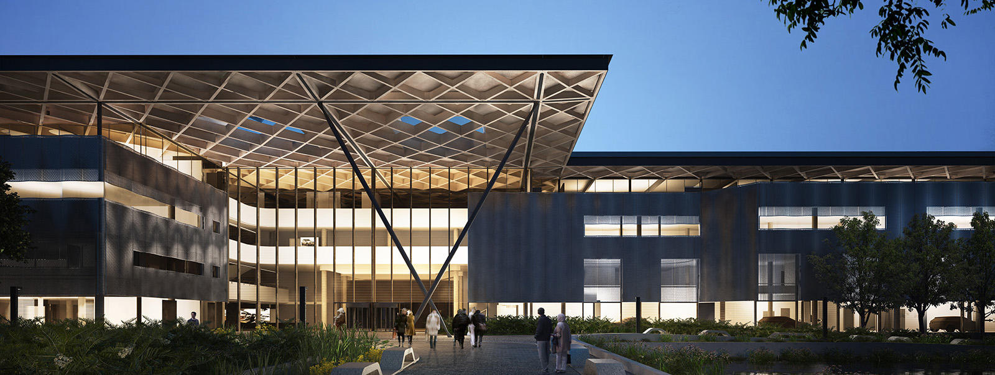
Challenges & Opportunities for the Manufacturing Sector in Achieving Net Zero
James Black
10/10/2024

Slide 2
James Black
Principal Engineer
WMG SME Group
www.linkedin.com/in/jdhblack
james.black@warwick.ac.uk

Slide 3
Content slide
WMG
29,000
Department of the University of Warwick​
Focused on translating R&D into industrial impact
Graduates around the world
Founded by Professor Lord Bhattacharyya in
1980
Strong relationships with
Cross-sectoral and interdisciplinary programmes in research and education
>1,000
900
companies of all sizes​
staff across 13 buildings
800+
UG, PG and Research degrees, short courses and work-based learning
3,700
Degree Apprentices​
students
© WMG 2024

Slide 5
Media slide

Slide 6
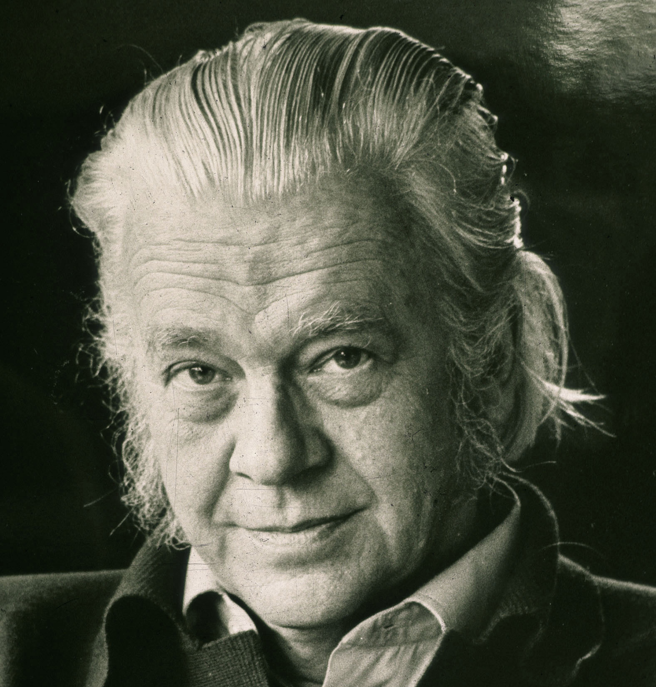
THE LINEAR ECONOMY: INCENTIVISED DESTRUCTION
1973: E. F. Schumacher – “Small is Beautiful”
Natural resources treated as freely available by businesses: just magically appear on the balance sheet.
Natural resources are taken, made it into something of more value, used (for a relatively short period of time) and then thrown away.
This is the traditional linear economy or ‘take, make, waste’.
6
© WMG 2024

Slide 7
THE CHALLENGE
Complexity.
Manufacturing SMEs face a complex net-zero journey due to shifting compliance, tricky Scope 3 emissions calculations, evolving reporting demands, and a lack of in-house skills. This makes it hard to navigate regulations, measure impact, and implement effective strategies.
CBAM
Scope 3 emissions
Lack of quality offset products
Sustainability reporting
Skills

Slide 8
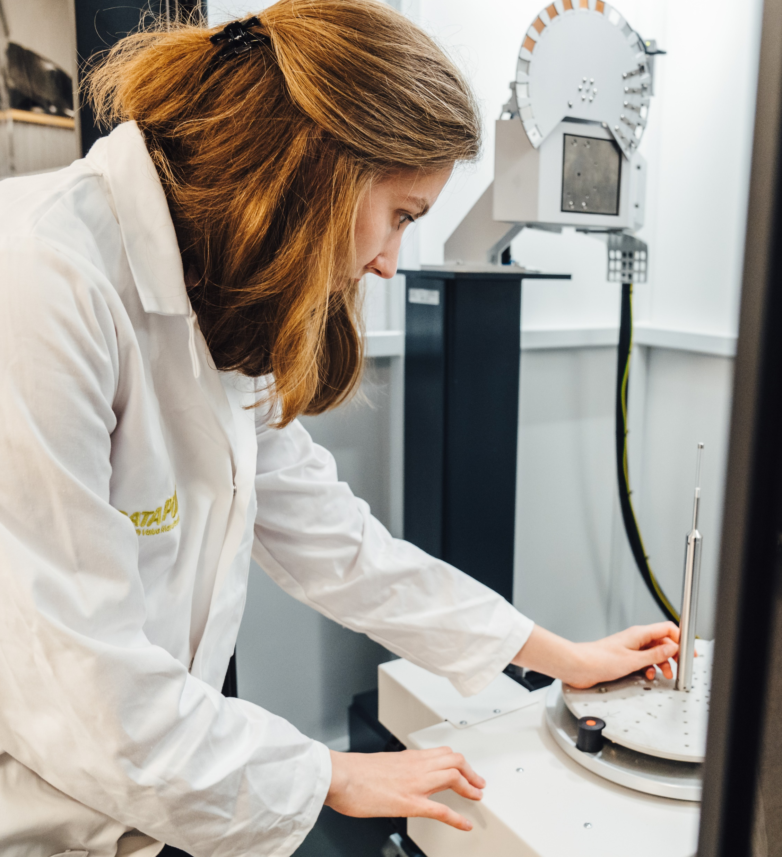
Manufacturing SME or not, there are only two routes to net zero: technological and organisational.
Technological solutions directly improve environmental performance.
Organisational solutions have an indirect impact on environmental performance.
Enterprise Research Council (ERC), 2021, ‘Drivers and Performance Outcomes of Net Zero Practices: Evidence from UK SMEs’, ERC Research Paper 95
© WMG 2024

Slide 9
Media slide
THE OPPORTUNITY
Waste needs to be reduced everywhere in the business.
Applies to processes, raw materials, labour, design… everything.
Net Zero becomes a cultural problem for an organisation.
TRANSFORM

Slide 10
“WHY” MATTERS MORE THAN HOW
Long-term sustainability: ‘leadership’, not ‘management’ challenge
Change takes sustained energy; you need multiple leaders
REFLECTION: What scares you about not having a culture of sustainability? What excites you about implementing it? Why? Be honest!
10
© WMG 2023
© WMG 2023
10
© WMG 2023
© WMG 2023

Slide 11
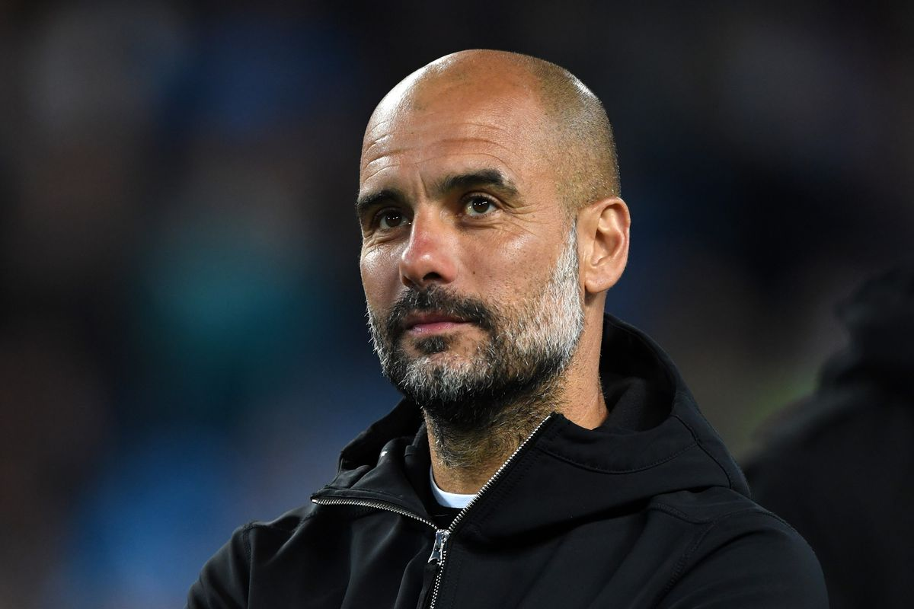
SUCCESS DEPENDS ON ASPIRATION
“We tried that before.” or “That won’t work here.”
Indicators that the person you are talking to has a low aspiration level when it comes to implementation.
REFLECTION: Who in the organisation sets the aspiration level? Who else within the organisation shares your aspiration level? Find them and collaborate on something.

Slide 12
RESIST PRESSURE: THINK LONG TERM
Organisational pressures encourage short-term thinking: worst case Enron & co.
The natural force is back to the way it was: some things won’t work! This is complicated in practice; often paradoxical.
RELECTION: Can you identify a change that will only pay off long-term? See it through. Demonstrate you are thinking long-term. Celebrate.

Slide 13
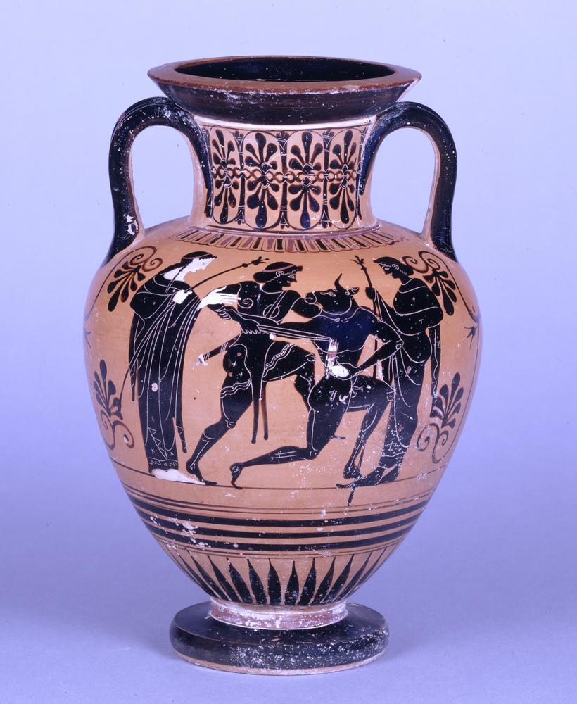
CELEBRATE STORIES & ARTEFACTS
What are the products, processes or bits of kit that show what you’re trying to do?
What behaviours do you want more of? What should people stop doing?
What stories are people telling when you’re around? How about when you aren’t?
REFLECTION: What are your 3 key cultural values? What do they look like as real behaviours? What stories embody those behaviours? Tell those stories.
© WMG 2024

Slide 14
ACT WITH INTENT…
Inward or outward focus?
Hierarchy or discretion?
Innovation or stability?
REFLECTION: What is your cultural profile? Where do you want to go?
14
© WMG 2024

Slide 15
FINAL THOUGHTS
How to work with us
A process is art before it is an algorithm
Do less, do it better
How many paths to “yes” ?
Benefit suppliers, customers and society
Never Perfect!

Slide 16
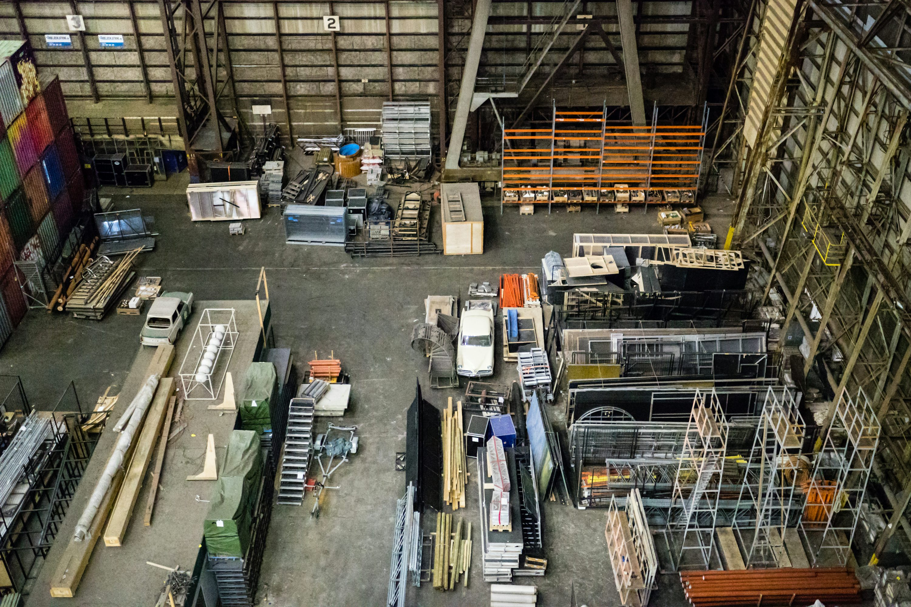
Do you have any questions?
Q&A

