Slide 1
Business Energy Advice Service (BEAS)

Slide 2
The Challenge
The West Midlands has a higher proportion of energy exposed (largely manufacturing) businesses than any other UK region.
These businesses are threatened by both rising energy costs and the need to transition to net zero.
Their relatively small size and dispersed nature means attempts to improve energy efficiency and resilience are hampered by significant market failures.
Government does not have access to a large enough data set of rich, consistently formatted data on energy efficiency potential to base future policy on.
Targeted public investment can reduce or remove market failures to support continued regional competitiveness and growth and provide a large data set to drive policy decisions.

Slide 3
Activities
Energy and Resource Efficiency Assessments providing businesses with clear information on where and how energy savings can be made
Grants to encourage investments in energy efficient manufacturing and process equipment and buildings measures.
Data collection for future policy creation.

Slide 4
Business Energy Advice Service (BEAS) Pilot
Building on SPF funded programmes across the West Midlands to provide more support and grants for energy demand reduction and data to inform future policy
£9 million
Energy Efficiency Assessments
Linked to the DNZ Programme in the WMCA area and other programmes across the west Midlands
£5 million in Grants
across Worcestershire, Stoke and Staffordshire and Warwickshire
£1000 - £100,000
50% match funded

Slide 5
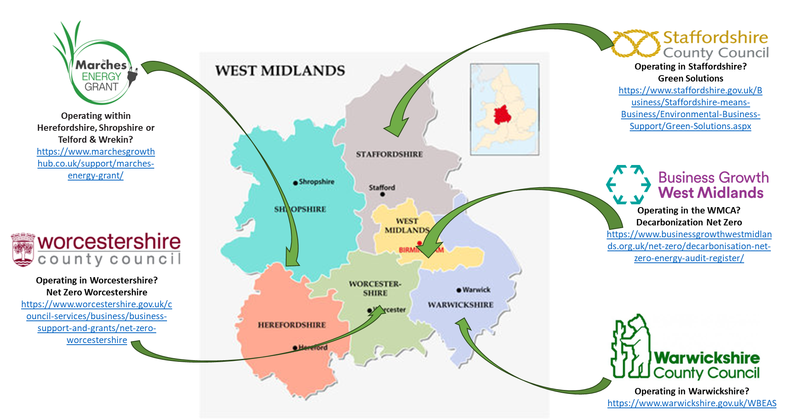
Business Energy Advice Service (BEAS) Pilot

Slide 6
Audit Stages
Standard Audits
Energy and resource efficiency assessments at business level
Energy Intensive Audits
Targeted at higher energy users with more complex needs and including some element of roadmapping, as needed.
Fewer high intensity = longer projects, bigger grants
Higher number of interventions = small projects, small grants etc
Notes:
There will be two ‘types’ of audit – standard and those aimed at higher energy users with more complex needs.

Slide 7
Decarbonization Net Zero
Providing immediate support to businesses so that they can deliver on net zero and in so doing enhance their competitiveness and sustainability
£4.5 million
Expert Information and Advice
Energy Efficiency Assessments
Net Zero Grants
£15 million
£1000 - £100,000
50% match funded

Slide 8
Achievements to Date
Over 1200 audits completed, providing:
A total estimated annual energy saving of over 90,000,000 kWh/yr
A total estimated annual carbon saving of over 175,000 tonnes CO2eqiv/yr
A total lifetime saving of over £18,000,000 per year for WM businesses
Data which the Department for Energy Security and Net Zero can use to inform a UK wide programme

Slide 9
www.businessgrowthwestmidlands.org.uk
Notes:
Speak to the business advisors on the stands
Register on the website

