Slide 1
Welcome!
Decarbonisation Success Stories

Slide 2
Housekeeping
Hello and Welcome!
Please turn your video off
Mute yourself to reduce background noise, but unmute to ask questions
You can also use the chat function to ask questions
This webinar will be recorded
There is a Q & A session at the end of each speaker so please interact
The slides and the recording will be sent out to all the attendees
We will also send out a feedback form, please let us know how we did!

Slide 3
Agenda
1:00 PM – Welcome and Introduction
1:00 – 1:20 PM – MTC's Sustainability Journey
1:20 – 1:30 PM – HPL Engineering Case Study
1:30 PM – End – Q&A Session

Slide 4
Marie Wells
Head of Sustainability
Manufacturing Technology Centre

Slide 5
MTC Net Zero Journey
Marie Wells
4th October 2024

Slide 6
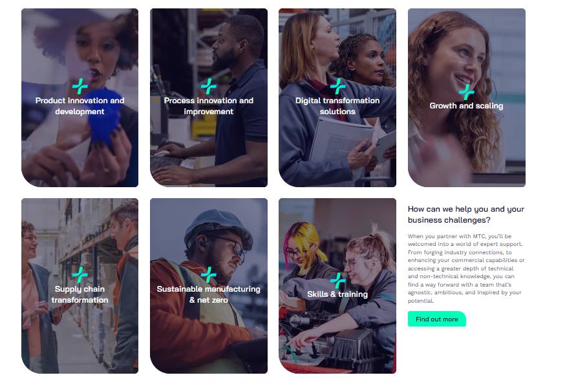
The Manufacturing Technology Centre
Where Industries Transform
How we can help
Solving manufacturing challenges with innovation across seven impact areas
Who we work with
From start-ups to global organisations and everything in between

Slide 7
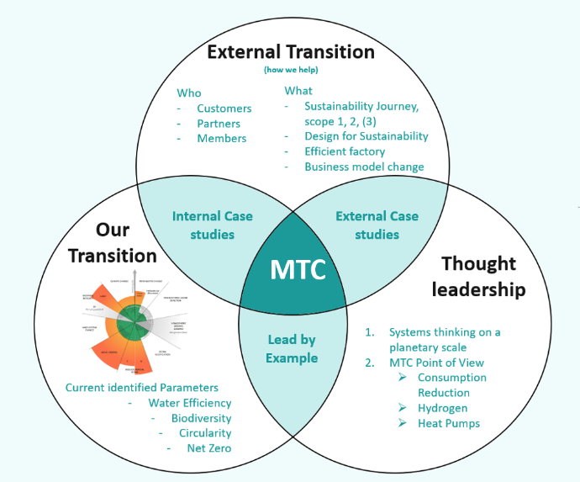
MTC Sustainability Strategy
Leading by example
Sustainable manufacturing is at the heart of the MTC strategy
Our ambition is to demonstrate how sustainable outcomes can be realized by:
Leading by example (Our transition to Net Zero and Sustainable operations)
Demonstrating sustainable innovation solution in manufacturing and supporting our industrial partners sustainable transition (External Transition)
Sharing key learnings about achieving sustainability in different aspects of manufacturing to the wider society (Through leadership)
MTC Sustainability Strategy

Slide 8
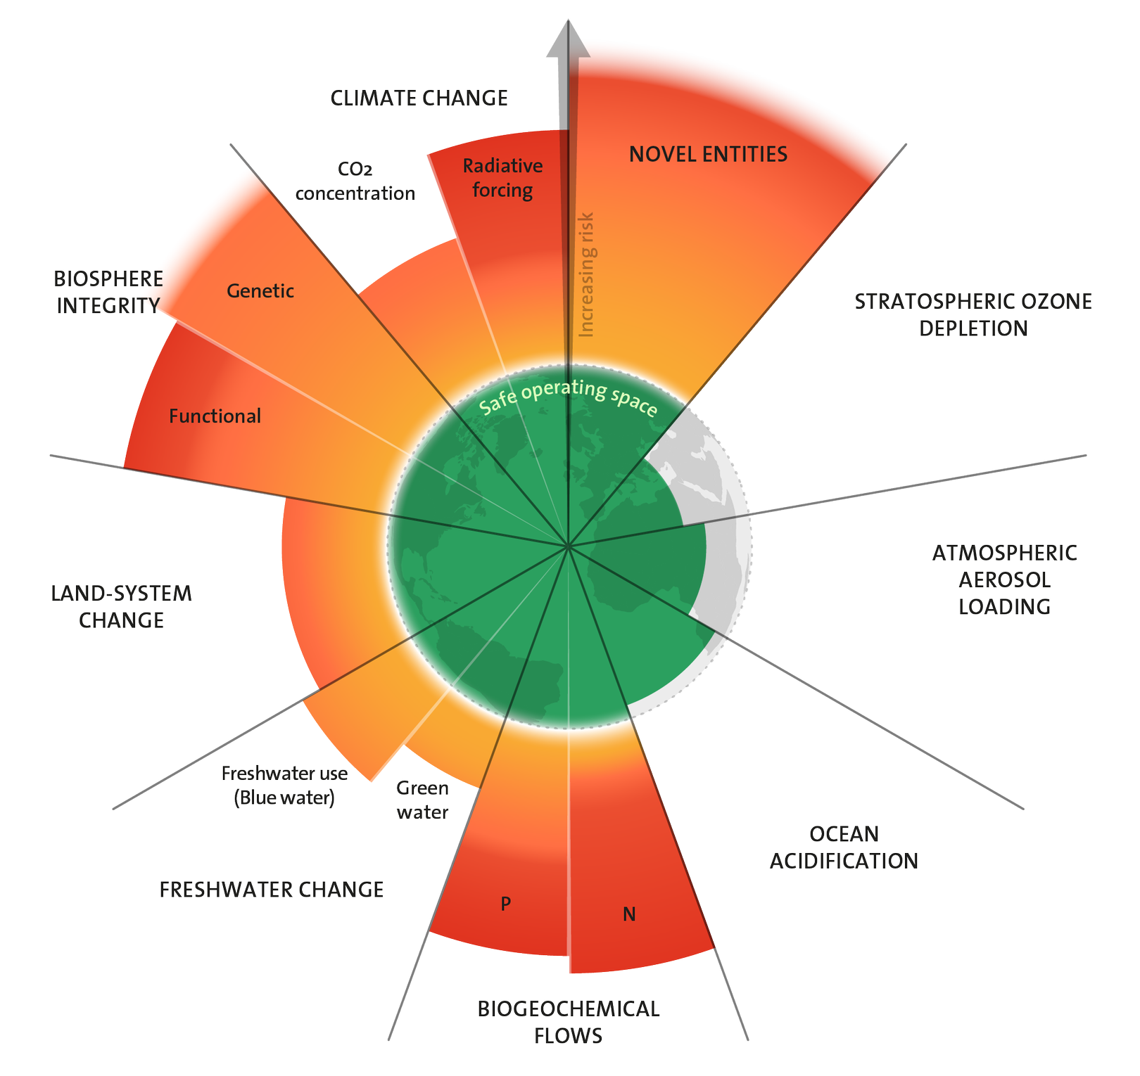
Wider Picture
Environmental Social Economic
The idea that economies and businesses need to develop within environmental limits while maintain the ability to do business
This requires transforming systems of production and consumption so that they can deliver while protecting ecosystems in a resource constrained world
Ref: Planetary boundaries - Stockholm Resilience Centre
Ref: About Doughnut Economics | DEAL

Slide 9
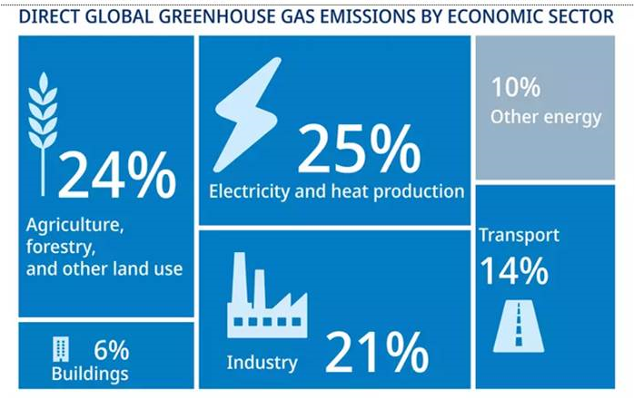
Manufacturing Impact
Manufacturing for Net Zero

Slide 10
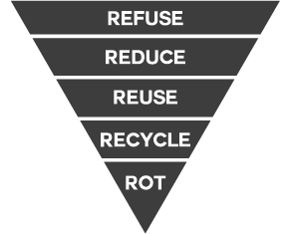
Manufacturing Impact
UK Aerospace sector manufacturing apportionment of emissions from MRIO model
(Top 20 attributable SIC codes- scaled from 52% total sector manufacturing emissions)
24%
60%
16%
MRIO model (1)
MRIO model (2)
MRIO model (3)
Raw Materials Extraction
Materials Processing
Engineering
Sub-component Manufacturing
Assembly of Sub-components into a Sub-system
Assembly of Sub-systems into a final Product
Operation of Product through life

Slide 11
UK Impact
If everyone lived like we do:
How many Earths? How many countries? - Earth Overshoot Day

Slide 12
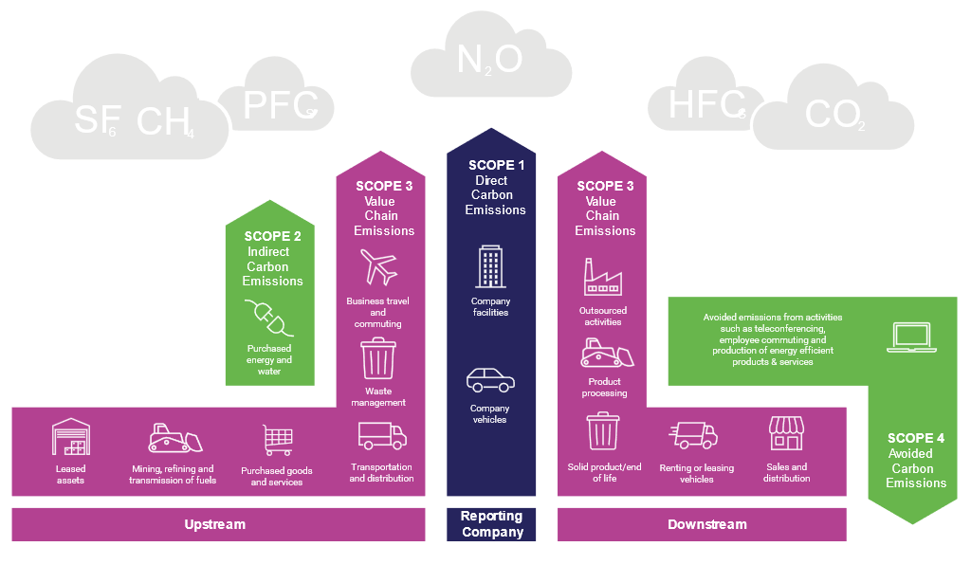
Net Zero Transition
Scopes of Emission

Slide 13
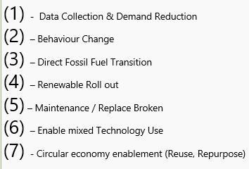
MTC Approach
Additionally Lead by example in areas not currently being considered in standards to increase employee satisfaction & thought leadership
Net Zero
Residuals
Carbon balancing within MTC control through supply chain and partnership arrangements
Develop leadership in carbon reduction through nature-based solutions for manufacturing
Transition to circular supply chain (7)
Enable transition through knowledge share & other initiates (2)
Low emitting consolidated logistics & travel (3) (7)
Decrease resource use & loss e.g. sale, re-use, repair and remanufacture
Prioritise sustainable suppliers driving circular thinking (3) (7)
All new builds Net Zero by Design
Net Zero (Scope 1 & 2)
Renewable Gas & Electricity commitment
Change all gas to renewable energy or electrify (3)
Extend Elect. generation & storage to cover 80% of usage (3)
Change Policy to no new emitting equipment (3)
Demand Reduction (1)
Baseline

Slide 14
UK Impact
Measure
Can not control what we can’t measure
UNDERSTAND
Manage / Control
BEHAVIOUR
A sustainable business has a sustainable culture
Scope 1
All scope 1 must be transitioned to other fuel
sources to achieve Net Zero in scope 1 & 2
Scope 2 already be considered near zero if market-based
analysis is used, hence lower priority than other scopes
REDUCE
Scope 3
Scope 2
Scope 1
MITIGATE
Scope 3
Scope 2
OFFSET

Slide 15
Net Zero Transition
Carbon Accounting:
Challenges:
Carbon accounting uses country, company, or individual data to estimate the greenhouse gas emissions associated with that entity.
The accuracy of the estimation is dependent on many elements, including the quality of the data and the emission factors used.
While it may be challenging achieving perfectly accurate results, the estimation is still useful as it allows organisations to identify their hot spots so they can prioritise areas to target.
Larger companies are making more disclosure requests
Trust in supply chain data
Data sensitivity
Standardisation of methodology
Keeping up with reporting requirements (mandatory and non-mandatory)
Requests for data in varying formats
What is the accuracy required

Slide 16
Net Zero Transition
Scope 1
Require transition of all direct emissions to none fossils fuel alternative
Heat represents almost ½ UK energy demand with 57% of that for space & water heating. Most of this from Natural gas
High heat manufacturing processes represent a significant challenge
Transition to none fossil fuel vehicles and / or change to transport strategies
Technology change for emitting processes

Slide 17
Net Zero Transition
Scope 2
Require transition of all indirect emissions to none fossils fuel alternative and increase in energy efficiency
Electricity
REGO backed renewable energy contract
Virtual or direct Power Purchase Agreements
Own generation and energy storage onsite
Heating / Cooling Networks
Approach depends on the generation method of that resource e.g.:
Can use waste heat (Low carbon)
Heat pumps (Dependant on Electricity)
CHPs (Higher Carbon )

Slide 18
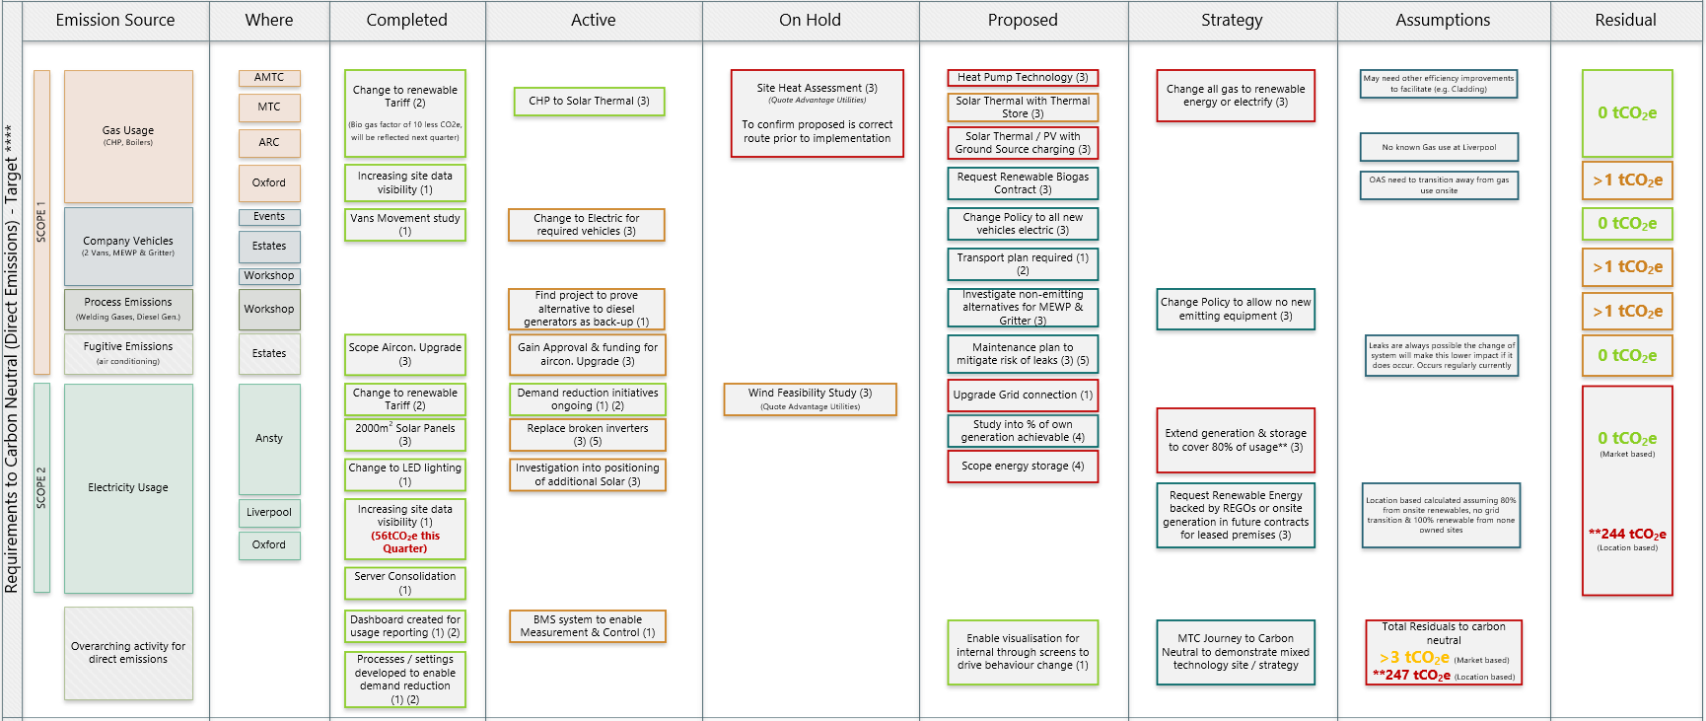
IGB
Carbon Neutral Detail View
Notes:
If the MTC can’t change what chance does industry have?
Should we re-baseline 2019 as now have better data management and updated conversion factors showing reduced scope 3 footprint by ~0.5 tCO2e

Slide 19
Why do we include Scope 3?
No need to define targets
No need to define targets
No need for others to adapt
No need for others to adapt
Targets
Scope 1 & 2 Only
Notes:
Scope 1 – All Direct Emissions from the activities of an organisation or under their control. Including fuel combustion on site such as gas boilers, fleet vehicles and air-conditioning leaks.
Scope 2 – Indirect Emissions from electricity purchased and used by the organisation. Emissions are created during the production of the energy and eventually used by the organisation.
Scope 3 – All Other Indirect Emissions from activities of the organisation, occuring from sources that they do not own or control. These are usually the greatest share of the carbon footprint, covering emissions associated with business travel, procurement, waste and water.
Define key metrics
Resource use – Waste Hierarchy
CO2e – Water, Waste, energy for scope 1 – 3 emissions
Project metrics (Drive reduction in scope 3 )
Roadmaps against key boundaries - Climate / biodiversity / land use
The role requires engagement across varying functions, initially this will be focused on internal change to benchmark our current position and enable our transition embedding sustainability in to the MTC, this will require the role holder to:
Engage with the wider community of colleagues to affect behavioural change enabling our journey to become a sustainable business through initiatives such as the environmental working group
Work with varying functions such as estates and continuous improvement to drive a transition within the MTC to sustainable / net zero practices in line with policy and legislation, including the way our projects are delivered;
To provide input to the future skills team to creating a training framework around sustainable capability gaps for AMTC and to tie into university partners. To allow the development of internal and external training materials to create the next generation of sustainable engineers;
Form links with relevant bodies such as the Ellen MacArthur foundation, WRAP etc. to ensure our sustainability metrics align with industry recognised methodology and form useful collaborations;
Engage with events management to ensure that MTC events are held in a sustainably way and demonstrate the MTC’s commitment to sustainable practice

Slide 20
Why do we include Scope 3?
No need to define targets so uptake sporadic and dependant on individual policy
Targets
Scope 1 & 2 Only
Notes:
Scope 1 – All Direct Emissions from the activities of an organisation or under their control. Including fuel combustion on site such as gas boilers, fleet vehicles and air-conditioning leaks.
Scope 2 – Indirect Emissions from electricity purchased and used by the organisation. Emissions are created during the production of the energy and eventually used by the organisation.
Scope 3 – All Other Indirect Emissions from activities of the organisation, occuring from sources that they do not own or control. These are usually the greatest share of the carbon footprint, covering emissions associated with business travel, procurement, waste and water.
Define key metrics
Resource use – Waste Hierarchy
CO2e – Water, Waste, energy for scope 1 – 3 emissions
Project metrics (Drive reduction in scope 3 )
Roadmaps against key boundaries - Climate / biodiversity / land use
The role requires engagement across varying functions, initially this will be focused on internal change to benchmark our current position and enable our transition embedding sustainability in to the MTC, this will require the role holder to:
Engage with the wider community of colleagues to affect behavioural change enabling our journey to become a sustainable business through initiatives such as the environmental working group
Work with varying functions such as estates and continuous improvement to drive a transition within the MTC to sustainable / net zero practices in line with policy and legislation, including the way our projects are delivered;
To provide input to the future skills team to creating a training framework around sustainable capability gaps for AMTC and to tie into university partners. To allow the development of internal and external training materials to create the next generation of sustainable engineers;
Form links with relevant bodies such as the Ellen MacArthur foundation, WRAP etc. to ensure our sustainability metrics align with industry recognised methodology and form useful collaborations;
Engage with events management to ensure that MTC events are held in a sustainably way and demonstrate the MTC’s commitment to sustainable practice

Slide 21
Why do we include Scope 3?
Require targets
Scope 1, 2 & 3
Targets may be required
Targets pushed into supply chain
Downstream CO2e reduced by upstream
Targets
Scope 1, 2 & 3
Lost business
Allows supply to those with targets
Scope 1, 2 & 3
Notes:
Scope 1 – All Direct Emissions from the activities of an organisation or under their control. Including fuel combustion on site such as gas boilers, fleet vehicles and air-conditioning leaks.
Scope 2 – Indirect Emissions from electricity purchased and used by the organisation. Emissions are created during the production of the energy and eventually used by the organisation.
Scope 3 – All Other Indirect Emissions from activities of the organisation, occuring from sources that they do not own or control. These are usually the greatest share of the carbon footprint, covering emissions associated with business travel, procurement, waste and water.
Define key metrics
Resource use – Waste Hierarchy
CO2e – Water, Waste, energy for scope 1 – 3 emissions
Project metrics (Drive reduction in scope 3 )
Roadmaps against key boundaries - Climate / biodiversity / land use
The role requires engagement across varying functions, initially this will be focused on internal change to benchmark our current position and enable our transition embedding sustainability in to the MTC, this will require the role holder to:
Engage with the wider community of colleagues to affect behavioural change enabling our journey to become a sustainable business through initiatives such as the environmental working group
Work with varying functions such as estates and continuous improvement to drive a transition within the MTC to sustainable / net zero practices in line with policy and legislation, including the way our projects are delivered;
To provide input to the future skills team to creating a training framework around sustainable capability gaps for AMTC and to tie into university partners. To allow the development of internal and external training materials to create the next generation of sustainable engineers;
Form links with relevant bodies such as the Ellen MacArthur foundation, WRAP etc. to ensure our sustainability metrics align with industry recognised methodology and form useful collaborations;
Engage with events management to ensure that MTC events are held in a sustainably way and demonstrate the MTC’s commitment to sustainable practice

Slide 22
Why do we include Scope 3?
Everyone needs to define targets so uptake more universal or business is lost
Business risk
(No reporting)
Lost business
Business risk
(Scope 1 & 2 reporting only)
Creates new opportunities
Targets
Scope 1, 2 & 3
Notes:
Scope 1 – All Direct Emissions from the activities of an organisation or under their control. Including fuel combustion on site such as gas boilers, fleet vehicles and air-conditioning leaks.
Scope 2 – Indirect Emissions from electricity purchased and used by the organisation. Emissions are created during the production of the energy and eventually used by the organisation.
Scope 3 – All Other Indirect Emissions from activities of the organisation, occuring from sources that they do not own or control. These are usually the greatest share of the carbon footprint, covering emissions associated with business travel, procurement, waste and water.
Define key metrics
Resource use – Waste Hierarchy
CO2e – Water, Waste, energy for scope 1 – 3 emissions
Project metrics (Drive reduction in scope 3 )
Roadmaps against key boundaries - Climate / biodiversity / land use
The role requires engagement across varying functions, initially this will be focused on internal change to benchmark our current position and enable our transition embedding sustainability in to the MTC, this will require the role holder to:
Engage with the wider community of colleagues to affect behavioural change enabling our journey to become a sustainable business through initiatives such as the environmental working group
Work with varying functions such as estates and continuous improvement to drive a transition within the MTC to sustainable / net zero practices in line with policy and legislation, including the way our projects are delivered;
To provide input to the future skills team to creating a training framework around sustainable capability gaps for AMTC and to tie into university partners. To allow the development of internal and external training materials to create the next generation of sustainable engineers;
Form links with relevant bodies such as the Ellen MacArthur foundation, WRAP etc. to ensure our sustainability metrics align with industry recognised methodology and form useful collaborations;
Engage with events management to ensure that MTC events are held in a sustainably way and demonstrate the MTC’s commitment to sustainable practice

Slide 23
Net Zero Transition
Scope 3 - Upstream
Resources manufacturing needs to make their product
Materials
Use less
Use Secondary Materials
Manufacturing Wastes
Decrease
Find alternative uses – Economic Benefit
Example: Our processes result in almost zero waste | Co-products (britishsugar.co.uk)
Travel
Prioritise public transport and low carbon options
Transport & distribution
Smart distribution routing
Change of transport method
Co-locating delivery
Require Action from your supply chain

Slide 24
Net Zero Transition
Scope 3 - Downstream
Resources being used after sale and end of life emissions
Materials
Divert to Secondary Material use
Increase
Utilisation
longevity of products produced
Resource efficiency of using product or service
Transport & distribution
Smart distribution routing
Change of transport method
Co-locating delivery
Avoid investments in high emitting industry
Require Action from your supply chain
Understand locus of control

Slide 25
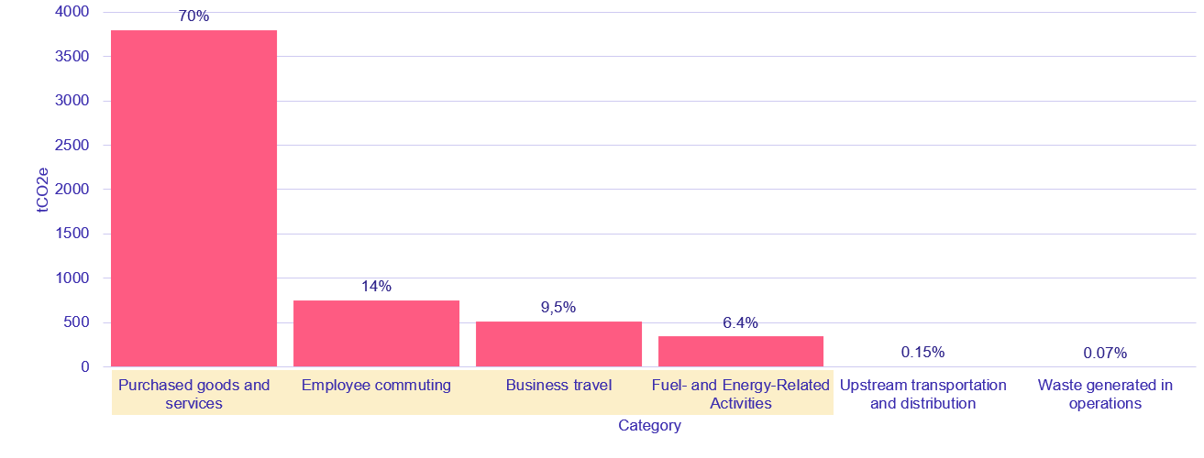
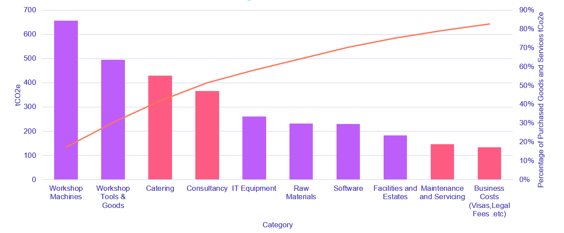
Understanding What’s Important
Scope 3 – Pareto Analysis
Different Hotspots will drive different actions for MTC
Purchased Goods & services
Supplier Change or Commitment
Efficiency (buy what we need)
Change goods or materials to lower impact
Asset share / lease vs buy for new equipment
Employee Commuting & Business Travel
Understand commuting behaviour & levers
Is it required?
Reduce flights e.g. train over short haul
Enable access to public transport
Incentivise Cycle to work & Car Sharing
Enable access to low emission vehicles
Fuel & Energy Related Activities
Increase use of PPAs
Increase own renewable generation

Slide 26
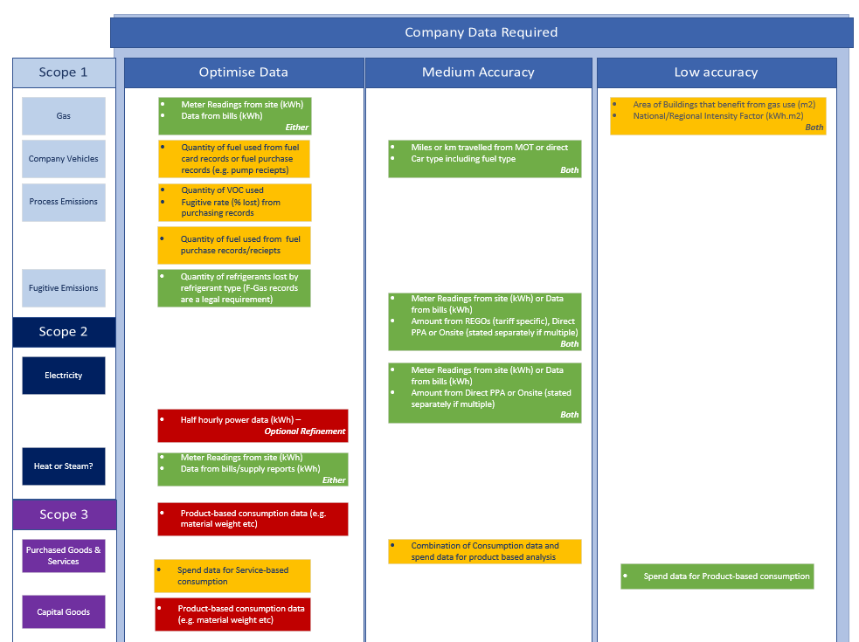
Improving Data & Accuracy
All Scopes
Data Type
Primary Data
Secondary date
Data Cleaning e.g. Removing Duplicates
Traceability

Slide 27
Target Setting
Scope 1 & 2
In your locus of control so can be defined by:
Speed and level of investment possible for the business
Availability of external funding
Timeline of implementation of infrastructure projects
Scope 3
If none of your supply chain are Net Zero in Scope 1 & 2 by your target date for scope 3 and there is no option to:
Change suppliers
Reduce demand
You will not hit your target date, getting to Net Zero is a joint effort

Slide 28
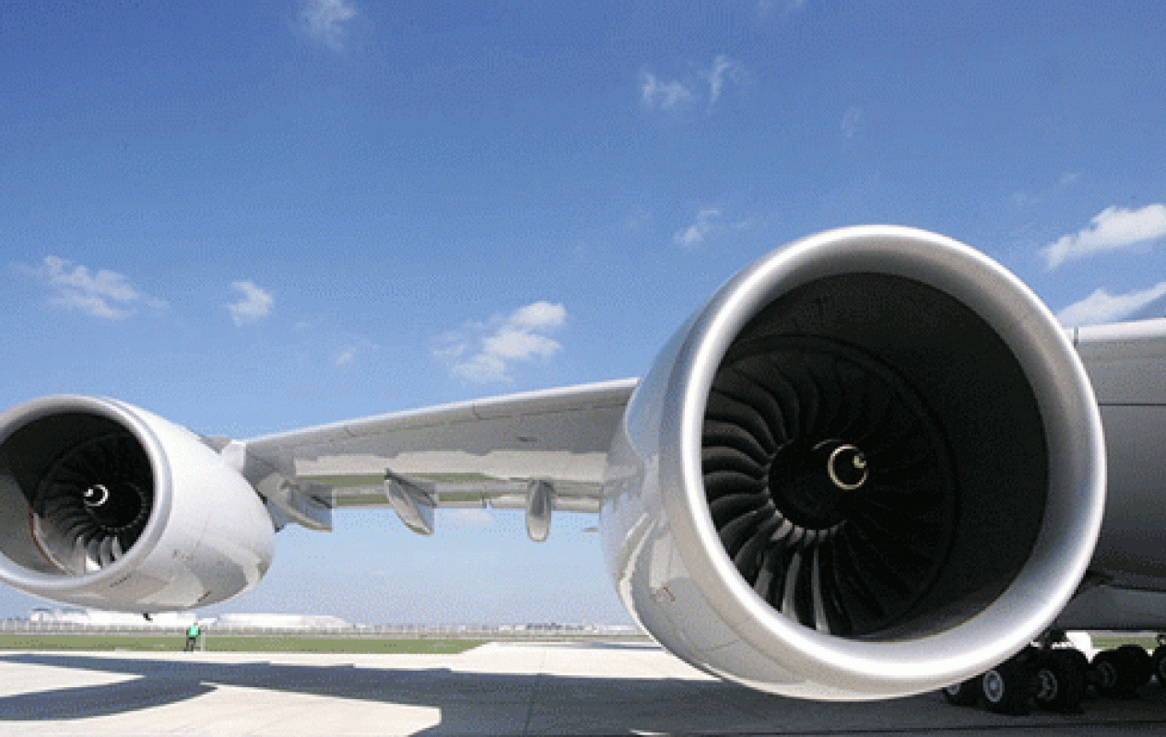
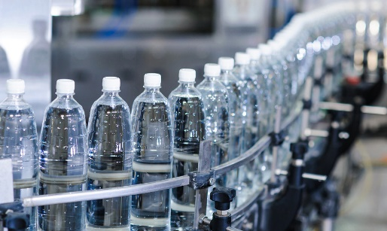
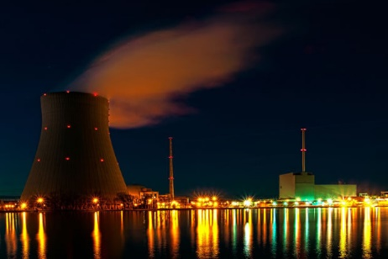
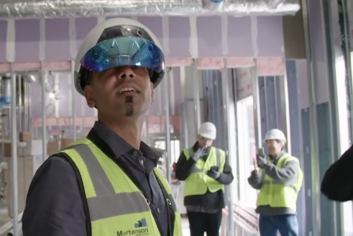
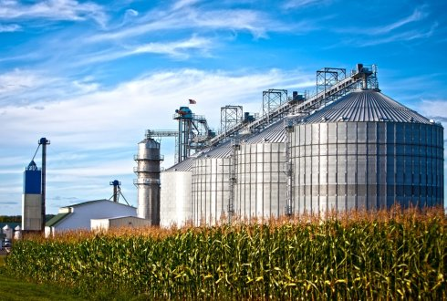
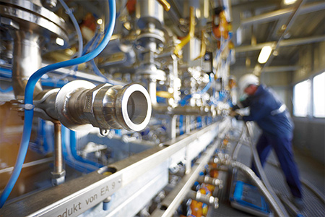
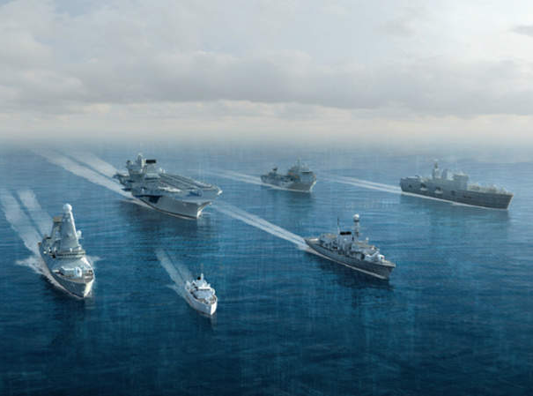
Thank you for listening. Any questions?
Sustainability……
….. Affects all, visibly & invisibly

Slide 29
Christian Keen
Operations Director
HPL Prototypes Limited

Slide 30
Decarbonisation
Net Zero Programme
HPL Prototypes
Christian Keen – Operations Director

Slide 31
About us
HPL Prototypes Ltd builds driveable and non-driveable vehicle prototypes to ensure car manufacturers get the perfect shape, feel and look from their design before moving on to working models.
This is done from CAD drawings and a brief on a full-size model of the vehicle, with a whole or split view; a precise interior, complete with detailed trim, a showroom quality painted full-scale model for exhibitions. This is turned into a prototype of world-class quality in just six to eight weeks.

Slide 32
Our net zero journey
As a company, we’ve always been committed to improving both our operational efficiency and environmental impact. The rising energy costs, coupled with the increasing focus on sustainability, made us reassess our energy consumption.
We had inefficient halogen lighting and electric heaters that were costly and energy-intensive, misaligned with our sustainability goals.
Our aim is to lower our carbon footprint and operating costs by making our facilities energy-efficient and environmentally friendly.. We saw an opportunity to modernise our infrastructure and improve our energy efficiency while contributing to our environmental commitments.

Slide 33
Decarbonisation Net Zero Programme Project
We are replacing outdated halogen lights with LEDs and swapping electric space heaters for efficient air conditioning units, significantly reducing our energy consumption and emissions.
Grant value: £31,207
Outcomes:
Annual saving on electricity: £2,169 (LED), £4,806 (heating), Total £6975 (payback 4.5 years)
Annual carbon saving (tonnes) : 3.07 (LEDs), 6.83 (heating), Total 9.9 tonnes

Slide 34
Other projects
We’re also exploring the installation of solar panels and replacing gas heaters in our design studios to further reduce our reliance on fossil fuels and cut emissions.
We are reducing non-recyclable waste by partnering with a national waste services provider, ensuring more efficient waste management.
Additionally, we are continuing to collaborate with Coventry City Council to explore further opportunities for SME growth and energy reduction initiatives.

Slide 35
Next steps
We’re also exploring the installation of solar panels and replacing gas heaters in our design studios to further reduce our reliance on fossil fuels and cut emissions.
Our next steps involve completing the LED and air conditioning installations, conducting a post-project energy audit, and exploring additional sustainability measures like solar power and further heating system upgrades.

Slide 36
Challenges and opportunities
Upfront costs of energy-efficient upgrades
Long term cost savings and carbon reduction
Navigating complex regulations and incentives
Access to grants and financial support
Integrating sustainability into existing operations
Enhanced reputation and competitiveness

Slide 37
My advice to other businesses
Coventry City Council, and particularly Denise, have been fantastically helpful. My advice would be to reach out to them straight away to accelerate your journey to net zero.

Slide 38
DNZ PROGRAMME
The Decarbonisation Net Zero Programme aims to provide information and expert advice and support to businesses enabling them to make significant decarbonization and money-saving changes to their business.
This Programme is part of the wider West Midlands Business Support activity funded through the UK Shared Prosperity Fund (UKSPF).
Introduction
Notes:
The decarb net zero programme will identify areas where you can save money through being more energy efficient within your business – provide free energy audits
Grant support - up to 50%, grants between £1k - £100k.

Slide 39
Apply for a free energy audit
EMAIL ADDRESS
decarb@aston.ac.uk
PHONE NUMBER
0121 204 4828
TO REGISTER
West Midlands: bit.ly/DNZ-Audit-Register
Warwickshire: https://bit.ly/3skX34q
PLEASE NOTE: Due to different funding streams, we are currently offering grants towards renewable energy for West Midlands businesses only.
Learn more about the programme

Slide 40
Q & A

